Slide 1
RAVE-O
Retrieval, Automaticity, Vocabulary, Engagement with Language
and Orthographic Fluency
RAVE-O is a “comprehensive, fluency-based reading intervention program” designed by Tufts Professor Maryanne Wolf and her colleagues at Tufts University’s Center for Reading and Language Research. It is based on a 10-year tri-city research project funded by the National Institute of Child Health and Human Development (NICHD).

Slide 2
RAVE-O: Key Concepts
Word Retrieval: The things we know best are the easiest to retrieve from memory. When a reader “madly, truly, deeply” knows the many meanings of a word, she will find it easier to retrieve (and read) than if she relies primarily on the letters.
Fluency: Fluent reading is built on the ability to recognize every level of print automatically and fast.
III. Strategic Thinking and Cognitive Flexibility is key to comprehension.

Slide 3
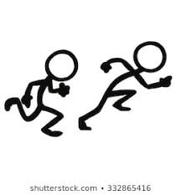
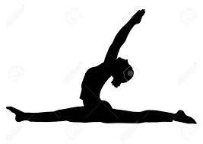
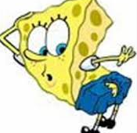
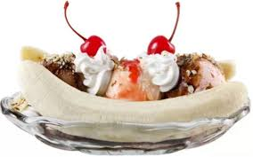
Word Retrieval
Printed words are stored in our brains according to what they look like; what they sound like AND their myriad meanings.
Let’s split!
Ss-pp-ll-spl- i-i-i tt
split

Slide 4
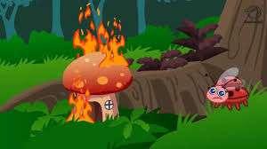
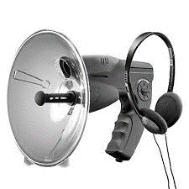
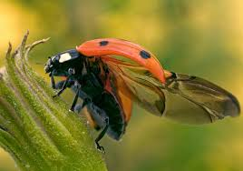
The more children know about a word’s meaning the more easily they will read it. In fact, research has shown that priming an adult reader with the meaning of “bug” as a “spy device” will cause the reader to recognize “bug” in the context of “insects” faster.
Ladybugs have thin underwings.
Ladybugs eat aphids.

Slide 5
RAVE-O is a word family approach.
Research shows that most readers break single syllable words into their onsets, the starting letters or letter blends, and their rimes – the part of the word that both looks and sounds the same.
b at s ack r ain h at r ack tr ain r at tr ack br ain
RAVE-O integrates this “word family” approach with more recent research based knowledge: recognizing words in print is heavily influenced by the word’s meaning. It is not just about the letter patterns and their sounds.
Based on the observation that we retrieve most easily what we know most thoroughly, RAVE-O seeks to saturate word part recognition with meaning.

Slide 6
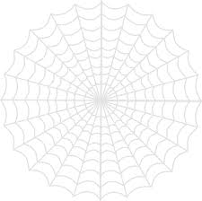
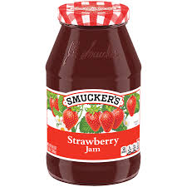
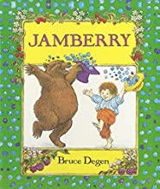
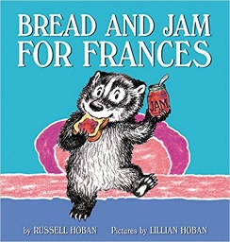
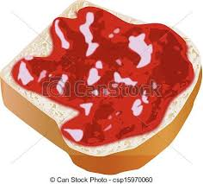
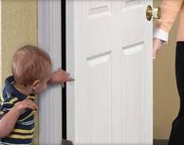
RAVE-O Curriculum uses selected words with “multiple meanings” to provide templates for many of the most common letter patterns in written English.
jam

Slide 7
Fluency
By cementing print to its sound, its sight AND its meaning, we can help struggling readers recognize words more easily.
Most teachers think of “fluency” as the end product, the ability to read connected texts smoothly and without errors. Once kids “crack the alphabetic code,” they develop fluency by practicing oral reading. Within the RAVE-O framework, “fluency” is established at all levels of print: letter sounds, letter combinations, syllables, words, sentences and texts.

Slide 8
A RAVE-O Lesson
Tell your tutee that small words can be broken into two parts. The “starter” is the letter that “starts” the word. Write the starter in the color of your choice (or the child’s choice). The second part is the “rime.” It’s called the rime because it rhymes with other words in the same word family. Write the rime in a different color.
…and this is the rime. It’s called that because it’s the part of the word that “rhymes” with other words in its family.
This is the starter...
r ock
Other words in the “ock” family: sock, lock, dock, mock, tock, block, sock, tock, stock, block, flock, smock, stock, flock, Spock, crock…

Slide 9
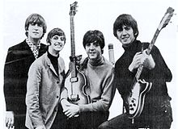
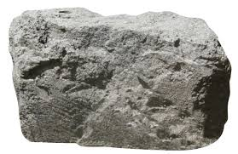
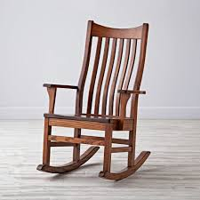
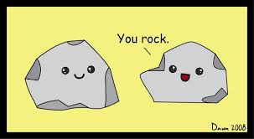
Introducing Multiple Meanings: Rock
Word Web: What do you think of, when you think of “rock?”
r ock

Slide 10
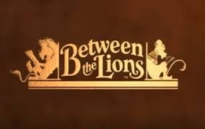
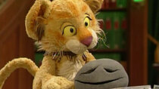
The Lost Rock
https://www.youtube.com/watch?v=0G5UhVrG7A4

Slide 11
Games to Practice the Pattern
Starter Rime
r ock Wheels
m ock Roll & Read
s ock Slap
sh ock Word Hunts
l ock
cl ock
fl
m
bl
d
cl
r
l
s
ock

Slide 12
rock
Please circle all the words that include “ock” as fast as you can.
rock tip cat mock sock
sip pet jam pot luck
rip peg cap block flip
flock step stop block slap

Slide 13
Strategic Thinking & Cognitive Flexibility
Think Ahead! Thoughtful readers make ongoing predictions about the texts. As they read, they draw on what they read to make “educated guesses” about the events they believe are coming.
Think Back! Thoughtful readers keep track of what they read, and they change their understanding as they go along. They also ask questions about what they are reading. They often look back at what they have read to answer those questions.

Slide 14
Strategic Thinking & Cognitive Flexibility
Think for Yourself! When we read, we get to think deeply about the story and how it makes us feel. Our own thoughts are the real treasures we dig for when we read. We ask ourselves questions like:
● What did I find out that I never knew before?
● Do I have new thoughts and feelings?
● Could this really happen?
● Can I retell this story in my own words?

