Slide 1
Work Plan For 6LoWPAN Platform
Feilong liu

Slide 2
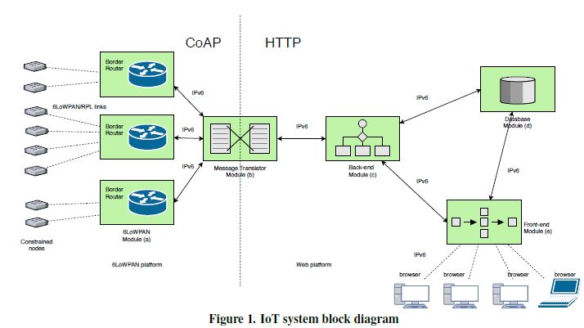
Overview Of The Platform

Slide 3
MY Work
Test all the modules in platform record and found bugs
Familiar with code testing skill like test plan, test design, test closure
Familiar with BugZilla a widely used bug tracking software

Slide 4
Introduce to BugZilla
It is used by Linux, Apache and Red Hat also self-hosting
It has high performance: 1. Powerful search function 2. Historical change record
3. Handle bugs by tracking and describing
4. Complete product classification and detail
security strategy

Slide 5
Work plan
Read Xiaozheng and Sean’s code to familiar with configuration of the web platform
Learn about Linux. Apache, Tomcat, Java and CoAP
Learn how to use BugZilla to test and track bugs
Test and fix the bugs on all models

