Slide 1
Globally interconnected 6lowPAN
Wenhao Zhang

Slide 2
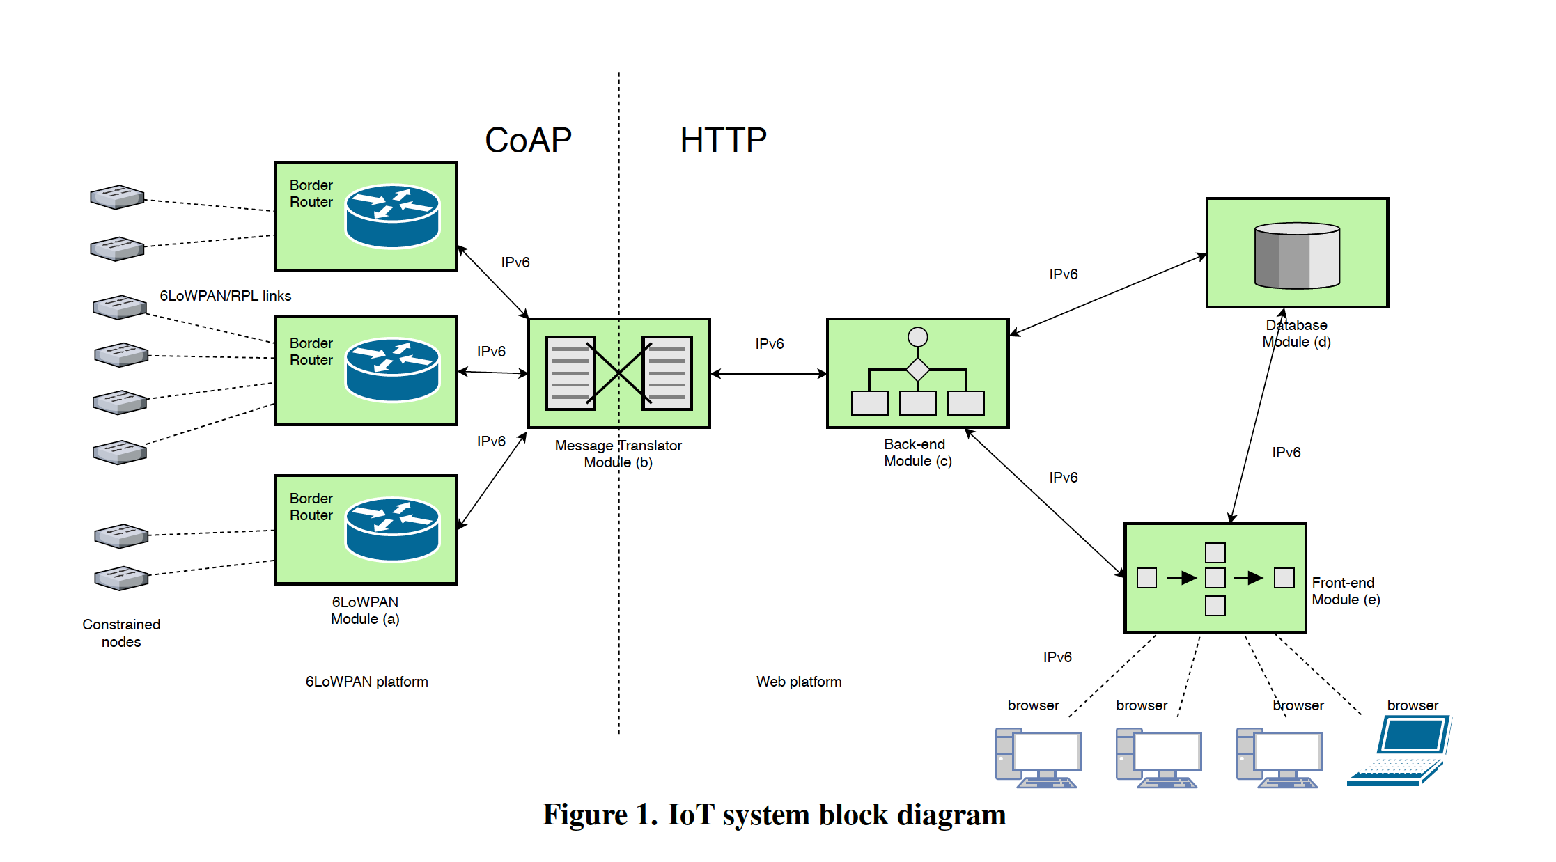

Slide 3
Web Platform
Front-end Module
Back-end Module
Database Module
Message Translator Module

Slide 4
Front-end Module
The front end is everything involved with what the user sees, including design and some languages like HTML, CSS and JavaScript.

Slide 5
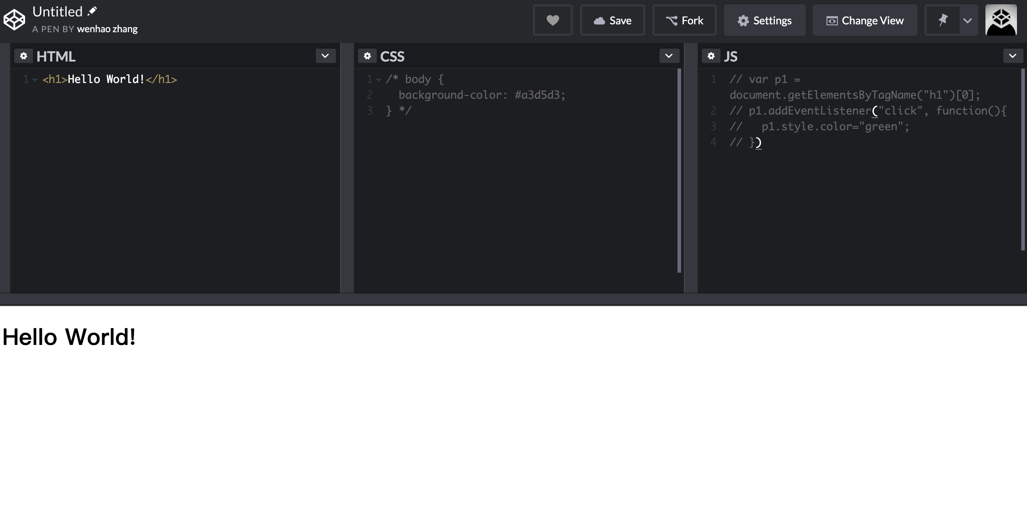

Slide 6
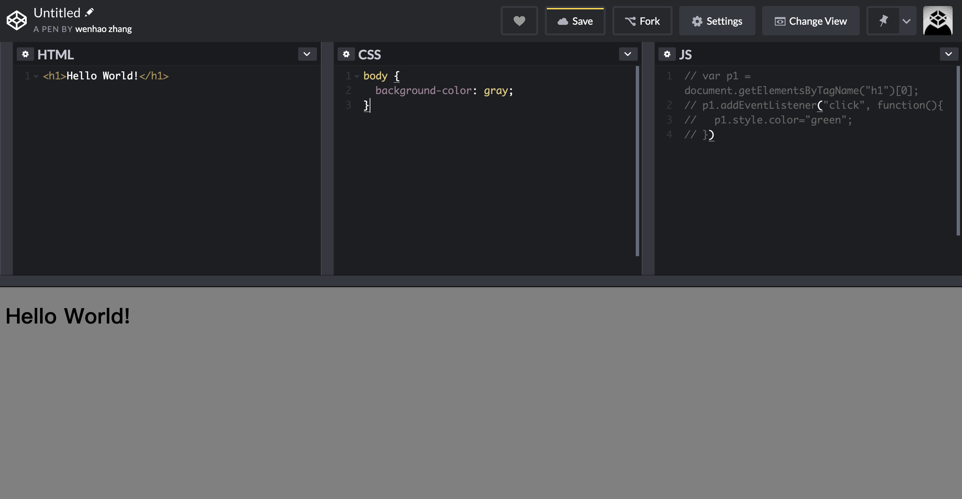

Slide 7
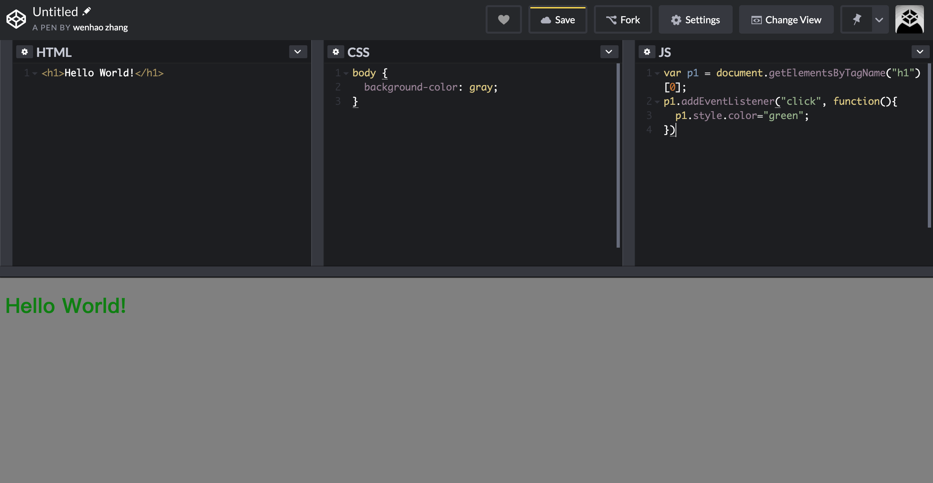

Slide 8
Back-end Module
The back end, or the “server side”, is basically how the site works, updates and changes. This refers to everything the user can‘t see in the browser, like how servers respond to all the requests from users, and connects to databases and access the data.

Slide 9
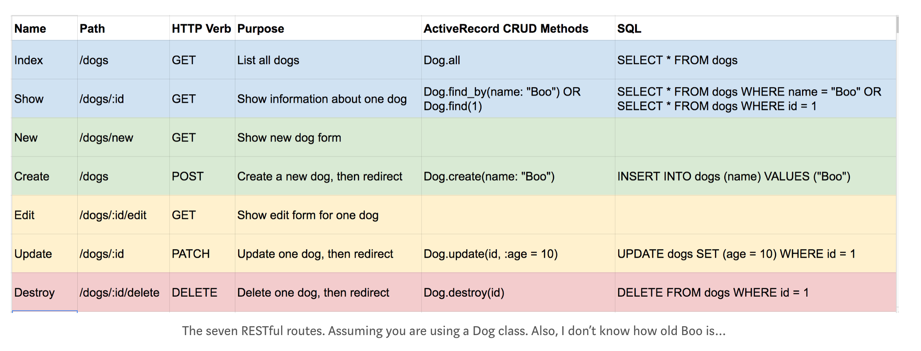
RESTful Routes

Slide 10
Database Module
SQL
ER model
Complex query
Has transaction, safer
NoSQL
Key-value pair
Easy data access

Slide 11
Summary
What I’ve done: Figured out the framework of this project, learned some basic knowledge about some skills on front-end, back-end and database, like HTML, CSS, JavaScript, Bootstrap, RESTful Routes, MySQL database. Have some basic code understanding on those languages.
What I’ll do: Keep learning how to write front-end, back-end, database code and how to interconnect them, then try to understand the code and relationship between the files wrote by Xiaozheng. Finally be able to find the shortage and update them.

