Slide 1
6LoWPAN Platform Project
Feilong Liu

Slide 2
Building and Deploy
Environment needed to be set
Operating system: Windows 8.1
Browser: Google Chrome
Tomcat: tomcat 9.0.16
JDK: oracle64-1.8.0_201
MySQL: 8.0.15
Maven

Slide 3
Problem:
Apache-maven not built successfully
Using command mvn -v
It shows: ‘mvn’ is not recognized as an internal or external command, operable program or batch file
Try :
Add System Variables
name: MAVEN_HOME
value: ‪D:\apache-maven-3.6.0
name: path
value: %JAVA_HOME%\bin; %MAVEN_HOME%\bin;
%SystemRoot%\system32;%SystemRoot%;%SystemRoot%\System32\Wbem

Slide 4
Testing levels and types
Unit testing
To verify a single program or a section of a single program
Integration Testing
To verify interaction between system components
System Testing
To verify and validate behaviors of the entire system against the original system objectives.

Slide 5
Testing levels and types
Black box Testing
Test cases are written from definitive source document, like specification or requirements documents
White box Testing
Know the knowledge of program structure, front-end or back-end. Know the purpose of code.
Stress Testing
Test edge case of program. Expose the weak links to determine if system could recover gracefully

Slide 6
Some thing about HTML
HTML define the structure of webpage
Like the order of the content, add some imgs, the style of headlines
CSS define the style of HTML
Add some background color or change the pixes of the content
JavaScript adds logic and interactivity to a page
Load new data from other webpage or change color when user click

Slide 7
Some thing about HTML

Slide 8
Some thing about HTML

Slide 9
Some thing about HTML

Slide 10
Some thing about HTML

Slide 11
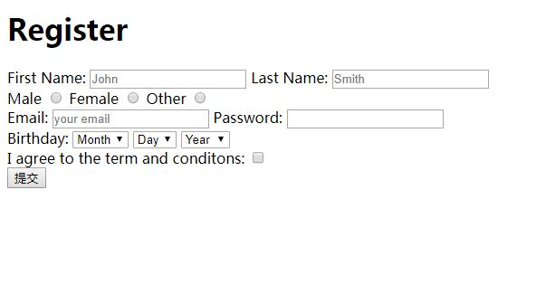
Some thing about HTML
In HTML I learn how to add input and validation for input in webpage, make labels add dropdown list or radio button ect.

