Slide 1
Improvement on the Platform
Wenhao Zhang

Slide 2
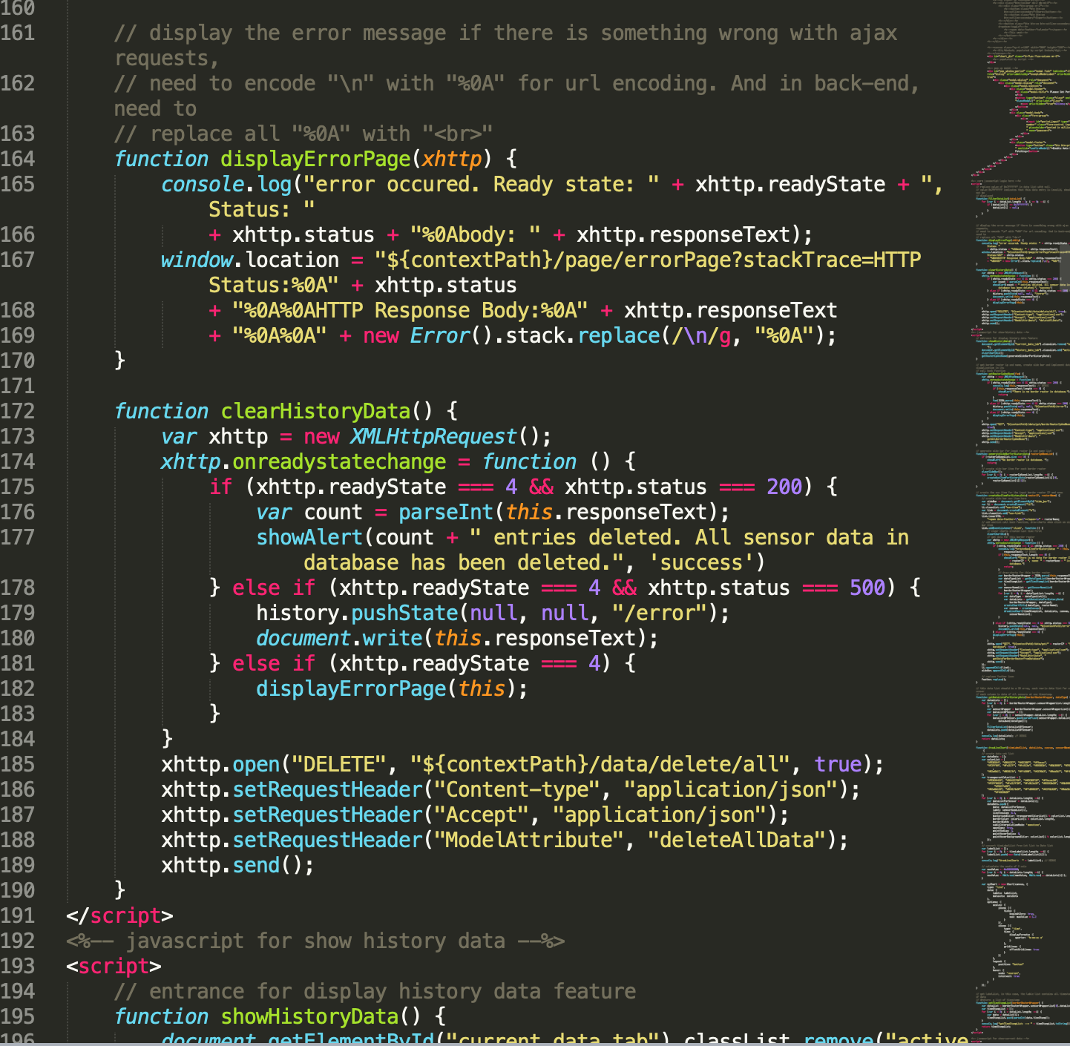
Improvement 1
Remove JavaScript on html

Slide 3
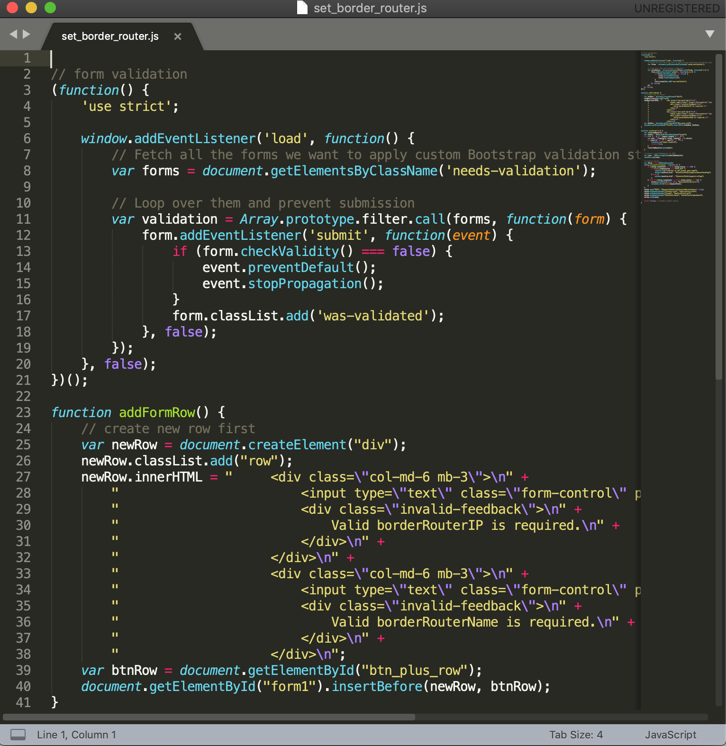
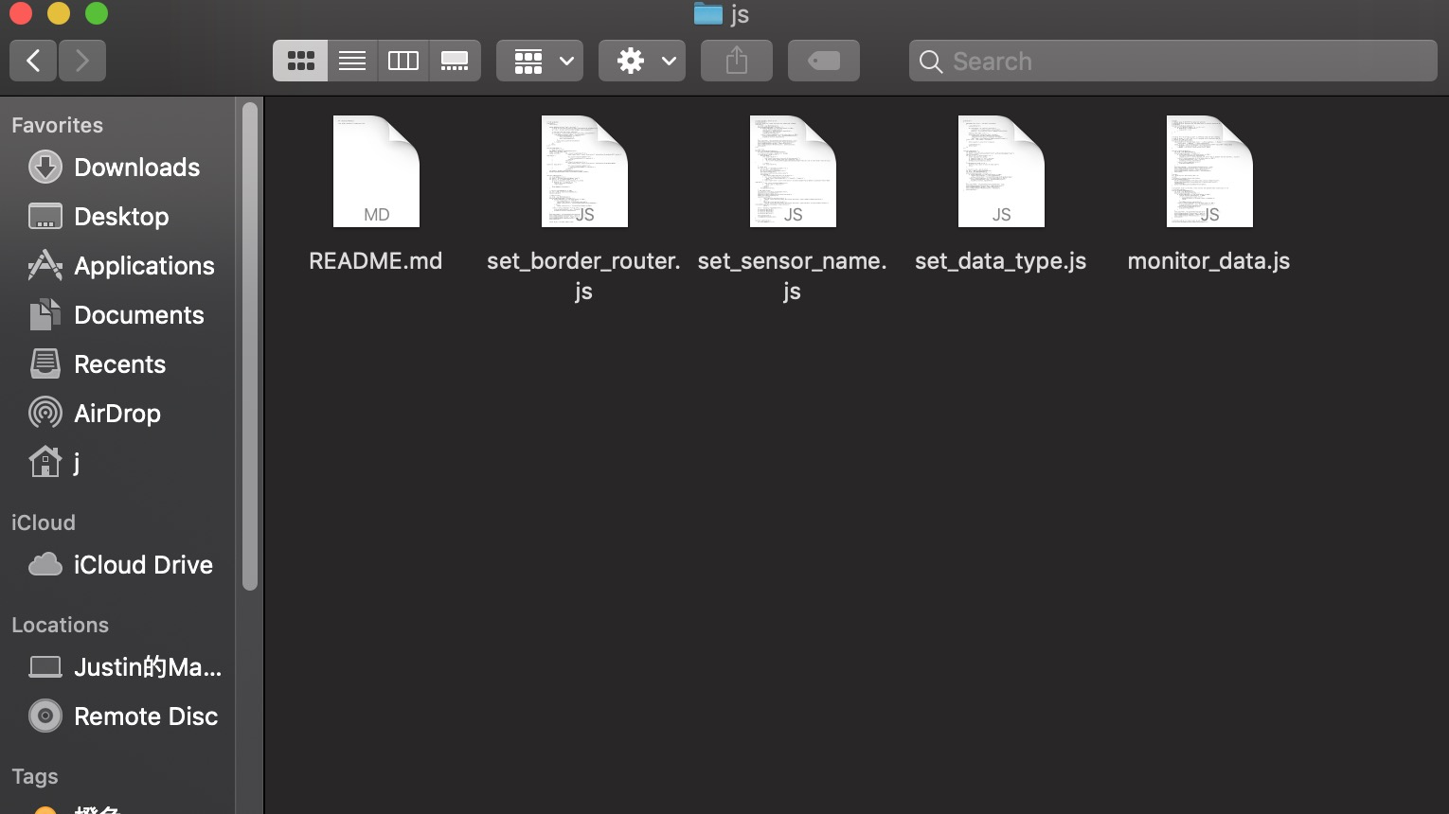
Improvement 1 Done!
I’ve moved all JavaScript code from jsp file to new separate files and link them correctly back to corresponding jsp files.

Slide 4
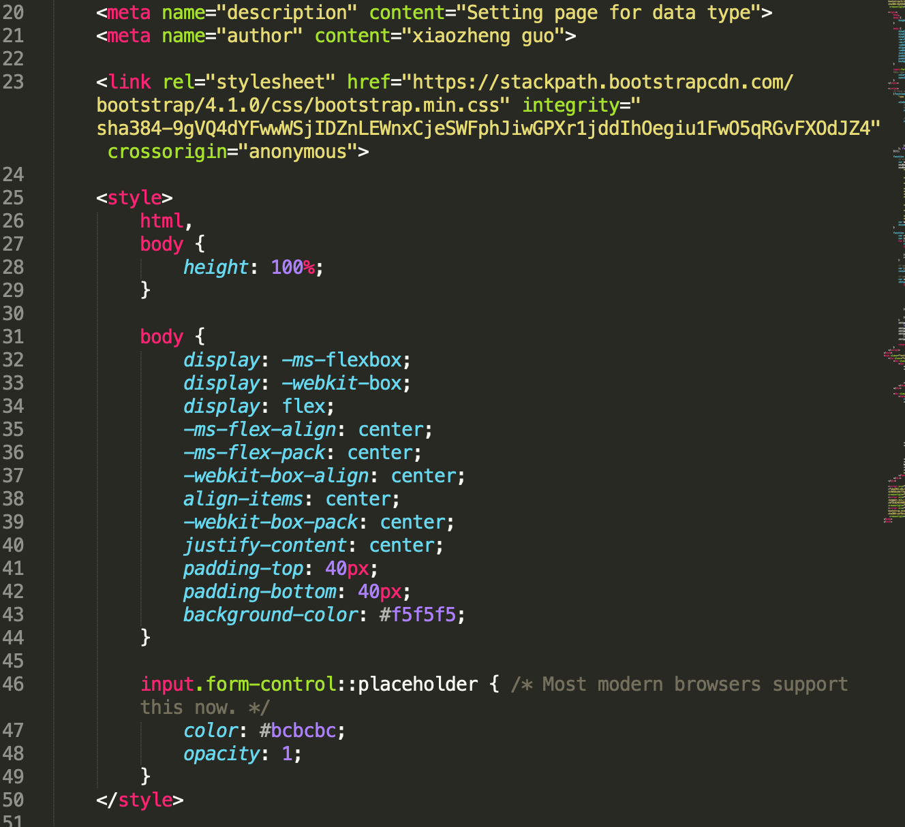
Improvement 2
Remove CSS on html

Slide 5
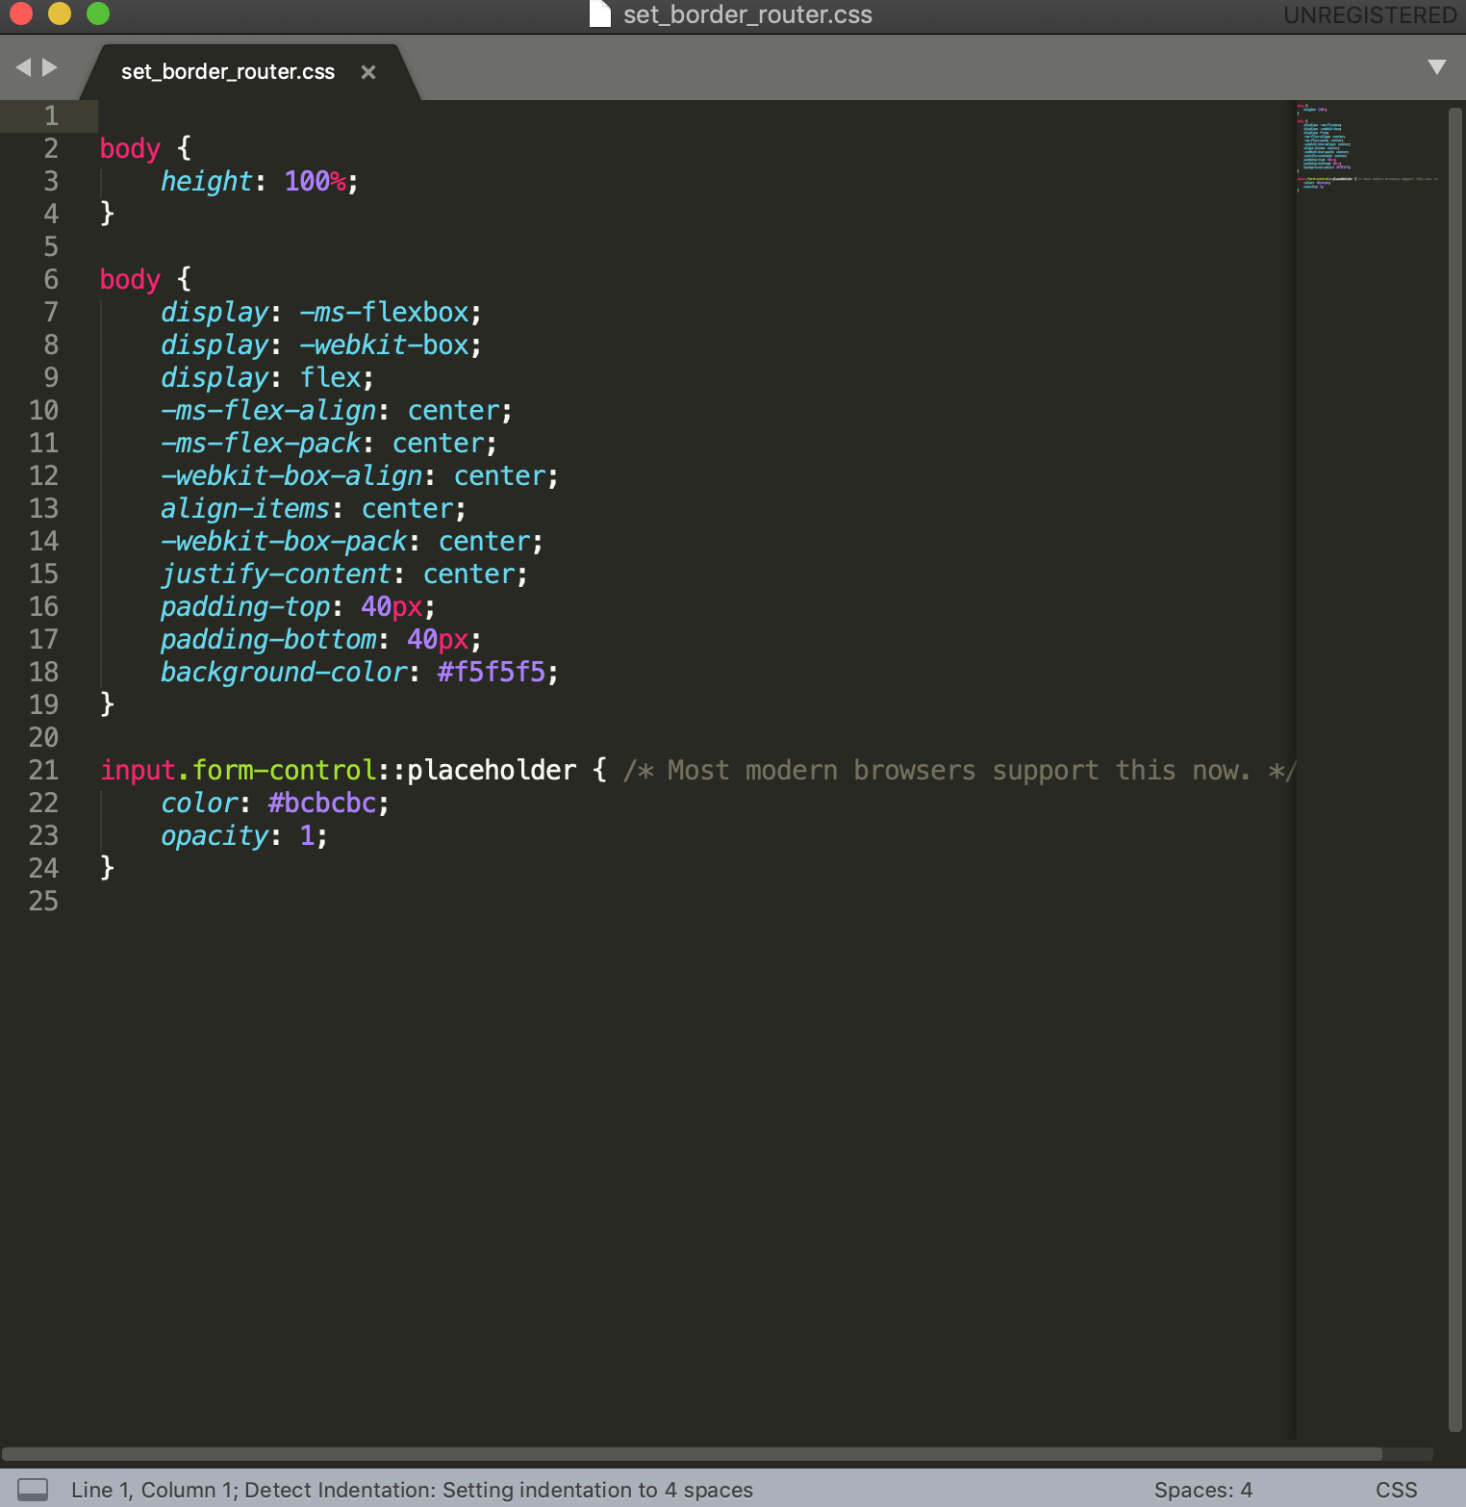
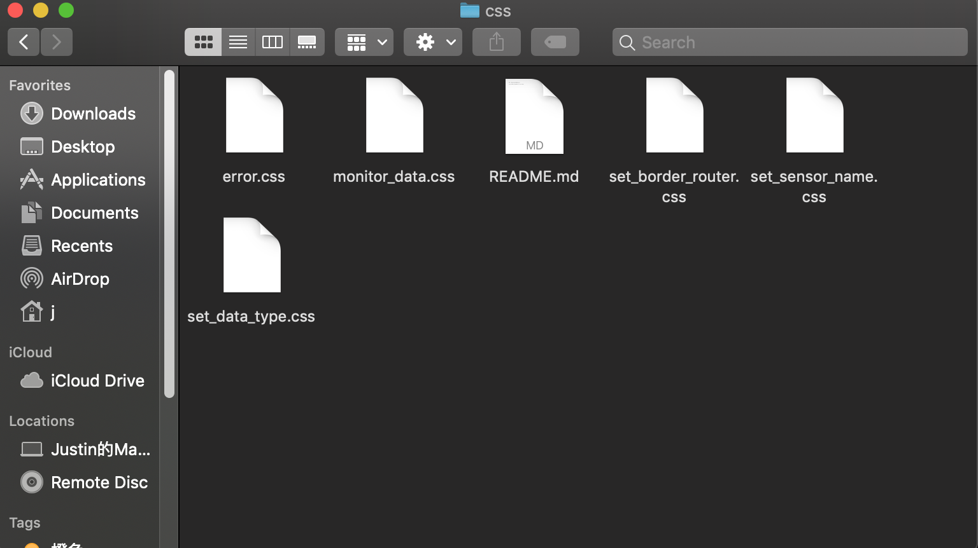
Improvement 2 Done!
I’ve moved all CSS code from jsp file to new separate files and link them correctly back to corresponding jsp files.

Slide 6
Improvement 3
Remove redundant code on JavaScript

Slide 7
Improvement 3
There was some problems on my slide for last presentation, I found some redundant JavaScript code but it turns out that they are under the different script tag. So for this part, I’ve not done too much, I will try to emerge all script tag to one file when I dive into the whole functionality and understand the logic.

Slide 8
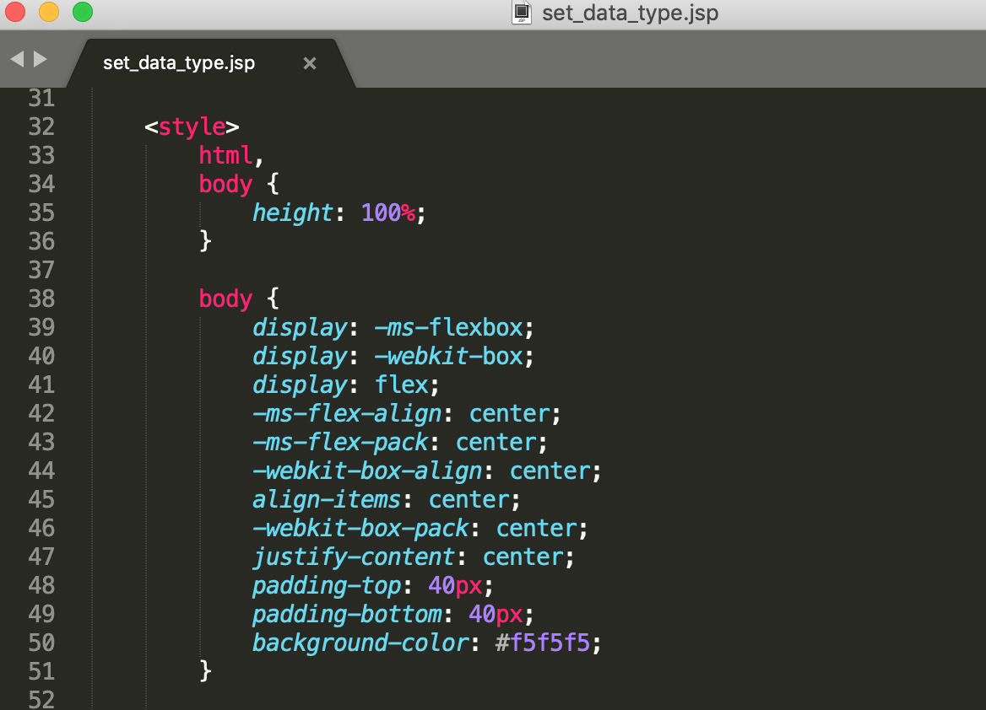
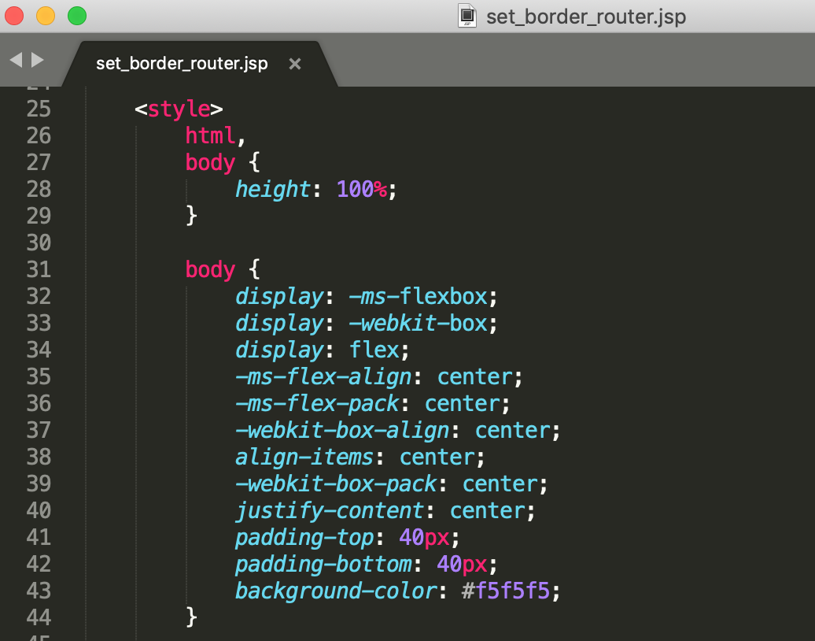
Improvement 4
Remove redundant code on CSS and create a new file

Slide 9
Improvement 4 Done!
I’ve checked all css file, and removed all redundant code I can find right now. I will do this one more time after I improve the layout of some pages

Slide 10
Summary
I’ve been diving into the layout of jsp files, relation among jsp, css, javascript files, and some tech Xiaozheng used on this project. Then I’ve finished the improvement 1-4 as I mentioned last time.
I will keep learning and try to implement next several improvements.

