Slide 1
Computer Assistance Cloud Classification
By Menyang

Slide 2
Could Family
Clouds Family | Cloud Category
Low | Cumulus
 | Cumulonimbus
 | Stratocumulus
 | Stratus
 | Nimbostratus
Middle | Altostratus
 | Altocumulus
High | Cirrus
 | Cirrostratus
 | Cirrocumulus
Low cloud:
Height <= 2000m
Middle could:
2000m < Height <= 5000m
Hight could:
5000m < Height

Slide 3
Binocular Camera
Two independent lenses

Slide 4
Method
Using math formula

Slide 5
The Error Between Real and Measure
Line: Real height
(laser measurement)
Points: Our result

Slide 6
3D Height Map

Slide 7
Future Works

Slide 8
Get Special Points
Using subpixel detection the edge points
(The red points is what we got)

Slide 9
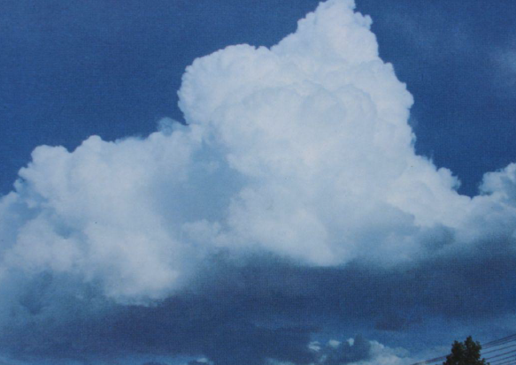
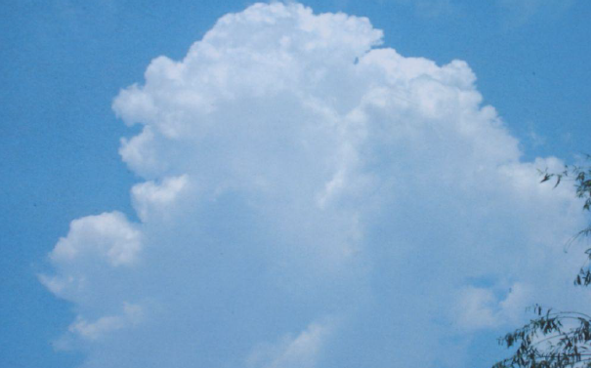
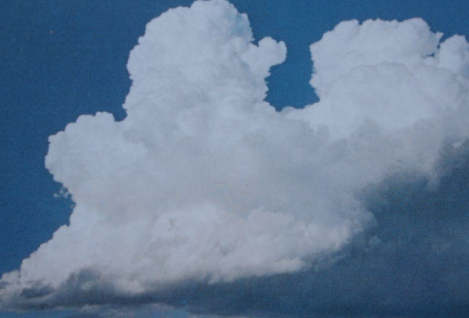
Training Classification Module
Using plenty of this extract cloud pictures training our module.
(We have nearly 6,000 pictures now)

Slide 10
Classification
1: Stratocumulus 2: Altocumulus

Slide 11
Thanks!

