Slide 1


Transforming smallholder farming in Africa:
From headwinds to tailwinds in agricultural development
William A. Masters
Professor, Friedman School of Nutrition Science and Policy and
Department of Economics (by courtesy)
http://sites.tufts.edu/willmasters
Fletcher Food Policy Group
November 17, 2014

Slide 2
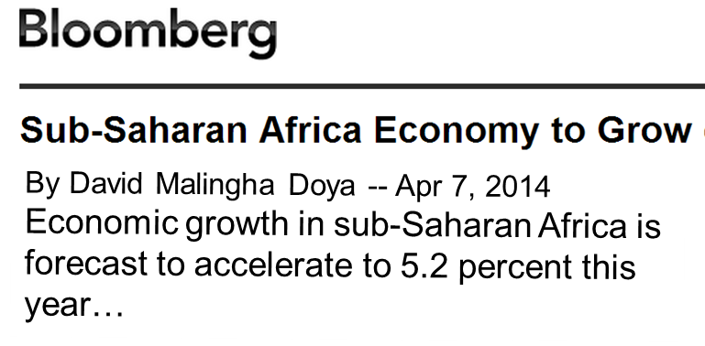



Africa has some of the world’s fastest
economic growth rates
+Today’s google news search for: “economic growth” africa

Slide 3
Africa is catching up, but still has far to go
Food supply and real income by region, 1990-2012
Dietary energy (kCal/pers/day)
Real income per capita (GDP at 2011 PPP prices)
Source: Author’s calculations, May 2014. Real income is from World Bank, World Development Indicators (April 2014), downloaded from http://data.worldbank.org. Food supply is from FAO, Food Security Indicators (December 2013), downloaded from http://www.fao.org/economic/ess/ess-fs. Each point is a 3-year average, from 1990-92 to 2010-12.

Slide 4
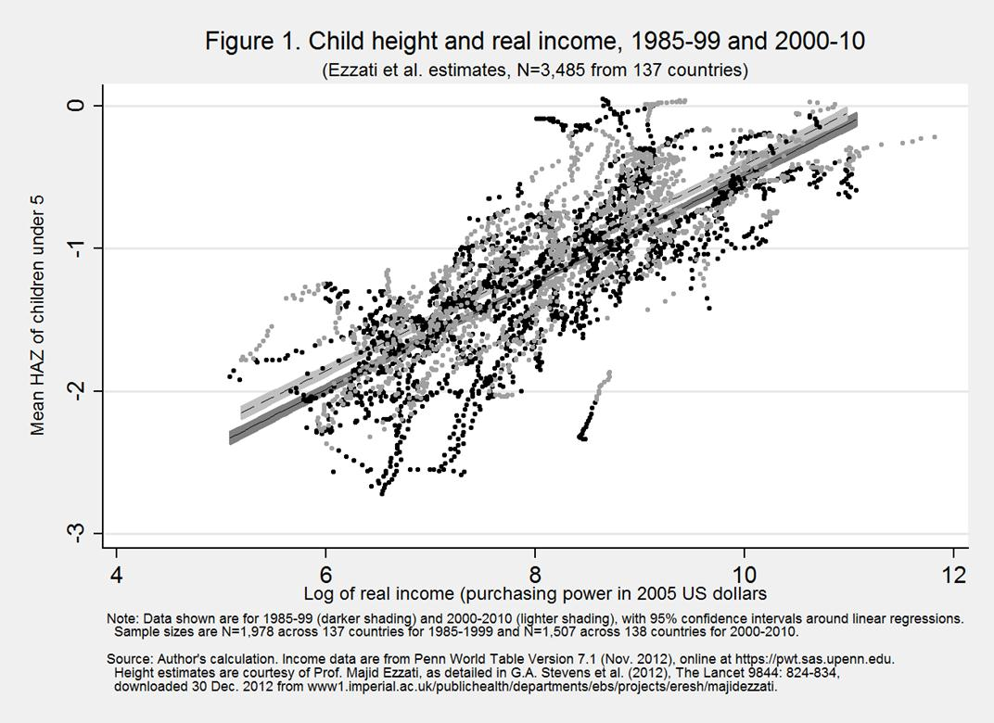
With higher incomes, children grow taller
…and at each income level, children are slightly
taller
now
Source: W.A. Masters, 2013. “Child Nutrition and Economic Development”, Nutrition in Pediatrics, 5th ed. (chapter 44), edited by C.P. Duggan, J.B. Watkins, B. Koletzko and W.A. Walke, Shelton, CT: PMPH-USA.

Slide 5
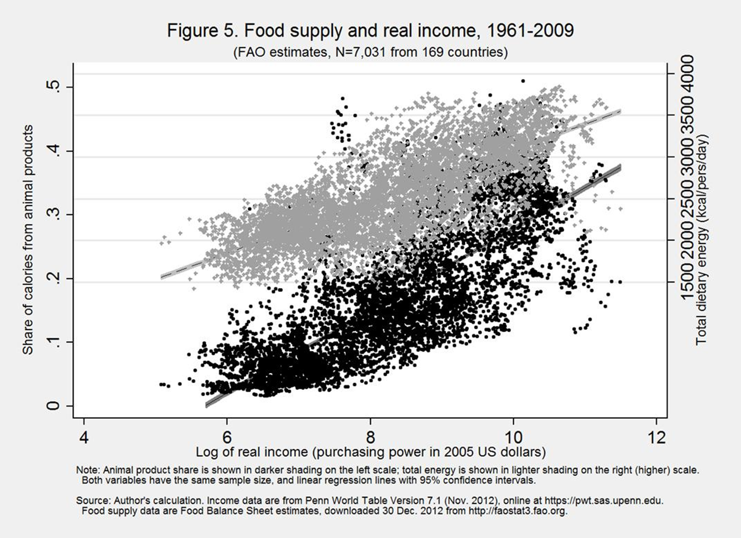
Higher income changes diet quality as well as quantity
Share of calories from animal sources, total food supply and income, 1961-2009
Total calories available rise from under 2000
to over 3500
per person/day
Animal-sourced foods rise from about 5% to about 40% of calories
Source: W.A. Masters, 2013. “Child Nutrition and Economic Development”, Nutrition in Pediatrics, 5th ed. (chapter 44), edited by C.P. Duggan, J.B. Watkins, B. Koletzko and W.A. Walke, Shelton, CT: PMPH-USA.

Slide 6
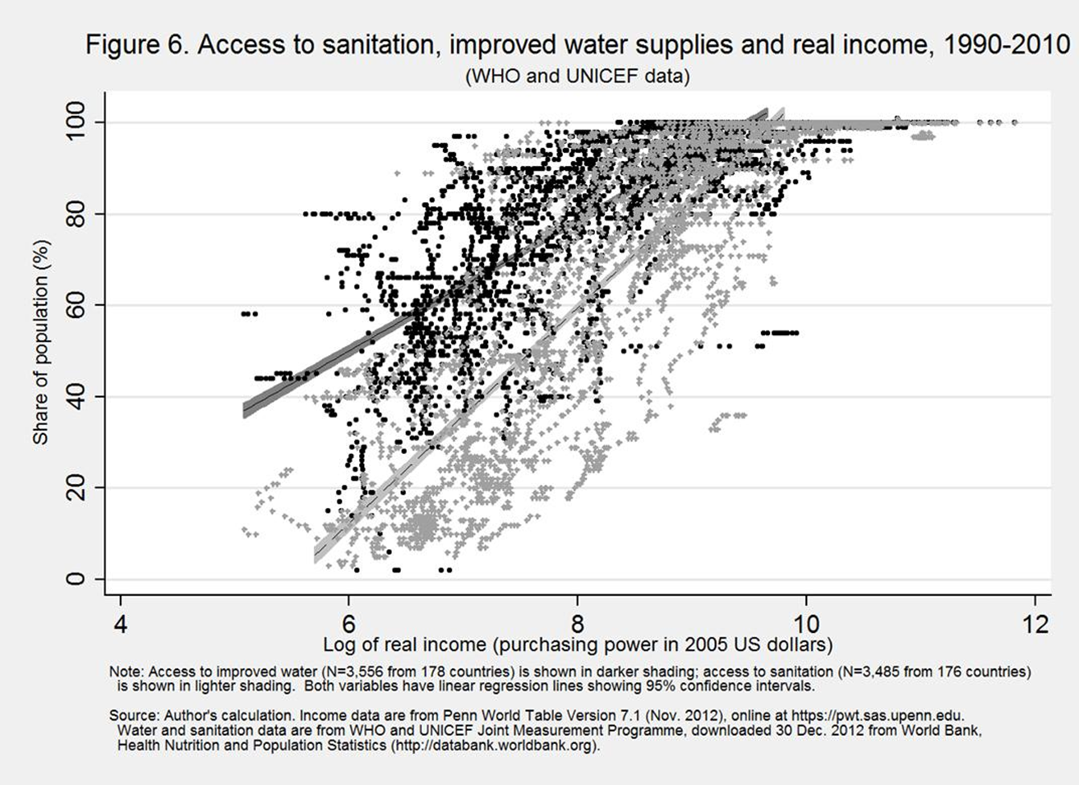
Higher income also buys sanitation and
clean water (among other things)
Access to sanitation, improved water and income, 1990-2010
Access to improved water rises from under 40% to 100% of households
Access to sanitation rises from under 5% to 100%
of households
Source: W.A. Masters, 2013. “Child Nutrition and Economic Development”, Nutrition in Pediatrics, 5th ed. (chapter 44), edited by C.P. Duggan, J.B. Watkins, B. Koletzko and W.A. Walke, Shelton, CT: PMPH-USA.

Slide 7
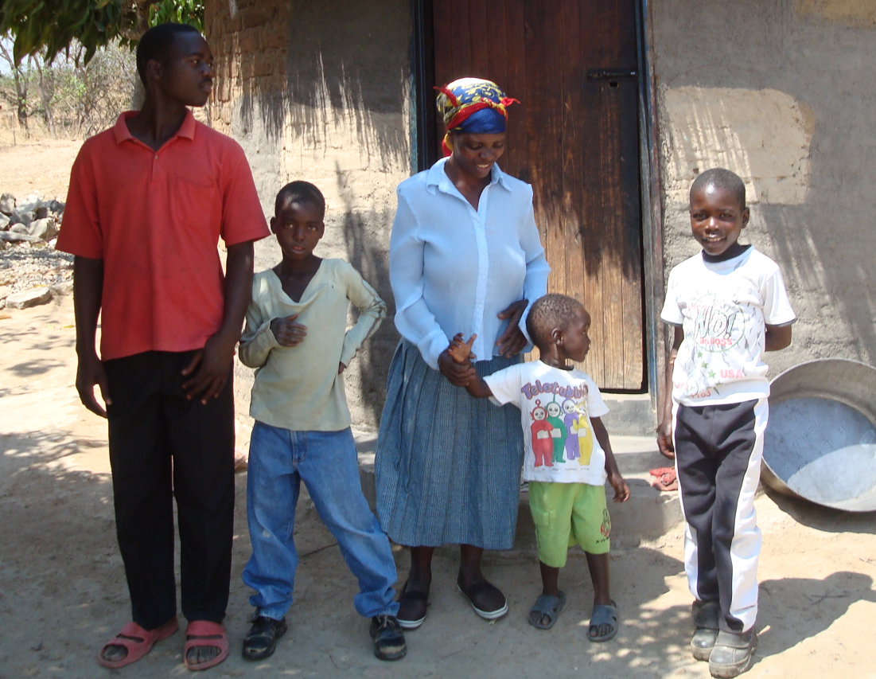

What happens to smallholder farmers during economic growth?
In most countries, most of the poorest live in rural areas
  they rely on agriculture for economic opportunity
  and move to off-farm work as soon as they can
Amai Nickson and family at Chakuma Village, Zimbabwe
25 years after I taught in the classroom at right (with Tadius Shumba)
Notes:
Photos taken Sept 2010.
At left, Amai Nickson surrounded by, from left: Shingirai (19, in Form 6 at Rukweza); Blessing (son of Nickson); Rudo (daughter of Greta); John (10, her last born).
At right, Jamela (real name = Tadius Shumba)

Slide 8
Urbanization and off-farm work can eventually employ all the children of farmers
World population by principal residence, 1950-2050
Number of people
(billions)
2014
For the world as a whole, rural population has almost peaked and will soon begin to decline
Source: Calculated from UN World Urbanization Prospects, 2011 Revision,
released October 2012 at http://esa.un.org/unpd/wup. Downloaded 18 April 2013.

Slide 9
Urbanization and off-farm work can eventually employ all the children of farmers
Sub-Saharan Africa population by principal residence, 1950-2050
Number of people
(billions)
2014
Africa still faces
30+ years of rural population growth
Source: Calculated from UN World Urbanization Prospects, 2011 Revision,
released October 2012 at http://esa.un.org/unpd/wup. Downloaded 18 April 2013.

Slide 10
Africa’s year-to-year rural population increase has been fast but is now slowing
Rural population increase in Africa, South Asia and Worldwide, 1950-2050
Annual change
in rural population
(% growth)
From 1970 to 1995, Africa had over 2% per year rural population increase
Africa’s rural population growth is now slowing and will eventually stop
2014
For the world as a whole,
rural population growth will soon
become negative, allowing more land per farm
Source: Calculated from UN Population Division, World Population Projections (http://esa.un.org/unpd/wpp), accessed 11 Aug 2012, based on UN Population Prospects: The 2010 Revision and World Urbanization Prospects: The 2011 Revision.

Slide 11
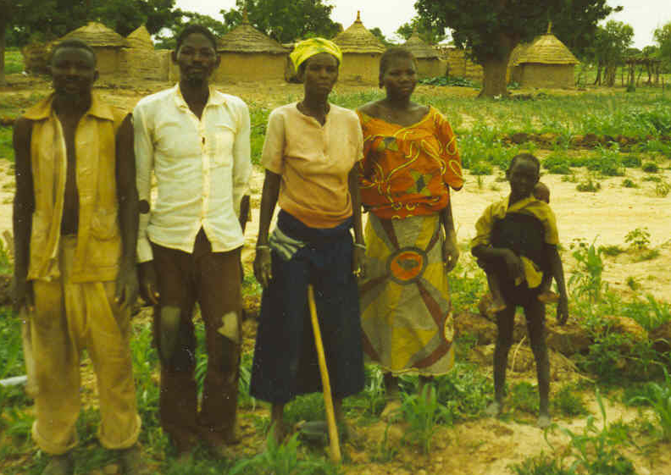
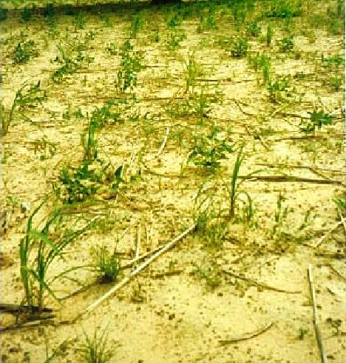
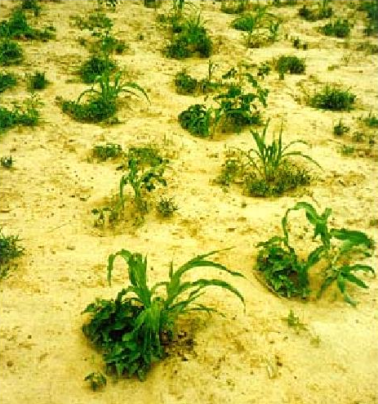
Adapting to higher rural population density
calls for difficult, surprising innovations
Traditional planting
“Zai” pits
Burkina Faso, 1997
Digging zai pits concentrates moisture and nutrients, making it worthwhile to use more fertilizer and
new seed varieties

Slide 12
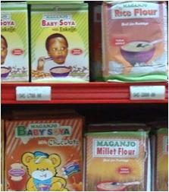

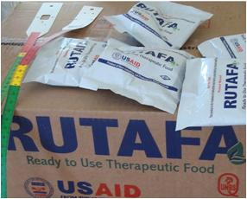
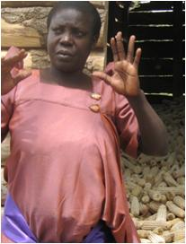
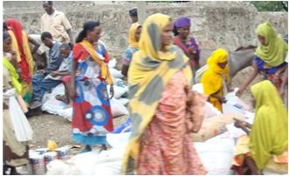
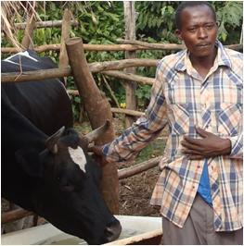
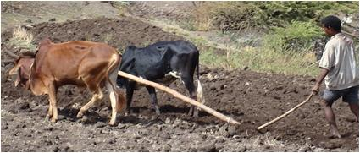
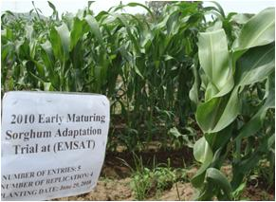

Interventions to improve agriculture and nutrition can start a cycle of success
What drives nutritional change?
Food composition
Food supplementation
and food assistance
Food availability
Successes
seize local opportunities to meet changing needs
Agriculture and food systems
Education and
behavior change
Technological change
Notes:
Photos are from Will Masters in Uganda, Ethiopia and Ghana, 2010-13

Slide 13
Africa’s population increase also imposed a
heavy burden of child dependency
Child and elderly dependency rates by region (0-15 and 65+), 1950-2030
Children or elderly per 100 adults of working age (16-65)
From 1970 to 1995, Africa had
over 90 child dependents
per 100 working-age adults
That dependency rate is still high but now falling
(a "demographic gift")
2014
Source: Calculated from UN Population Division, World Population Projections (http://esa.un.org/unpd/wpp), accessed 11 Aug 2012, based on UN Population Prospects: The 2010 Revision (April 2011).

Slide 14
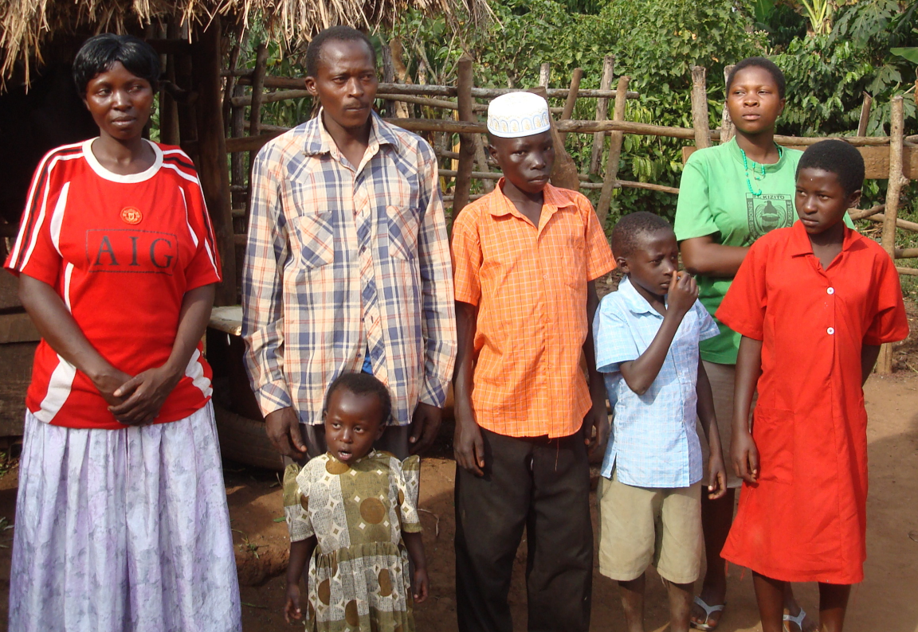

Africa is in the last stage of demographic transition from large to small families
Two families involved in USAID-Heifer International projects in Nakasongola and Luweero districts, Uganda (2011)
Notes:
Photos by Will Masters 2011

Slide 15
Africa has a long way to catch up:
Africa’s ag R&D is 25 years behind Asia’s
Percent of cropped area reached by new varieties
Source: Reprinted from W.A. Masters, “Paying for Prosperity: How and Why to Invest in Agricultural Research and Development in Africa” (2005), Journal of International Affairs, 58(2): 35-64.

Slide 16
Africa’s green revolution
has now started, 25 years after Asia’s
USDA estimates of average cereal grain yields (mt/ha), 1961-2013
Source: Calculated from USDA , PS&D data (www.fas.usda.gov/psdonline), downloaded 2 August 2013. Results shown are each region’s total production per harvested area in barley, corn, millet, mixed grains, oats, rice, rye, sorghum and wheat.

Slide 17
U.S. aid for agriculture has just begun to recover after being sharply cut in 1980-99
US foreign aid commitments by sector, 1967-2012
(ODA, millions of 2012 USD)
After Asia’s green revolution, 20 years of complacency about agriculture
In the 2000s, donors (re)discovered health
…and then agriculture
Note: Health includes nutrition. Agriculture includes forestry and fisheries. Values are billions of constant USD dollars at 2012 prices. Source: Calculated from OECD (2014), Official Bilateral Commitments by Sector, downloaded 4 Oct. 2014 (http://stats.oecd.org/qwids).

Slide 18
Global aid trends have been similar to the U.S. trends, magnified times three
All DAC donors’ foreign aid commitments by sector, 1967-2012
(ODA, millions of 2012 USD)
After Asia’s green revolution, 20 years of complacency about agriculture
In the 2000s, donors (re)discovered health
…and then agriculture
Note: Health includes nutrition. Agriculture includes forestry and fisheries. Values are billions of constant USD dollars at 2012 prices. Source: Calculated from OECD (2014), Official Bilateral Commitments by Sector, downloaded 4 Oct. 2014 (http://stats.oecd.org/qwids).

Slide 19
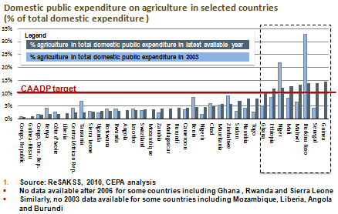
Many African governments are now focusing more on agriculture
Slide is courtesy of Prabhu Pingali, Greg Traxler and Tuu-Van Nguyen (2011), “Changing Trends in the Demand and Supply of Aid for Agriculture Development and the Quest for Coordination,” at the AAEA, July 24–26, 2011.
Notes:
Slide is courtesy of Prabhu Pingali, Greg Traxler and Tuu-Van Nguyen (2011), “Changing Trends in the Demand and Supply of Aid for Agriculture Development and the Quest for Coordination.” Presentation at the Annual Meetings of the AAEA, July 24–26, 2011.

Slide 20
Long-term trends are slowly shifting to favor agricultural development in Africa
From the 1970s through the 1990s, Africa faced the world’s heaviest demographic headwinds:
  Rural population growth rates rose to over 2% per year
  Child dependency rates rose to over 90 children per 100 adults
Africa is now catching up with Asia’s demographic transition and agricultural revolution, creating economic opportunity
  New farming techniques and crop varieties are finally arriving
  Many interventions help drive agricultural and nutrition improvements
“Africa” is 55 countries with many diverse challenges
  …but the odds of success are improving, with high payoffs to intervention

Slide 21
To conclude, back to our first slide:
Africa and Asia both still have far to go, offering big opportunities for rapid growth
Food supply and real income by region, 1990-2012
Dietary energy (kCal/pers/day)
Real income per capita (GDP at 2011 PPP prices)
Source: Author’s calculations, May 2014. Real income is from World Bank, World Development Indicators (April 2014), downloaded from http://data.worldbank.org. Food supply is from FAO, Food Security Indicators (December 2013), downloaded from http://www.fao.org/economic/ess/ess-fs. Each point is a 3-year average, from 1990-92 to 2010-12.

Slide 22
Thank you!
For research findings behind this talk, see http://sites.tufts.edu/willmasters

