Slide 1


Got baby food?
Understanding the market for packaged complementary foods in developing countries
Will Masters
Friedman School of Nutrition Science and Policy, Tufts University
http://sites.tufts.edu/willmasters
Friedman Seminar
Wednesday, February 3rd 2016

Slide 2
Much of the world’s growth faltering is
experienced from around 3 to 24 months of age
Mean z scores relative to WHO standards across 54 DHS/MICS surveys, by age (1-59 mo.)
What can explain sudden and severe shortfalls during this period?
3-24 months of age
Weight-for-height
Weight-for-age
Height-
for-age
Source: CG Victora, M de Onis, PC Hallal, M Blössner and R Shrimpton, “Worldwide timing of growth faltering: revisiting implications for interventions.” Pediatrics, 125(3, Mar. 2010):e473-80.

Slide 3
Many factors could cause this pattern of onset and duration
For example:
  Exposure to pathogens
  Expression of earlier deficits
...but also inadequate nutrient intake
Mean intake as a percentage of WHO recommended needs, by age
 |  | 6–8 months |  | 9–11 months |  | 12–18 months
Energy | (kcal) | 84% |  | 90% |  | 91%
Protein | (g) | 89% |  | 99% |  | 88%
Calcium | (mg) | 66% |  | 69% |  | 78%
Iron | (mg) | 33% |  | 44% |  | 75%
Vitamin A | (IU) | 535% |  | 663% |  | 443%
Vitamin B1 | (mg) | 59% |  | 67% |  | 60%
Vitamin B2 | (mg) | 48% |  | 50% |  | 35%
Niacin | (mg) | 53% |  | 41% |  | 44%
Note: Data shown are mean values for a sample of 400 children in Eastern Ghana.
Source: C.A. Nti and A. Lartey (2007). “Young child feeding practices and child nutritional status in rural Ghana.” International Journal of Consumer Studies, 31: 326-332.

Slide 4
What could make it difficult to reach nutrient adequacy?
Total quantity of food needed is very small (<50g/day to start)
  daily cost of adequate quantity is low, even for poor households
...but infants have small stomachs relative to potential growth velocity
so adequate complementary foods must have different qualities
What attributes are needed to reach adequate nutrient intake?
  higher nutrient density and digestibility than family foods
  more frequent feeding than other family meals
Every culture has traditional approaches to complementary feeding
  starchy staples may be germinated, fermented etc. for digestibility
  other ingredients added for protein, fats and micronutrients
Getting it right costs more than money
  time to prepare special foods 3-5 times per day
  information about which foods have adequate density

Slide 5
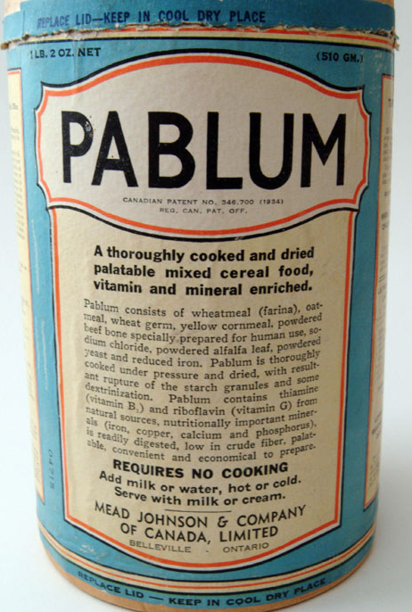
How can sufficient nutrient density be reached consistently, given caregivers’ constraints?
Toronto Hospital for Sick Children, 1931

Slide 6
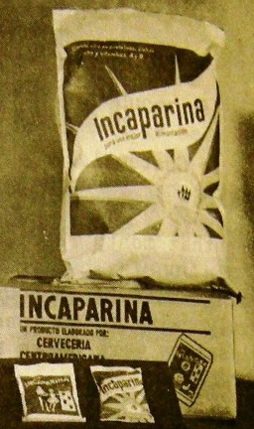
How can sufficient nutrient density be reached consistently, given caregivers’ constraints?
Toronto Hospital for Sick Children, 1931
INCAP, 1961

Slide 7
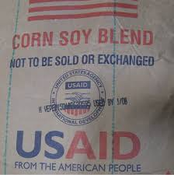
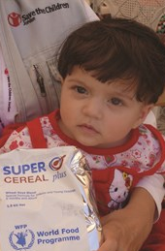
How can sufficient nutrient density be reached consistently, given caregivers’ constraints?
Toronto Hospital for Sick Children, 1931
INCAP, 1961
Various soy blends since 1970s
...and since 2010,
SuperCereal+

Slide 8

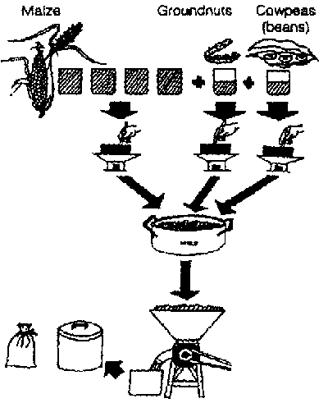
How can sufficient nutrient density be reached consistently, given caregivers’ constraints?
Home and artisanal production projects, 1980s
Toronto Hospital for Sick Children, 1931
Burkina Faso, 1983
UNICEF in Ghana
INCAP, 1961
Weanimix
Soy blends and SuperCereal+

Slide 9

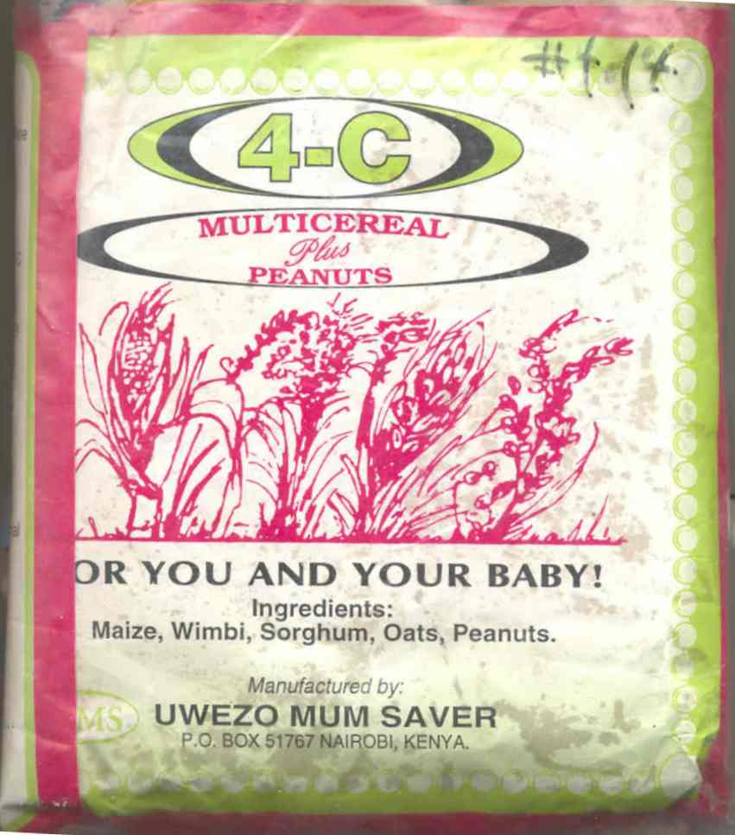
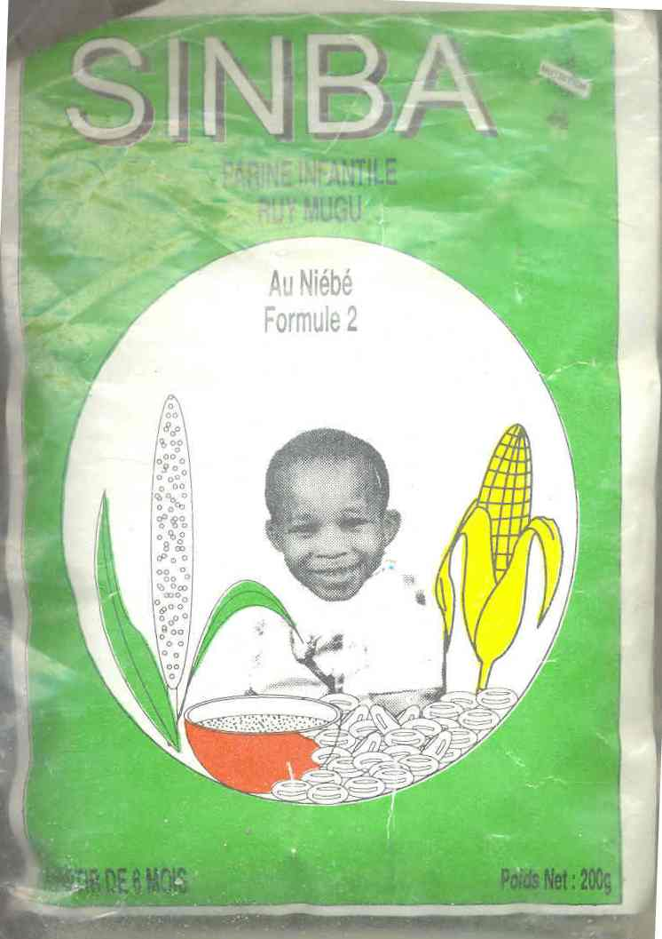
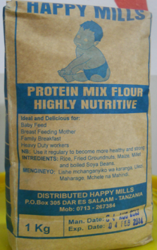
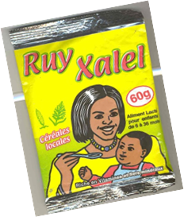
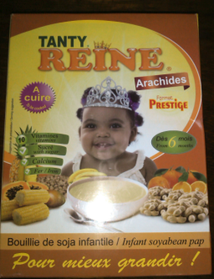
How can sufficient nutrient density be reached consistently, given caregivers’ constraints?
Home and artisanal production projects, 1980s
Toronto Hospital for Sick Children, 1931
Many small-scale millers making infant cereals since 1990s
Weanimix
Misola
INCAP, 1961
Cereal-soy blends
SuperCereal+

Slide 10
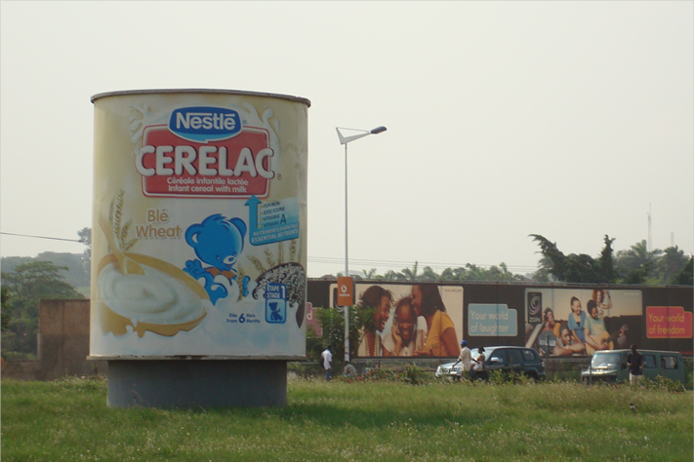
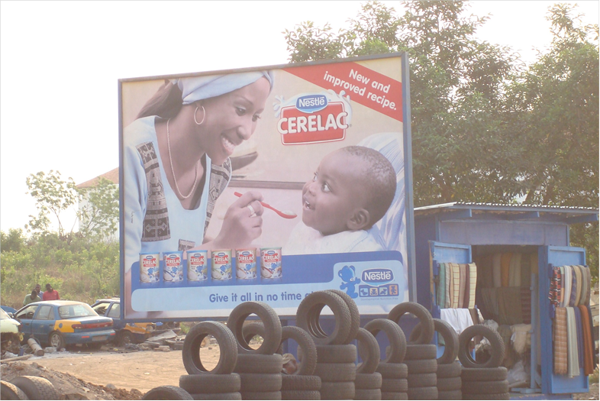
Accra, Ghana (2010)
So what products are most widely available in low-income countries?

Slide 11
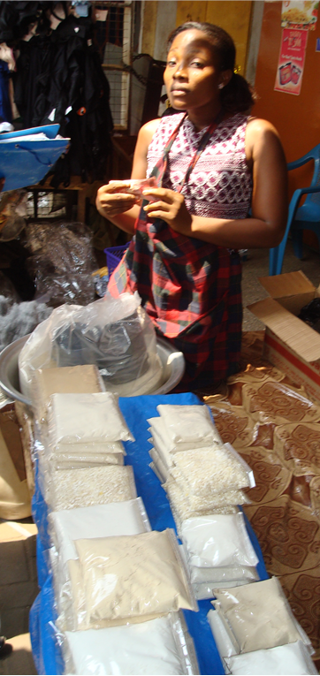
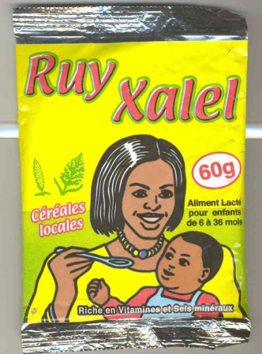
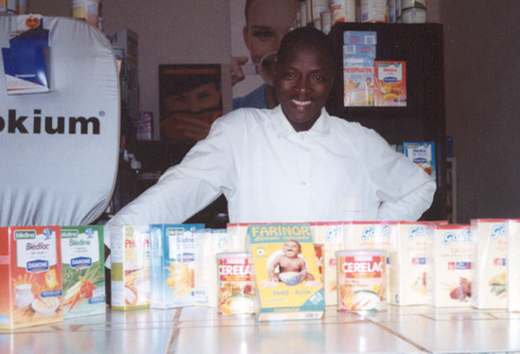
One can find many alternatives out there
In Ghana,
generic weanimix
Local grain millers’ brands,
e.g. from elsewhere in Africa:
Tanzania
Senegal
Kenya
Mali
Cameroon
And various multinationals, typically sold in supermarkets and pharmacies:

Slide 12
How do economists explain persistence of fancy brands, when equally-good alternatives are known to exist?
Advertising.
Fancy brands may signal social status
  sometimes plausible, but can’t explain private use by the poor
Fancy brands may be bought by mistake
  sometimes plausible, but how often can people be fooled?
Fancy brands provide quality assurance
  George Akerlof won Nobel in 2001 for this explanation
    If buyers can’t see qualities that sellers control, they rely on trust
    Trust is earned through brand identity, which allows persistently high prices
    Examples include specialized legal or medical services, education etc.
  Infant foods are subject to this kind of market failure
    Nutrient densities cannot be seen, even during or after feeding
    Many confounding factors affect child’s appetite, health and growth
  => The only remedy is 3rd party quality testing and certification

Slide 13
Here is the market I studied first:
All infant foods for sale in Bamako, Mali (1999)
Brand name Packaging Retail Prices (FCFA/unit)*
Mkt. Stores Pharmacy
Cérélac (wheat) 400 g. can 1400 1500 1615
Cérélac (wheat) 200 g. box 600 850
Cérélac (rice) 400 g. can 1600
Cérélac (wheat/Banana) 400 g. can 1750
Cérélac (wheat +3 fruits) 400 g. can 2240
Blédilac** (wheat) 250 g. can 1270
Blédina** lactée fruits 250 g. box 1830
Farinor** (maize/soy) 400 g. box 1690 1750
UCODAL (e.g. Sinba) 200 g. bag 200
MISOLA 500 g. bag 300
All branded imports charged much more than local products, which could be just as nutritious
…but despite low cost had very few sales, except to institutional buyers
Of the branded imports, only Cerelac was widely available.
D. Sanogo and W.A. Masters (2002), “A market-based approach to child nutrition: mothers’ demand for quality certification of infant foods in Bamako, Mali,” Food Policy, 27(3): 251-268.

Slide 14
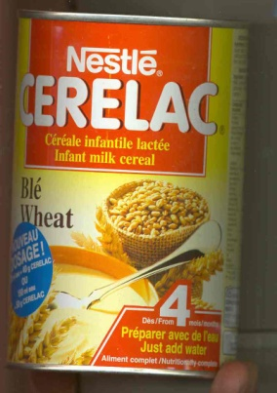

How do we know why consumers choose Cerelac?
A market experiment in Bamako, Mali (2000):
The question is,
Why would women buy this?
Cerelac (400 g. cans)
1617 FCFA = $2.49
Instead of this?
Sinba (2 x 200 g. bags)
2 x 200 FCFA = $0.61
Or just raw ingredients
to mix at home…
W.A. Masters and D. Sanogo (2002), “Welfare Gains from Quality Certification of Infant Foods:
Results from a Market Experiment in Mali”, American Journal of Agricultural Economics, 84(4): 974-989.

Slide 15
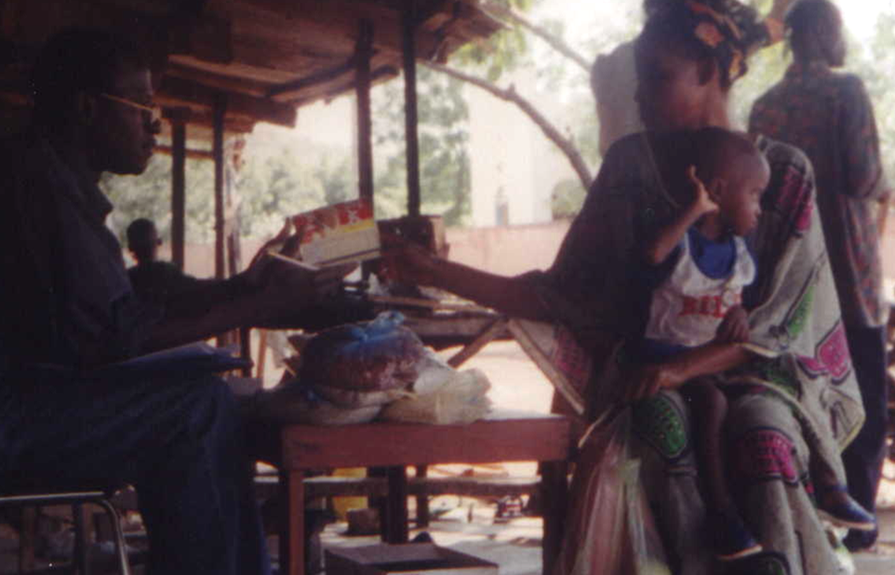
In very low income peri-urban areas, used market intercepts to recruit 240 mothers with infants
How do we know why consumers choose Cerelac?
A market experiment in Bamako, Mali (2000):
We gave participants a can of Cerelac, then offered to swap
for increasing quantities of other infant foods

Slide 16
The experiment allowed people to reveal their preferences one step at a time
We asked them to compare:
the only difference is:
The well-known brand
(Cerelac, in 400 g. metal canister)
A sealed, “certified” mix
(Certilac, in 400 g. plastic bag)
An open, unidentified mix
(Anonymous, in open bags)
Raw materials in fixed proportions (Ingredients, in open bags)
brand & packaging
certification
processing

Slide 17
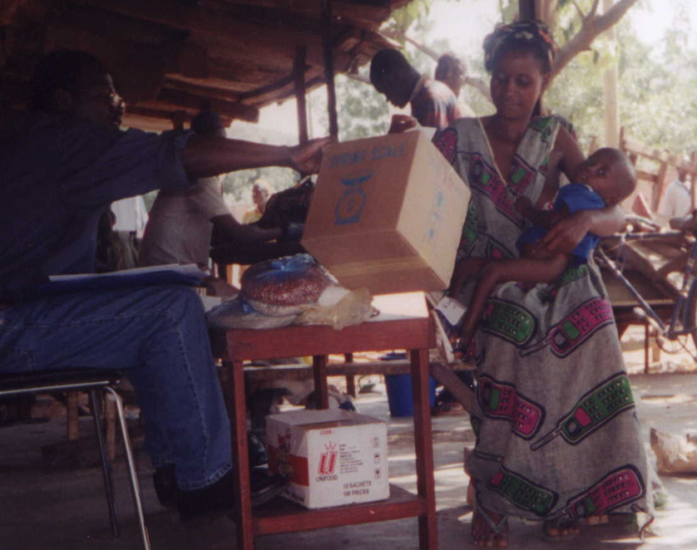
To avoid response bias, these were real decisions;
respondents took home one of their actual choices

Slide 18
On average, the mothers in our experiment cared about product certification almost as much as processing
Mean willingness to pay for product:
Implied willingness to
pay for the difference:
Certilac: 1160 FCFA
Generic: 705 FCFA
Ingredients: 120 FCFA
455 FCFA for certification
(=$0.70 per 400 g. bag)
585 FCFA for processing
(=$0.90 per 400 g. bag)

Slide 19
We also estimated
the cost of certification
We found that:
  introducing certification would be worth at least $20 per year per child needing infant foods (between 6 mo. and 2 yrs. of age)
  this amounts to a value of about $1 million per year for the city of Bamako as a whole
This is money that they’re still not getting
  fifteen years later, still no certification systems in place

Slide 20
A decade later in 2010, DFID funded a scoping study to revive the question for Ghana…
This time, we could address two other questions:
  Are the locally produced infant foods actually available?
  Are the locally produced infant foods actually high quality?
    Our economic theory has clear predictions:
      After start-up the products will be rarely available, because buyers will be skeptical about quality
      and skepticism will be justified, because quality will be low and variable since the sellers lack motivation to keep it high

Slide 21
Here is the full range of what I bought
from diverse vendors around Accra in 2010
Multinationals

Slide 22
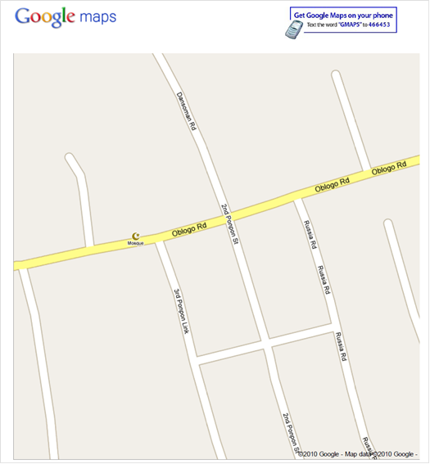
Question #1:
Are local infant foods as available as Cerelac?
This is a difficult question...
To answer in terms of Greater Accra as a whole, we divided the city into quadrants defined like this:
http://maps.google.com/maps?
&ll=5.558740,-.253961
&spn=0.0025,0.0025
&pw=2
Then randomly generated latitude and longitude locations and visited each one until we found over 200 shops to judge…

Slide 23
Are local infant foods as available as Cerelac?
No. Cerelac is as ubiquitous as toothpaste and soap, but local foods are often entirely unavailable.
Source: W.A. Masters, J. Kuwornu and D. Sarpong, “Improving Child Nutrition through Quality Certification of Infant Foods: Scoping Study for a Randomized Trial in Ghana.” London: International Growth Centre Working Paper, February 2011.

Slide 24
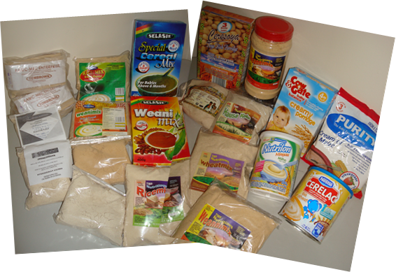
Question #2:
Are local infant foods as good as Cerelac?
To answer, we took 14 samples and sent them without labels to a commercial lab in Omaha
We did proximate analysis for macronutrients, plus iron & zinc

Slide 25
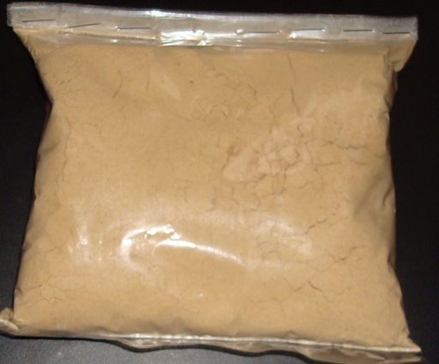
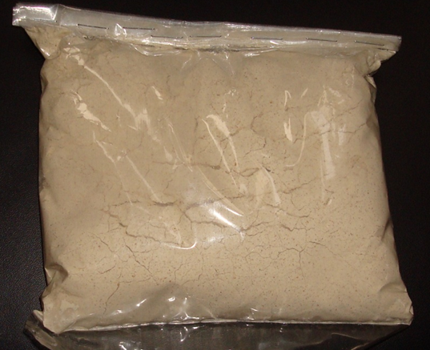
Nutrient density often exceeded international benchmarks
but often didn’t.
More nutrient-dense than international benchmarks
Less nutrient-dense than international benchmarks

Slide 26
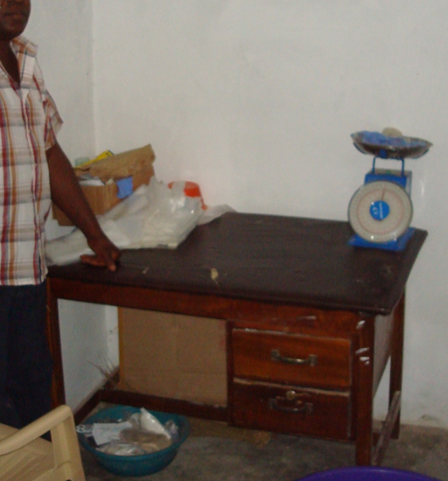
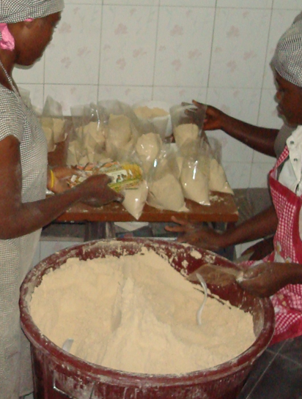
We had visited several of these manufacturers, and were surprised:
This producer’s mix had similar nutrient density to international benchmarks
This product had much lower fat, implying little of the claimed soy content

Slide 27
So…
Locally produced foods could be widely available at much lower cost and similar nutrient density as Cerelac
…and yet they are not.
  they are rarely available, and when found their quality is variable
  certification could help them be more widely sold with higher quality
There is no demand for quality certification.
  public agencies do their own inspection and testing, e.g. for SuperCereal+
  richer households can buy enough of the multinationals
  potential beneficiaries don’t know it would help them
This is a classic market failure.
  the remedy is clear enough, but policy depends on politics
How were existing quality assurance programs created?
  public (e.g. FDA) and private (e.g. UL) introduced after scandals
  international programs (e.g. ISO) used for new attributes
What might alter policy and grantmaking in this domain?

Slide 28
The latest project, funded by IFPRI, with Friedman students Winnie Bell and Marc Nene:
What’s for sale now, and is it any good?
A global catalog of packaged complementary foods:
  All products found by our collaborators around the world
  Criterion: sold as complement to breastmilk, for >6 months of age
  Typical product is precooked, in packages of 100-500g
Random sampling to test for nutrient composition
  Budgeted to sample 100 products from 20 countries
  Test for protein, fats, calories, iron and zinc
  Actually able to test 108 products from 22 countries

Slide 29
Results from 108 products in 22 countries
Samples are from Africa (18) and Asia (3), plus Haiti
Table 1. Number of samples by country of purchase
Country | Number of samples |  | Country | Number of samples
Benin | 5 |  | Kenya | 5
Botswana | 5 |  | Madagascar | 3
Burkina Faso | 5 |  | Malawi | 2
Cameroon | 5 |  | Mali | 7
China | 1 |  | Mauritania | 3
Cote d'Ivoire | 4 |  | Morocco | 2
DR Congo | 1 |  | Nepal | 5
Ethiopia | 12 |  | Rwanda | 6
Ghana | 10 |  | Senegal | 4
Haiti | 4 |  | South Africa | 6
Indonesia | 8 |  | Uganda | 5
Total number of countries |  | 22
Total number of samples |  | 108
Source: Masters, Nene and Bell (2016), in progress.

Slide 30
Results from 108 products in 22 countries
Greatest variance is in micronutrients
Fat content also varies widely
Source: Masters, Nene and Bell (2016), in progress.

Slide 31
Macronutrient results
Many products exceed SuperCereal+ benchmarks,
but few meet or exceed for all three macronutrients
Lines are SCP benchmarks
Energy
14 of 108 products meet or exceed all three macronutrient benchmarks
Protein
Fats
Source: Masters, Nene and Bell (2016), in progress.

Slide 32
Micronutrient results
Many products exceed SuperCereal+ benchmarks,
but few meet or exceed for both micronutrients
10 are OK on zinc but not iron
18 of 108 products meet or exceed both micronutrient benchmarks
12 are OK on iron but not zinc
68 of 108 products (63%) are below both benchmarks
Source: Masters, Nene and Bell (2016), in progress.

Slide 33
Some packages have nutrient fact claims.
How accurate are they?
Dashed lines are at 45º
Protein
Fats
Claims are mostly useless
Solid lines are SCP benchmarks
Claims themselves are basically random
Iron
Zinc
Source: Masters, Nene and Bell (2016), in progress.

Slide 34
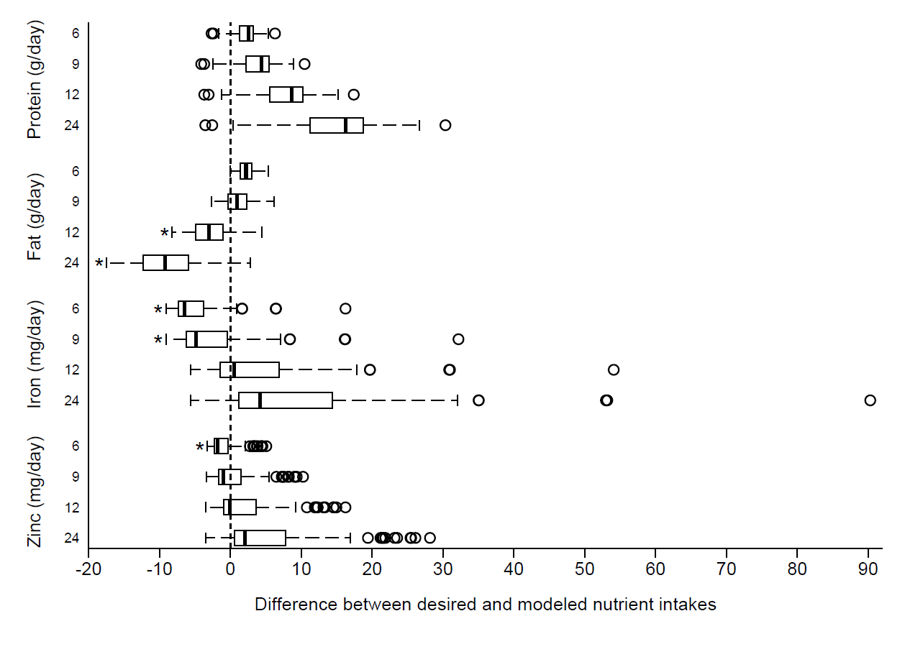
What would happen if a child consumed only breastmilk plus these complementary foods?
Age
(in months)
Macronutrient inadequacy after 12 months of age
Micronutrient inadequacy in first 12 months
Boxes show 25th-50th-75th percentile; whiskers extend to +/- 1.5 IQR; circles show outliers.
Source: Masters, Nene and Bell (2016), in progress.

Slide 35
Conclusion:
Locally made packaged complementary foods can have adequate nutrients
but they usually don’t
-- To remedy market failure, would need quality assurance
-- Effectiveness could be measured by an RCT
  Establish an Infant Nutrition Quality Assurance Project (INQAP)
  Recruit millers to participate, and issue time limited INQAP-OK stickers
  Roll out billboards and demonstrations at randomly-chosen markets
  Use surveys and growth monitoring to track food purchases & infant growth
  Use child’s age at the time of market advertisements to identify causal effect of certification on growth
-- Will keep submitting proposals for research
But would an RCT showing benefit really cause policy change?
  what information is most likely to alter policy and grantmaking?
Research can identify and explain the puzzle, but that’s just a start!

Slide 36
Acknowledgements
Co-authors: Winnie Bell and Marc Nene (+ others on earlier papers)
Funding: IFPRI, for a USAID-funded Linkage Grant (+ USAID and DFID for previous projects)
Sample collection: Ambroise Agbota, Jean-Paul Anoh, Mahaman Bamba, Aaron Cheng, Gnangbo Christian, Amelia Darrouzet-Nardi, Claude Emile, Issa Fadiga, Matt Hazel, Dorothy Nzembi Kimanthi, Yolande Kouame, Emmanuel Kouame, Rachid Laajaj, Perrine Loock, Janeen Madan, Will Masters, Menno Mulder-Sibanda, Fatouman Ouattara, Galase Ramolefhe, Marianne Santoso and Robin Shretha.
Nutrient testing: Midwest Labs, Omaha.
Thank you!

