Slide 1
ANH Academy
Learning Lab on Indicators of Food Insecurity and Malnutrition
Addis Ababa, Ethiopia
20-21 June 2016
Innovative Metrics and Methods for
Agriculture and Nutrition Actions

Slide 2
ANH Academy
Learning Lab on Indicators
of Food Insecurity and Malnutrition
William A. Masters
http://www.nutrition.tufts.edu/profile/william-masters
Shibani Ghosh
http://nutrition.tufts.edu/profile/faculty/shibani-ghosh-phd
Feed the Future Innovation Lab for Nutrition
Notes:
To insert your implementing partner institutional logo, go to View >> Slide Master, and replace the gray box with your logo, placing it to the right of the USAID logo at the bottom. No text or partner logos can be placed within the upper blue banner.

Slide 3
Structure of this Learning Lab
Part A: Classification and definitions of the indicators
There are over 150 indicators in current use
We will focus on 33 distinct measures in 8 categories
Part B: Interpretation and use of the indicators
Form groups of 3-6 people around a category of indicator
that is particularly important for your work, to discuss:
1. What best practices can you recommend?
2. What common pitfalls would you warn against?
3. What priorities for action can you identify
--for research in agriculture, nutrition and health;
--for policymaking at global, national and local levels;
--for program management in agriculture and nutrition
Then report back to compare your views with other groups

Slide 4


Background reference document
Technical Working Group
on Measuring Food and Nutrition Security www.fsincop.net/topics/fns-measurement
Measuring Food and Nutrition Security:
An Independent Technical Assessment
and User’s Guide for Existing Indicators
June 2016
Uma Lele (Chair), William A. Masters (Co-Chair), Joyce Kinabo, J.V. Meenakshi, Bharat Ramaswami and Julia Tagwireyi with Winnie F.L. Bell and Sambuddha Goswami

Slide 5
Origins of the user’s guide
October 2012 – FSIN launched by WFP, FAO and IFPRI, to support local and regional food security data analysts
November 2014 – FSIN launches a Technical Working Group (TWG) on Measuring Food & Nutrition Security to provide an independent assessment of major indicators
http://www.fsincop.net/topics/fns-measurement
June 2015 – The TWG and its Expert Advisory Panel meets in Rome to guide revisions, followed by presentations at ICAE, IFAD, the Africa Union and online feedback
June 2016 – The FSIN User’s Guide published

Slide 6
Authorship of the user’s guide
Technical Working Group members:
Uma Lele (Chair, Independent Scholar)
William Masters (Co-Chair, Tufts University)
Joyce Kinabo (Sokoine University)
J.V. Meenakshi (Delhi School of Economics)
Bharat Ramaswami (Indian Statistical Institute)
Julia Tagwireyi (Indep. Consultant, Zimbabwe)
with Winnie Bell (Tufts University) and
Sambuddha Goswami (Indep. Consultant)

Slide 7
Authorship of the user’s guide
FSIN Steering Committee members:
Piero Conforti and Carlo Cafiero (FAO)
Arif Husain and John McHarris (WFP)
Maximo Torero (IFPRI)

Slide 8
Authorship of the user’s guide
Expert Advisory Panel members:
Awudu Abdulai (University of Kiel)
Harold H. Alderman (IFPRI)
Zulfiqar A. Bhutta (Aga Khan University)
Laura Birx (Bill & Melinda Gates Found.)
Calogero Carletto (World Bank)
Jennifer Coates (Tufts University)
Cheryl Doss (Yale University)
Jessica Fanzo (John Hopkins University)
Lawrence Haddad (IFPRI)
Nanak Kakwani (U. of New South Wales)
Elizabeth W. Kimani-Murage (APHRC, Kenya)
Reynaldo Martorell (Emory University)
Eunice Nago (U. of Abomey-Calavi, Benin)
Ricardo Uauy (University of Chile)

Slide 9
Motivation and objectives
The TWG on food & nutrition security measurement found:
  -- over 150 distinct indicators in current use
  -- many criteria and ways of classifying and choosing indicators
  -- much confusion about which indicator to use for what purpose
    indicators are often variants of each other
    terminology and descriptions are historical and institutional
  ➔ we saw big opportunities to clarify and explain!

Slide 10
Motivation and objectives
FSIN stakeholders had diverse views about what was needed
-- a single, unified dashboard?
  -- multiple dashboards for different purposes?
  ➔ we chose to construct a “user’s guide”, with descriptions and assessments of the most widely used indicators to help readers:
    find the most useful indicators, and
    discover new indicators that readers might not know about.

Slide 11
Definitions and terminology
Food security exists when all people, at all times,
have physical and economic access
to sufficient, safe and nutritious food
which meets their dietary needs and food preferences
for an active and healthy life.
-- World Food Summit, 1996

Slide 12
Definitions and terminology
Food security exists when all people, at all times,
have physical and economic access
to sufficient, safe and nutritious food
which meets their dietary needs and food preferences
for an active and healthy life.
-- World Food Summit, 1996 (as amended in 2009)
, social
The four pillars of food security are
availability, access, utilization and stability.
-- World Summit on Food Security, 2009

Slide 13
Key principles
The TWG identified four underlying goals for measurement:
1. Measure more than calories
  Capture the dimensions of diet quality, care practices, and other factors behind food insecurity, undernutrition, obesity and diet-related disease
2. Look over the whole life cycle
  See the thousand-day period of gestation and infancy in context, identifying the specific needs of particular groups in each life stage
3. Watch out for whole food system
  Recognize the interdependences between agriculture, nutrition and health that are needed for resilience and sustainability
4. Use data to mobilize action
  Present appropriate indicators in useful ways, to help jumpstart improvements and generate demand for better data

Slide 14
Criteria for indicator selection & assessment
Criteria for inclusion |  | Specific questions asked
Domain | Food security | Does or could it measure availability and access to food in general?
 | Nutrition security | Does or could it measure availability & access to healthier foods, or to non-food causes of malnutrition?

Slide 15
Criteria for indicator selection & assessment
(Continued from previous slide)
Criteria for inclusion |  | Specific questions asked
Scale and Scope | Geographic scale | For what areas is/could this measure be most valuable (global, national, and local)?
 | Time frame | Over what period is/could this measure be most useful (over years, within years)?

Slide 16
Criteria for indicator selection & assessment
(Continued from previous slide)
Criteria for inclusion |  | Specific questions asked
Validity | Scientific validity | Has/could this measure been validated against a gold standard?
 | Statistical sensitivity | Does/could this measure change when the underlying concept changes? (Type II)
 | Statistical specificity | Does/could this measure change when the underlying concept does not? (Type I)
 | Transparency | Is/could this measure be clear regarding data sources, weighting and methods?
 | Comparability | Does/could the measure conform to international standards?

Slide 17
Criteria for indicator selection & assessment
(Continued from previous slide)
Criteria for inclusion |  | Specific questions asked
Difficulty of Data Collection and Use | Cost of collection | What is/can be the relative difficulty of collecting underlying observations?
 | Frequency | Is/Can the measure be collected often enough to capture temporal variation?
 | Spatial density | Is/Can it be collected for enough places to capture spatial variation?
 | Sustainability | Is/Can funding and staffing for data collection & analysis be secured?
 | Timely accessibility | Is/Can results be made available quickly in accessible form to end-user?

Slide 18
Criteria for indicator selection & assessment
(Continued from previous slide)
Criteria for inclusion |  | Specific questions asked
Usefulness of the Indicator | Relevance | Is the concept being measured within stakeholders' scope of responsibility?
 | Significance | Does the measure have clear implications for action by stakeholders?
 | Ease of interpretation | Is/can the measure be readily understood and communicated?
 | Political legitimacy | Is there political support for using this measure? (e.g. WHA, MDG/SDGs)

Slide 19
Criteria for indicator selection & assessment
(Continued from previous slide)
Criteria for inclusion | Specific questions asked
Covariance | Does information from this indicator correspond with information from other indicators?
Gender/Age Sensitivity | Can this indicator be disaggregated by sex? By age group? Geocoding and small area estimation?

Slide 20
What we want to measure
Food security exists when all people, at all times,
have physical and economic access
to sufficient, safe and nutritious food
which meets their dietary needs and food preferences
for an active and healthy life.
-- World Food Summit, 1996 (as amended in 2009)
, social
The four pillars of food security are
availability, access, utilization and stability.
-- World Summit on Food Security, 2009

Slide 21
Definitions embody history
The food crisis of 1973-74
  “Availability at all times of adequate world food supplies of basic foodstuffs to sustain a steady expansion of food consumption and to offset fluctuation in production and prices”
  --World Food Conference, 1974
  The structural adjustment era of the 1980s
    “Ensuring that all people at all times have both physical and economic access to the basic food stuff that they need.”
    -- FAO, 1983
Health and human development since the 1990s
  “Food security exists when all people, at all times, have physical and economic access to sufficient, safe and nutritious food which meets their dietary needs and food preferences for an active and healthy life.”
  -- World Food Summit, 1996

Slide 22
Definitions provide a causal framework
The FAO’s four pillars:
Food Security and Nutrition
Food Availability
Farm production
Storage and processing
Transport and distribution
International trade
Food Access
Markets
Income
Intra-household sharing
Social safety nets
Food Utilization
Food preparation
Health and child care
Sanitation and hygiene
Disease environment
Stability
…in availability
…in access
…in utilization
Source: Adapted from Burchi, Fanzo and Frison (2011).

Slide 23
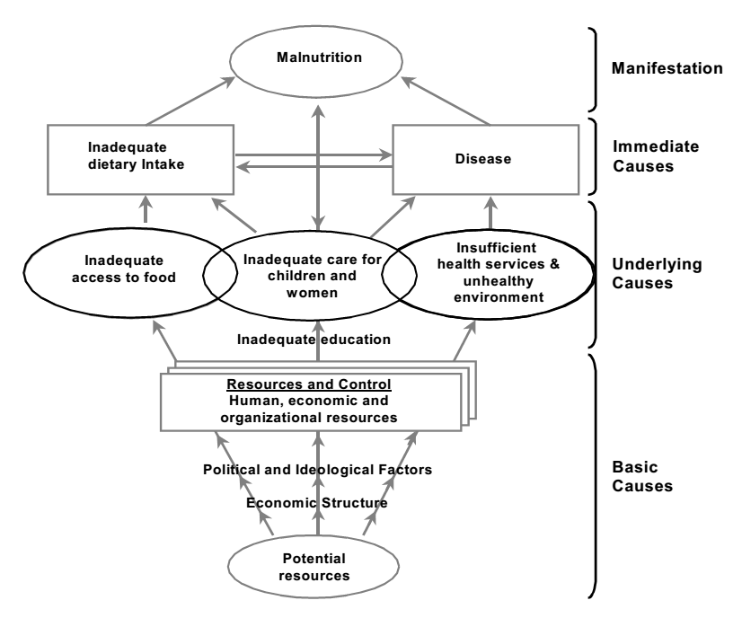
Other perspectives can also be helpful
The UNICEF framework of basic, underlying and immediate causes:
Source: UNICEF (1990).

Slide 24
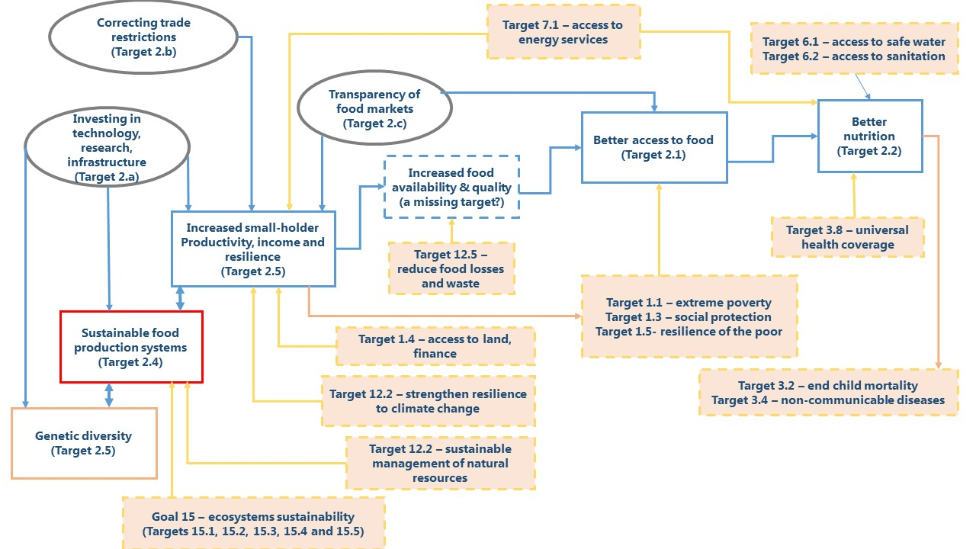
Systemic change involves many actors
A “causal pathway” diagram among SDG2 targets
Source: Cafiero and Gennari (2015).

Slide 25
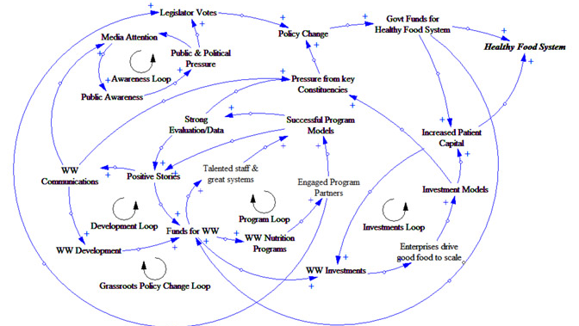
Causality runs in many directions
A “system dynamics” diagram for food system change
Source: Ross (2014).

Slide 26
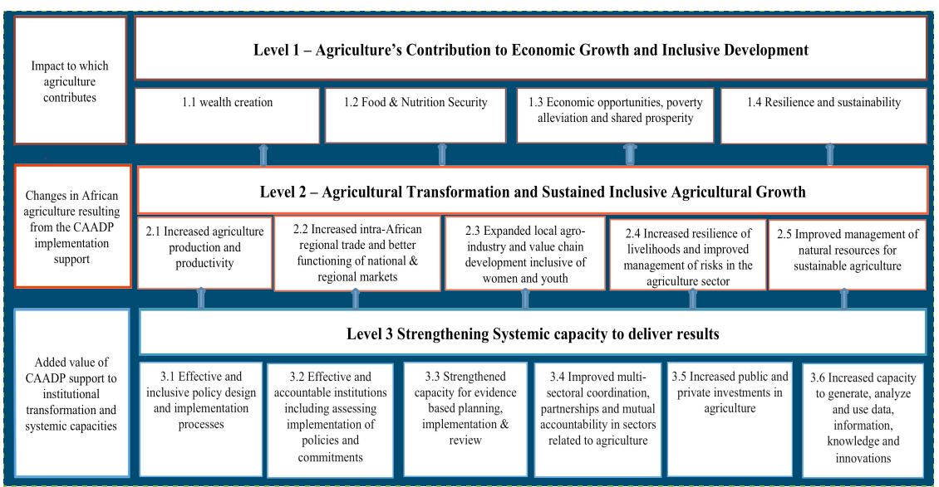
Measurement guides policy & programs
The CAADP Results Framework for Africa Union investments
Source: NEPAD Planning and Coordinating Agency (2015).

Slide 27
Our goal is to guide measurement
Some things can be measured only at a national scale
Countries
For example, food balance sheets
are constructed for each commodity
from a country’s national accounts
(a) Quantity produced
+ (b) Quantity imported
- (c) Quantity exported
- (d) All non food uses, stock change and waste
= (d) Food supply available for consumption

Slide 28
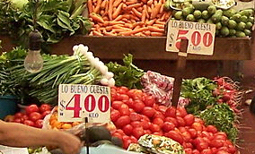
Our goal is to guide measurement
Some things exist at the scale of a locality, like a marketplace
Countries
Markets and communities
For example, food prices are observed
where products are bought and sold
There are usually many buyers & sellers
who may bring food to & from elsewhere

Slide 29
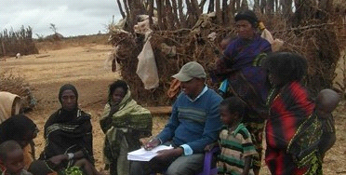
Our goal is to guide measurement
Other things can be measured for a household
Countries
Markets and communities
Households
Households are defined as shared cooking
and may also farm together
so are the natural unit for food transactions
(production – sale + purchase – loss = consumption)

Slide 30
Our goal is to guide measurement
Many things are attributes of individuals
For example this boy’s height:
Photo credits: Country map is public domain, market photo is by Bernal (2006) licensed under CC, photos of household interview and child height measurement are from Bekele Megersa (IMMANA Postdoctoral Fellow).

Slide 31
We use 8 categories to review 33 indicators
Classifying the indicators by what is actually observed:
National data
  – five indicators at country level, from national accounts or international trade
Market data
  – three indicators about markets, involving people located elsewhere
Household or individual recall
  – seven indicators from surveys about families or individuals
Anthropometric measurement
  – five indicators of body size, using heights and weights or circumferences
Prevalence of Undernourishment
  – two indicators that combine data from categories 1-4
Biomarkers and clinical data
  – three indicators obtained from biological samples or clinical services
Breastfeeding and sanitation
  – four indicators about a mother-child dyad or a community
Composite and multidimensional measures
  – four indicators that combine different kinds of observations

Slide 32
Category #1: National data
Five indicators observed at the country level:
From national accounts, reported to FAO in Food Balance Sheets:
1. Dietary energy in the food supply (kcal/capita, or pct of requirements)
2. Dietary quality of the food supply (g/cap of each nutrient or food)
3. Diversity of food supply (Shannon-type indexes of attributes or sources)
4. Variability of the food supply (std. deviations of kcal/capita over time)
From government accounts, reported to IMF or UN agencies:
5. Public expenditure (pct of spending, or specific commitments)
These indicators use observations that are initially made at the country level, as administrative data for the population as a whole. Researchers can infer the share attributable to a subset of the population, but the original data source is a national total or per-capita average.

Slide 33
Category #2: Market data
Three indicators observed in marketplaces, with many participants:
From price data, at any scale:
  1. Domestic food price index (local food prices relative to other prices)
  2. Food affordability indexes (local food prices relative to labor earnings)
  3. Volatility of food prices (standard deviations of prices over time)
These observations could be an average over many transactions, or a single representative transaction in the market. The actual agents involved are typically unknown and may be located anywhere.

Slide 34
Category #3: Household or individual recall
Seven indicators derived from surveys of people and families:
From responses to survey questions:
  1. Food budget share (share of total spending)
  2. Dietary diversity (no. of food groups, or prevalence of low diversity)
  3. Dietary energy from household surveys (kcal/day, or pct. of requirement)
  4. Diet quality indexes (ratios, indexes or qty/day of a food or nutrient)
  5. Nutrient adequacy (pct. of requirements for specific nutrients)
  6. Experience-based scales
  7. Coping Strategies Index (CSI)
Household data refers to questions at the level of a family or other unit eating from a common cooking pot. Individual data refers to a specific person, who may or may not be the respondent. For example, a child’s dietary intake is typically provided by the mother or other caregiver.

Slide 35
Category #4: Anthropometry
Five indicators derived from heights, weights and circumferences
From measurement of body size:
  1. Child height-for-age (prevalence of stunting, or mean height)
  2. Child weight-for-height and MUAC (prevalence of wasting or thinness)
  3. Child underweight: weight-for-age (number or pct. of children)
  4. Adult, adolescent & child BMI (prevalence of under/overweight or obesity)
  5. Waist circumference (pct. of population above risk thresholds)
Anthropometric data is usually combined with demographic information on age and sex, and compared to reference populations to determine a group’s prevalence of extreme values, or changes in the group mean and variation. Heights and weights may be complemented by arm, waist and head circumference for additional insight.

Slide 36
Category #5: Prevalence of Undernourishment
Two indicators obtained by combining data sources
From national, household and anthropometric data:
  1. Prevalence of Undernourishment (pct. of pop., or millions of people)
  2. Depth of food deficit (kcal/capita/day)
PoU methodology provides the headline “number of hungry people” calculated by FAO every year. The PoU combines country-level estimates of national dietary energy supply with household survey data to estimate inequality in access and distribution of food, relative to needs estimated using demographic data on age and sex, and anthropometric data on population heights. The result is a compound measure in which year-to-year changes in food supply can be compared to each population’s energy needs.

Slide 37
Category #6: Biomarkers and clinical data
Three indicators derived from biological samples or health services
Micronutrient status and disease:
  1. Anemia among women and children (percent of population)
  2. Vitamin A deficiency and supplementation (pct. of pre-school children)
Maternal and reproductive health:
  3. Low and very low birthweight (percent of births)
Of the many laboratory tests and clinic records, these are the most widely used to track food security and malnutrition. Micronutrient status is most commonly assessed with blood tests, and maternity service records reveal the prevalence of low birth weight.

Slide 38
Category #7: Breastfeeding and sanitation
Four indicators about interactions between people
Within the household
  1. Breastfeeding: initiation, exclusivity and continuation (pct. of children)
  2. Diarrhea: Incidence and treatment (percent of children)
Between households
  3. Drinking water: use of clean water sources (percent of households)
  4. Open defecation: use of toilets (percent of households)
Data on pairs or groups of people are obtained from interviews and direct observation, using specific kinds of survey instruments to capture the appropriate unit of observation. For example, breastfeeding indicators are specific to a mother-child dyad, and sanitation indicators often refer to the shared environment of each household.

Slide 39
Category #8: Composite indexes
Four examples of composite or multidimensional measures
Combining several other indicators into one:
  1. The Global Hunger Index (GHI)
  2. The Global Food Security Index (GFSI)
  3. The Global Hidden Hunger Index (GHHI)
  4. The Hunger and Nutrition Commitment Index (HANCI)
When combining different indicators into a single ranking or classification, the weights assigned to each element reflect its relative importance for users of the index. Most of these weight all components equally.

Slide 40
Questions for your working group
Using the information presented here, form
small groups to discuss a category of indicator
that is particularly important for your work.
1. What best practices can you recommend?
2. What common pitfalls would you warn against?
3. What priorities for action can you identify
--for research in agriculture, nutrition and health;
--for policymaking at global, national and local levels;
--for program management in agriculture and nutrition
Then report back to share your views with others!

