Slide 1
Agricultural Transformation and Human Nutrition in Africa: What Has Changed?
Will Masters
Friedman School of Nutrition Science & Policy, Tufts University
www.nutrition.tufts.edu | http://sites.tufts.edu/willmasters
Organized Symposium on Frontiers of Agricultural Transformation
at the annual meetings of the AAEA, August 1st 2016

Slide 2
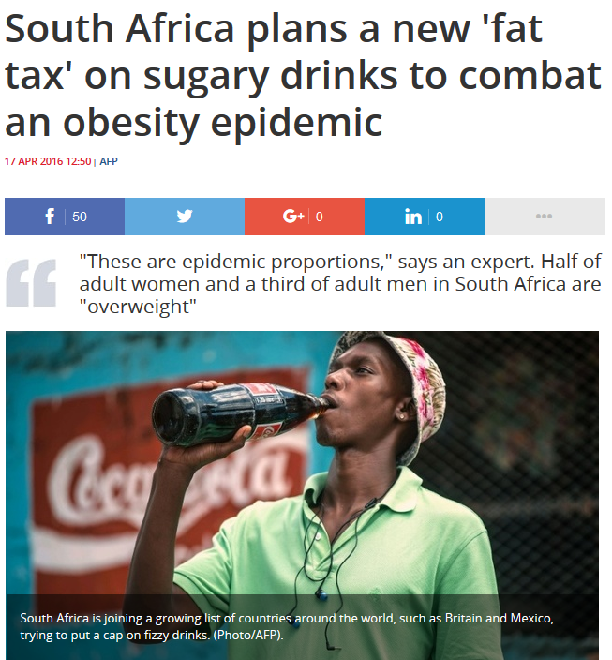
Typical news from Africa:
Also, this:

Slide 3
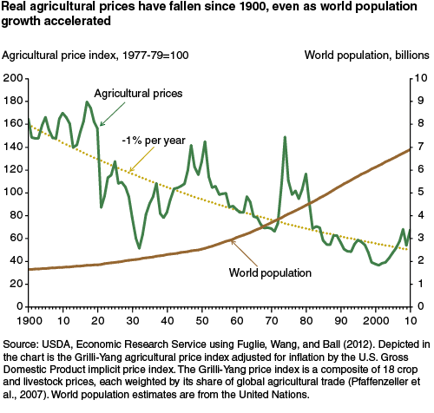
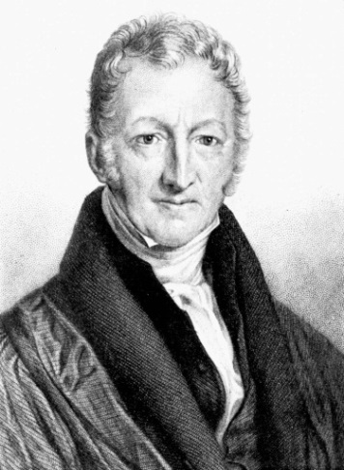
Globally, we are still winning
the race against Malthus,
with more food & lower fertility
1800
1850
We are
here
(approx.)

Slide 4
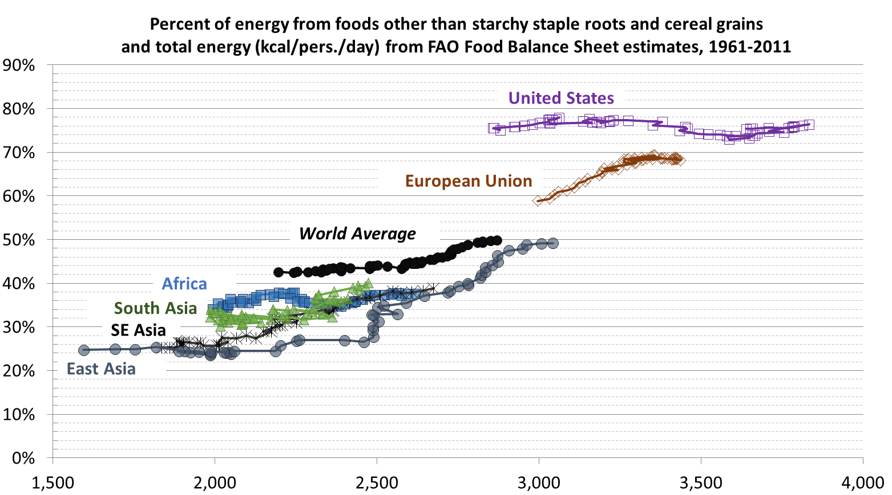
Globally, the race against Malthus is shifting from more food to more diverse foods
Source: Calculated from FAO Food Balance Sheet data, faostat3.fao.org/download/FB/FBS/E

Slide 5
Agricultural transformation is closely tied to urbanization and rural population growth
Regions differ greatly in timing and speed of change
>50% urban in 2008
>50% urban in 2040
“peak rural” is 2022
Rural still
rising past 2050!
Source: Calculated from UN World Urbanization Prospects, 2014 Revision. Released July 2014 at http://esa.un.org/unpd/wup.

Slide 6
Our aim is to distinguish between more of the same and structural shifts
Preston curves: what has changed in agriculture | nutrition | policy
Strategy
test for shifts in the global average at each level of national income
this generalizes the Preston curve, first applied to life expectancy (Preston 1975, Bloom & Canning 2007),
Data
national income: purchasing power per capita (not household income!)
agriculture: rural pop. growth, ag. employment and earnings
nutrition: child height, adult obesity, diet quality
policy choices: price effects of agricultural policies
Method
all data are nationally representative
each test compares African countries to all others, and 1990s to 2010s

Slide 7
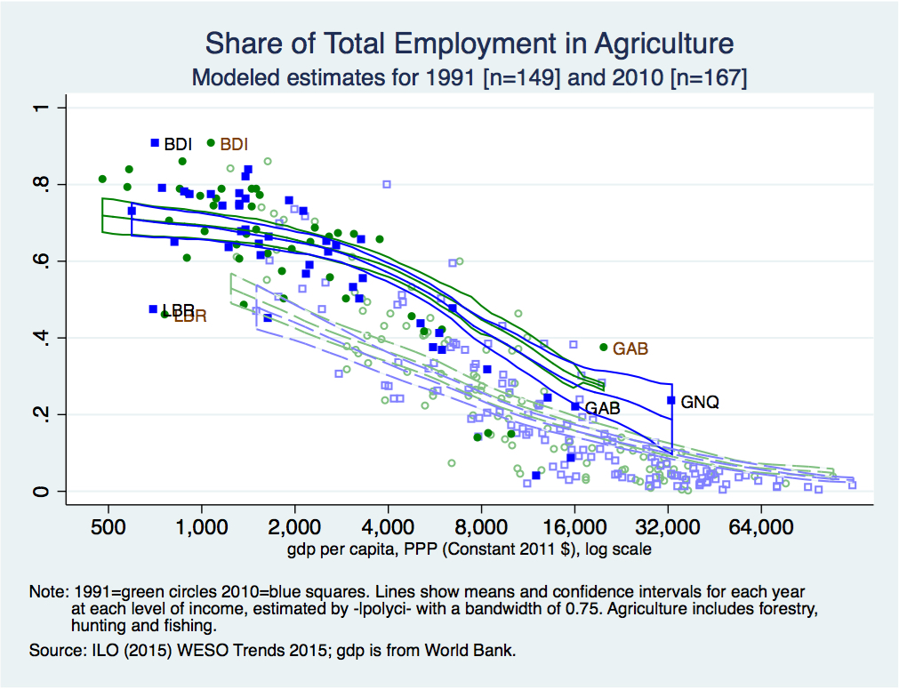
Structural transformation involves shifting workers from agriculture to other sectors
Preston curves: what has changed in agriculture | nutrition | policy
Ag’s share of the workforce
has remained much higher
in Africa than elsewhere
and did not shift down
from 1991 to 2010

Slide 8
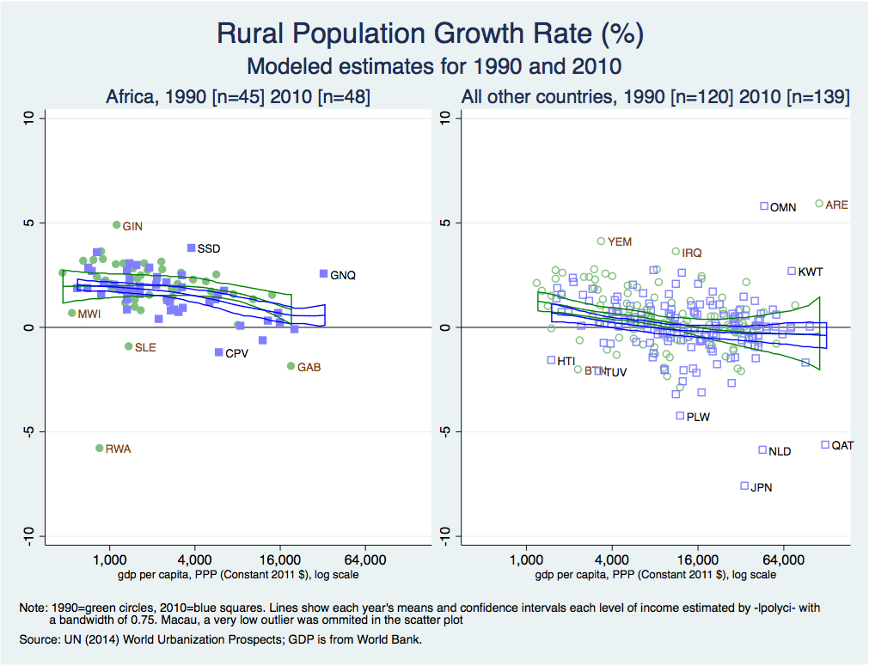
Preston curves: what has changed in agriculture | nutrition | policy
Rural population growth leaves many people
no choice but to keep farming
Rural population has grown much faster in Africa than elsewhere
and has not shifted down over time

Slide 9
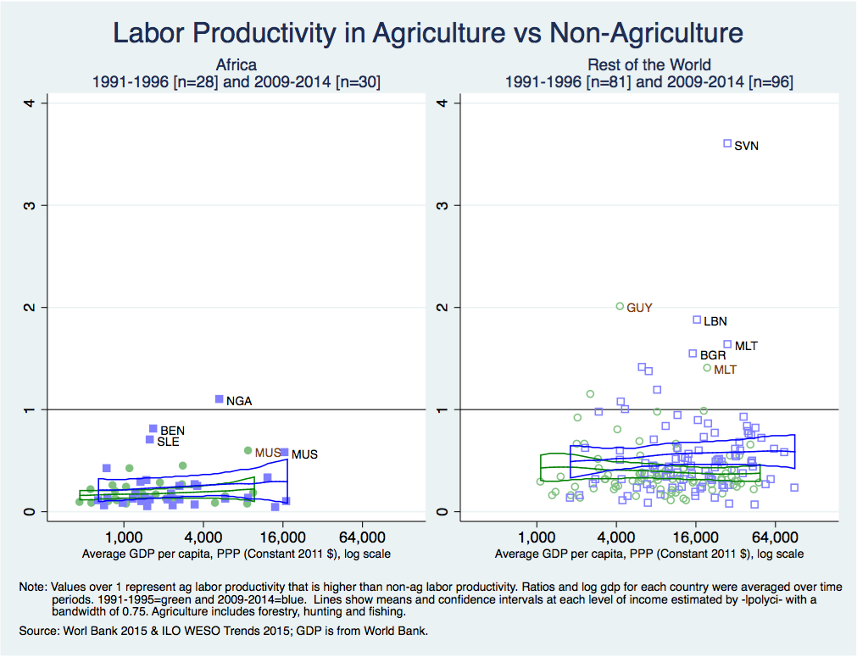
Preston curves: what has changed in agriculture | nutrition | policy
Worker productivity in agriculture is typically lower than in other sectors
The productivity gap is especially large in Africa
and has shifted up only in richer countries

Slide 10
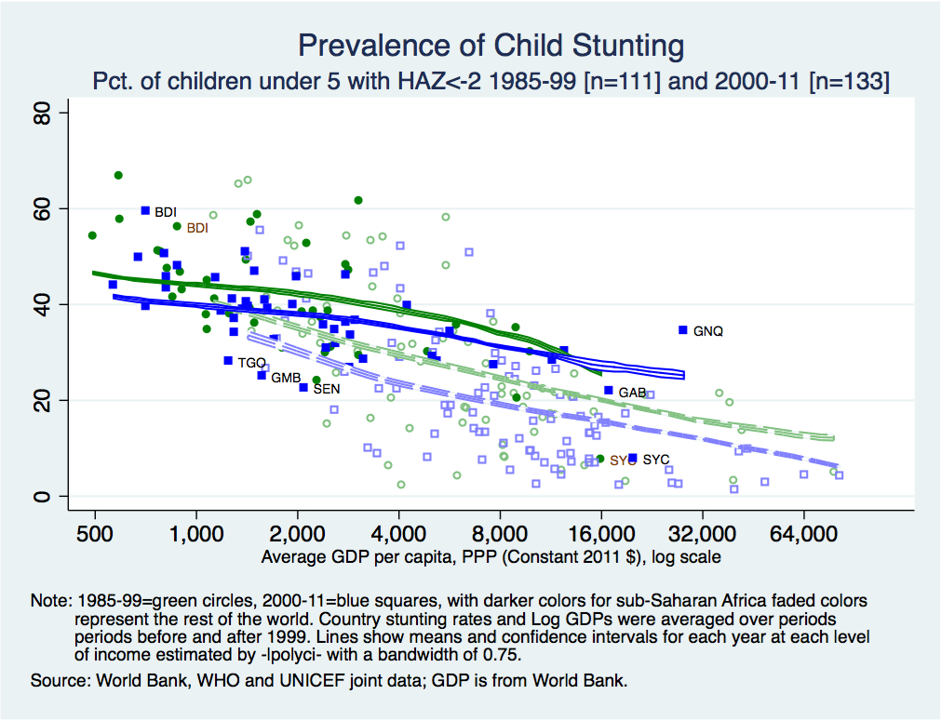
Preston curves: what has changed in agriculture | nutrition | policy
Heights are often used to measure child health
Africa’s stunting rates have shifted down, but remain higher than others’ at each income level

Slide 11
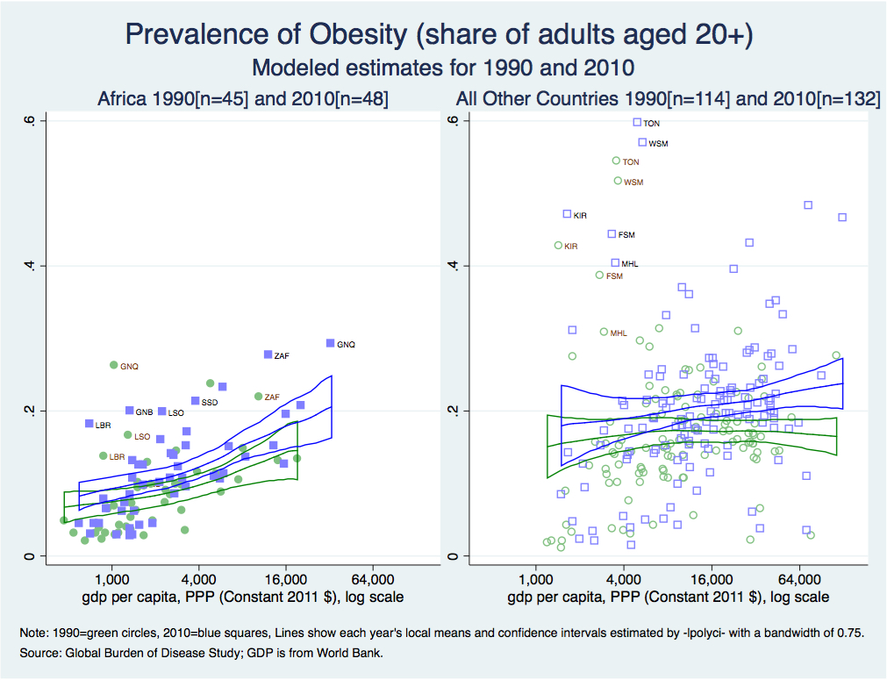
Preston curves: what has changed in agriculture | nutrition | policy
Obesity is increasingly important for adult health
Obesity has shifted up only in the richest countries outside Africa

Slide 12
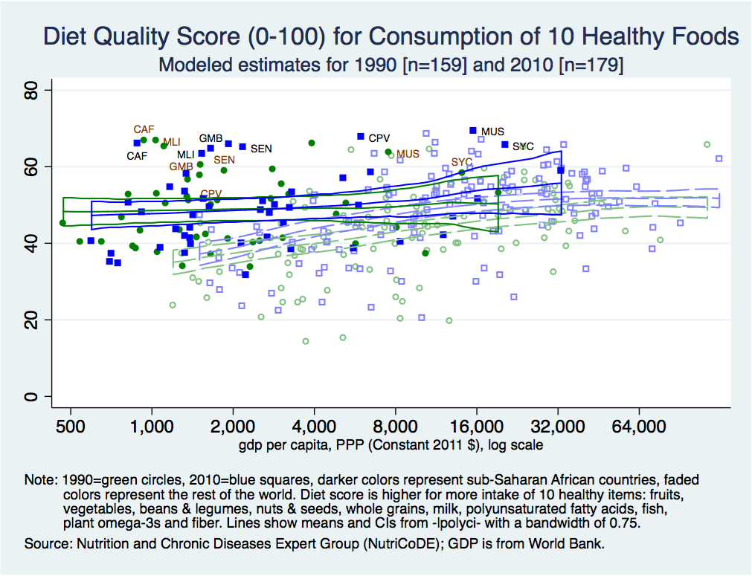
Preston curves: what has changed in agriculture | nutrition | policy
Diet quality depends on
eating more healthy foods
Low income populations eat more healthy foods in Africa than elsewhere

Slide 13
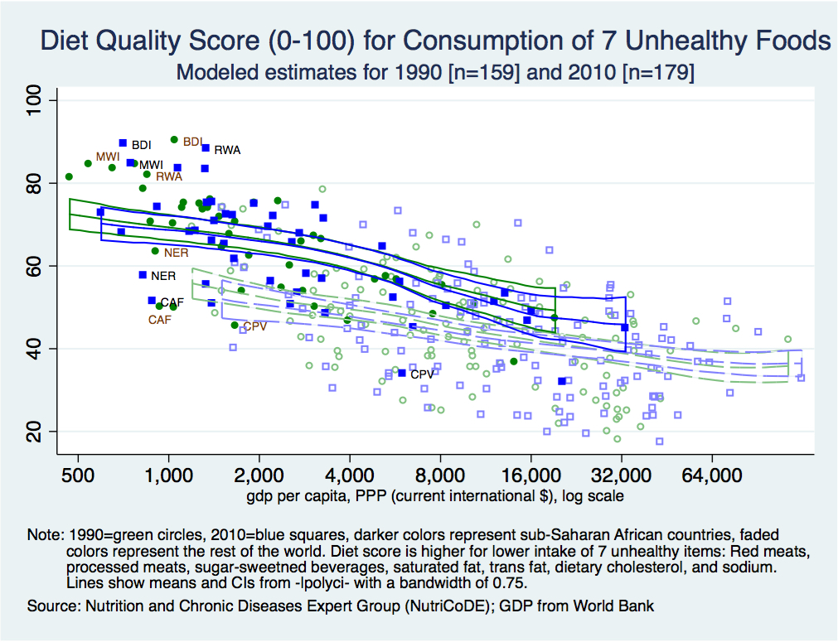
Preston curves: what has changed in agriculture | nutrition | policy
Diet quality also means
eating less unhealthy foods
Low income populations also eat less unhealthy foods in Africa than elsewhere

Slide 14
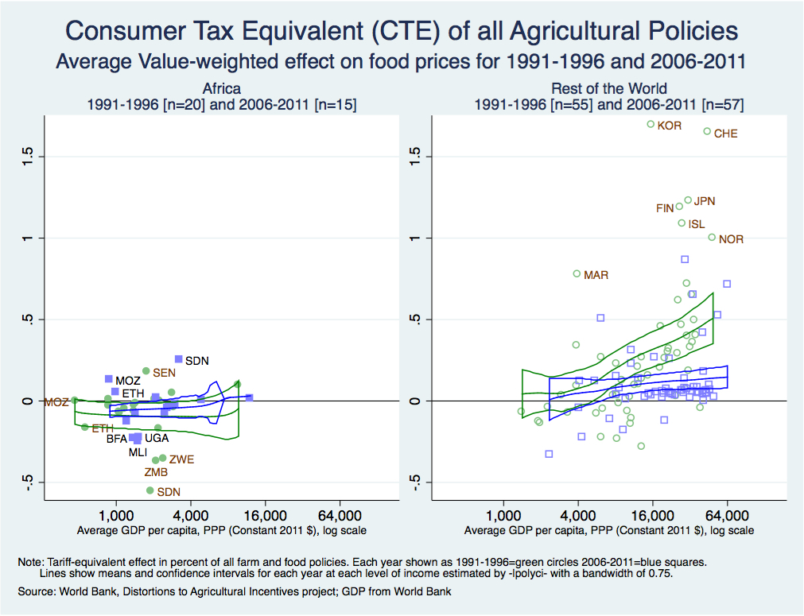
Preston curves: what has changed in agriculture | nutrition | policy
Food policy has often shifted with income growth from lowering to raising food prices
African governments have generally
kept prices low,
at farmers’ expense
In richer countries, extremes of support have been cut

Slide 15
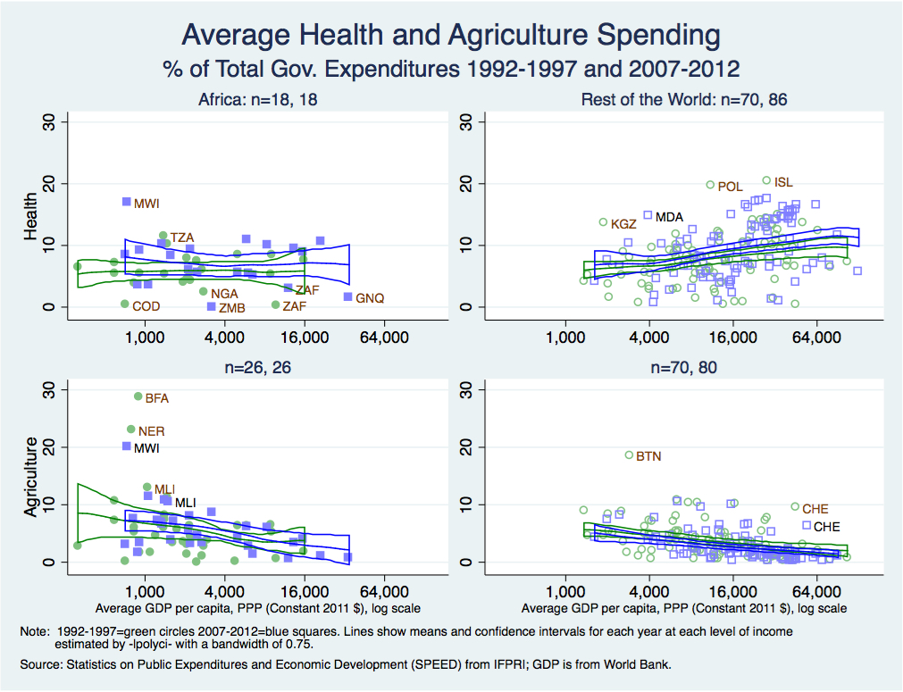
Preston curves: what has changed in agriculture | nutrition | policy
Fiscal spending on agriculture has generally risen more slowly than national income
As ag. spending share declines, health spending has been flat or rising with income

Slide 16
Preston curves: what has changed in agriculture | nutrition | policy
Comparing Africa to other regions reveals a lot:
Preston curves reveal how the present is like the past, or not…
most change is movement along a stable development path
-- only a few variables differ and shift over time
Some remarkable differences include:
Rapid rural population in Africa will continue past 2050
despite rapid urbanization, due to population momentum
Africa continues to have a larger share of its workers in agriculture,
with lower productivity relative to nonfarm workers
Africa has had higher rates of child stunting at each income level,
but stunting rates have shifted down rapidly in Africa like elsewhere
Africa’s unique demography will remain its greatest challenge
Without faster agricultural productivity growth where the rural poor live, their increasing numbers will force even more of them into poverty
…even with rapid urbanization and health improvements

Slide 17
Acknowledgements
Robel Alemu Getachew, Nathaniel Rosenblum,
Anaya Hall, Elena Martinez, Peilin Shi, Gitanjali Singh,
Patrick Webb and Dariush Mozaffarian
Feed the Future Policy Impact Study Consortium
Funded by USAID
Global Nutrition and Policy Consortium
Funded by BMGF: www.globaldietarydatabase.org
Feed the Future Innovation Lab for Nutrition
Funded by USAID: www.nutritioninnovationlab.org

Slide 18
thank you!

