Slide 1



Farm production and child diets:
Role of child age and household wealth
Prajula Mulmi³, William A. Masters¹, Shibani Ghosh¹, Grace Namirembe¹, Ruchita Rajbhandary², Swetha Manohar², Binod Shrestha², Rolf Klemm^{2,3},
Keith P. West, Jr², Patrick Webb¹
¹ Friedman School of Nutrition Science & Policy, Tufts University
² Bloomberg School of Public Health, Johns Hopkins University
³ Helen Keller International
Selected paper for presentation at the annual meetings of the
Agricultural and Applied Economics Association, 1 August 2017
Feed the Future Innovation Lab for Nutrition

Slide 2
Motivation | Method | Results | Conclusions
What is the link between a family’s food production and their child’s diet quality?
  There is now a large literature showing a positive link between what farm families grow and what their children consume
    Especially for more remote households, further from food markets, who are more reliant on own production (e.g. Shibatu et al., 2015)
  We use two rounds of PoSHAN survey data (2013 & 2014) to test two key hypotheses about how and for whom production is linked to intake:
    1) Is farm production linked to intake only for older children?
    Older children can consume the family diet, whereas infant feeding requires special care
    2) Is farm production linked to intake only for poorer households?
      Poorer families may depend on their own farm, whereas richer ones can buy childrens’ food
  Outcomes are
    Diet diversity: whether child consumes ≥ 4 of 7 food groups
    Individual food groups: whether child consumes that food group

Slide 3
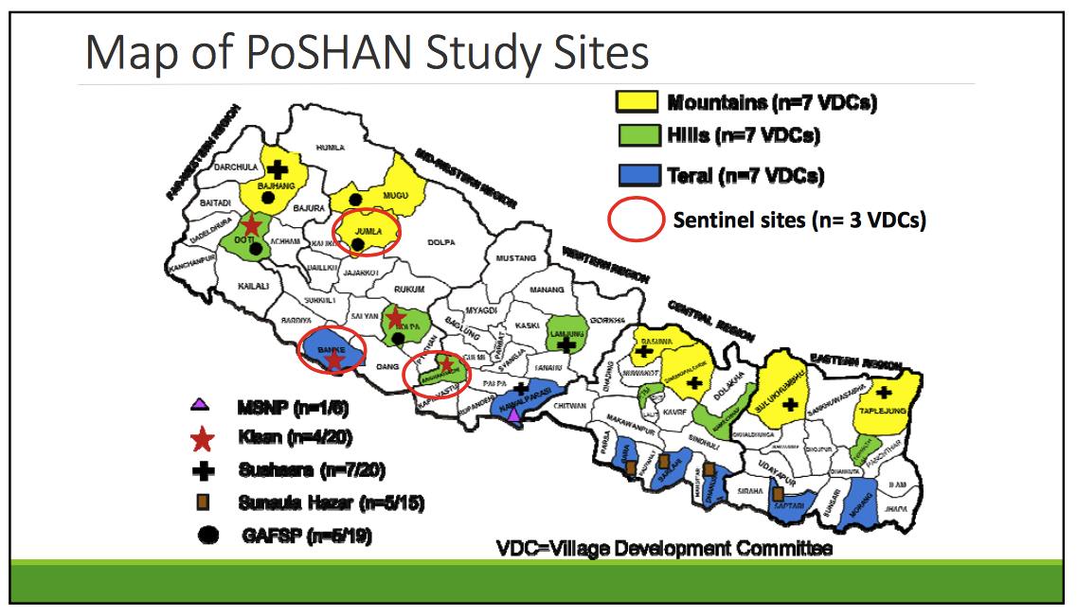
Motivation | Method | Results | Conclusions
Our sample spans a very wide range of
agro-ecological and socioeconomic conditions
Two rounds of household panel data (2013 – 2014)
Representative of wards from the 21 VDCs
Sampling strategy: SRS for VDCs and PPS for wards
Data on: child and maternal nutrition, anthropometrics, diet diversity, food security, agricultural practices and types of food grown and marketed, and demographics
Baseline report indicated n= 4,287 households with women= 4,509 and children under five 5,401
Manohar et al., 2014

Slide 4
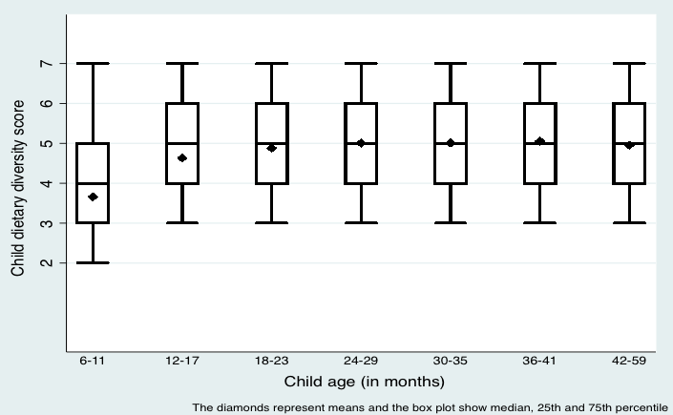
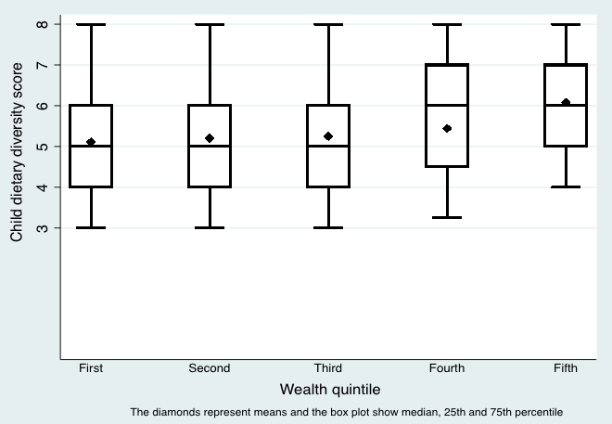
Motivation | Method | Results | Conclusions
Does farm production raise intake only for the poor,
as their lack of cash constrains access to markets?
Child dietary diversity score (0-7) by wealth quintile
Can own farm production fill this gap, for children in poorer households?
Spoiler alert: the answer turns out to be yes
Dataset: Policy and Science of Health, Agriculture, and Nutrition (PoSHAN) 2013 and 2014
Notes:
Mention evidence from studies on link between food production and consumption

Slide 5
Motivation | Method | Results | Conclusions
Does farm production raise intake only for older children,
as they can consume the same as other family members?
Child dietary diversity score (0-7) by age category
Can own farm production fill this gap, for infants who need special care?
Spoiler alert: the answer turns out to be no
6-23 months
24-59 months
Dataset: Policy and Science of Health, Agriculture, and Nutrition (PoSHAN) 2013 and 2014

Slide 6
Hypotheses, aims and potential significance
Motivation | Method | Results | Conclusions
Hypothesis: A household’s own farm production is associated with more child diet diversity and intake of each food group, but
only for children in poorer households
only for children at older ages
Aim: To identify mediating effects of household wealth and child age on the relationship between household food production and child dietary intake
Implications: Evidence for these hypotheses would imply that:
home garden and farm diversification programs could improve child diets mainly if targeted to the poorest in Nepal, and
other programs would be needed to reach the youngest children.

Slide 7
Motivation | Method | Results | Conclusion
How is production diversity
linked to diet diversity?
Effect modifiers
Agricultural production diversity
Farmers vs. non-farmers
Number of food groups grown (0-7)
also have results using food species, not shown here
Whether child meets
minimum dietary diversity
(≥ 4 of 7 food groups)
Child age
HH wealth

Slide 8
Motivation | Method | Results | Conclusion
How is production of each group
linked to dietary intake of that group?
Production of each food group
Starchy staples
Vitamin A-rich fruits & veg.
Other fruits & vegetables
Meat, fish, and poultry
Eggs
Dairy
Legumes, nuts and seeds
Effect modifiers
Intake of each food group
Starchy staples
Vitamin A-rich fruits & veg.
Other fruits & vegetables
Meat, fish, and poultry
Eggs
Dairy
Legumes, nuts and seeds
Child age
HH wealth

Slide 9
Motivation | Method | Results | Conclusion
How is production diversity
linked to diet diversity?
Statistical test:
Logit with VDC and year fixed effects
MDDC_{i} = B₀ + B₁ farmdiv_{ih} + B₂ wealth_{ih} + B₃ farmdiv_{ih} X wealth_{ih} + δ Z_{i} + α VDC_{i} + γ year + μ_{i}
Outcome Variable:
Whether child meets
minimum dietary diversity (≥4)
Mediating variable:
Wealth quintile (1-5)
Control variables:
Maternal: Age, education, BMI
Household: Caste, religion, land owned/rented
Child: Sex, whether breastfed
Geography: Altitude, ecological zone
VDC and year fixed effects
to absorb other characteristics of each place and time
Interaction term
to test for mediation
Farm production
predictor variable:
Food groups grown (0-7)
Agricultural diversity quintile (0-5)
Farmers vs. non-farmers (0 or 1)

Slide 10
Motivation | Method | Results | Conclusion
How is production of each group
linked to dietary intake of that group?
Statistical test:
Logit with VDC and year fixed effects
Cnsmptn’_{ih} = B₀ + B₁ prdctn’_{ih} + B₂ wealth_{ih} + B₃ prdctn’_{ih} X wealth_{ih} + δ Z_{i} + α VDC_{i} + γ year + μ_{i}
VDC and year fixed effects
Outcome Variable:
Consumption of each individual food group (from 1 to 7)
Mediating variable:
Wealth quintile (1-5)
Control variables:
Maternal: Age, education, BMI
Household: Caste, religion, land owned/rented
Child: Sex, whether breastfed
Geography: Altitude, ecological zone
Interaction term
to test for mediation
Farm production
predictor variable:
Production of that same food group (from 1 to 7)

Slide 11
Motivation | Method | Results | Conclusion
Household food production diversity is positively associated with child dietary diversity for older children in poorer households
 | (1) | (2) | (3) | (4) | (5)
 | MDDC ≥4 6-11 mo. | MDDC ≥4 12-17 mo. | MDDC ≥4 18-23 mo. | MDDC ≥4 6-23 mo. | MDDC ≥4 24-59 mo.
Number of food groups grown (0-7) | 0.183 (0.17) | -0.086 (0.20) | 0.430*** (0.13) | 0.139 (0.10) | 0.253*** (0.09)
Quintile of household wealth (1-5) | 0.218 (0.31) | -0.034 (0.34) | 0.786*** (0.20) | 0.232 (0.18) | 0.497*** (0.19)
Wealth X number of groups grown | -0.037 (0.05) | 0.088 (0.07) | -0.137*** (0.04) | -0.030 (0.02) | -0.039 (0.03)
Controls | Yes | Yes | Yes | Yes | Yes
VDC & year fixed effects | Yes | Yes | Yes | Yes | Yes
Observations | 396 | 399 | 800 | 1,635 | 4,343
Notes. Unit of observation is an individual child between 6-59 months. Standard errors in parentheses, clustered on VDCs. All results are from weighted logit regressions with fixed effects for each of 21 VDCs and 2 years. Survey weights are used for children in the balanced panel, in which each child is observed twice. The weights are 0.537 for Mountain, 1.711 for Hill and 0.834 for Terai.
*** p<0.01, ** p<0.05, * p<0.1

Slide 12
Motivation | Method | Results | Conclusion
Results hold with the larger, unbalanced sample
 | (1) | (2) | (3) | (4) | (5)
 | MDDC ≥4 6-11 mo. | MDDC ≥4 12-17 mo. | MDDC ≥4 18-23 mo. | MDDC ≥4 6-23 mo. | MDDC ≥4 24-59 mo.
Number of food groups grown (0-7) | 0.083 (0.09) | -0.131 (0.13) | 0.335** (0.10) | 0.052 (0.07) | 0.166** (0.08)
Quintile of household wealth (1-5) | 0.211* (0.12) | -0.070 (0.21) | 0.559*** (0.21) | 0.160 (0.11) | 0.369** (0.18)
Wealth X number of groups grown | -0.031 (0.03) | 0.093** (0.04) | -0.096*** (0.03) | -0.007 (0.02) | -0.011 (0.03)
Controls | Yes | Yes | Yes | Yes | Yes
VDC & year fixed effects | Yes | Yes | Yes | Yes | Yes
Observations | 1,034 | 934 | 1,040 | 3,033 | 6,213
Notes. Unit of observation is an individual child between 6-59 months. Standard errors in parentheses, clustered on VDCs. All results are from weighted logit regressions with fixed effects for each of 21 VDCs and 2 years. Survey weights are used for children in the unbalanced panel. The weights are 0.449 and 0.504 for Mountain, 1.730 and 1.714 for Hill and 0.871 and 0.847 for Terai for panel 1 and 2, respectively. *** p<0.01, ** p<0.05, * p<0.1

Slide 13
Motivation | Method | Results | Conclusion
The link between farm production and child intake holds only for some food groups
Coefficients on the association between individual food group production & consumption mediated by child age
Production of: | 6-11 mo. (cons.) | 12-17 mo. (cons.) | 18-23 mo. (cons.) | 6-23 mo. (cons.) | 24-59 mo. (cons.)
Vitamin A-rich F&V | 0.71 | 0.61 | 1.24*** | 0.98*** | 0.45
Other F&V | 1.16 | 0.50 | 0.73 | 0.56 | 1.08***
Meat | 1.83 | -1.76 | 0.87 | 0.12 | 0.21
Eggs | 0.78 | 0.22 | 1.64*** | 1.32*** | 0.98***
Dairy | -1.71*** | -0.49 | 0.98*** | 0.06 | 1.20***
Legumes, nuts & seeds | 0.08 | 0.47 | -0.36 | 0.03 | 0.63
Observations | 396 | 399 | 800 | 1,635 | 4,343
Notes. Unit of observation is an individual child between 6-59 months.. All results are from weighted logit regressions with fixed effects for each of 21 VDCs and 2 years. Survey weights are used for children in the balanced panel. The weights are 0.537 for Mountain, 1.711 for Hill and 0.834 for Terai. *** p<0.01, ** p<0.05, * p<0.1

Slide 14
Motivation | Method | Results | Conclusion
The link between home production and intake holds only for specific food groups,
among older and poorer children
For Vitamin A-rich F&V child intake is positively associated with household production only for older children in poorer households. The same holds for other F&V except that richer households do not feed more other F&V at any age.
 | 6-11 mo. (cons.) | 12-17 mo. (cons.) | 18-23 mo. (cons.) | 6-23 mo. (cons.) | 24-59 mo. (cons.)
Vitamin A-rich F&V
HH produces this group HH wealth HH prod. X wealth |  |  | 1.24*** 0.18* -0.27* | 0.98*** -0.21** | 1.20** -0.15*
Other Fruits & Vegetables
HH produces this group HH wealth HH prod. X wealth |  |  |  |  | 1.08*** -0.24*
Observations | 396 | 399 | 800 | 1,635 | 4,343
Notes: Coefficients not significantly different from zero are not shown, and coefficients on control variables are also omitted. Unit of observation is an individual child between 6-59 months.. All results are from weighted logit regressions with fixed effects for each of 21 VDCs and 2 years. Survey weights are used for children in the balanced panel. The weights are 0.537 for Mountain, 1.711 for Hill and 0.834 for Terai. *** p<0.01, ** p<0.05, * p<0.1

Slide 15
Motivation | Method | Results | Conclusion
The link between home production and intake holds only for specific food groups,
among older and poorer children
For Dairy, child intake is positively associated with household production only for older children in poorer households. The same holds for Eggs, except that richer households feed more eggs at all ages.
 | 6-11 mo. (cons.) | 12-17 mo. (cons.) | 18-23 mo. (cons.) | 6-23 mo. (cons.) | 24-59 mo. (cons.)
Dairy
HH produces this group HH wealth HH prod. X wealth |  |  | 0.98*** 0.36*** -0.28** |  | 1.23*** 0.42*** -0.26***
Eggs
HH produces this group HH wealth HH prod. X wealth | 0.68*** | 0.37** | 1.64*** 0.15* | 1.32*** 0.27*** | 0.98*** 0.21***
Observations | 396 | 399 | 800 | 1,635 | 4,343
Notes: Coefficients not significantly different from zero are not shown, and coefficients on control variables are also omitted. For dairy, anomalous results for 6-11 month olds are also omitted. Unit of observation is an individual child between 6-59 months.. All results are from weighted logit regressions with fixed effects for each of 21 VDCs and 2 years. Survey weights are used for children in the balanced panel. The weights are 0.537 for Mountain, 1.711 for Hill and 0.834 for Terai. *** p<0.01, ** p<0.05, * p<0.1

Slide 16
Summary of findings
Motivation | Method | Results | Conclusions
Agricultural production diversity and child dietary diversity is:
  Positively associated but only for older children (18 or 24 mo.)
  Positively associated but in poorer households (lowest one or two quintiles)
Individual food group production and consumption is:
  Positively associated for older children at all levels of wealth only for eggs
  Positively associated for older children at lower levels of wealth for fruits and vegetables, and dairy

Slide 17
Implications of the findings
Motivation | Method | Results | Conclusions
    Farm-diversifying programs aimed at improving child dietary diversity will likely see benefits only after 18 months of age
    Improving dietary quality of younger children will require other kinds of complementary feeding interventions
    For older children, maximum benefits of these interventions can be seen when poorer households that are further from markets are targeted
    Except for eggs, production of food groups such as fruits and vegetables and dairy and its consumption are mediated by wealth

Slide 18
Appendix

Slide 19
Categorization of food items consumed by a child into food groups as per FAO
FAO food groups | Food items listed in 7-day food frequency questionnaire⁺
Starchy staples | Lito, rice, corn, wheat, millet, potato
Dark Green Leafy Vegetables (DGLVs) | Dark Green Leafy Vegetables (DGLVs)
Vitamin A rich fruits and vegetables | Carrots, pumpkin, drumstick, ripe mango, ripe jackfruit and ripe papaya
Other fruits and vegetables | Gundruk, green beans, green peas, gourd, okra, eggplant, green jackfruit, tomato, cauliflower, cabbage, guava, orange, apple, pineapple and banana
Flesh foods (meat, fish and poultry) | Chicken, duck, goat, buff, pork, fish and snails
Eggs | Egg
Dairy (milk and milk products) | Milk and curd
Legumes, nuts and seeds | Daal, maseura, legumes and peanuts

Slide 20
Categorization of crops and livestock produced by households for food
FAO Food groups | Crops and livestock produced for food
Starchy staples | Barley, buckwheat, finger millet, maize, potatoes, rice, sorghum, wheat, cassava, taro, and yam
Dark Green Leafy Vegetables (DGLVs) | Green leaves
Vitamin A rich fruits and vegetables | Sweet potatoes, carrots, drumstick, mango, melon, papaya, and pumpkin
Other fruits and vegetables | Banana, peas, apple, avocado, green beans, berries, bitter gourd, cabbage, capsicum, cauliflower, bottle gourd, chili, cucumber, eggplant, guava, lemon, lychee, okra, onions, orange, pineapple, peach, plum, radish, sponge gourd, squash, tomato, other fruit and vegetables
Flesh foods (meat, fish and poultry) | Cattle, buffalo, ox, cow, yak, goat, poultry, sheep, pigs, and fish ponds
Eggs | Poultry, guinea, fowls and pig
Dairy (milk and milk products) | Cattle, buffalo, ox, cow, yak, goat, and sheep
Legumes, nuts and seeds | Beans, chickpeas, groundnut, lentils, oil seeds, soybeans, and sunflower

Slide 21
Distribution of food species grown
Dataset: Policy and Science of Health, Agriculture, and Nutrition (PoSHAN) 2013 and 2014
Notes:
Mention evidence from studies on link between food production and consumption

Slide 22
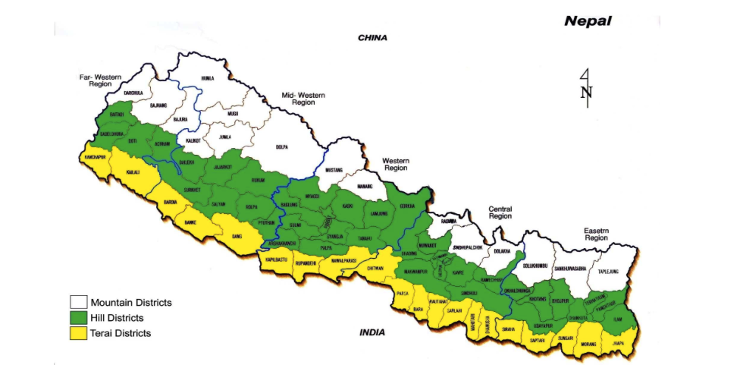
Results also control for altitude and zone
Source: www.mof.gov.np

Slide 23
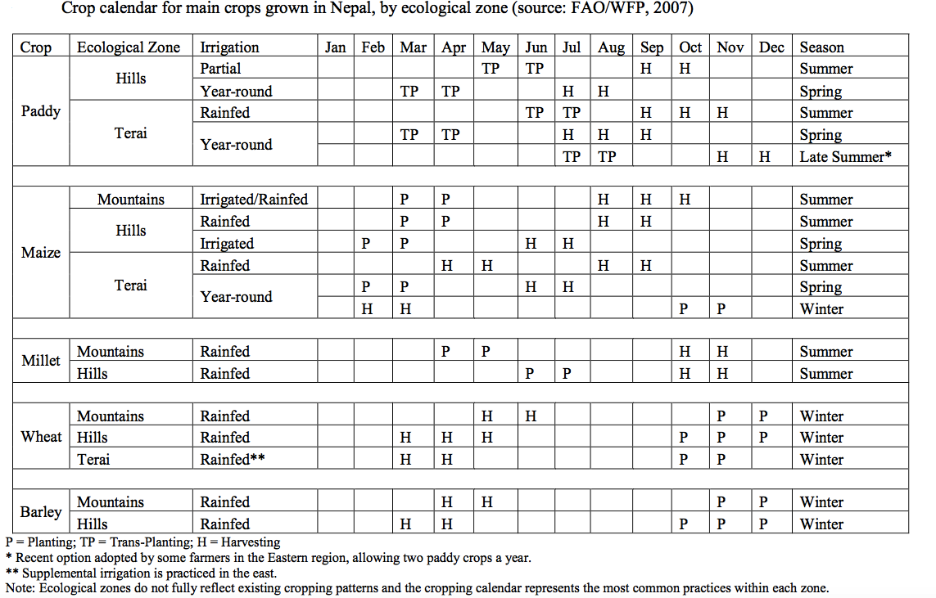
Crop calendar and crops grown

Slide 24
NLSS: Determining market participation
NLSS District-level means:
Value of food purchased in markets
Value of food obtained in donations
Value of food produced in household farms
We compute:
District's average share of food consumption that is purchased or donated (market use): (1+2/ 1+2+3)
  ‘High market use’ districts = above or equal median market use
  ‘Low market use’ =below median of market use

Slide 25
Motivation | Method | Results | Conclusion
Economic model of farm households
Time allocated for farming
Farm households
Food production
Time allocated for child care
Access to markets
Possess purchasing power
✓ Consumption needs fulfilled
✗ Child care needs not fulfilled
Source: de Janvry et al., 1991; Foster and Rosenzweig, 2010; Eswaran & Kotwal, 1989; Bardhan & Udry, 1999
Notes:
‘Perfect’ markets:
Complete and accurate access to information on the price of crops
Minimal transaction costs reaching buyers
Ability to substitute household farm labor for hired labor
Input and output markets are rarely perfect in developing-country contexts

Slide 26
Motivation | Method | Results | Conclusion
Economic model of farm households
Time allocated for farming
Farm households
Food production
Time allocated for child care
Access to markets
Possess purchasing power
✓ Consumption needs fulfilled
✗ Child care needs not fulfilled
Source: de Janvry et al., 1991; Foster and Rosenzweig, 2010; Eswaran & Kotwal, 1989; Bardhan & Udry, 1999
Notes:
‘Perfect’ markets:
Complete and accurate access to information on the price of crops
Minimal transaction costs reaching buyers
Ability to substitute household farm labor for hired labor
Input and output markets are rarely perfect in developing-country contexts

