Slide 1

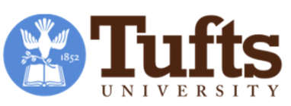

Development and Use of a
Multi-dimensional Index for
Nutrition Knowledge among
Mothers and Health Workers in Malawi
Kate Schneider and Will Masters
Friedman School of Nutrition Science & Policy, Tufts University (USA)
ICABR – 13 June 2018
Project website:
http://sites.tufts.edu/willmasters/research/ubale

Slide 2
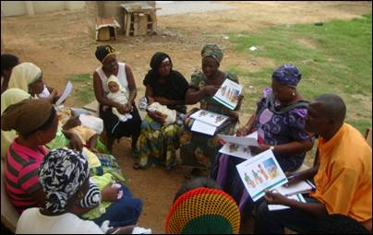
Many interventions aim to influence nutrition by altering knowledge

Slide 3
Different types of knowledge
may have different causes and effects
Studies usually test directly for impacts on outcomes
Education -------?------> Outcomes
Here, for the start of the UBALE project in Malawi,
we aim to improve measurement of knowledge itself:
Education ---?--> Knowledge ---?--> Outcomes
Step 1
Step 2
Our Hypothesis:
Knowledge of causal mechanisms is different and may be more closely linked to action than knowledge about desired behaviors

Slide 4
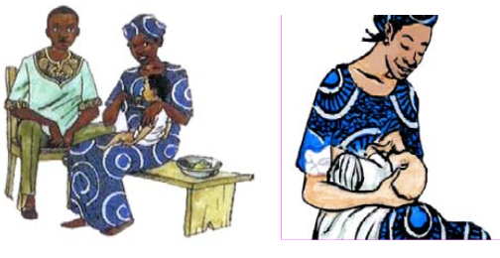
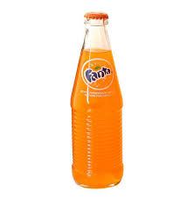
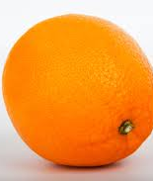
Motivation and hypotheses
Do people act on knowledge about mechanisms
more than on knowledge about desired behaviors?
Behavioral knowledge
(taught in BCC programs)
e.g. the WHO’s Essential Nutrition Actions
Mechanism knowledge
(taught in science classes)
e.g. functions of nutrients
daily energy vs future health
+
vs

Slide 5
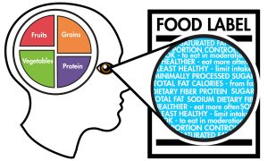
Previous research on knowledge differs by region
Low-income countries
Knowledge, Attitudes and Practices (KAP) surveys and impacts of schooling
e.g. Vollmer et al. 2017, Karmacharya et al 2017
High-income countries
Nutrition literacy and knowledge of links between diets and disease
e.g. Parmenter & Wardle 1999, Miller et al. 2010
+

Slide 6
Our study
Setting
UBALE project in Malawi
Development food aid program funded by USAID
Implemented by CRS using cascade model through local NGO partners
Sample
316 villagers
26 health volunteers
18 health professionals
Data
Drawn from previous surveys
  28 questions
  42 variables (=1 if correct)
Retained if answered correctly by 10-90% of respondents
  23 questions
  33 variables
+

Slide 7
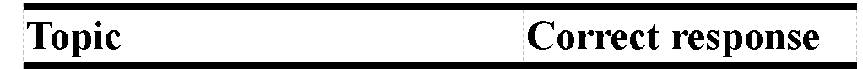
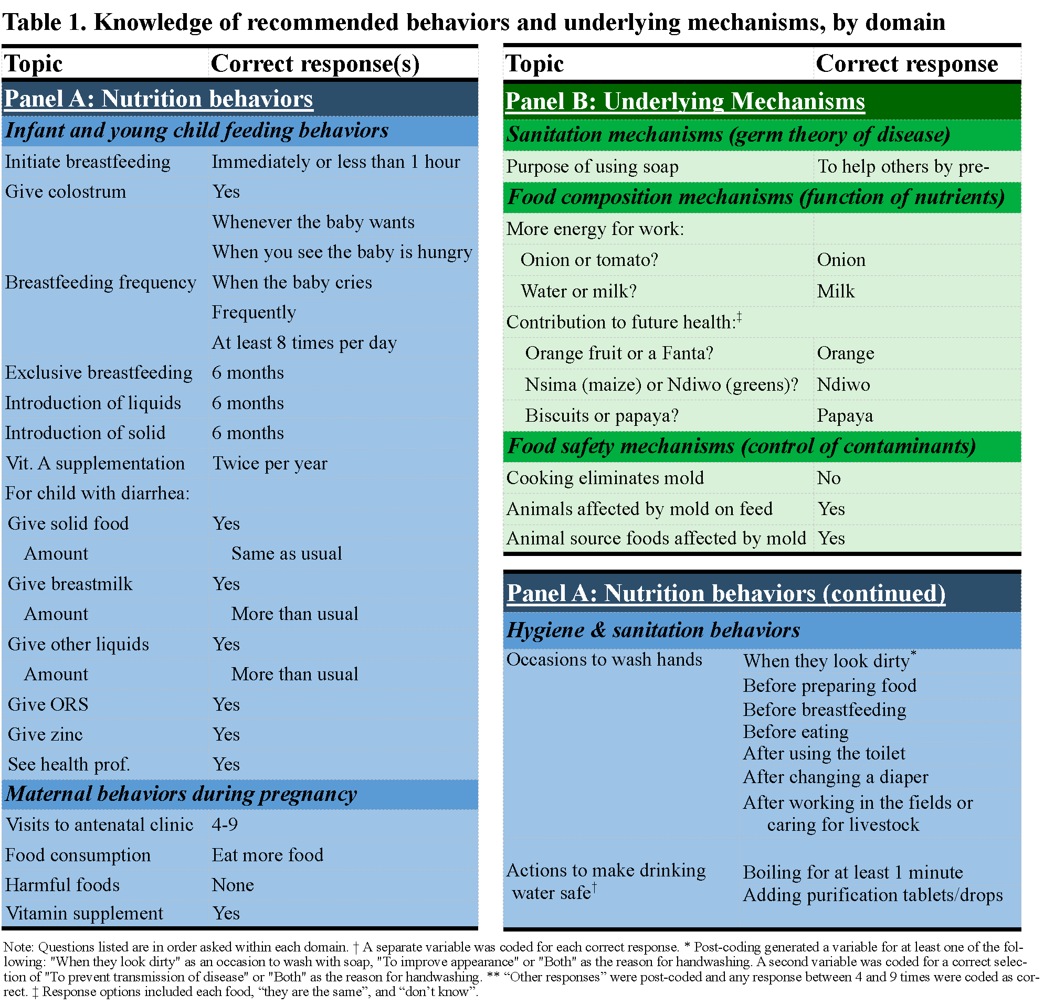
Data:
Desired behaviors

Slide 8
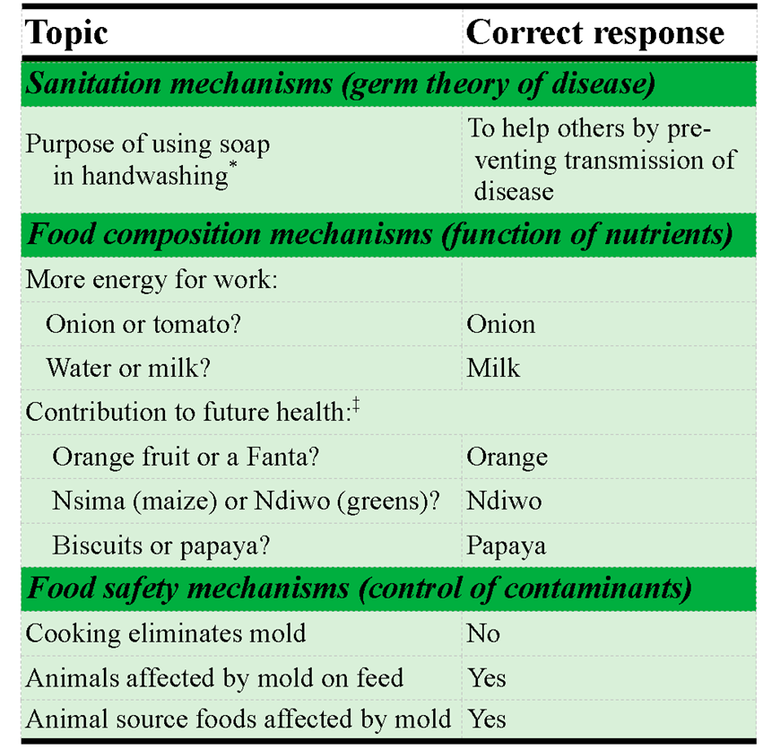
Data:
Causal mechanisms

Slide 9
Results:
Desired behaviors are widely known Causal mechanisms known only to staff
50%
Health professionals score well, others ~random
Training cascade from staff to villagers

Slide 10
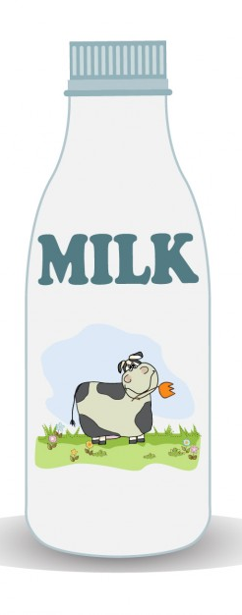
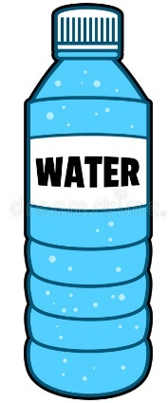
Results:
Responses to mechanism questions about nutrients and their function
Which contributes more
energy for work each day:
or
?
Answered correctly: 43% of villagers, 83% of professionals
Which contributes more
for your future health:
or
?
Answered correctly: 45% of villagers, 100% of professionals

Slide 11
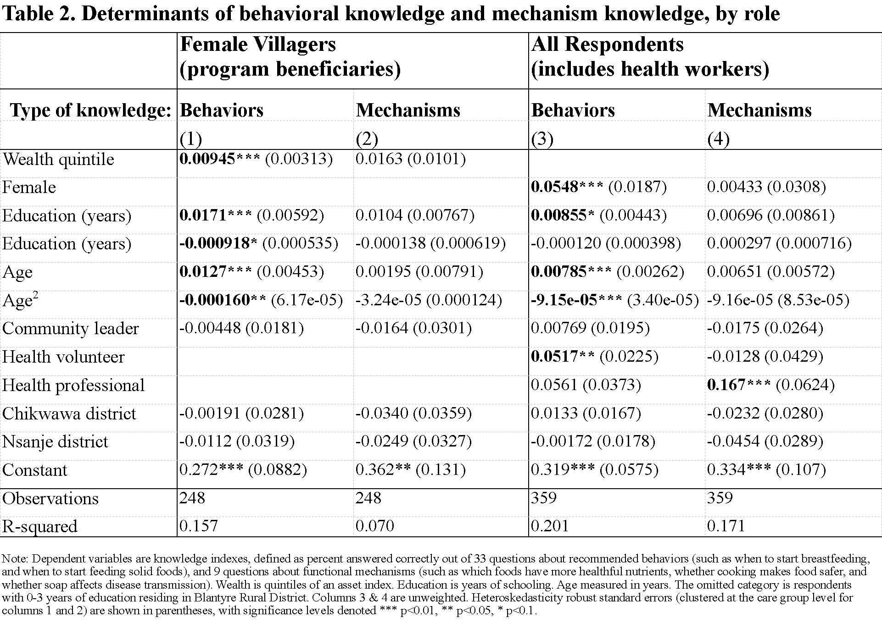
Results:
Behavioral knowledge diffuses with education and age
Mechanism knowledge is limited to professionals

Slide 12
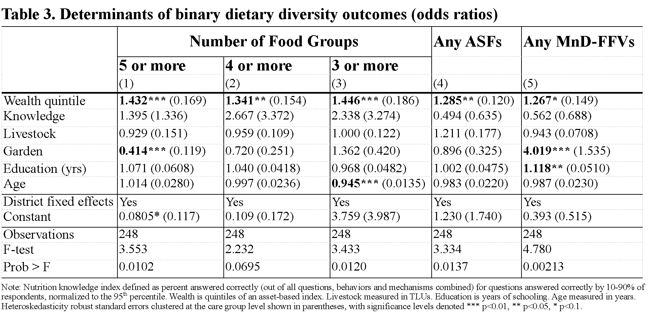
Results:
Maternal diet diversity is not significantly associated with knowledge
MDD is linked only with wealth and a few other factors

Slide 13
Conclusions
Differentiating between types of knowledge reveals differences in what’s known by villagers versus what’s known by health professionals
In Malawi,
  knowledge of desired behaviors has diffused well along the cascade from staff to villagers
  knowledge of causal mechanisms is held only by health professionals
  neither kind of knowledge is closely linked to dietary intake
Identifying and teaching causal mechanisms might improve effectiveness of nutrition messages

Slide 14
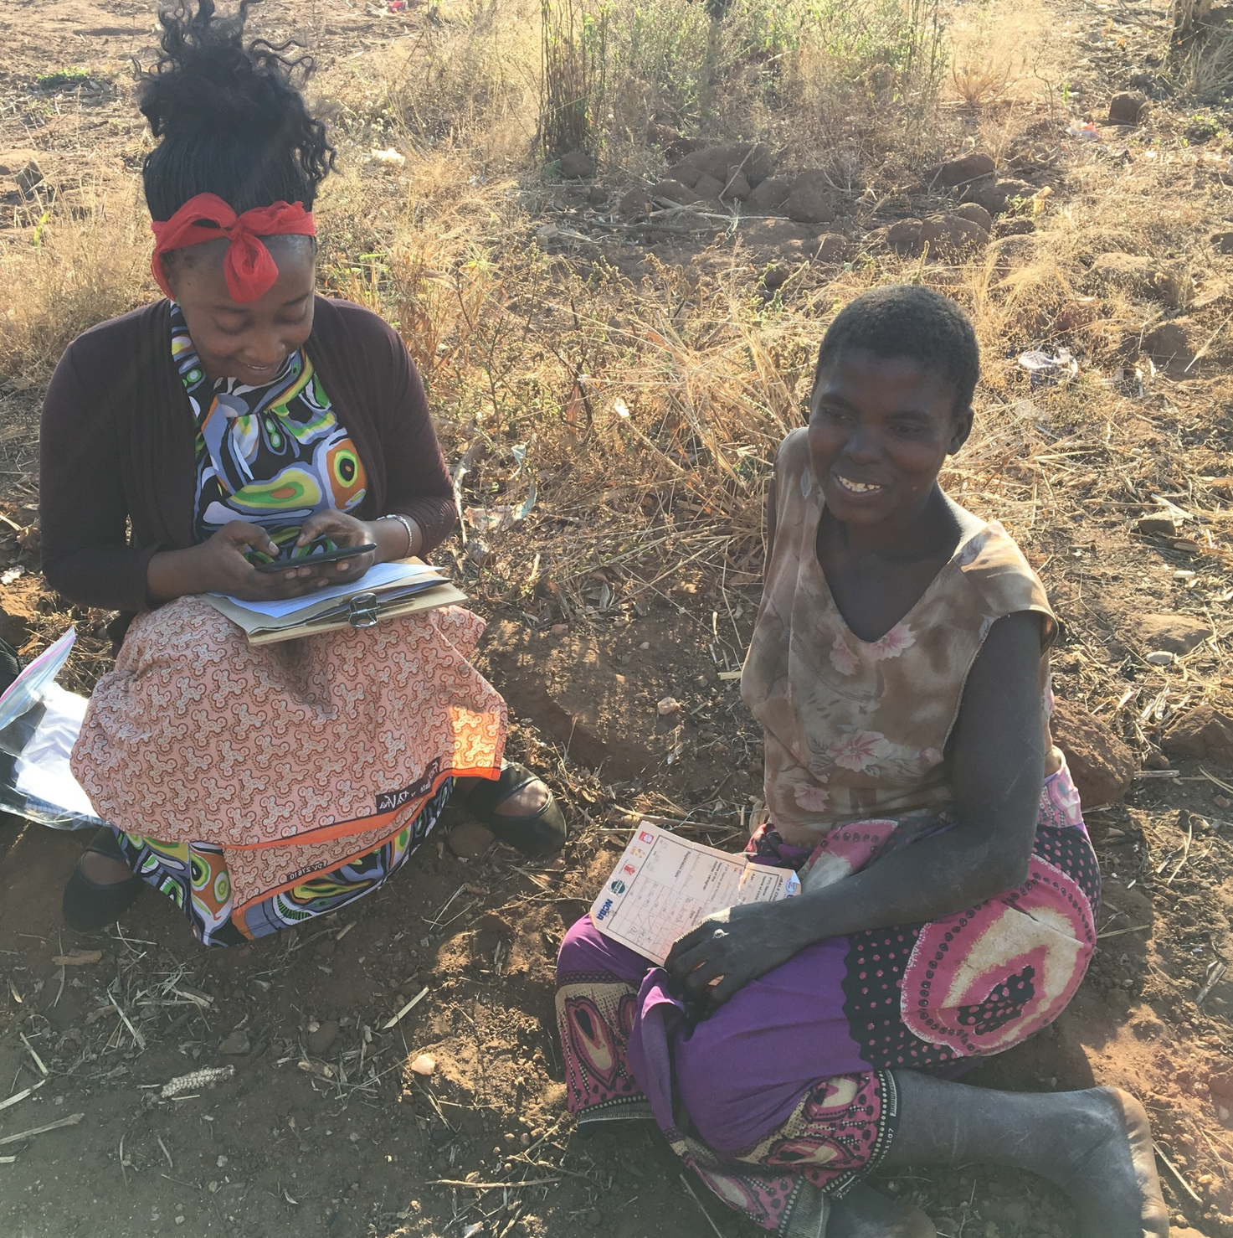
Thank you!
…especially to all respondents and enumerators
This study was made possible by the generous support of the American people through the support of the Office of Food for Peace, Bureau for Democracy, Conflict and Humanitarian Assistance, United States Agency for International Development (USAID) under terms of Cooperative Agreements No. AID-FFP-A-14-00006 and AID-OAA-A-15-00019, through the United in Building and Advancing Life Expectations Project (UBALE), managed by Catholic Relief Services (CRS). The contents are the responsibility of Tufts University and do not necessarily reflect the views of CRS, USAID or the United States Government.

