Slide 1

Data analyst as detective:
Apparent seasonality in child health as an artifact of random errors in child age
William A. Masters
Friedman School of Nutrition, Tufts University
with Anna Folke Larsen (Dept. of Economics, University of Copenhagen)
and Derek Headey (Poverty, Health & Nutrition Division, IFPRI)
Paper forthcoming in Demography, as “Misreporting Month of Birth: Diagnosis and Implications for Research on Nutrition and Early Childhood in Developing Countries”.
Preprint at http://sites.tufts.edu/willmasters
Speed talk for the Tufts nutrition data summit, October 4th 2018

Slide 2
Motivation
Shocks in utero and infancy have lifelong consequences
Previous work, including my own, found strong patterns of seasonality
  poor outcomes for children born at bad times of year
  not just unexpected shocks, but also monsoons, Ramadan, lean seasons etc.
The main outcome measure is attained height
  Heights can be measured quickly and non-invasively, during an interview
  Attained heights are very sensitive to shocks, especially if experienced before age 2
  Population heights in childhood predict many later outcomes
As Jef Leroy explains, population heights are just a symptom
  …but a very useful marker of deprivation

Slide 3
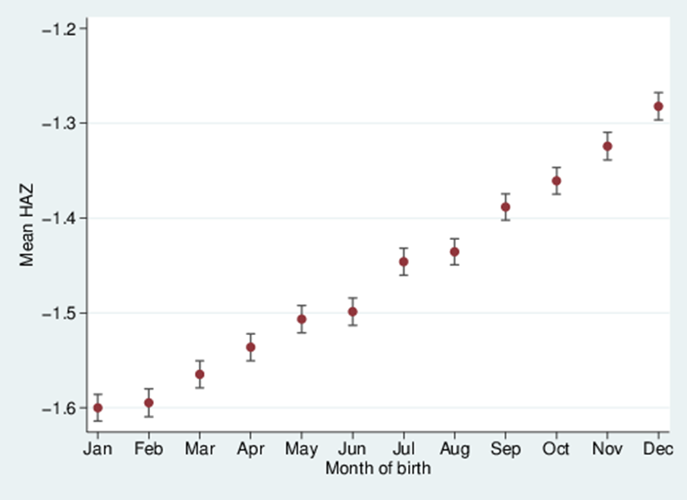
The puzzle
When pooling all countries,
we found this:
What could have caused this pattern?
Previous work focuses on heaping,
but we find a monthly gradient and Dec-Jan gap
Source: DHS data for 990,231 children from 62 countries, various years.
Note: Data shown are mean height-for-age z-scores (HAZ) by month of birth (MOB).
Vertical bars indicate standard errors of the mean HAZ.

Slide 4
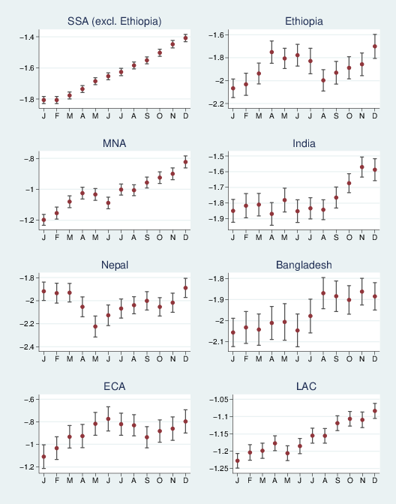
The puzzle
Our mysterious gradient arises in diverse regions:
The gradients differ when non-standard calendars are used:
Orthodox new year
Hindu new year
Data shown are mean height-for-age z-scores (HAZ) by month of birth (MOB). Vertical bars indicate standard errors of the mean HAZ.

Slide 5
Standard controls do not remove the anomaly
The gradient is somewhat smaller for kids with literate mothers
m1: MOB anomalies without other controls
m2: adds controls for child sex, age, age-squared and survey fixed effects
m3: adds household assets, parental education, total number of children, total number of adults, toilet availability, water source and rural location

Slide 6
The anomaly almost disappears when interviewers are shown a birth certificate
This contrast is the clearest evidence that Dec-Jan gaps are caused by MOB errors
m1: MOB anomalies without other controls
m2: adds controls for child sex, age, age-squared and survey fixed effects
m3: adds household assets, parental education, total number of children, total number of adults, toilet availability, water source and rural location

Slide 7
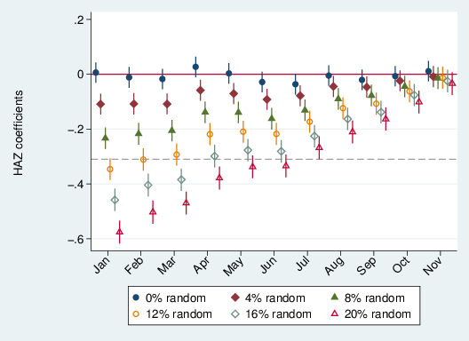
We can replicate the anomaly by introducing purely random MOBs
With 0% random, there is no MOB effect
With 11% random, we replicate the actual gap of
0.3 HAZ points

Slide 8
How does random MOB leave a nonrandom trace?
When MOB errors occur within years,
kids with recorded MOB late in the year
are older than reported
Some of these kids were actually born earlier,
so are older and their
true HAZ is lower than this
Children with recorded MOB early in the year are younger than reported
Some of these kids were actually born later,
so are younger and their
true HAZ is higher than this
The only children whose HAZ is unbiased are those with a July 1st birthday
Data shown are mean height-for-age z-scores (HAZ) by month of birth (MOB), across all DHS surveys (990,231 children from 62 countries, various years). Vertical bars indicate standard errors of the mean HAZ.

Slide 9
This finding is weird, fun -- and useful
My own research had been contaminated by a previously unknown artifact
  Most measurement error is undetectable and causes only attenuation bias
  Here, random misreporting of month within years causes artifactual seasonality
The artifact caused by misreported birth months is large but plausible
  The artifactual Dec-Jan gap is 0.32 HAZ points, in DHS (990,231 children)
  That could be explained by 11% of children having randomly assigned birth months
The artifact can be used to detect errors in age reporting
  By measuring the Dec-Jan gap in average HAZ
    Before using existing surveys in studies of seasonality or early life shocks
    While conducting new surveys to improve data quality
The artifact was found by pooling data across countries with different seasons but same calendar (except Nepal & Ethiopia)
  What other facts can be seen only across countries, not within them!?

Slide 10
Thank you!
Contact details:
  Will Masters, Friedman School of Nutrition (william.masters@tufts.edu)
Funding:
  IFPRI: Bill & Melinda Gates Foundation, for Advancing Research on Nutrition and Agriculture (ARENA) at IFPRI
  Tufts: Feed the Future Innovation Lab for Nutrition (USAID grant AID-OAA-L-1-00005) and the Feed the Future Policy Impact Study Consortium (USDA cooperative agreement TA-CA-15-008).
  Copenhagen: Danish Council for Independent Research

