Slide 1
Pull mechanisms and prize contests in agriculture and nutrition: Insights from winner-take-all vs. proportional rewards
William A. Masters
Friedman School of Nutrition & Department of Economics, Tufts University
http://sites.tufts.edu/willmasters
AAEA organized symposium on pull mechanisms and prize contests -- 23 July 2019

Slide 2
Proportional rewards in agriculture and nutrition
motivation | lab experiments | field trials | conclusions
Motivation: why pull mechanisms and prize contests?
Innovation is often self-financed, from past earnings or equity investors
repaid with profits only when innovations are proprietary & excludable
also valuable as a signal of skill (e.g. writers of open-source code)
trifecta of market failures: asymmetric information, externalities & market power
Policies to spur innovation have side effects, need ‘economics of the second-best’
stronger IPRs solve asymmetric info & externalities, but worsen market power
patents may be better than secrets, due to time limits and disclosure of methods
“push” mechanisms (grants & contracts) face asymmetric information
funders cannot know who will succeed, select on both past performance & future promise
grantees form an echo chamber, based on experience with previous grants
researchers must invest in costly signaling and grant-writing
“pull” mechanisms (prizes & rewards) can help solve all three market failures
useful whenever desired outcome is known to the funder
widespread in all kinds of organizations, throughout history
large literature in economics and lots of policy interest, e.g. agresults and NAS panel on U.S. prizes

Slide 3
Proportional rewards in agriculture and nutrition
motivation | lab experiments | field trials | conclusions
Prizes may be winner-take-all, or proportional to success
Prize competitions typically focus on top performers, in rank order
Aim is high-powered incentive (Lazear & Rosen in AER, 1981)
“And the winner is…” (McKinsey & Co., 2009)
No incentive for lower-ranked outcomes may discourage entry & lower total effort (Brown in JPE, 2011)
Other competitions reward everyone, in proportion to success
“Proportional rewards” is used here to mean that contestants win varying shares of the total reward
Examples include portfolio weights in financial markets; bonus pools and ownership shares within firms
Like a royalty or commission, but in sponsored contests the total reward is usually fixed
When might proportionality be useful for contest design?
Contest must have a measurable outcome
Funder must value all achievements, not just best
For proportionality, need a cardinal metric (e.g. quantity or value)
Can convert ordinal rank to cardinal percentiles (Barlevy & Neal, AER 2012)
Why so much focus on top performers?
Contests leverage the signaling value of information about success
Stories about individual winners are more compelling than stories about data
…but cultural norms may be shifting back towards interest in the whole population

Slide 4
Proportional rewards in agriculture and nutrition
motivation | lab experiments | field trials | conclusions
Evidence on proportional rewards versus winner-take-all prizes
Lab experiments with students at Purdue
Cason, T.N., Masters, W.A. and Sheremeta, R.M., 2010. Entry into winner-take-all and proportional-prize contests: An experimental study. Journal of Public Economics, 94(9-10), pp.604-611.
(Solving math problems -- real effort, with unobservable skill)
Cason, T.N., Masters, W.A. and Sheremeta, R.M., 2018. Winner-take-all and proportional-prize contests: theory and experimental results. Journal of Economic Behavior & Organization, in press.
(Investing cash to win rewards -- chosen effort, with unique Nash equilibrium)
Field trials with childcare workers in India
Singh, P. and Masters, W.A., 2017. Impact of caregiver incentives on child health: Evidence from an experiment with Anganwadi workers in India. Journal of Health Economics, 55, pp.219-231.
(Benchmarking performance pay versus unconditional bonus)
Singh, P. and Masters, W.A., 2018. Performance bonuses in the public sector: Winner-take-all prizes versus proportional payments to reduce child malnutrition in India. J. of Development Econ., in press.
(Direct comparison of proportional versus winner-take-all contest)
Conclusions

Slide 5
A lab experiment with real effort: Can proportional rewards attract more entrants, and more success?
Proportional rewards in agriculture and nutrition
motivation | lab experiments | field trials | conclusions
Abstract
This experiment compares the performance of two contest designs: a standard winner-take-all tournament with a single fixed prize, and a novel proportional-payment design in which that same prize is divided among contestants by their share of total achievement. We find that proportional prizes elicit more entry and more total achievement than the winner-take-all tournament. The proportional-prize contest performs better by limiting the degree to which heterogeneity among contestants discourages weaker entrants, without altering the performance of stronger entrants. These findings could inform the design of contests for technological and other improvements, which are widely used by governments and philanthropic donors to elicit more effort on targeted economic and technological development activities.

Slide 6
Proportional rewards in agriculture and nutrition
motivation | lab experiments | field trials | conclusions
Using students’ performance on unfamiliar arithmetic problems, we find that initial success drove willingness to compete
To start, all subjects were
paid for each solved problem
Performance in arithmetic contests, with endogenous entry
then shown their score relative to others
Subjects were then offered
each type of contest in random order, and
chose whether to enter
Piece rate
Winner-take-all contests (one winner)
The alternative to entry was continued piece rate payment, like a job
Warning: With proportional rewards, the contestant pool includes more less-skilled people, facing less highly-powered incentives
More
solutions
in the contest
More
entrants
With proportional rewards,
more people entered
Proportional reward contests (share of correct answers)
and more problems were solved
by more lower-skill workers
More
solutions in total
Note: Results shown are for 207 contests involving 69 subjects, conducted in computer labs at Purdue University

Slide 7
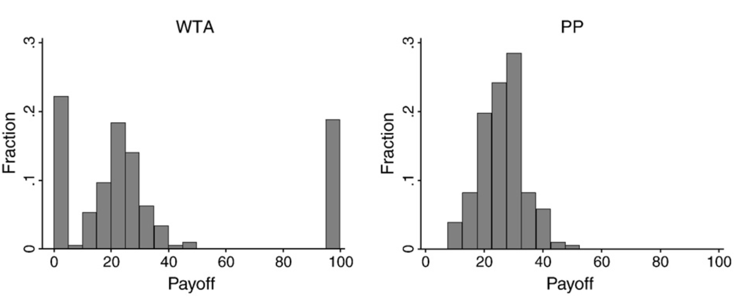
Our lab experiment was designed to mimic real choices between earning wages and entering a contest
Proportional rewards in agriculture and nutrition
motivation | lab experiments | field trials | conclusions
Offering proportional contests led to more entry
and more total effort, with less inequality in payoffs
Winner-Take-All Contests
Proportional Prize Contests
Lost
Did not enter
Won
Distribution includes entrants and non-entrants
Results shown are for 207 contests involving 69 subjects
Source: Cason, T.N., Masters, W.A. and Sheremeta, R.M., 2010. Entry into winner-take-all and proportional-prize contests: An experimental study. Journal of Public Economics, 94(9-10), pp.604-611.

Slide 8
Using known cost functions to solve for equilibrium, we find that proportionality limits behavioral bias
Proportional rewards in agriculture and nutrition
motivation | lab experiments | field trials | conclusions
Abstract
This study provides a unified framework to compare three canonical types of contests: winner-take-all contests won by the best performer, winner-take-all lotteries where probability of success is proportional to performance, and proportional-prize contests in which rewards are shared in proportion to performance. We derive equilibria and observe outcomes from each contest in a laboratory experiment. Equilibrium and observed efforts are highest in winner-take-all contests. Lotteries and proportional-prize contests have the same Nash equilibrium, but empirically, lotteries induce higher efforts and lower, more unequal payoffs. Behavioral deviations from theoretical benchmarks in different contests are caused by the same underlying attributes, such as risk-aversion and the utility of winning. Finally, we find that subjects exhibit consistent behavior across different types of contests, with subjects exerting higher effort in one contest also exerting higher effort in another contest.

Slide 9
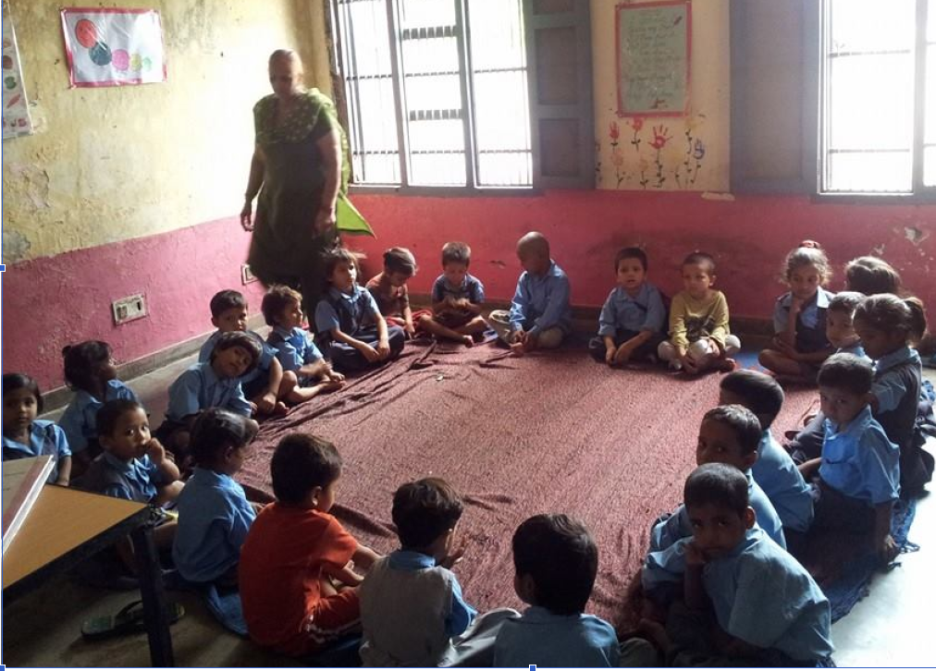
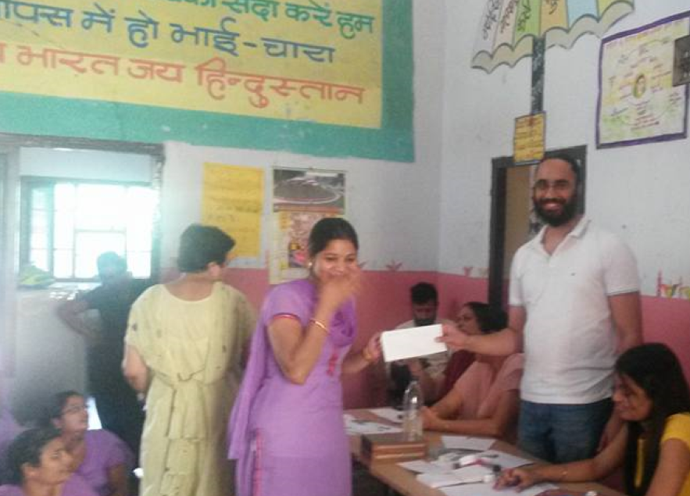
Proportional rewards in agriculture and nutrition
motivation | lab experiments | field trials | conclusions
Field trials with childcare workers in Chandigarh, India
Aim of randomized trial was to help Indian ICDS childcare centers reduce underweight
We used contests among caregivers in Chandigarh, offering small cash incentives for improved outcomes to reveal what actions led to observed improvements
Trial #1: pay-for-performance vs fixed bonus
Control group (fixed salary only)
Pay-for-performance (200 Rs/child improved)
Fixed bonus (600 Rs to all workers)
Trial #2: winner-take-all vs shared rewards
Traditional contest (one winner)
Proportional prizes (share of children improved)

Slide 10
Proportional rewards in agriculture and nutrition
motivation | lab experiments | field trials | conclusions
Incentives + measurement focus workers’ attention
Abstract
This paper tests the effectiveness of performance pay and bonuses among government child-care workers in India. In a controlled study of 160 ICDS centers serving over 4000 children, we randomly assign workers to either fixed bonuses or payments based on the nutritional status of children in their care, and also collect data from a control group receiving only standard salaries. In all three study arms mothers receive nutrition information. We find that performance pay reduces underweight prevalence by about 5 percentage points over 3 months, and height improves by about one centimeter. Impacts on weight continue when incentives are renewed and return to parallel trends thereafter. Fixed bonuses are less expensive but lead to smaller and less precisely estimated effects than performance pay, especially for children near malnutrition thresholds. Both treatments improve worker effort and communication with mothers, who in turn feed a more calorific diet to children at home.

Slide 11
Proportional rewards in agriculture and nutrition
motivation | lab experiments | field trials | conclusions
Proportional rewards help even weak performers do better
In press, at doi.org/10.1016/j.jdeveco.2018.10.003
Abstract
We conduct a randomized trial to compare incentives for improved child outcomes among salaried caregivers in Chandigarh, India. A contest whose prize is divided among workers in proportion to measured gains yielded more improvement than a winner-take-all program. In our population of about 2000 children served by 85 workers, using proportional rewards led to weight-for-age malnutrition rates that were 4.3 percentage points lower at 3 months (when rewards were paid) and 5.9 points lower at 6 months (after the contest had ended), with mean weight-for-age z scores that were 0.071 higher at 3 months, and 0.095 higher at 6 months. Proportional bonuses led to larger and more sustained gains because of better performance by lower-ranked workers, whose efforts were not rewarded by a winner-take-all prize. Results are consistent with previous laboratory trials and athletic events, demonstrating the value of proportional rewards to improve development outcomes.

Slide 12
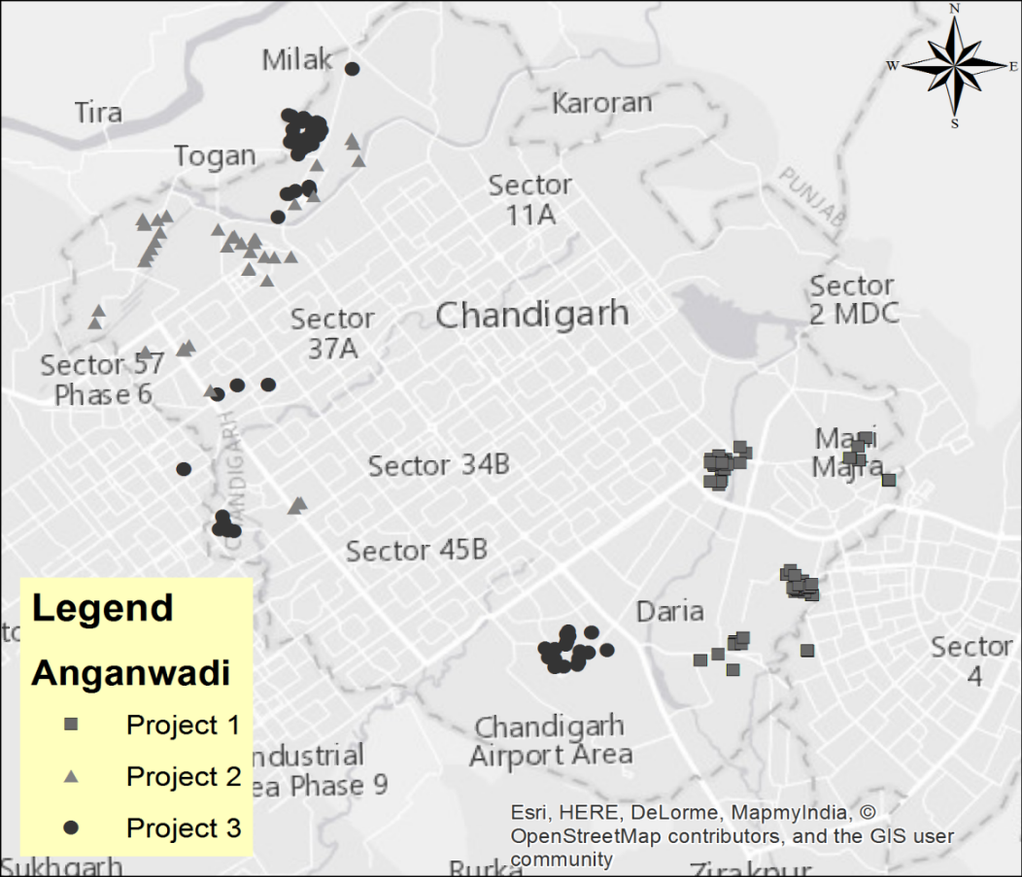
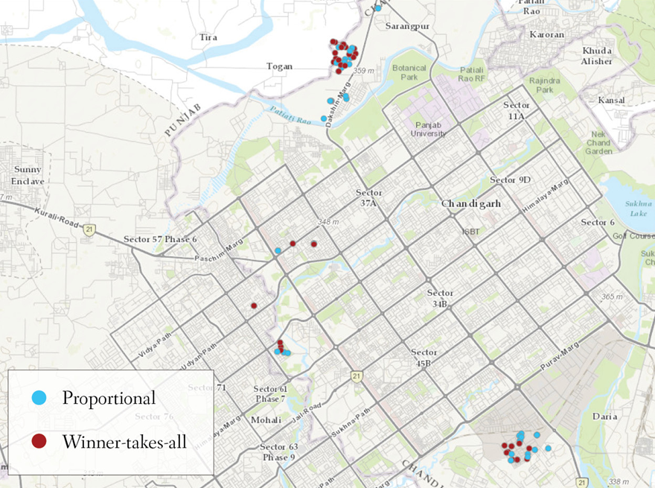
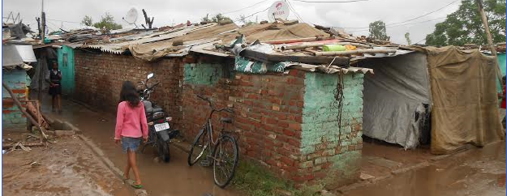
Proportional rewards in agriculture and nutrition
motivation | lab experiments | field trials | conclusions
Effect of incentives depends on context
Context for these trials is Chandigarh ICDS
-- Planned city in far north India
-- Capital of both Punjab and Haryana
-- Population size < 2 million
Previous paper:
fixed bonus vs piece rate
Trials were developed with ICDS management
-- Geographically separated blocks in slum areas
-- First study compares two blocks, one as control for trends and seasonality, the other for 2 treatments
-- Contest study used different sites for 4 rounds of data collection at 3 month intervals, Oct 2014 - July 2015, with surveys of workers, children and their mothers
In the contest design study, workers were randomly assigned to a proportional-rewards or winner-take-all contest in their neighborhood

Slide 13
Proportional rewards in agriculture and nutrition
motivation | lab experiments | field trials | conclusions
The contests in this trial were designed to meet ICDS needs
Bonus pool in each cluster total Rs. 600 per worker (3% of monthly salary)
Equal expected value and timing of payment in each treatment arm
In the winner-take-all contest, the highest performer wins the entire bonus pool
In proportional rewards treatment, each successful performer wins their share of the bonus
Simple implementation: Goal cards with gains needed for each child
Status improvements can be from severe (WAZ<-3) to moderate (WAZ<-2) or to none
Status improvements exclude any cases of overweight relative to height (WHZ>+1)
Bonuses are net of any declines in status into moderate or severe malnutrition
Bonuses are additional to regular salaries, and cannot be negative

Slide 14
Proportional rewards in agriculture and nutrition
motivation | lab experiments | field trials | conclusions
Timeline of measurement was designed to capture trends in control areas, and test for persistence of contest impacts
• Baseline I (October 2014)
• Baseline II (January 2015)
• Assigned to treatment in early February 2015
• Endline I (April 2015)
• Payouts given in early May 2015, no further incentive offered
• Endline II (July 2015)
Pre-trends?
Treatment effects within contest period
Treatment effects after contest ends

Slide 15
Proportional rewards in agriculture and nutrition
motivation | lab experiments | field trials | conclusions
Malnutrition rates were reduced significantly more
with proportional rewards than with a winner-take-all contest
especially after the contest ended
Average treatment effects of proportional rewards (vs. winner-take-all)
 |  | Weight (kg) | WAZ score | Malnutr. status |  | Weight (kg) | WAZ score | Malnutr. status |  | Weight (kg) | WAZ score | Malnutr. status
 |  | (1) | (2) | (3) |  | (4) | (5) | (6) |  | (7) | (8) | (9)
Within the contest period (after 3 months)
 | Proportional | 0.0764 | 0.071* | -0.043* |  | 0.138 | 0.064 | -0.038 |  | 0.138 | 0.064 | -0.037
 | Child and mother-level controls |  |  |  |  | X | X | X |  | X | X | X
 | Worker Controls |  |  |  |  |  |  |  |  | X | X | X
 | N | 2348 | 2342 | 2342 |  | 1665 | 1665 | 1665 |  | 1665 | 1665 | 1665
Larger, more significant gains in longer run could be due to biological delays, or behavioral effect of contest on attitudes and intrinsic motivation
Over the longer term (after 6 months)
 | Proportional | 0.202 | 0.095* | -0.059** |  | 0.209** | 0.088* | -0.052* |  | 0.200* | 0.082* | -0.050*
 | Child and mother-level controls |  |  |  |  | X | X | X |  | X | X | X
 | Worker Controls |  |  |  |  |  |  |  |  | X | X | X
 | N | 2325 | 2272 | 2272 |  | 1935 | 1934 | 1934 |  | 1935 | 1934 | 1934
Dependent variables are Weight (kg), Weight-for-Age Z scores (WAZ), Malnutrition status (WAZ below -2 threshold)
Significance levels shown are * 10%, ** 5%, *** 1%.

Slide 16
Proportional rewards in agriculture and nutrition
motivation | lab experiments | field trials | conclusions
Malnutrition rates improved more with proportional rewards especially among the lower-ranked workers
Heterogeneity in treatment effects of proportional rewards (vs. winner-take-all)
 | Wfa z |  | Weight | Wfa z | Weight | Wfa z | Weight
 | (1) |  | (2) | (3) | (4) | (5) | (6)
Within the contest period (after 3 months)
Proportional (PRP) | 0.0703* | 0.0703* | 0.076 | 0.0638 | 0.138 | 0.0642 | 0.138
Difference to Mean Payout | 0.0111 | 0.0111 | 0.0256 | 0.0181 | 0.0342 | 0.018 | 0.0341
Difference to Mean Payout*PRP | -0.0101 | -0.0101 | -0.0376 | -0.0158 | -0.0317 | -0.0163 | -0.0316
Child and mother-level controls |  |  |  | X | X | X | X
Worker Controls |  |  |  |  |  | X | X
N | 2342 | 2342 | 2348 | 1665 | 1665 | 1665 | 1665
Largest gains were among workers with lower payouts
Over the longer term (after 6 months)
Proportional (PRP) | 0.0947* | 0.203* | 0.0880* | 0.210** | 0.0836* | 0.202**
Difference to Mean Payout | 0.0351** | 0.0403 | 0.0307** | 0.0667** | 0.0278** | 0.0610**
Difference to Mean Payout*PRP | -0.0508*** | -0.0935** | -0.0447*** | -0.0920*** | -0.0377*** | -0.0783***
Child and mother-level controls |  |  | X | X | X | X
Worker Controls |  |  |  |  | X | X
N | 2272 | 2325 | 1934 | 1935 | 1934 | 1935
Difference to mean payout coefficients are in thousands of rupees
Dependent variables are Weight (kg) or Wfa z (WAZ)
Significance levels shown are * 10%, ** 5%, *** 1%.

Slide 17
Proportional rewards in agriculture and nutrition
motivation | lab experiments | field trials | conclusions
Conclusions
Contests with known payouts and fixed timelines can elicit effort and information about what works, in a budget-friendly and administratively feasible manner
Bonus of ~5% of salary lowered malnutrition rates by 6% after 6 months, 4% after 3 mo.
Impacts were persistent, implying that additional incentives did not displace other motivations
Using proportional rewards encourages all workers, not just top performers
Avoids discouragement of lower-ranked workers found in winner-take-all contests
We find larger gains among those with below-average initial outcomes
Developing real-world contests relies on funder interest, suitability of the problem
Contest must have a measurable outcome
Funder must value all achievements, not just best
Contests are best seen as complements to other mechanisms
Prize amounts must be sufficient to attract interest, but no larger (to limit distortion)
Contest focuses attention on what is measured, and reveals what works
Experience of AgResults offers many great examples & lessons!

Slide 18
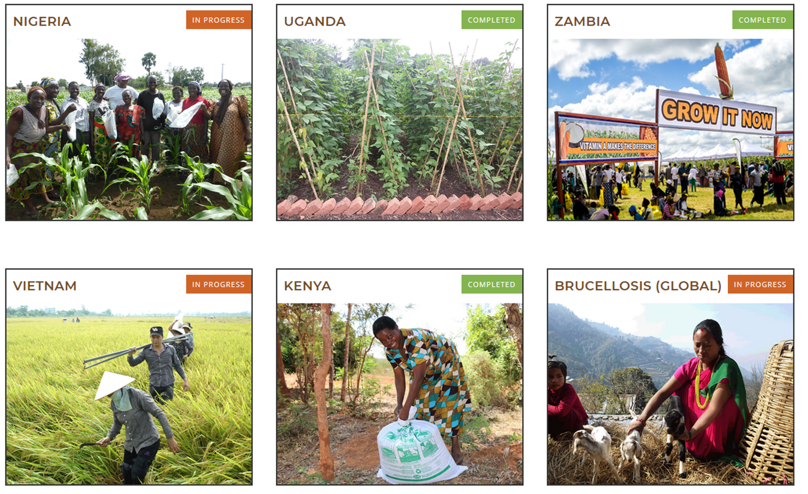
Next up: The experience of AgResults
Proportional rewards in agriculture and nutrition
motivation | lab experiments | field trials| conclusions
Aflasafe maize seed & grain
Certified legume seeds
Vit. A maize seed & grain
Low-emission rice paddies
Insect-proof grain storage
Small ruminant vaccination
Source: Agresults.org, May 2019

