Slide 1
Measuring nutritional resilience
of a community:
Evidence from Nepal, Bangladesh, and Uganda
Track session on new ideas about “resilience”
Health Economics Section (HES) and
Food and Agricultural Marketing Policy Section (FAMPS)
August 2nd, 2021
Will. Masters (william.masters@tufts.edu)
Friedman School of Nutrition Science and Policy, Tufts University and the Feed the Future Innovation Lab for Nutrition

Slide 2
Empirical results are from:
S. Zaharia, W.A. Masters, S. Ghosh, G.E. Shively, S. Gurung, S. Manohar, A.L. Thorne-Lyman, K.P. West, K.H. Appel, L. Liang, R. Shrestha, B. Bashaasha, N. Kabunga and P. Webb (2021). “Recovery without resilience? Measuring resilience in Nepal, Bangladesh, and Uganda.” Feed the Future Innovation Lab for Nutrition Working Paper, in review.
First author: https://www.nutritioninnovationlab.org/profile/Sonia-Zaharia

Slide 3
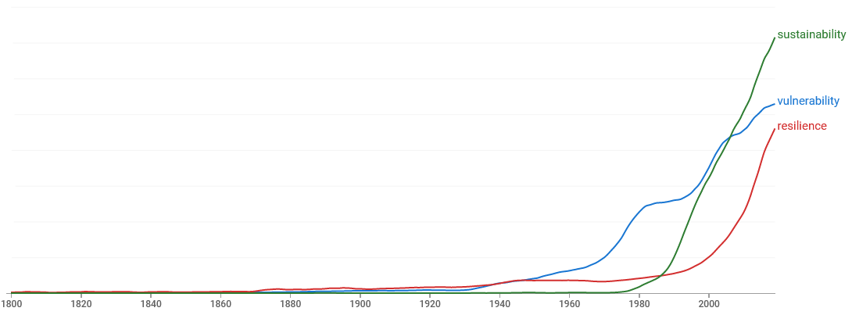
“Resilience” is an old new thing
-- from Latin, via Francis Bacon (1626)
Dictionary definitions of resilience:
1. the capacity to recover quickly from difficulties; toughness.
Example: "the often remarkable resilience of so many British institutions"
2. the ability of a substance or object to spring back into shape; elasticity.
Example: "nylon is excellent in wearability and resilience"
Sustainability
Frequency of selected words in English-language books, 1800-2019
Vulnerability
“Resilience” was more widely used than “vulnerability” or “sustainability” until the 1940s, then all three grew rapidly in sequence
Resilience
Takeoff decade:
1950s
1980s
2000s
word frequency is from Google Books ngram viewer (https://books.google.com/ngrams), 24 July 2021.
Source: Definition is from Oxford Languages (https://languages.oup.com/google-dictionary-en)

Slide 4
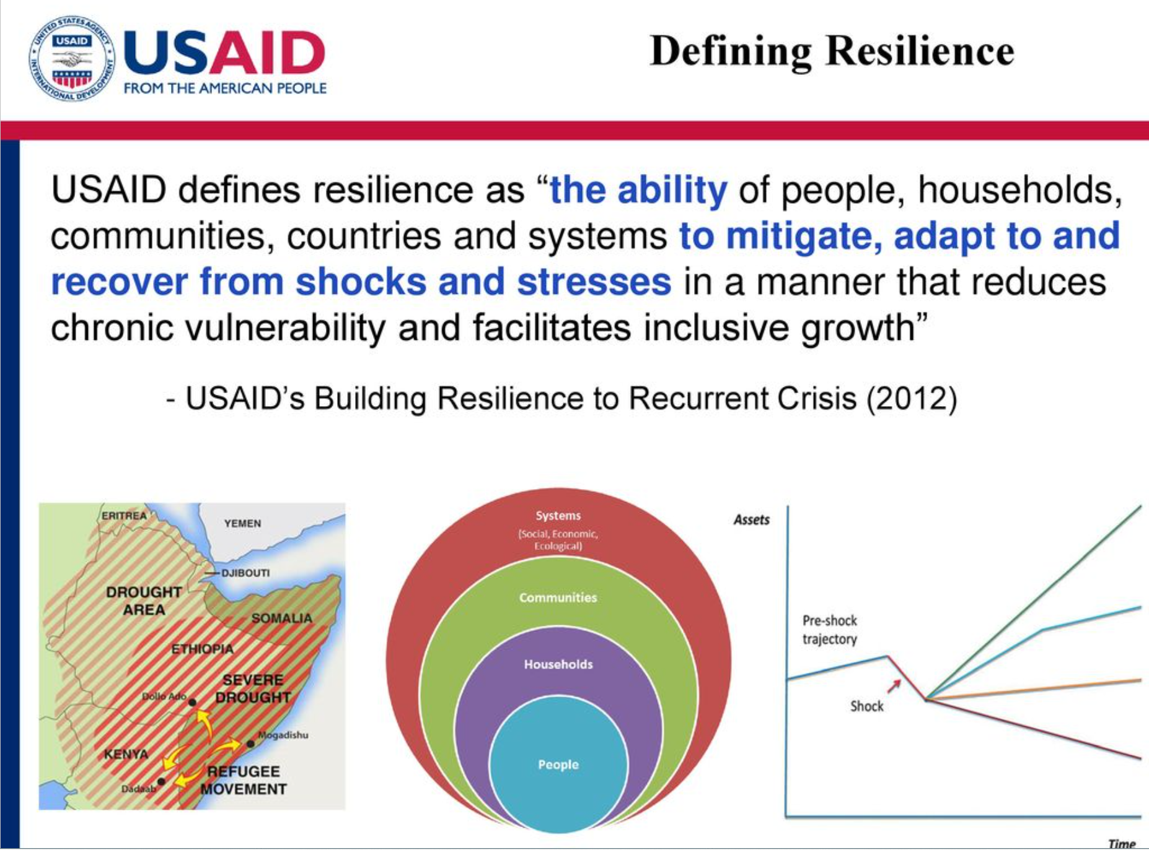
What we want to measure
In other words:
Do people succeed despite adversity?
Source: Andre Mershon (2012), Resilience in USAID, https://slidetodoc.com/resilience-in-usaid-andre-mershon-center-for-resilience;
Other materials at USAID Center for Resilience (resiliencelinks.org).

Slide 5
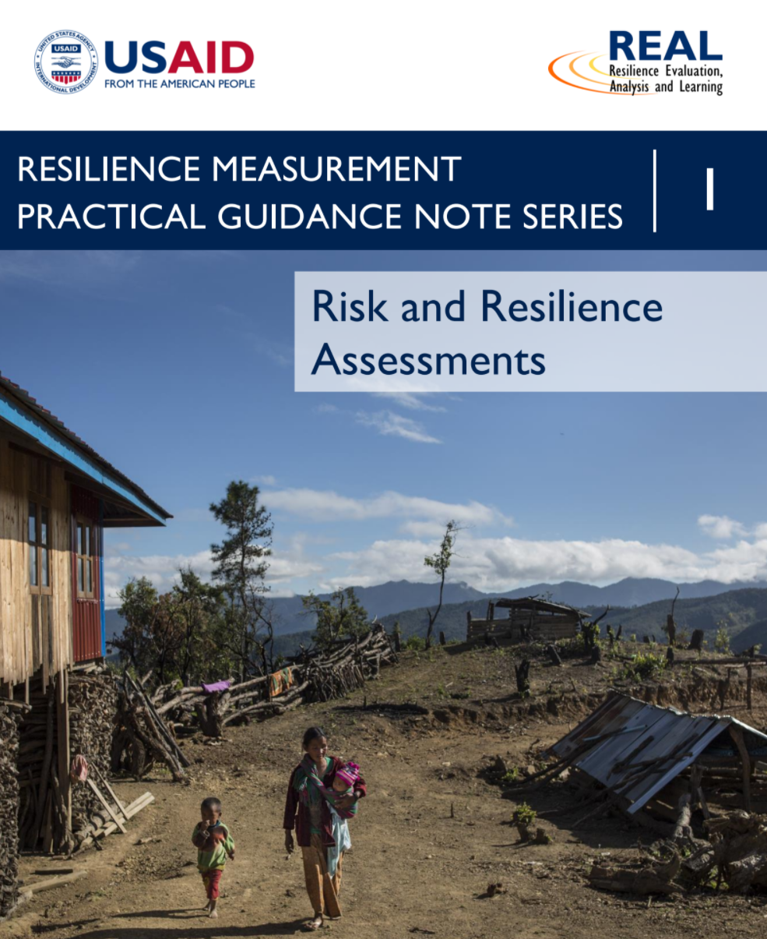
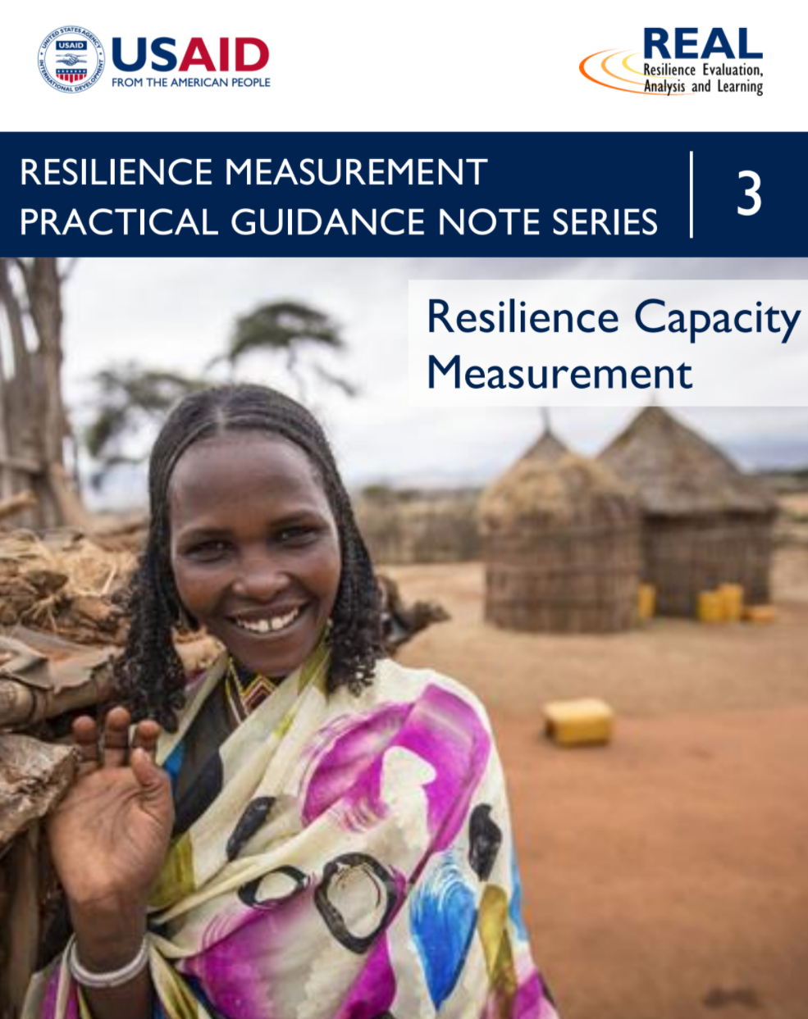
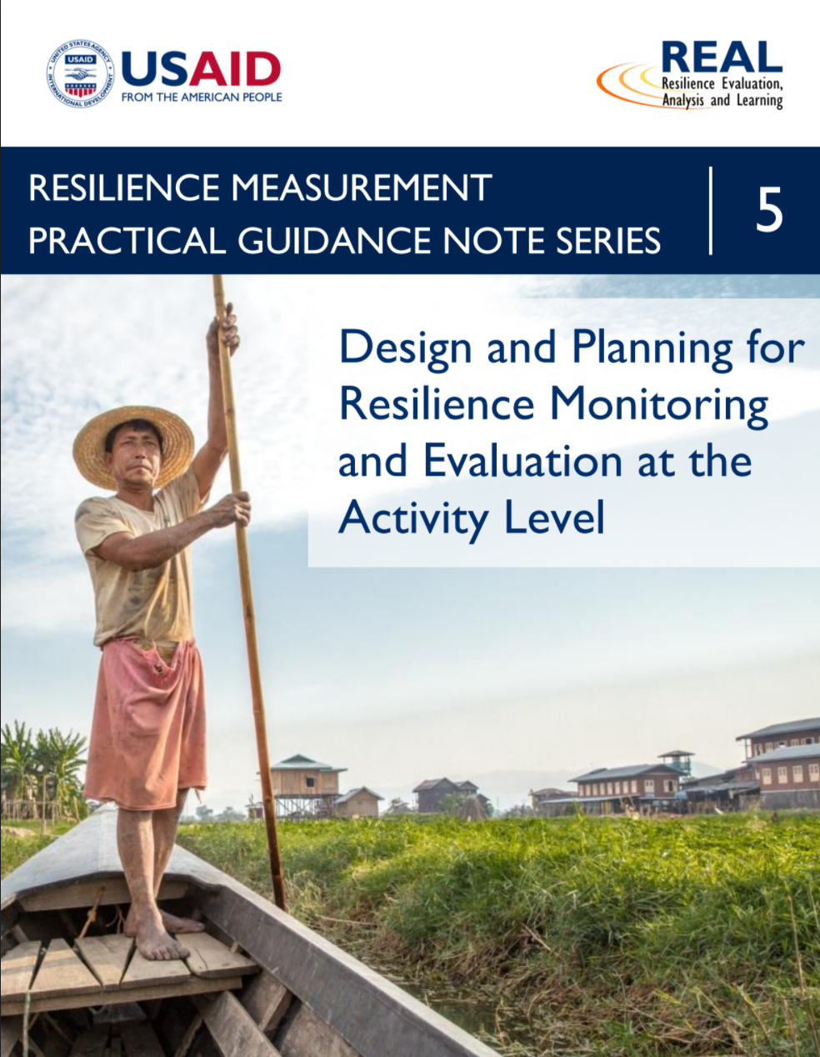
USAID invests a lot in trying to measure resilience
Source: https://spark.adobe.com/page/rSG16suIleW7d/

Slide 6
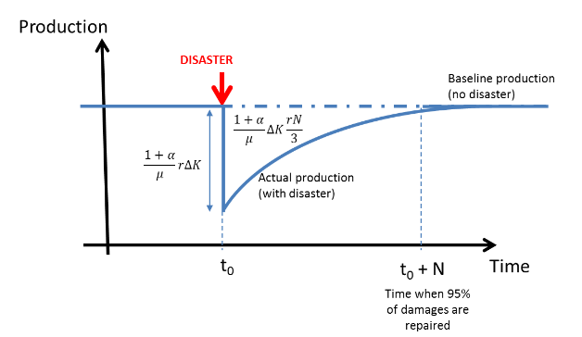
The usual idea is something like this
Do people succeed despite adversity?
-- many studies regress outcomes on shocks, to find causes of success
-- many studies posit a set of attributes as “resilience”, and test for its links with success
-- such studies generally do not distinguish “resilience” from success in general
-- here we focus on people who actually experienced a loss
t=1
t=2
t=3
…
t=n
Source: Hallegatte S. (2014) “Economic resilience. Definition and Measurement”, Policy Research Working Paper 6852, The World Bank
http://documents.worldbank.org/curated/en/350411468149663792/pdf/WPS6852.pdf

Slide 7
Our approach focuses on those who experienced a loss
Among people whose outcomes worsened
do they recover at least some of what they lost?
Are they truly resilient, or did they “recover” due to random noise and mean reversion?
We compare them to others in their community who initially gained:
With random noise, gainers will lose at least some
of their gains
Better
With resilience, those who initially lost will recover more than would be expected from randomness
Worse
Our approach tests for resilience to any shock,
as in all-cause insurance.
t=1 t=2 t=3

Slide 8
To measure resilience, we compare two successive changes
Our focus is on recovery after decline,
which we compare to decline after improvement
45 degree line = all changes are just random noise
Recovery
Later change
(for example,
from 2014 to 2015)
Horizontal line = initial changes are not reversed
Decline
Decline
Improvement
Initial change
(for example, from 2013 to 2014)

Slide 9
Any panel with ≥3 time periods can reveal dynamics of change
For example, over the four years of the PoSHAN survey (2013-16) in Nepal
women whose dietary diversity declined recovered some of their losses
while those whose diets initially improved kept most of their gains.
We test for this kind of resilience
in other outcomes and other populations
Women dietary diversity scores (Nepal)
Change from
2014 to 2015 (t=2 to 3)
or from
2015 to 2016
(t=3 to 4)
About half of initial declines were reversed the following year
About 1/4th of initial gains were reversed
Change from 2013 to 2014 (t=1 to 2), or from 2014 to 2015 (t= 2 to 3)
Source: NiL PoSHAN survey data, from Zaharia et al 2020. n=1,808 women (Terai subsample only).
Notes:
Sonia, can you confirm sample size for this figure?

Slide 10
Observations in the shaded quadrant are improvements after decline.
Is that resilience? Or is recovery just random mean reversion?
Evidence of resilience
(recovery is greater than expected)
Mean reversion
(recovery is as expected)
We compare recovery among those who initially decline to
the degree of mean reversion experienced by those who initially gained
Recovery without resilience
(recovery is less than expected)
Initial change (from t=1 to t=2)
Subsequent change
(from t=2 to t=3)
Source: Zaharia, Masters, Shively & Webb (2020) Measuring Resilience as Asymmetric Mean Reversion. Working Paper, Tufts University.

Slide 11
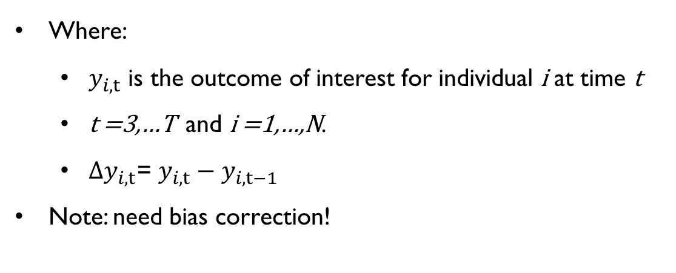
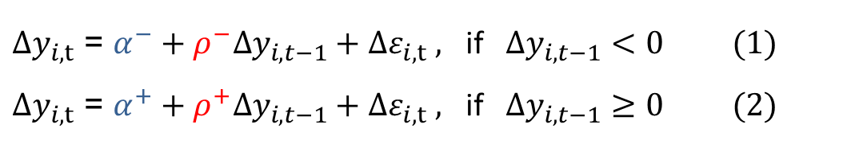
We estimate the asymmetry in mean reversion:
Do those who initially declined recover faster than expected?
${∆y}_{i,t}$ = ${α^{−}+ρ^{−}∆y_{i,t−1}+∆ε}_{i,t} ,$ if $∆y_{i,t−1}<0$ (1)
${∆y}_{i,t}$ = ${α^{+}+ρ^{+}∆y_{i,t−1}+∆ε}_{i,t} ,$ if $∆y_{i,t−1}≥0$ (2)
trend
reverting tendency
Where:
  $y_{i,t}$ is the outcome of interest for individual i at time t
  t =3,…T and i =1,…,N.
  ${∆y}_{i,t}$= $y_{i,t}−y_{i,t−1}$
Note: need bias correction!

Slide 12



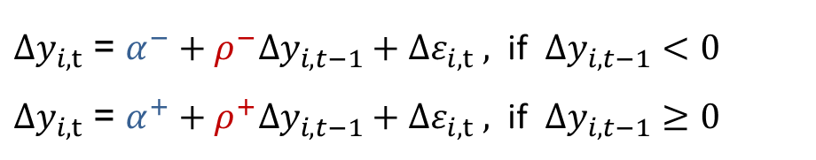
${∆y}_{i,t}$ = ${α^{−}+ρ^{−}∆y_{i,t−1}+∆ε}_{i,t} ,$ if $∆y_{i,t−1}<0$
${∆y}_{i,t}$ = ${α^{+}+ρ^{+}∆y_{i,t−1}+∆ε}_{i,t} ,$ if $∆y_{i,t−1}≥0$
Slope:
$$ρ^{−}<0$$
Mean reversion
Subsequent change
(from t=2 to t=3)
0
Slope:
$$ρ^{+}<0$$
$$ρ^{−}=ρ^{+}$$
0
Initial change (from t=1 to t=2)

Slide 13



${∆y}_{i,t}$ = ${α^{−}+ρ^{−}∆y_{i,t−1}+∆ε}_{i,t} ,$ if $∆y_{i,t−1}<0$
${∆y}_{i,t}$ = ${α^{+}+ρ^{+}∆y_{i,t−1}+∆ε}_{i,t} ,$ if $∆y_{i,t−1}≥0$
With this kind of asymmetry, recovery after decline
Is greater than random
Slope:
$$ρ^{−}<0$$
Resilience
Subsequent change
(from t=2 to t=3)
0
$$ρ^{−}<ρ^{+}$$
Slope:
$$ρ^{+}<0$$
0
Initial change (from t=1 to t=2)

Slide 14



${∆y}_{i,t}$ = ${α^{−}+ρ^{−}∆y_{i,t−1}+∆ε}_{i,t} ,$ if $∆y_{i,t−1}<0$
${∆y}_{i,t}$ = ${α^{+}+ρ^{+}∆y_{i,t−1}+∆ε}_{i,t} ,$ if $∆y_{i,t−1}≥0$
Slope:
$$ρ^{−}<0$$
With this kind of asymmetry, conditions are like quicksand:
gains lead to bigger declines, and declines are followed by smaller gains
Non-resilience
Subsequent change
(from t=2 to t=3)
0
$$ρ^{−}>ρ^{+}$$
Slope:
$$ρ^{+}<0$$
0
Initial change (from t=1 to t=2)

Slide 15

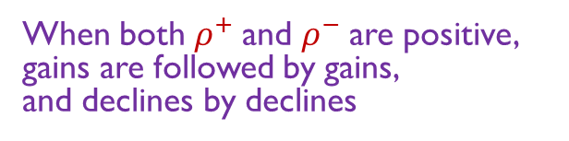

${∆y}_{i,t}$ = ${α^{−}+ρ^{−}∆y_{i,t−1}+∆ε}_{i,t} ,$ if $∆y_{i,t−1}<0$
${∆y}_{i,t}$ = ${α^{+}+ρ^{+}∆y_{i,t−1}+∆ε}_{i,t} ,$ if $∆y_{i,t−1}≥0$
Slope:
$$ρ^{+}>0$$
Subsequent change
(from t=2 to t=3)
0
When both $ρ^{+}$and $ρ^{−}$are positive,
gains are followed by gains,
and declines by declines
Momentum
Slope:
$$ρ^{−}>0$$
0
Initial change (from t=1 to t=2)

Slide 16
All possible cases
Resilience
Non-resilience
Momentum
Source: Zaharia, Masters, Shively & Webb (2020) Measuring Resilience as Asymmetric Mean Reversion. Working Paper, Tufts University.
Notes:
All possible combinations of rho- and rho+ result in 11 cases

Slide 17
Data for pilot tests
Data sources:
Nepal: PoSHAN survey (Klemm et al. 2018)
Bangladesh: BAHNR survey
Uganda: Uganda panel survey
Populations
Women (13 to 47 years old) and children (2 to 5 years old)
Outcomes
Dietary diversity scores (DDS) from 7-day and 24-hour diet recalls
Women’s Body Mass Index (BMI)
Children’s weight-for-height z-score (WHZ)
Location & time
Nepal: Terai region, 2013-2016 (yearly)
Bangladesh: Feed the Future Zone of Influence, 2016-2017 (bi-annual)
Uganda: six districts from N and SW Uganda, 2012-2016 (biennial)

Slide 18
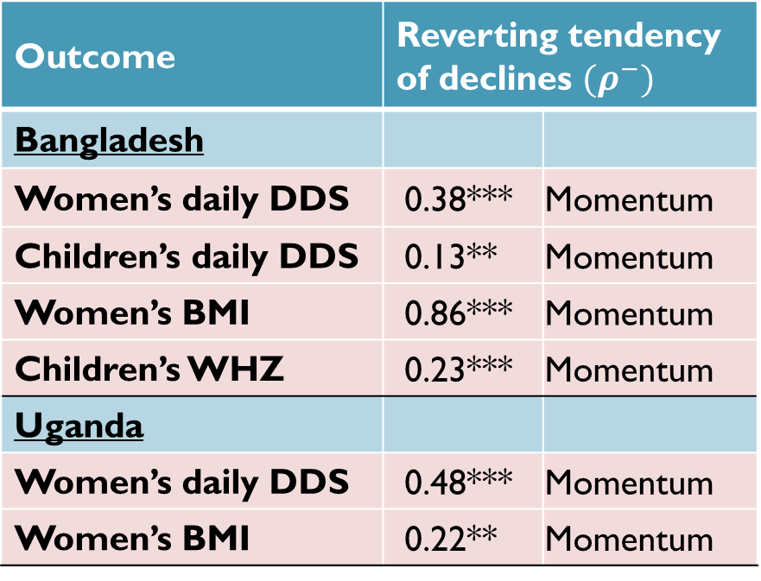
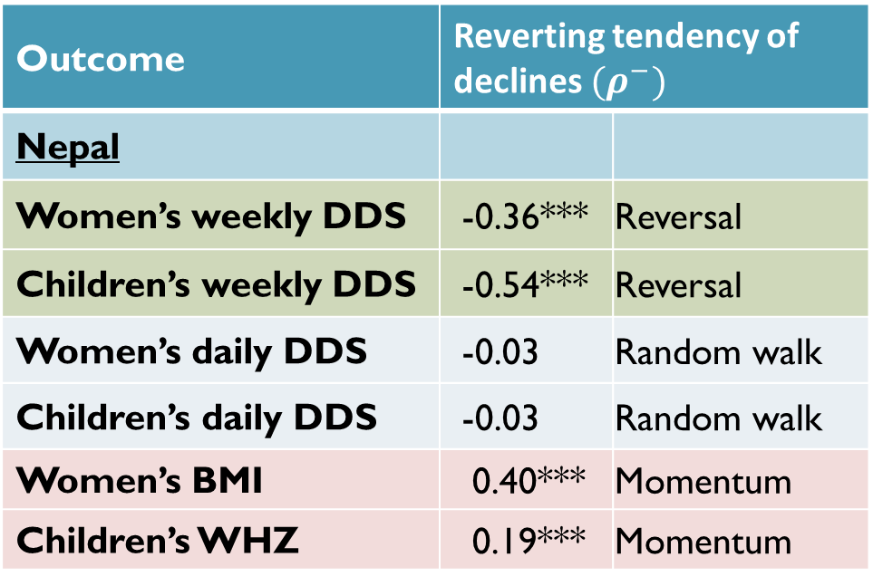
Results of pilot tests – do declines revert? (𝝆^− < 0)
Outcome | Reverting tendency of declines $(ρ^{−})$
Nepal
Women’s weekly DDS | -0.36*** | Reversal
Children’s weekly DDS | -0.54*** | Reversal
Women’s daily DDS | -0.03 | Random walk
Children’s daily DDS | -0.03 | Random walk
Women’s BMI | 0.40*** | Momentum
Children’s WHZ | 0.19*** | Momentum
Outcome | Reverting tendency of declines $(ρ^{−})$
Bangladesh
Women’s daily DDS | 0.38*** | Momentum
Children’s daily DDS | 0.13** | Momentum
Women’s BMI | 0.86*** | Momentum
Children’s WHZ | 0.23*** | Momentum
Uganda
Women’s daily DDS | 0.48*** | Momentum
Women’s BMI | 0.22** | Momentum
OLS regressions, corrected for bias. *p<0.1, ** p<0.05, ***p<0.01.
Nepal: n=3,752 (women) & 2,203 (children)
Bangladesh: n=2,753 (women) & 1,547 (children);
Uganda n=1,617 (women).
Source: S. Zaharia, et al. (2021). “Recovery without resilience? Measuring resilience in Nepal, Bangladesh, and Uganda.” Feed the Future Innovation Lab for Nutrition Working Paper, in review.

Slide 19
Results of pilot tests – do declines revert more than improvements?
This is resilience, in the sense of greater-than-random
recovery after decline
Source: S. Zaharia, et al. (2021). “Recovery without resilience? Measuring resilience in Nepal, Bangladesh, and Uganda.” Feed the Future Innovation Lab for Nutrition Working Paper, in review.
Notes:
All possible combinations of rho- and rho+ result in 11 cases

Slide 20
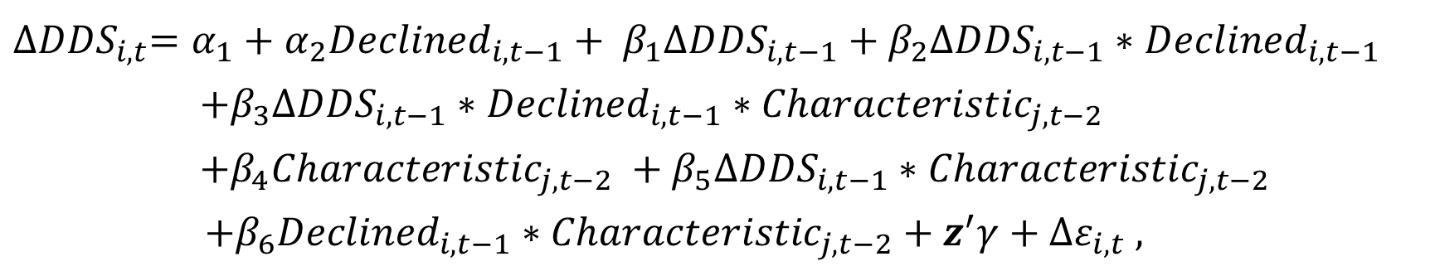
Where we see it, how does resilience vary in the population?
In Nepal, dietary diversity resilience of women and children varies across households and districts.
Who is most resilient?
$${∆DDS}_{i,t}=α_{1}+α_{2}{Declined}_{i,t−1}+ β_{1}{∆DDS}_{i,t−1}+β_{2}{∆DDS}_{i,t−1}∗{Declined}_{i,t−1}$$
$+β_{3}{∆DDS}_{i,t−1}∗{Declined}_{i,t−1}∗{Characteristic}_{j,t−2}$
$+β_{4}{Characteristic}_{j,t−2} +β_{5}{∆DDS}_{i,t−1}∗{Characteristic}_{j,t−2}$
$$+β_{6}{Declined}_{i,t−1}∗{Characteristic}_{j,t−2}+z^{′}γ+{∆ε}_{i,t} ,$$

Slide 21
Women and children from more market-oriented households
we more likely to exhibit resilience
More resilient
Less resilient
Household has one or more credits
Share sold of own crop production
Share consumed of own crop production
Coefficient estimates with 95% CI for women’s weekly DDS
Source: Zaharia et al. (2020).

Slide 22
Women and children from districts with more infrastructure were more likely to exhibit resilience
More resilient
Less resilient
No. of female teachers
No. of post office workers
No. of haat bazaars
No. of permanent bazaars
Coefficient estimates with 95% CI for children’s weekly DDS
Source: Zaharia et al. (2020).

Slide 23
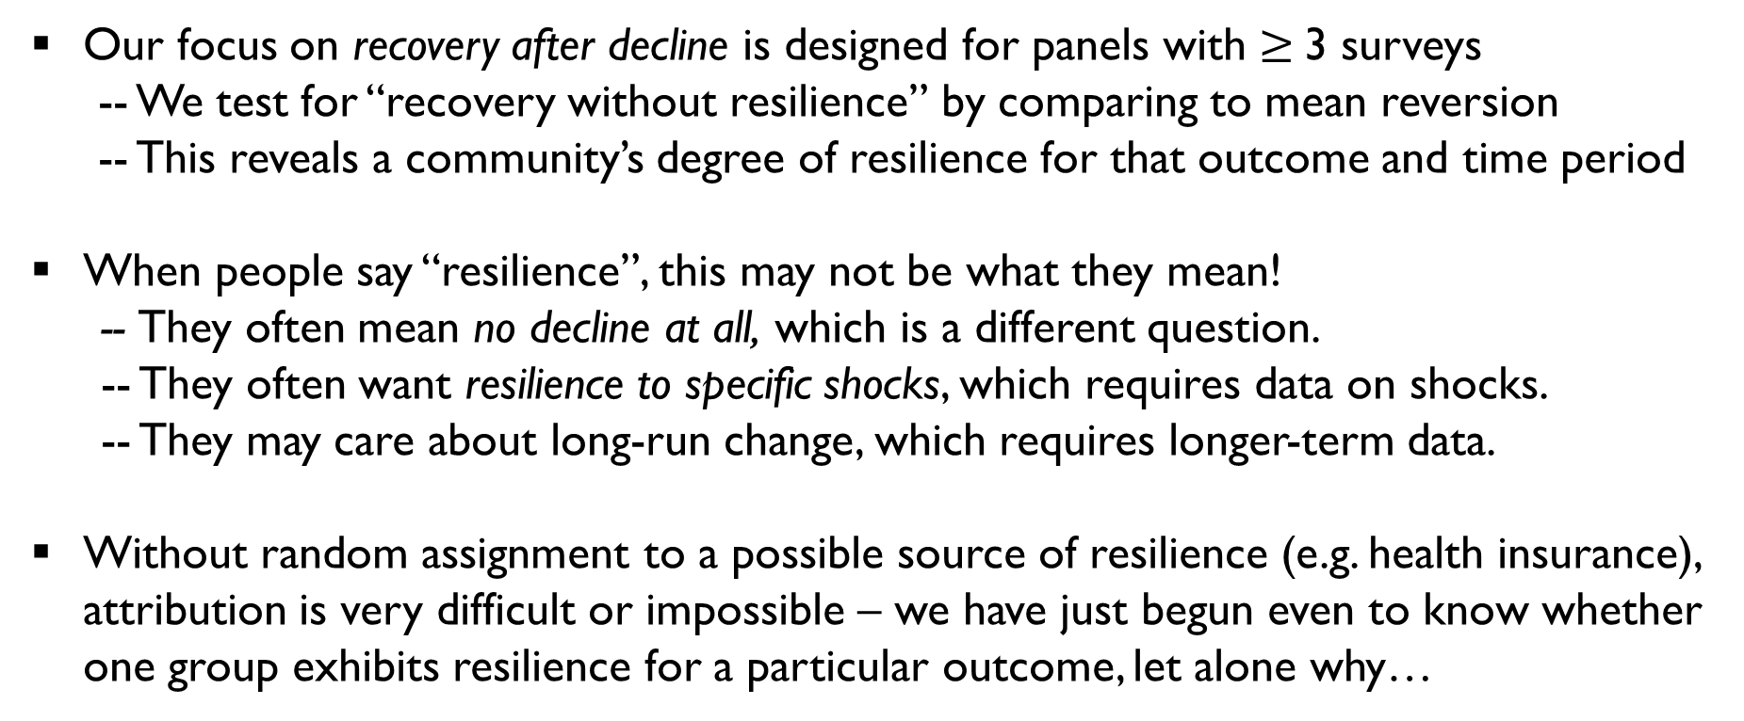
This work has many limitations!
  Our focus on recovery after decline is designed for panels with $≥$3 surveys
  -- We test for “recovery without resilience” by comparing to mean reversion
  -- This reveals a community’s degree of resilience for that outcome and time period
  When people say “resilience”, this may not be what they mean!
    -- They often mean no decline at all, which is a different question.
    -- They often want resilience to specific shocks, which requires data on shocks.
    -- They may care about long-run change, which requires longer-term data.
  Without random assignment to a possible source of resilience (e.g. health insurance), attribution is very difficult or impossible – we have just begun even to know whether one group exhibits resilience for a particular outcome, let alone why…

Slide 24
Thank you to our collaborators and funders
This work was conducted as part of the Feed the Future Innovation Lab for Nutrition, under grant contracts AID-OAA-L-10-00006 and AID-OAA-LA-14-00012 from the United States Agency for International Development (USAID).
POSHAN community studies – Nepal:
  Led by Johns Hopkins University with in-country partners; National Agriculture Research Council (NARC), Nepal Technical Assistance Group (NTAG), New Era, Tribhuvan University Institute of Medicine (TUTH IOM), Tufts University.
BAHNR study – Bangladesh:
  Tufts University, HKI Bangladesh, Horticulture Innovation Lab, WorldFish, AquaFish Innovation Lab, Dhaka University, Strengthening Partnerships, Results, and Innovations in Nutrition Globally (SPRING).
Uganda panel survey – Uganda:
  Makerere University School of Public Health, Uganda; the Uganda Science and Technology Council, Kampala, Uganda.

Slide 25











U.S. Government Partners
Notes:
Please include this slide in your presentation in the appropriate location. Notes: Feed the Future connects U.S. Government efforts targeted at global hunger and food security. Led by USAID, Feed the Future draws on the resources and expertise of the U.S. Departments of Agriculture, Commerce, State and Treasury; the Millennium Challenge Corporation; the United States African Development Foundation; the Peace Corps; the Overseas Private Investment Corporation; the Office of the United States Trade Representative; and the U.S. Geological Survey.

Slide 26
Notes:
To insert your implementing partner institutional logo, go to View >> Slide Master, and replace the gray box with your logo, placing it to the right of the USAID logo at the bottom. No text or partner logos can be placed within the upper blue banner.

