Slide 1
Food prices for nutrition:
Discussion of the past, present and future of
least-cost healthy diets research for poverty measurement and decision-making in agriculture and food systems
Will Masters
Friedman School of Nutrition and Department of Economics, Tufts University
william.masters@tufts.edu
https://sites.tufts.edu/foodpricesfornutrition
World Bank poverty research group -- November 29th, 2022
Interruptions welcome, extra slides are for future reference

Slide 2
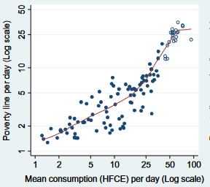
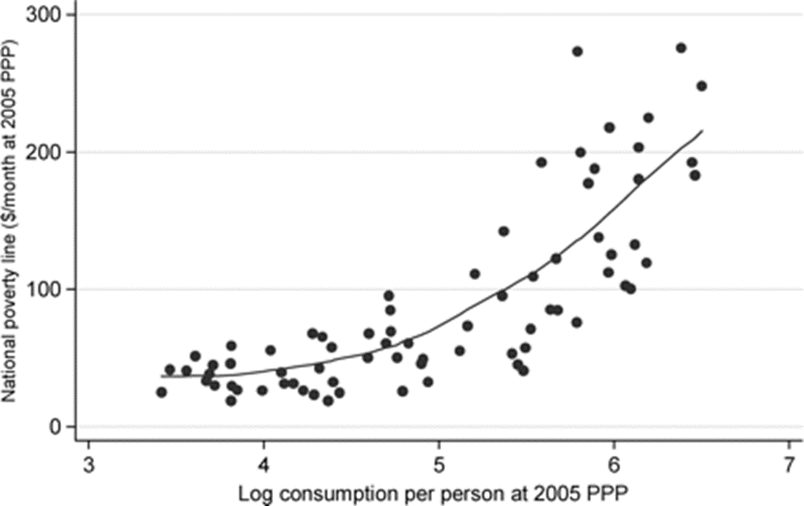
Starting points for today’s discussion
1. Even the poorest countries now use national poverty lines above subsistence floors
National poverty lines in 75 countries, 1985-2005
National poverty lines in 115 countries, 2004-2012
M. Ravallion, S. Chen and P. Sangraula (2009), Dollar a day revisited. World Bank Economic Review, 23(2): 163-184.
D. Jolliffe and E.B. Prydz (2016). Estimating international poverty lines from comparable national thresholds. Journal of Economic Inequality 14: 185–198.

Slide 3
Starting points for today’s discussion
2. Least-cost diets provide a useful food price index for the health production function
Methods expand the nutritional side of Allen (2017)
We introduced least-cost items by food group in 2018
Initial use by UN system in SOFI 2020 updated in 2022
Many related studies address within-country variation
Diet cost data are from FAO and the Food Prices for Nutrition project, using item prices reported by national statistical organizations through the International Comparison Program (ICP), downloaded from https://databank.worldbank.org/source/food-prices-for-nutrition, and national income (GNI) is from the World Development Indicators https://databank.worldbank.org/source/world-development-indicators. Guidelines are linear in the logarithm of income shown on the horizontal axis.

Slide 4
Starting points for today’s discussion
3. Actual food expenditure quickly rises above the $3-4/day cost of healthy diets
Food expenditure exceeds CoHD after about 5k/year ($14/day, of which ~1/3 is for food)
The first US poverty lines in 1965 were set at 3x food spending because that was national average from the most recent survey in 1955
FPN provides a food-for-health cost line
Much else matters for welfare and poverty, even in food
Diet cost data are from FAO and the Food Prices for Nutrition project, using item prices reported by national statistical organizations through the International Comparison Program (ICP), downloaded from https://databank.worldbank.org/source/food-prices-for-nutrition. Food expenditures are derived from those data, and national income (GNI) is from the World Development Indicators https://databank.worldbank.org/source/world-development-indicators. Guidelines are linear in the logarithm of income shown on the horizontal axis.

Slide 5
Starting points for today’s discussion
4. Food poverty beyond affordability of healthy diets includes experience of food insecurity
Unaffordability is more prevalent than food insecurity up to about $6k/yr
Above about 10k/yr, food insecurity is more than unaffordability
Since food needs are similar from week to week, food insecurity is an excellent metric of financial precarity
Data shown are FAO estimates, downloaded from https://databank.worldbank.org/source/food-prices-for-nutrition for affordability of healthy diets, and from https://databank.worldbank.org/source/world-development-indicators for experience of food insecurity and national income (GNI).

Slide 6
Starting points for today’s discussion
1. Even the poorest countries now use national poverty lines above subsistence floors
2. Least-cost diets provide a useful food price index for the health production function
3. Actual food expenditure quickly rises above the $3-4/day cost of healthy diets
-- Cost of calories (ave. $0.83/day in 2017 PPP terms) sets floor for short-term survival
-- Cost of nutrients (ave. $2.46) sets floor of access to avoid nutrient-related diseases
-- Cost of healthy diets (ave. $3.31) sets floor of access to avoid all diet-related diseases
-- Actual food spending (ave. $5.64) varies greatly and pursues goals other than health
4. Food poverty beyond affordability of healthy diets includes experience of food insecurity
-- Experience of food insecurity is skipping meals, eating less and going to bed hungry for lack of money to buy usual preferred foods, thereby measuring financial precarity
-- Other aspects of food poverty would include time and materials for meal preparation; water and air quality in kitchen and eating spaces, etc.
5. Food preferences and food choice is driven by factors other than health
-- As we’ll see, revealed preference is for more ASF & oil, and less F&V or legumes
-- Preferences within food groups may also favor less healthy versions
==> Question for today: what role for least-cost diets in policy research?

Slide 7
The FPN project has changed how food systems are measured
What core innovations did we bring?
measure access to healthy diets globally, as called for by Herforth & Ahmed (2015) and others
use least-cost items in each food group, in addition to least-cost foods for nutrient adequacy
first for MDD-W in Ghana & Tanzania (AJAE, 2018), then for quantified national FBDGs in 3 countries of South Asia (GFS, 2019)
global comparisons using ICP prices by 21 food groups (JN 2019), then for EAT-Lancet (LGH 2020) & ten FBDGs (SOFI 2020)
facilitate monitoring with global healthy diet basket targets, based on commonalities among many FBDGs (SOFI 2022)
=> access to least-cost healthy diets now the UN’s third core metric of world food security, after caloric undernourishment (PoU) and the food security experience scale (FIES), using their acronym cost and affordability of healthy diets (CoAHD)
New kinds of measurement can change policy and practice
transform routinely-collected data, creating demand for improved collection & reporting
match retail item price and availability to nutritional composition (food group and macronutrients, then micronutrients)
drives attention to each kind of information (data quality and harmonization, representativeness and timeliness)
use transparent and replicable methods, so that diverse analysts can use & adapt results
use local dietary guidelines, with updated requirements for an active and healthy life
compare diet costs to resources available for food, taking account of other basic needs
respond to growing needs with actionable data
diet transition since 1990s then world price spike of 2007-08 drove interest in access to healthy foods
for global health and nutrition, interest in agriculture and food environments driven by Lancet series (2008), Ag2Nut (2010- ), LCIRAH (2010- ), INFORMAS (2012- ), IMMANA (2015- ), ANH Academy (2017- ), with increasing focus on food environments
for economics and food policy, measuring diet costs allows distinguishing between supply (access) and demand (food choice)
--> The big change is using least-cost diets as a price index: cost of foods needed for health, vs other needs

Slide 8
Least-cost diets research has a long history
Food prices relative to wages provided the Western world’s first numerical metric of well-being
Vaughn (1675) for “labourers and servants”; Fleetwood (1707) for student stipends at Oxford
U.S. Bureau of Labor (1888) first survey of household spending (n=8,544 families, 1888-90) used as weights on retail prices (collected for 67 foods & 148 other items, 70 localities, 1889-1891)
Debates over item weights between initial quantities (Laspeyres, 1865) vs. ending quantities (Paasche, 1874), partly resolved by Irving Fisher’s geometric average of the two (Fisher, 1922)
Consumer price indexes for U.S. updated by Margaret Hogg (1934), under Frances Perkins as Sec. of Labor
Selection of least-cost items to meet nutrient needs introduced soon after requirements were quantified
Stigler (1945) described the problem mathematically; Dantzig (1963) developed Simplex solution algorithm
The U.S. Economy Food Plan (1961) for aid recipients met updated nutrient requirements (1958) plus palatability constraints based on low-income consumers’ use of 11 food groups in latest survey (1955)
For U.S. poverty lines (1965), Mollie Orshansky suggested threshold at 3x the Economy Food Plan cost, based on the national average expenditure share on food of 33% (from same household survey of 1955)
Updating of poverty lines then done with overall CPI; Thrifty Food Plan updated most recently in 2021
Least-cost diets for nutrient adequacy still widely used, e.g. Darmon et al. (2002) in France or for nutrition assistance as “Optifood” from Ferguson et al. (2008) and “Cost of the Diet” by Chastre et al. (2007) and Ferguson et al. (2017) used in WFP “Fill the Nutrient Gap” programming (de Pee et al. 2017)
--> The big change is using least-cost diets as a price index: cost of foods needed for health, vs other needs
Notes:
Also note Playfair (1821) first use of long-term price/wage ratios for both wheat grain and retail bread in London

Slide 9
Our use of least-cost diets builds on other efforts
Others tried to use least-cost diets as a price index, but for nutrient adequacy (rather than food groups)
O’Brien-Place and Tomek (1983) used least-cost of nutrients with U.S. CPI prices to describe food inflation
Omiat and Shively (2017) did that with Uganda CPI data, as part of Nutrition Innovation Lab research
Allen (2017) used least-cost foods, housing, clothing etc. with 2011 ICP prices to propose new poverty lines
Moatsos (2021) used least-cost items with (limited) worldwide food price data to track poverty since 1820
Others track prices of standardized low-cost foods, but with fixed baskets (rather than least-cost items)
The Economist’s Big Mac index, introduced 1986 as comparable basic food almost worldwide
Nigerian consultancy’s Jollof index, introduced 2016 to describe quarterly changes
WFP’s cost of a basic plate indicator, introduced 2017 to compare food costs to income across countries
Adapted with least-cost items for UNFSS in paper on “Cost and Affordability of Preparing a Basic Meal”
Food activist Jack Monroe got the UK ONS in 2022 to publish a least-cost grocery items price index
Many useful experiments use diverse sources of food prices
Webscraping from online vendors
Alberto Cavallo’s Billion Prices project from 2008, commercialized as PriceStats since 2011 for over 20 countries
Mike Rayner et al.’s FoodDB since 2017 for over 120k items from Tesco, Sainsbury & other grocery chains in the UK
Giulia Menichetti et al.’s GroceryDB from 2022 for over 50k items from Walmart, Target & Whole Foods in the US
Other approaches
Crowdsourcing in all countries such as Premise.com (vetted, paid contributors) or Numbeo (less reliable, unpaid)
Scanner and survey data from a few countries (IRI, Nielsen, SPINS, and we are talking with Euromonitor)
--> The big change is using least-cost diets as a price index: cost of foods needed for health, vs other needs
Notes:
The Economist’s Big Mac index
Analysis & charts: https://www.economist.com/big-mac-index
Data and code: https://github.com/TheEconomist/big-mac-data
Nigerian consultancy SBM Intelligence’s Jollof index
Quarterly report: https://www.sbmintel.com/?s=Jollof
Media-savvy author: https://gfcmediagroup.com/contributors/cheta-nwanze
UK campaigner Jack Monroe’s “Vimes Boots” index
Twitter activism: https://twitter.com/hashtag/VimesBootsIndex
Official govt response: https://www.ons.gov.uk/economy/inflationandpriceindices/articles/trackingthelowestcostgroceryitemsukexperimentalanalysis/april2021toapril2022

Slide 10
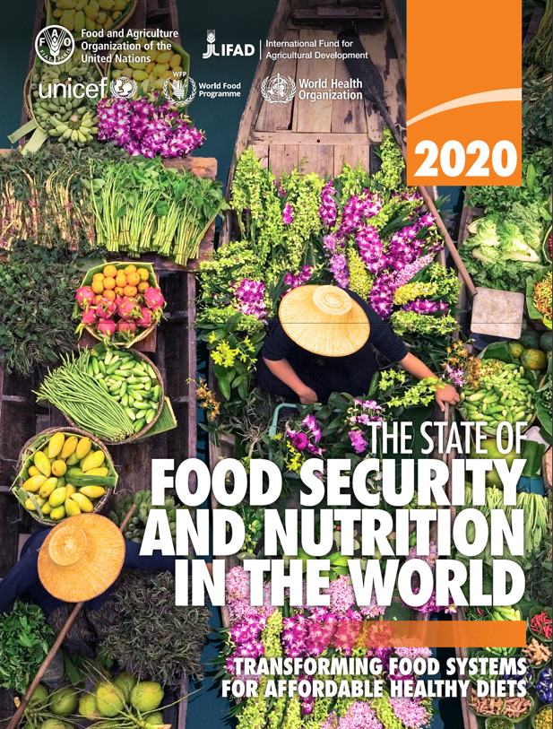
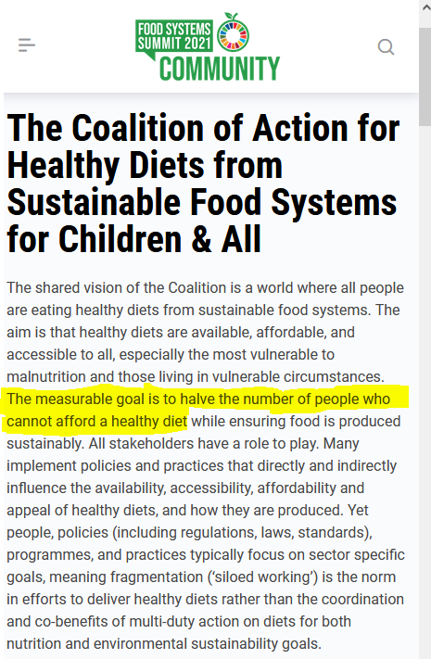
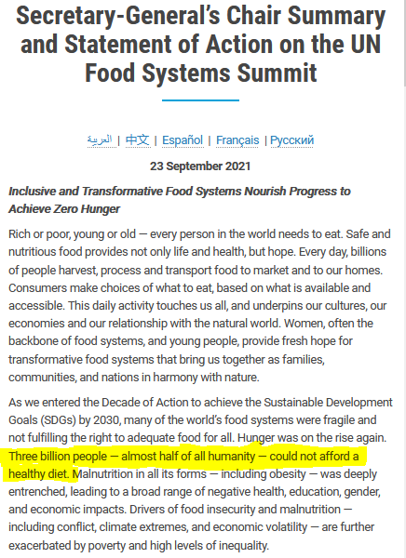
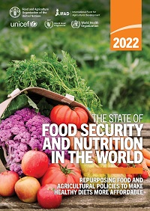
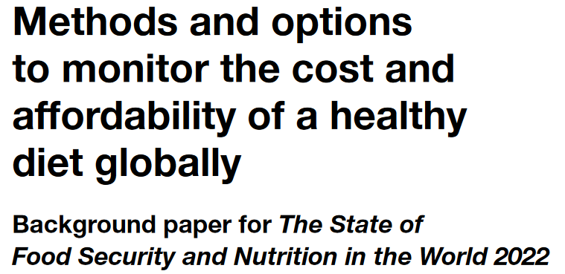
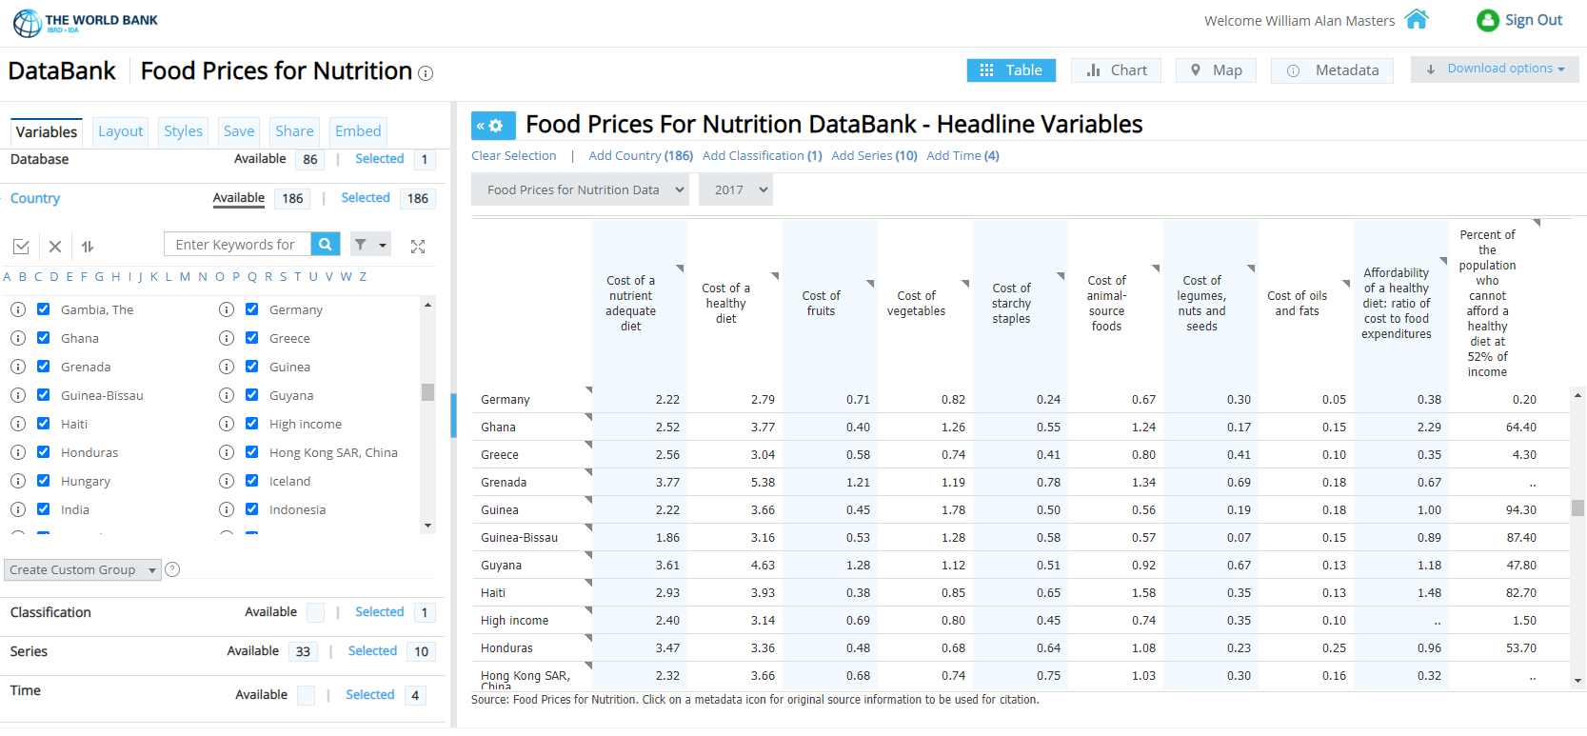
What is the
Food Prices for Nutrition project?
A four-year, $3m project led by Tufts, World Bank and IFPRI, funded by the Bill & Melinda Gates Foundation and UKAid, to scale up use of least-cost diets as a new price index for access to healthy foods in priority countries and worldwide
These data provide actionable new targets, as in the UN Food Systems Summit of 2021
Global use driven by SOFI 2020, from FAO, IFAD, UNICEF, WFP and WHO
Updates for monitoring used for SOFI 2022 and our World Bank DataHub
launched in July 2022
Source: UN Food System Summit (New York: United Nations): https://www.un.org/en/food-systems-summit/news/making-food-systems-work-people-planet-and-prosperity; https://foodsystems.community/coalitions/the-coalition-of-action-for-healthy-diets-from-sustainable-food-systems-for-children-all
Source: https://databank.worldbank.org/Food-Prices-For-Nutrition-DataBank---Headline-Variables/id/4608e28f

Slide 11
FPN project findings in one slide
We can now measure food access using least-cost healthy diets worldwide
Standardized data & methods, from SOFI 2020-2022 and new DataHub hosted by the WB
retail prices for thousands of items: from ICP, national CPI item lists, and international EWS data
global standards for diet quality: nutrients, plus food-group adequacy to meet dietary guidelines
matched to food composition, then select least-cost items per calorie at each place to meet global standards
We find that:
real costs per day are similar around the world, typically in the range of US$3-4 per day
for the 3 billion who cannot afford this, key barrier is lack of access: need supply & safety nets
remaining 4.9 b. could buy healthy items, barriers are meal preparation and displacement by other foods
We have just begun to address non-market aspects of diet costs
Major role for time use, cooking fuel and equipment for meal preparation
Full cost of home-cooked meals is more than ingredients, driving displacement of healthy items by other foods
Externalities have less impact on least-cost items than preferred foods
Least-cost items tend to have low use of energy and land (also often water) as well as labor & capital
Many opportunities for least-cost diets to complement demand analysis
New methods provide a cost index of foods for health, which differs from consumer preferences

Slide 12
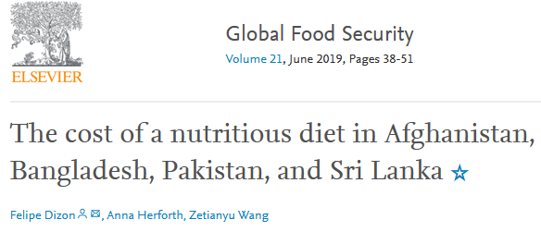
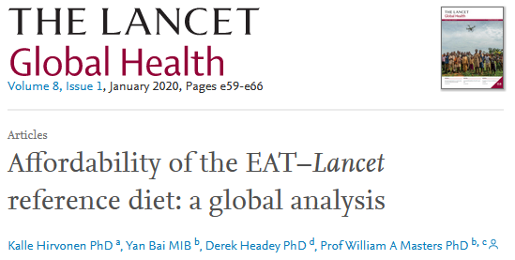
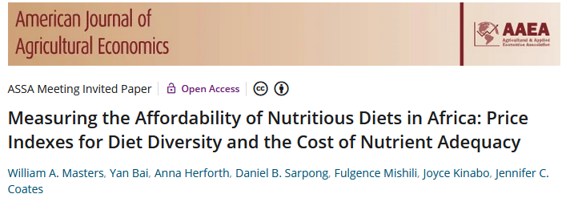
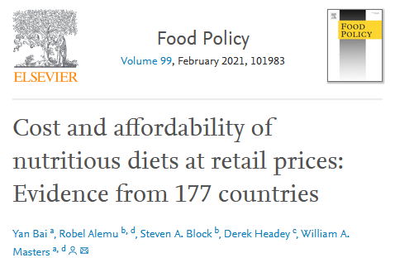
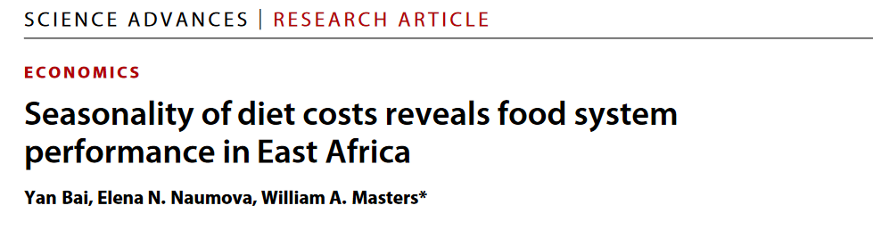
FPN project methods in one slide
We use least-cost diets as a new kind of food price index, counting the cost of food as an input to health
Both nutrients and food groups are important for healthy diets
Results help guide policies and programs by
-- distinguishing unaffordability from other barriers to healthy eating
-- guiding intervention to universal access via lower costs and safety nets
 |  |  | Food preferences, convenience and other goals (including food security, diet diversity, sustainability, equity and inclusion)
 | Caloric adequacy (short-term subsistence)
For actual food choice among affordable options, observed demand systems often displace healthy items with other foods
 |  |  | Healthy diets Meets national dietary guidelines by food group
 |  | Nutrient adequacy Avoids deficiency or excess of essential macro- and micronutrients
 | Daily energy Meets only calorie needs, for short-term survival and physical work
For SOFI 2022, the updated standard for the Cost of a Healthy Diet (CoHD) is a “Healthy Diet Basket” of 11 items in 6 food groups
For SOFI 2020, we used dietary guidelines for the Cost of Recommended Diets (CoRD)
Our AJAE 2018 article introduced a Cost of Diet Diversity (CoDD) metric
for comparison to cost of nutrients
Source: Food Prices for Nutrition (2022). https://sites.tufts.edu/foodpricesfornutrition

Slide 13
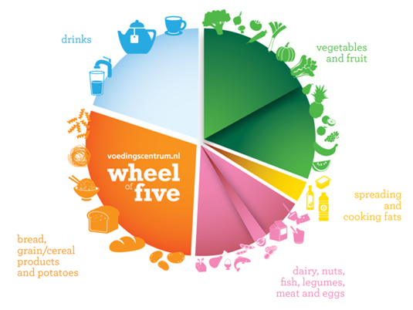
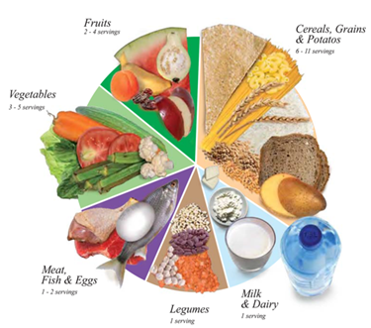
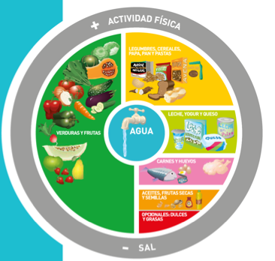
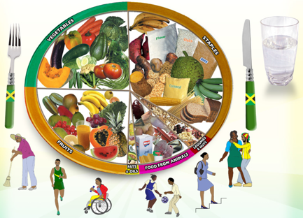
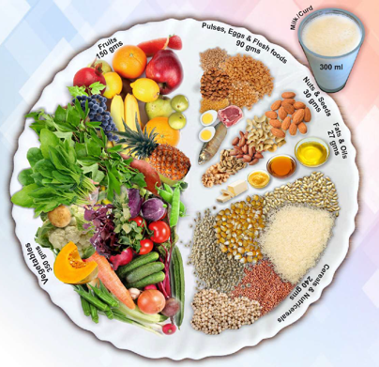
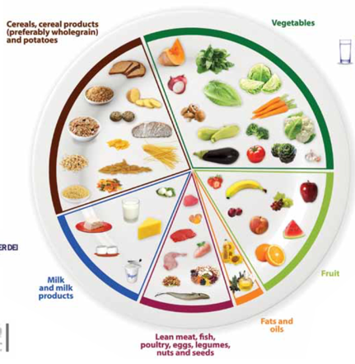
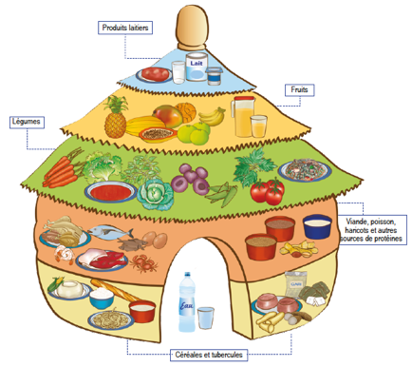
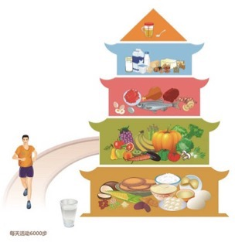
How do we define healthy diets to measure their cost
and affordability?
Use national dietary guidelines, in terms of food groups
Meet target quantities of each food group needed for a healthy diet
Allow substitution within energy balance, by converting volume and weight to calories
Guidelines differ in details, but food group requirements are similar
For SOFI 2020, used median cost of meeting 10 quantified guidelines from all UN regions
Now we use a single Healthy Diet Basket derived from 31 guidelines with food guides
Meeting targets for 6 food groups leads to nutrient-adequate diets within most guidelines
Quantities of food in the healthy diet
Typical weight (grams) | Typical volume (plate share)
322g dry rice | 25%
270-400g veg. | 25%
230-300g fruits | 25%
210g egg | 25%
85g dry bean
34g oil
Definition of the Healthy Diet Basket
Food group | Number of items | Total energy (kcal)
Starchy staples | 2 | 1,160
Vegetables | 3 | 110
Fruits | 2 | 160
Animal-source foods | 2 | 300
Legumes, nuts & seeds | 1 | 300
Oils and fats | 1 | 300
Total: 2,330

Slide 14
What are least-cost items for healthy diets, in practice?
Examples of actual least-cost healthy diet baskets in selected countries, using item prices from 2017 ICP data
Senegal |  |  |  | Pakistan |  |  |  | Italy
Item name | Qty (g/day) | Cost (USD/day) |  | Item name | Qty (g/day) | Cost (USD/day) |  | Item name | Qty (g/day) | Cost (USD/day)
Maize grains, white | 161 | 0.19 |  | Wheat flour | 161 | 0.19 |  | Wheat flour | 161 | 0.08
Rice, 25% broken | 164 | 0.22 |  | Maize | 161 | 0.22 |  | Pasta, short | 158 | 0.15
Onions, fresh | 108 | 0.23 |  | Onions, fresh | 108 | 0.19 |  | Carrots, fresh | 106 | 0.20
Carrots, fresh | 106 | 0.24 |  | Carrots, fresh | 106 | 0.21 |  | Onions, fresh | 108 | 0.21
Aubergine, fresh | 173 | 0.33 |  | Water spinach | 103 | 0.23 |  | Cabbage, fresh | 173 | 0.48
Dates, dried | 29 | 0.17 |  | Bananas | 89 | 0.39 |  | Bananas | 89 | 0.30
Mangoes, fresh | 132 | 0.25 |  | Coconut, green | 49 | 0.52 |  | Apples, fresh | 152 | 0.51
Sardines, dried | 36 | 0.12 |  | Buffalo milk, raw | 149 | 0.41 |  | Milk, whole UHT | 227 | 0.34
Small fish, dried | 36 | 0.25 |  | Chicken, live | 68 | 0.58 |  | Chicken, whole froz. | 68 | 0.43
Groundnuts, whole | 51 | 0.12 |  | Dhal, musur | 82 | 0.33 |  | Beans, dry white | 86 | 0.26
Palm oil | 33 | 0.19 |  | Vegetable oil | 34 | 0.19 |  | Sunflower oil | 33 | 0.06
Total cost (USD/day) |  | 2.29 |  | Total cost (USD/day) |  | 3.44 |  | Total cost (USD/day) |  | 3.02
Starchy staples
Starchy staples
Starchy staples
Vegetables
Vegetables
Vegetables
Fruits
Fruits
Fruits
Animal-sourced foods
Animal-sourced foods
Animal-sourced foods
Pulses, nuts and seeds
Pulses, nuts and seeds
Pulses, nuts and seeds
Oils and fats
Oils and fats
Oils and fats

Slide 15
How does the healthy diet basket relate to actual food consumption?
Shortfalls below healthy diet basket targets by income level in a global demand system (kcal/person/day)
No deficit, all HDB targets met
Lipids use reaches HDB target around $7k/yr
ASF use reaches HDB target around $3k/yr
Dietary transition displaces healthy diet basket foods after $15k/yr
Global deficit for the poorest is 580 kcal/day of healthy foods, that they now get from cheaper starchy staples
Adequacy of actual intake rises to just 300 kcal/day below target, then falls due to displacement by less healthy foods at higher incomes
Income per person ($US2022 /year )
Note: Adapted from W.Martin and W.A. Masters (2022), “Consumer demand for healthy diets: Modeling the impact of food access on consumption in low-, middle- and high-income countries”.
Food Prices for Nutrition project working paper, in progess. Data shown are projections using a MAIDADS demand system, originally estimated from FAO Food Balance Sheet data by Gouel and Guimbard (2019).

Slide 16
Use of healthy diet basket foods is influenced by displacement across the dietary transition
Excesses and deficiencies relative to healthy diet basket targets by income level (kcal/person/day)
Bennett’s law: starchy staple use shrinks rapidly
ASFs + oils & fats overshoot and displace healthy foods
Everyone loves sugar, but use changes little
Veg. & fruits and pulses, nuts & seeds
remain under HDB targets at all incomes
Actual intake of healthy diet basket foods rises towards adequacy, then falls with dietary transition
Note: Adapted from W.Martin and W.A. Masters (2022), “Consumer demand for healthy diets: Modeling the impact of food access on consumption in low-, middle- and high-income countries”.
Food Prices for Nutrition project working paper, in progess. Data shown are projections using a MAIDADS demand system, originally estimated from FAO Food Balance Sheet data by Gouel and Guimbard (2019).

Slide 17
Diet costs differ but least-cost diets are not less expensive in poorer countries

Slide 18
Diet costs differ but least-cost diets are not less expensive in poorer countries and cost has risen almost everywhere
Real costs relative to income
rose even more in 2021 and 2022
2017 (dots)
2017

Slide 19
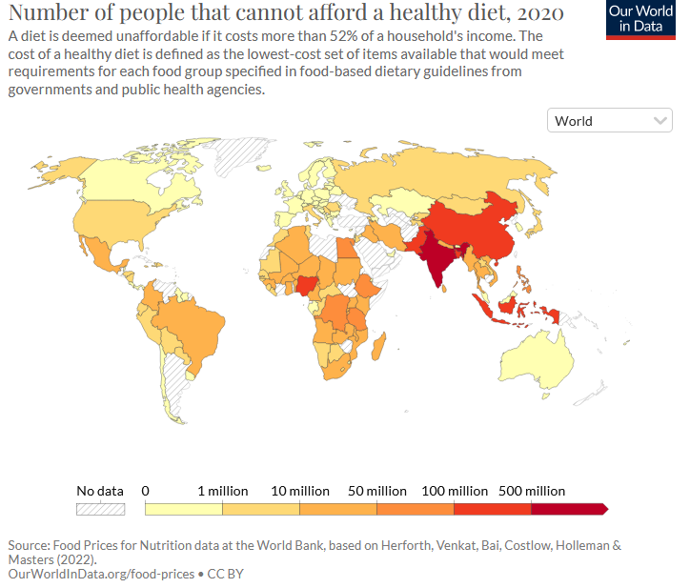
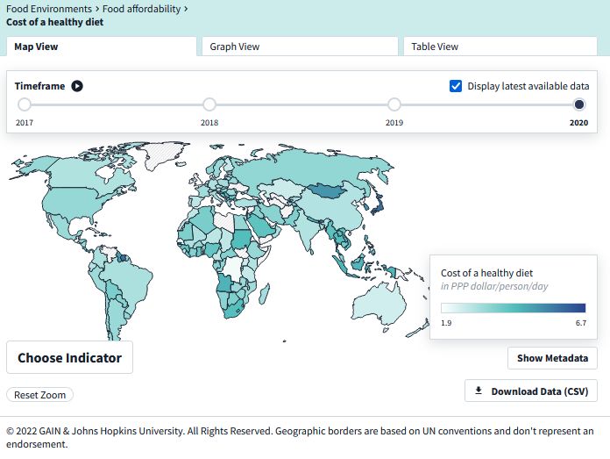
Our global results are now widely used
Source: Food Prices for Nutrition DataHub at WorldBank.org (July 2022)
https://www.worldbank.org/en/programs/icp/brief/foodpricesfornutrition,
https://databank.worldbank.org/source/food-prices-for-nutrition
Source:.https://ourworldindata.org/food-prices
Source: https://www.foodsystemsdashboard.org/indicators/cost-of-a-healthy-diet-co-hd/map

Slide 20
The cost of nutrient adequacy varies by demographic group, due to different requirements
Variation in least-cost diets by age, sex and reproductive status across 172 countries in 2017
Cost per day is highest for adolescents or during lactation, due to high needs for total energy and nutrients
Cost per calorie is highest for girls and women, due to high nutrient needs per unit of dietary energy
Source: Bai, Herforth and Masters, 2022. Global variation in the cost of a nutrient-adequate diet by population group. Lancet Planetary Health 6(1): 19-28.
Notes:
Cost is higher for some than others

Slide 21
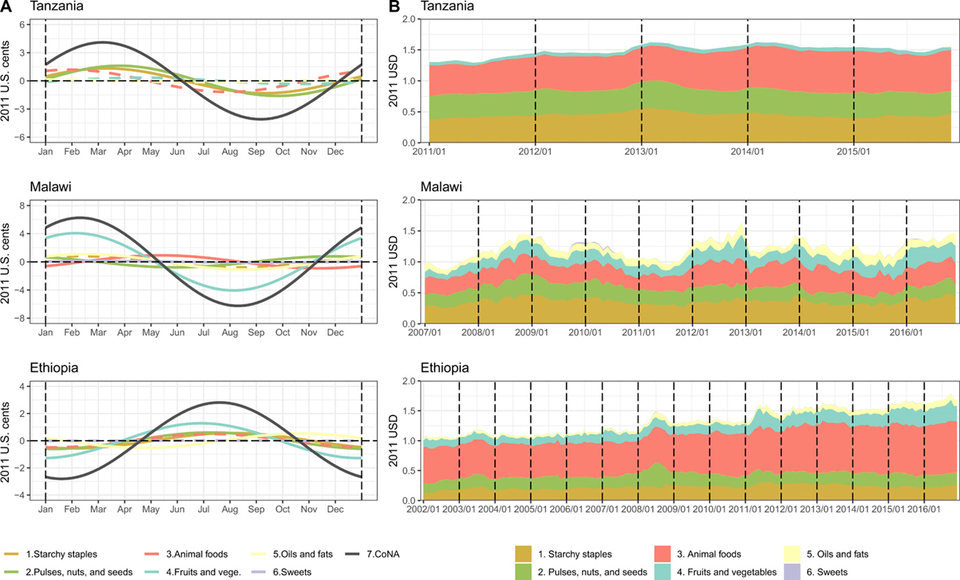
Diet costs differ by location within countries with important seasonality especially in remote places
Energy shares of least-cost diets
Seasonality of diet costs and cost by food group in Tanzania, Malawi and Ethiopia
Source:
Bai, Y., E. Naumova and W.A. Masters (2020). Seasonality in diet costs reveals food system performance in East Africa. Science Advances, eabc2162.
Notes:
Innovations for reduced seasonality of perishable items; and need for social safety nets as well.

Slide 22
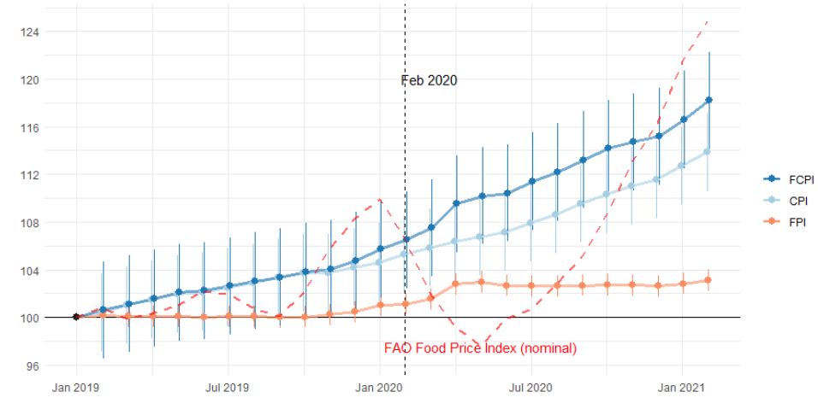
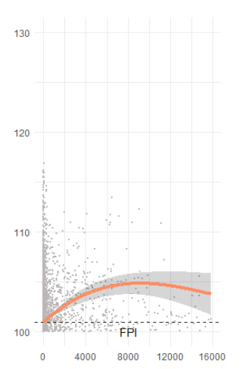
COVID impacts are mostly on income, but may include higher food prices
Monthly change in global consumer price indexes for food versus other items
(180 countries, Jan. 2019 – Feb. 2021)
Association with
cumulative COVID case counts
Larger (5%)
rise in countries
with higher case counts
3% rise in real food CPI since March 2020
(and does not follow commodity prices)
Source: Bai, Y. et al. (2022), Retail prices of nutritious food rose more in countries with higher COVID-19 case counts. Nature Food, 3: 325–330. (May 19, 2022)
Notes:
Could replace with slides from Ash on extreme weather

Slide 23
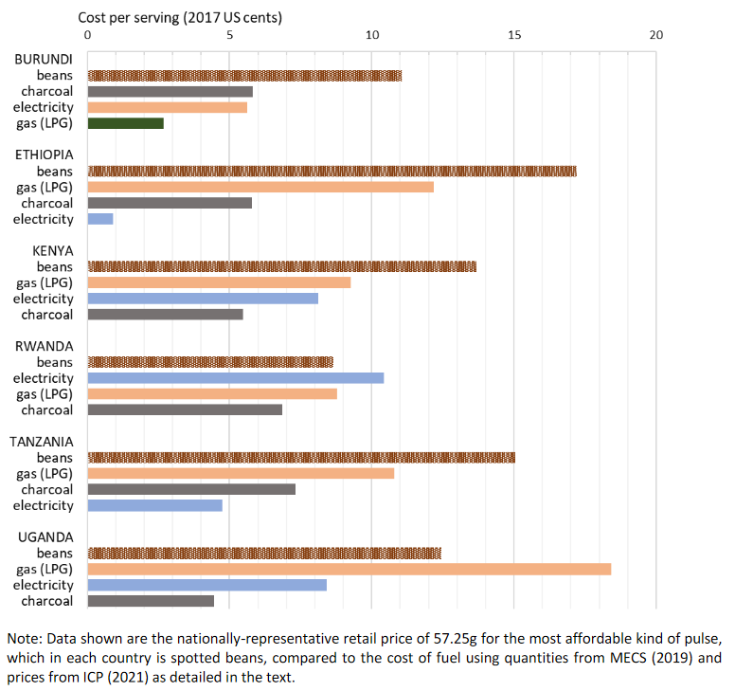
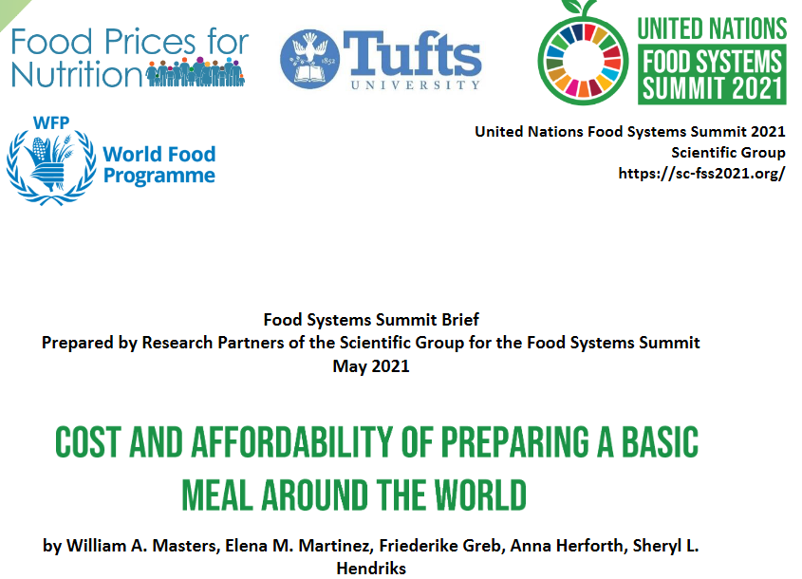
New frontiers include the cost of meal preparation and cooking
Cost per serving of cooking fuel, relative to the cost of dried beans in E. Africa
Source: Masters WA, Martinez EM, Greb F, Herforth A, Hendriks SL (2021). Cost and Affordability of Preparing a Basic Meal around the World. UN Food System Summit Scientific Group Partners’ Brief (23 pages), available online at https://sc-fss2021.org/materials/fss-briefs-by-partners-of-scientific-group
Notes:
Prompt discussion about low-cost sustainable cooking

Slide 24
We also need new data on externalities and true cost accounting
A more complete accounting framework for non-market costs and benefits
Examples of externalities in the food system
Domains of external costs and benefits
 | External Costs | External Benefits
Farm production of crops and livestock | GHG emissions, water depletion, antimicrobial resistance | Rural development, ecosystem services
 | Wage theft and mistreatment, animal welfare | Farm animal well-being, presence of traditional farms
 | Illness and accidents from occupational hazards
Food processing, storage and distribution, packaging and marketing | Landfill and pollution from food loss, packaging etc.
 | Underpayment and mistreatment of workers | Community development
 | Illness from food contamination, harmful advertising | Food safety, nutrient enrichment/fortification
Meal preparation and consumption at home and away from home | Landfill and pollution from food waste, cooking etc.
 | Time burden on caregivers | Enjoyment of food culture / traditions
 | Higher disease risk due to intake of unhealthy foods | Lower disease risk due to intake of healthy foods
Environmental
Social
Health

Slide 25
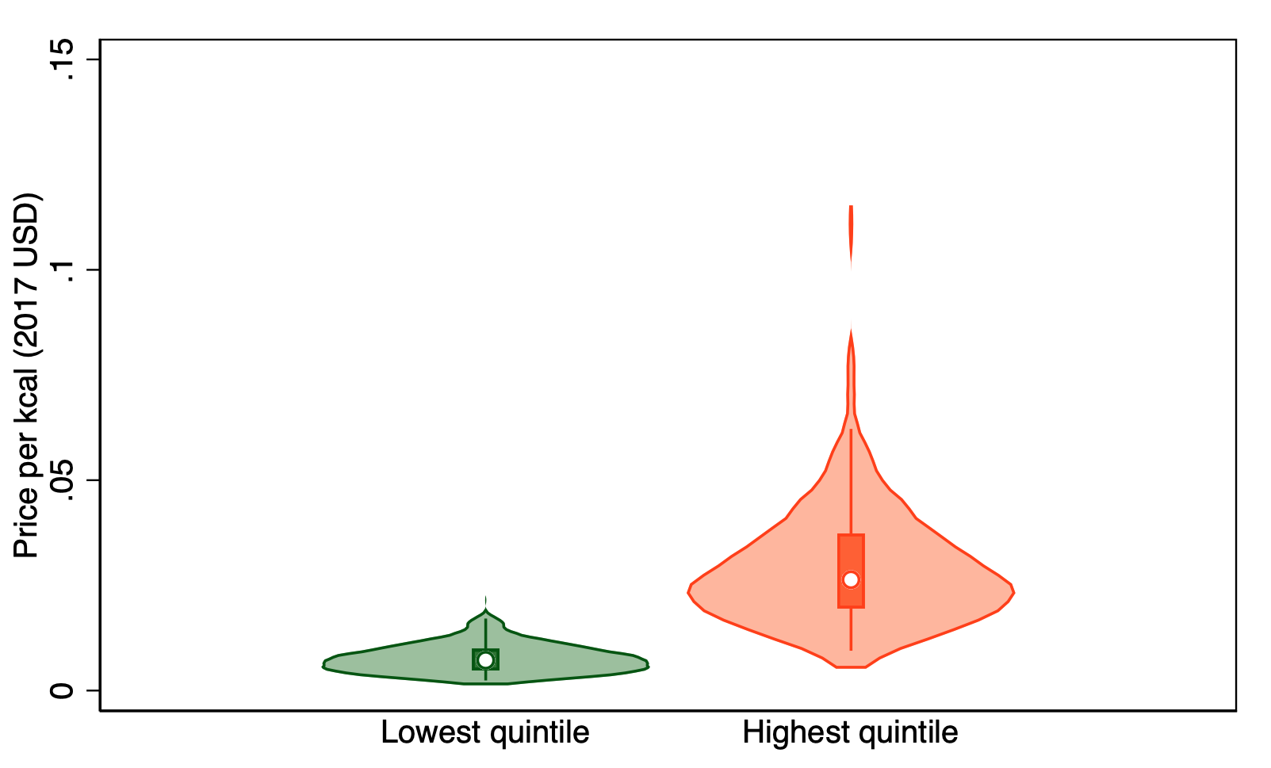
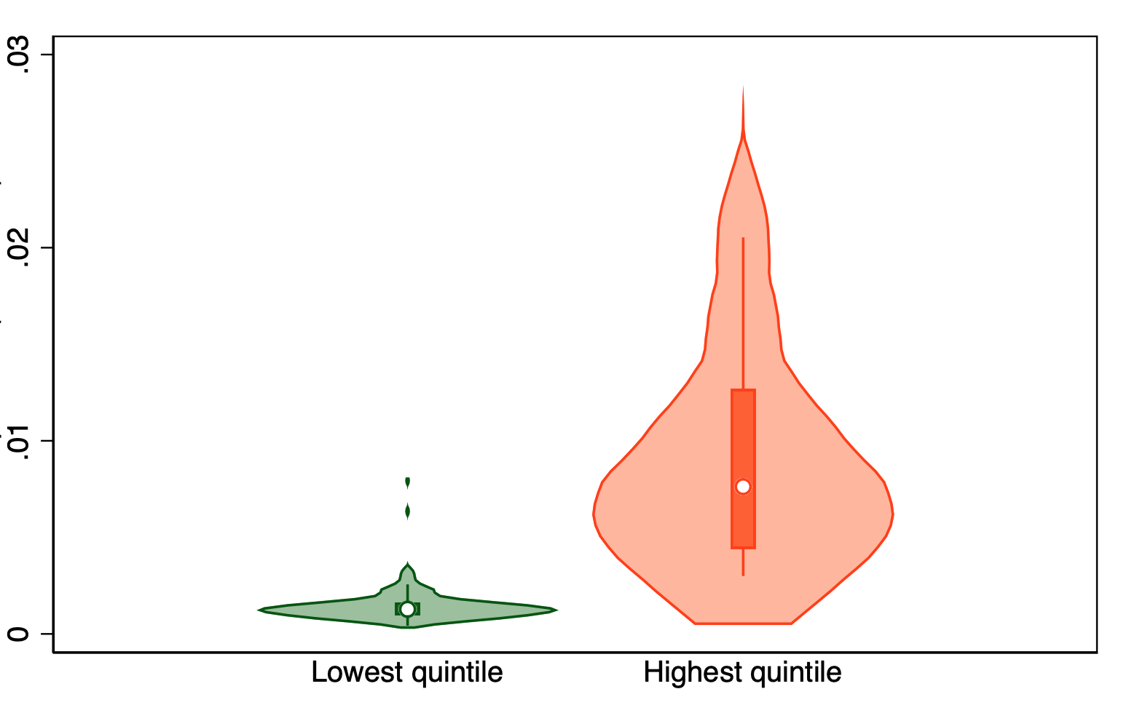
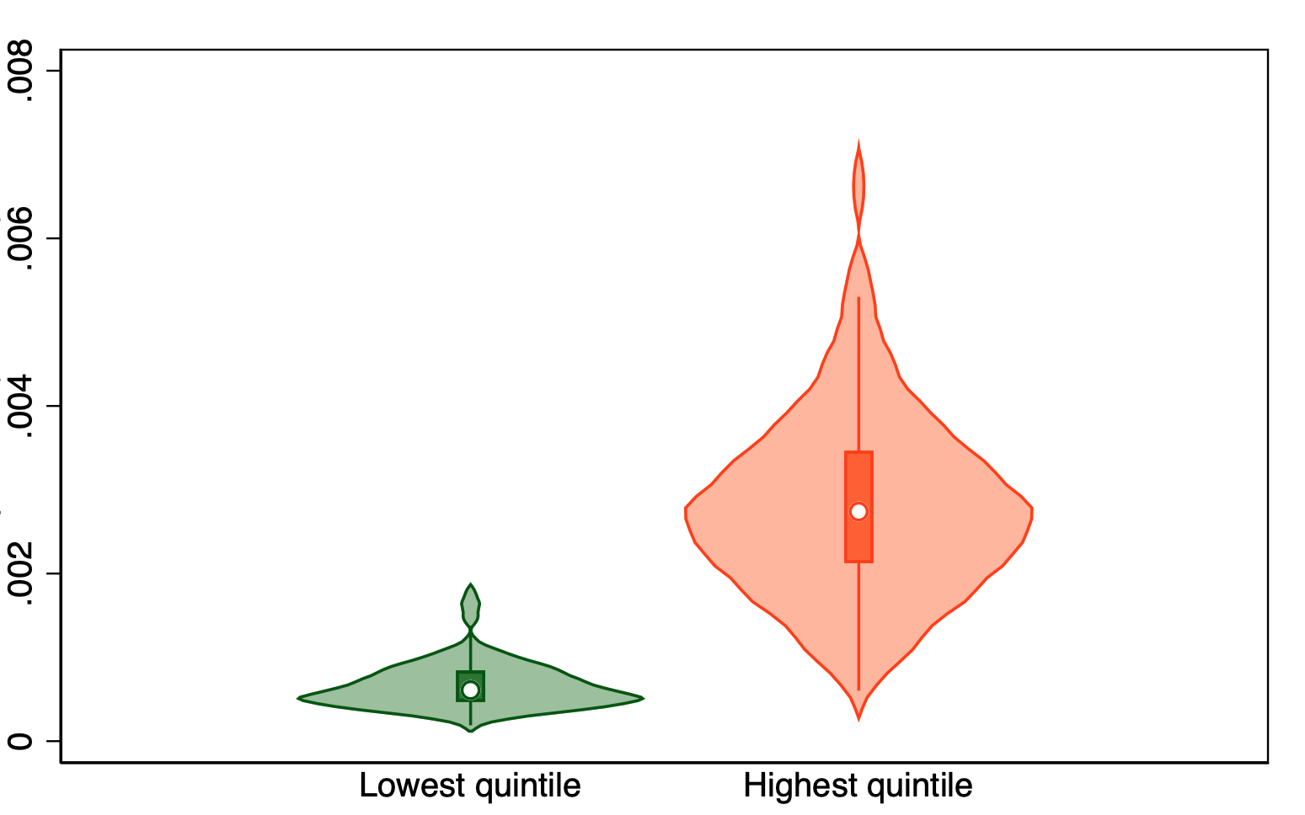
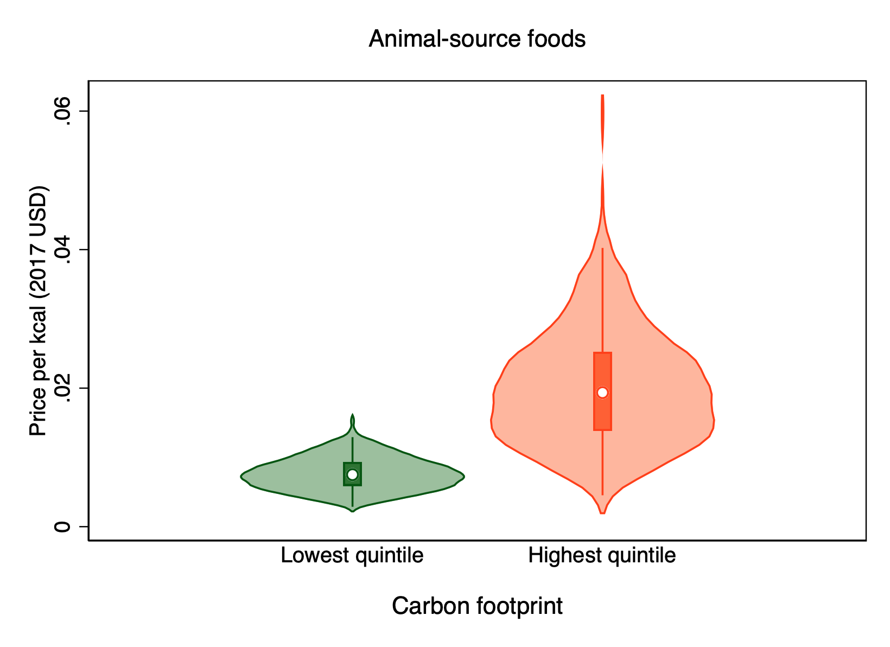
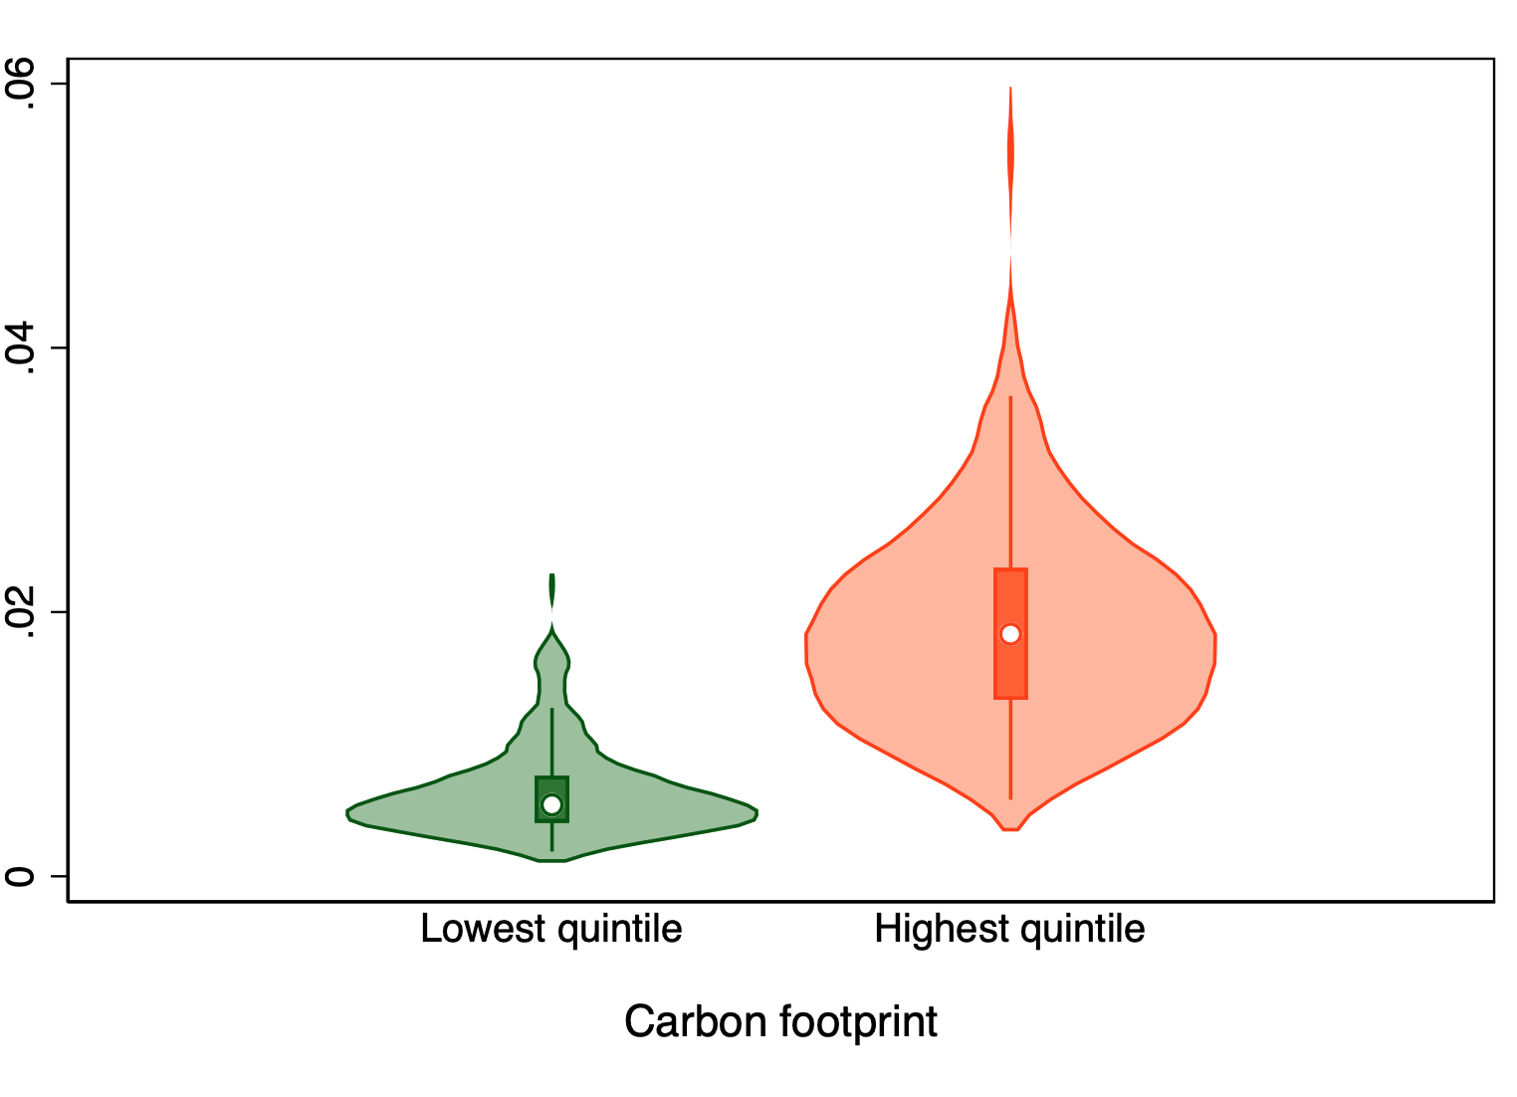
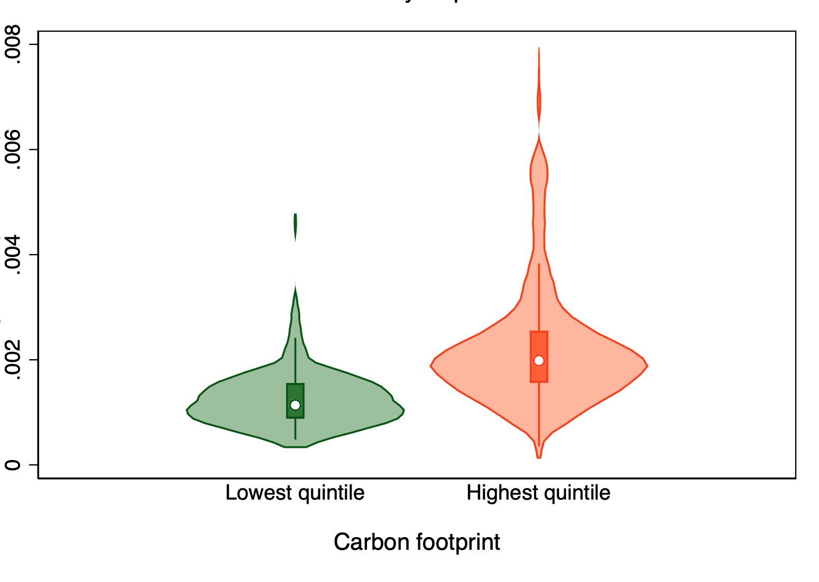
Initial results show that foods with lower emissions have lower prices
Cost of items by level of CO2-equivalent emissions (USD/kcal)
Vegetables
Legumes, nuts & seeds
Oils & fats
Animal-source foods
Starchy staples
Fruits
Source: Elena Martinez and William A. Masters (2022), in preparation.

Slide 26
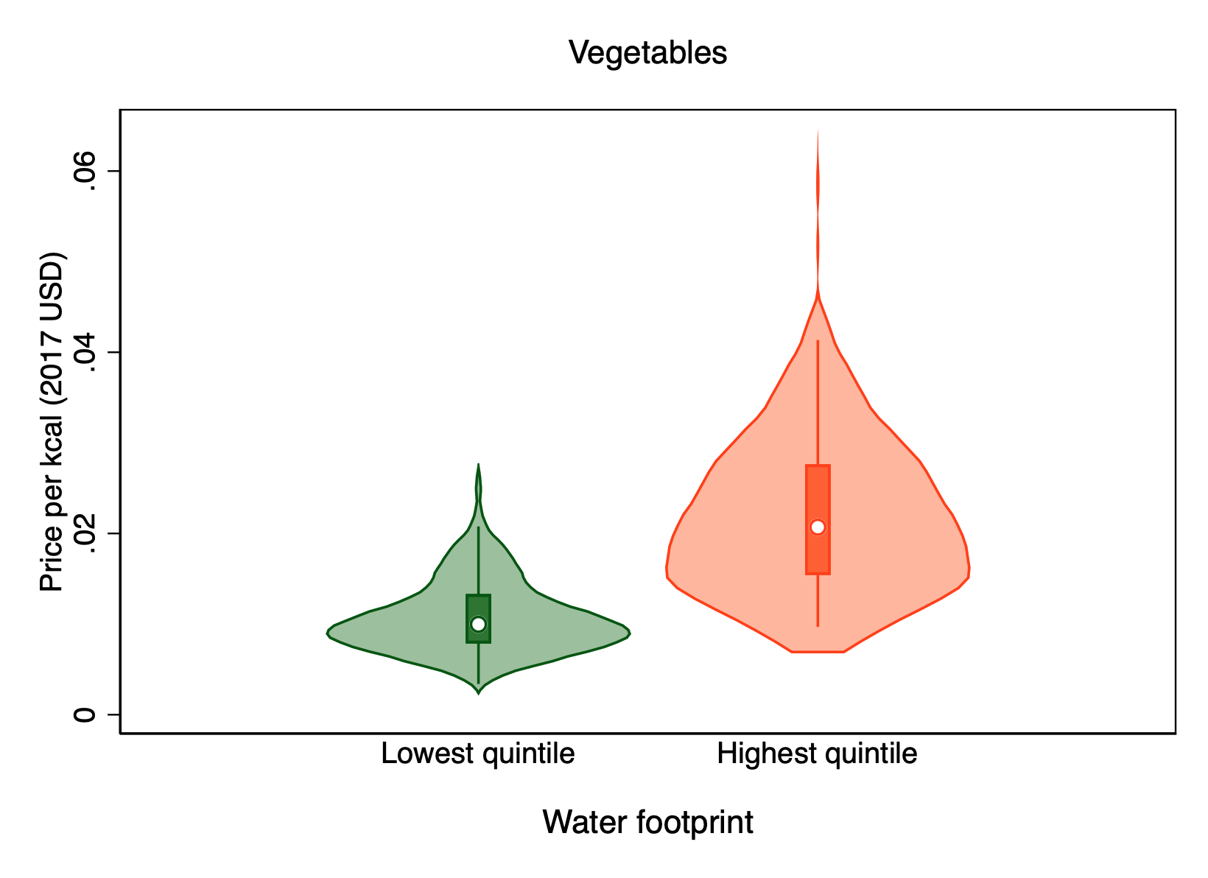
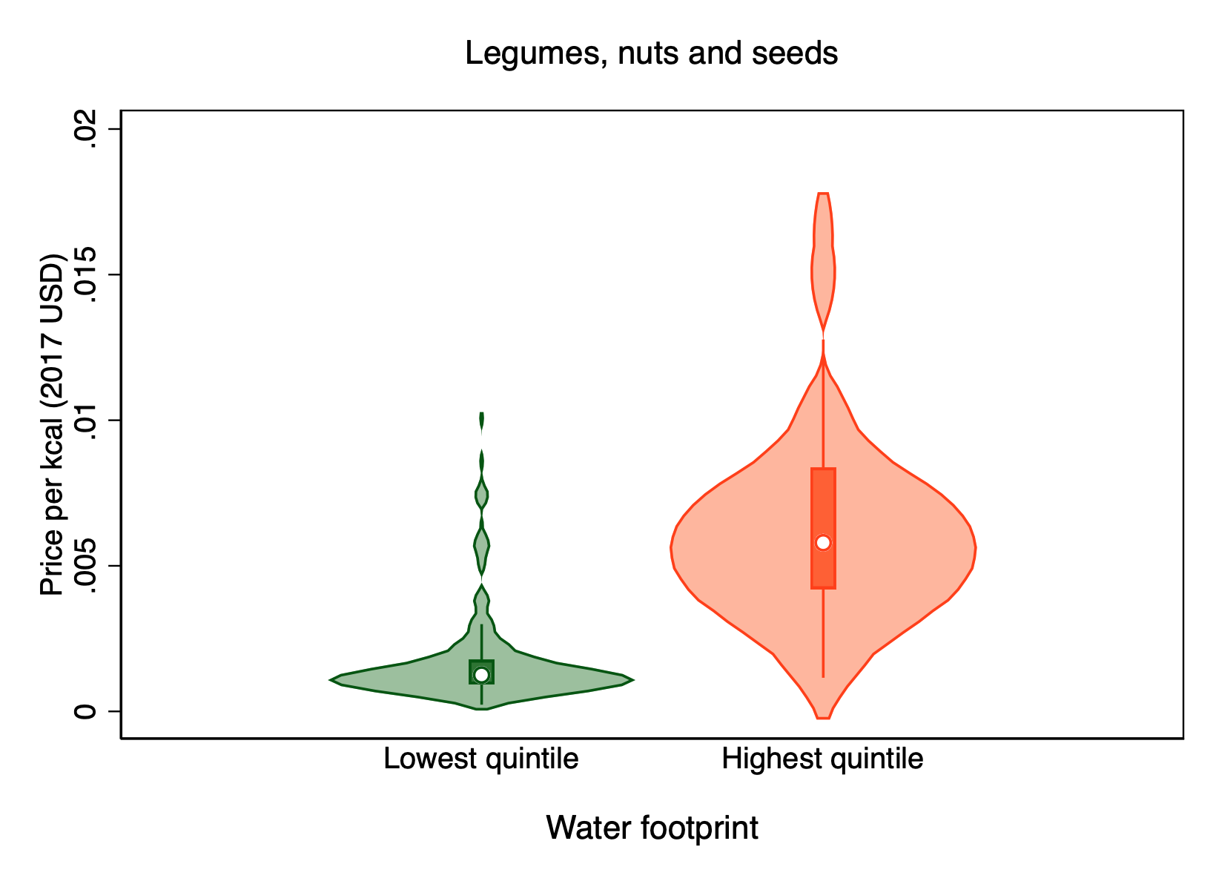
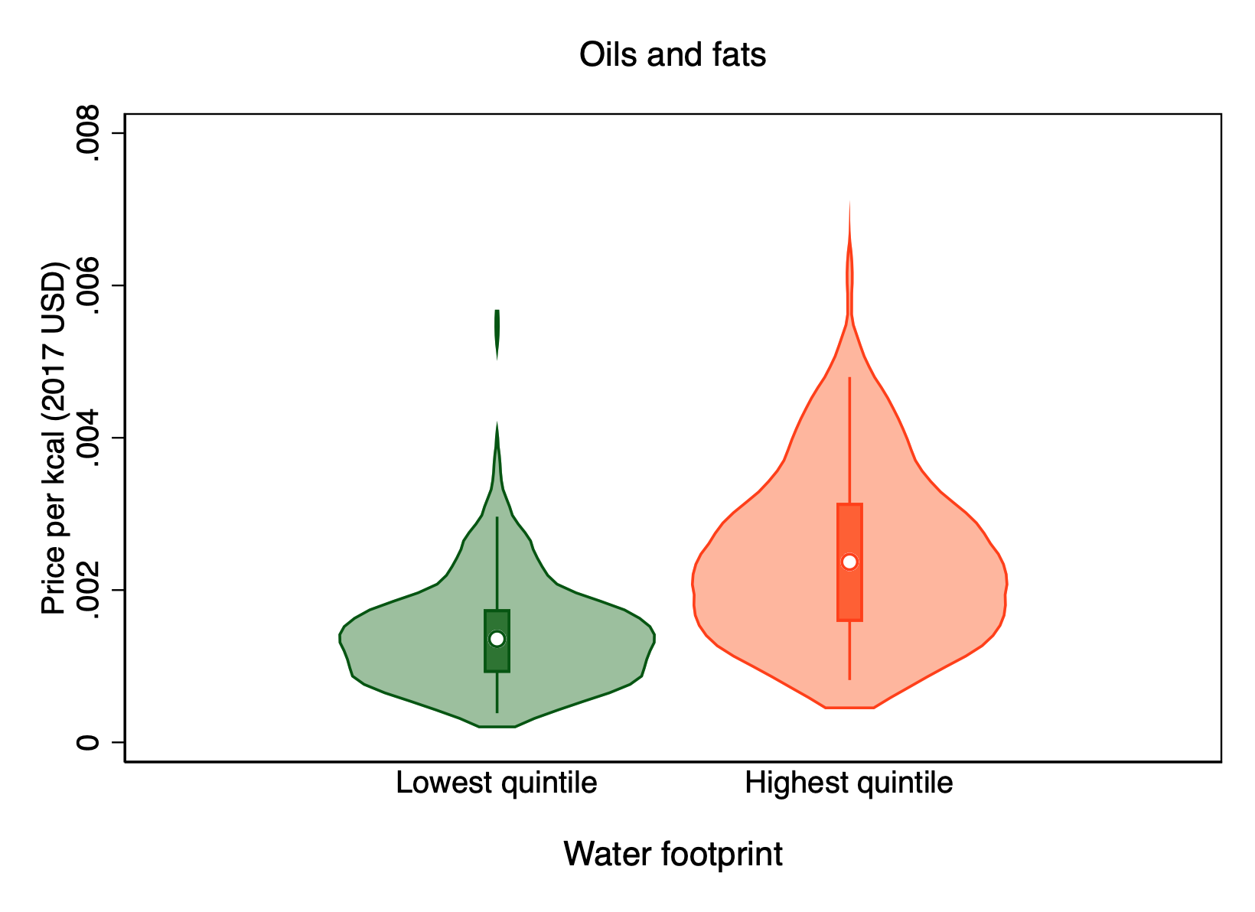
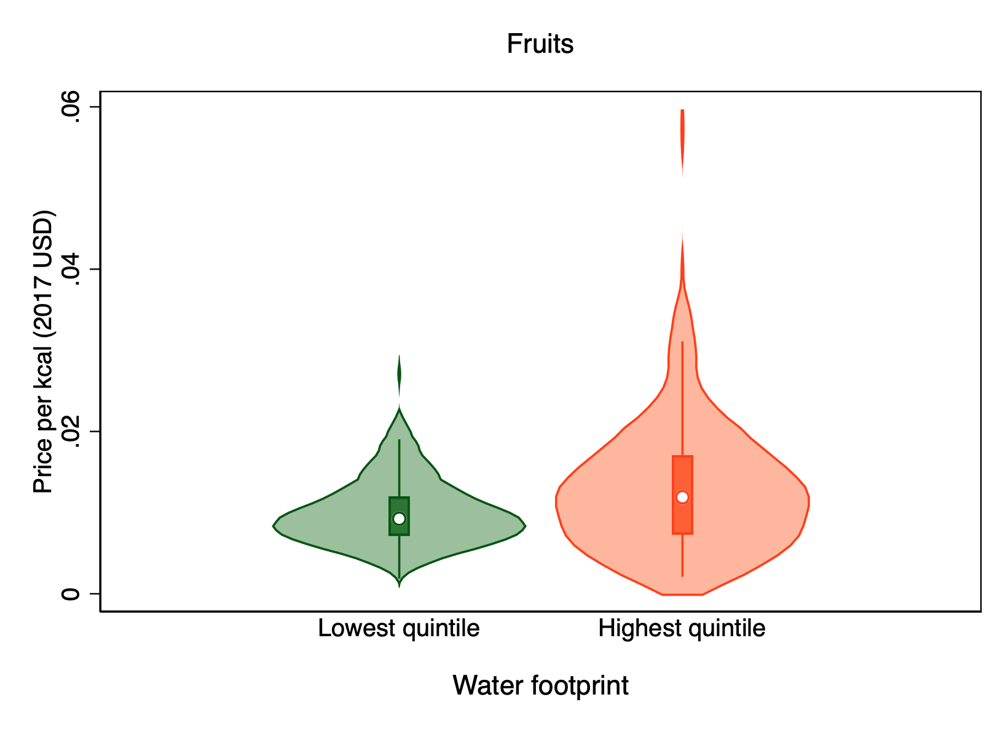
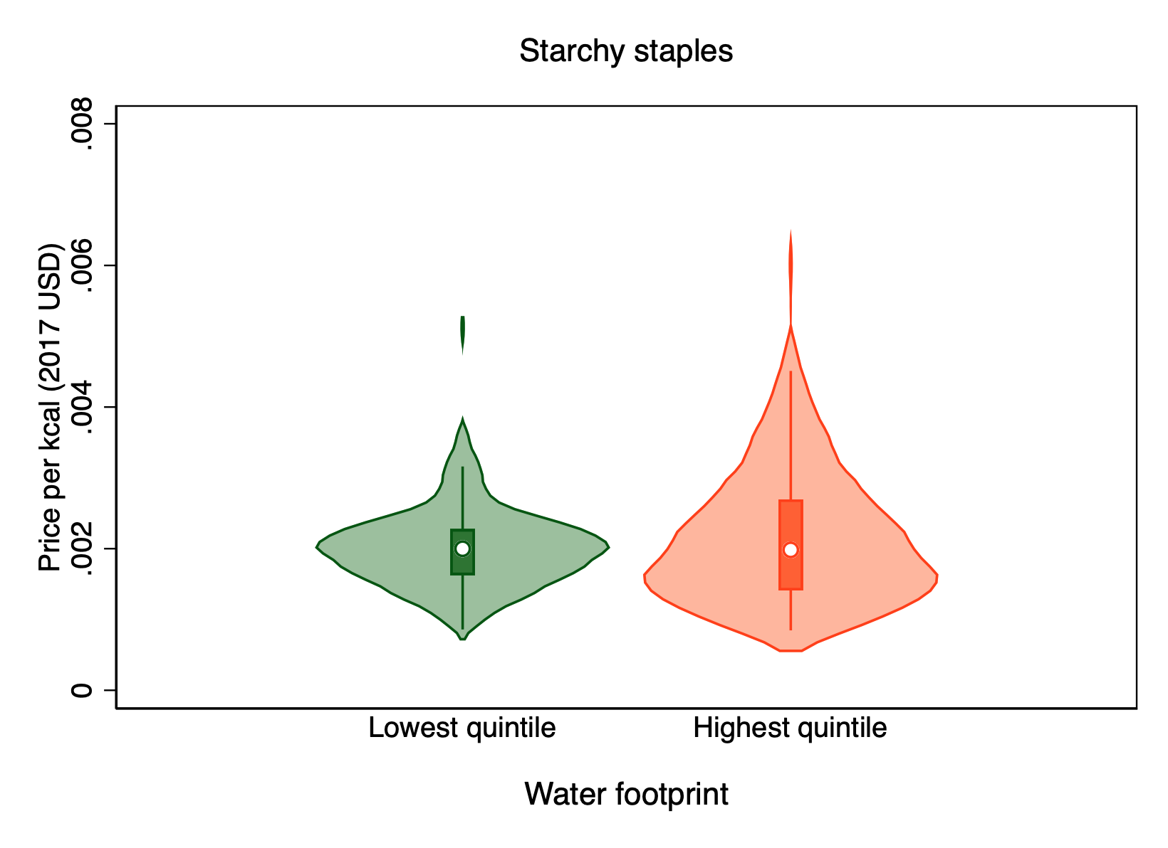
Foods with lower water use also have lower prices, but only in some food groups
Cost of items by level of water use (USD/kcal)
Legumes, nuts & seeds
Oils & fats
Vegetables
Animal-source foods
Starchy staples
Fruits
Source: Elena Martinez and William A. Masters (2022), in preparation.

Slide 27
Conclusion:
Least-cost healthy diets are a helpful complement to demand analysis
For many people (3 billion, 40% of world) healthy diets remain beyond reach
Perishable or bulky foods more costly to grow and distribute than starchy staples, vegetable oil & sugar
Seasonality and other price volatility is an important constraint on year-round access
Affordability requires income growth and safety nets, plus food system change to lower prices
Adding sustainability criteria does not raise diet costs, because least-cost items are not resource-intensive
For most people (4.9 billion, 60% of world) healthy diets are affordable but often not chosen
Many factors beyond health drive food choice
meal preparation time (time, fuel, water, equipment), food marketing (availability and advertising)
deeply rooted preferences for animal-sourced foods, oils & fats (food culture, physiology)
Items within healthy food groups are often processed into less healthy form
added salt and sugar, removal of fiber and nutrients from whole grain, additives etc.
Adding externalities for the true price of food should be based on a complete accounting framework
Include external benefits of healthy and sustainable foods, not just environmental costs of harmful foods

Slide 28
Looking forward: What role for least-cost diets for policy monitoring and analysis
Our work so far (publications & software tools for individual countries) is at:
https://sites.tufts.edu/foodpricesfornutrition
https://worldbank.org/foodpricesfornutrition
Policy engagement through FAO and other UN agencies via the SOFI reports:
https://www.fao.org/publications/sofi
Results are also disseminated on other platforms and dashboards:
Our World in Data: https://ourworldindata.org/food-prices
Food Systems Dashboard: https://www.foodsystemsdashboard.org/indicators/cost-of-a-healthy-diet-co-hd
Research on retail prices offers many new opportunities!

Slide 29
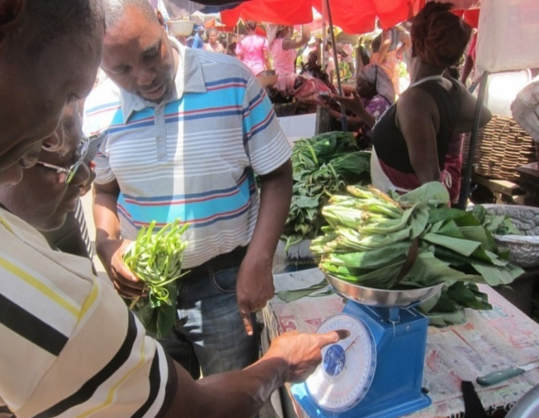
https://sites.tufts.edu/foodpricesfornutrition
Thank you!
The Food Prices for Nutrition project (https://sites.tufts.edu/foodpricesfornutrition) is conducted at Tufts University jointly with Anna Herforth, and with IFPRI (led by Derek Headey) and the World Bank (led by Nada Hamadeh, with Yan Bai and Marko Rissanen), with numerous Tufts students and staff including Robel Alemu, Leah Costlow, Rachel Gilbert, Elena Martinez, Julia Matteson, Kate Schneider, Kristina Sokourenko, Aishwarya Venkat, Jessica Wallingford, and faculty collaborators Steve Block, Shibani Ghosh, Elena Naumova and Patrick Webb. In-country studies have been led by Olutayo Adeyemi and Adeyinka Onabolu (FMARD and GAIN, Nigeria), Ajmal Jahangeer (FAO Pakistan), Stevier Kaiyatsa (Ministry of Finance, Malawi), Fulgence Mishili (Sokoine University, Tanzania), Daniel Sarpong (University of Ghana), Fantu Bachewe (IFPRI-Addis) and Kalyani Ragunathan (IFPRI-Delhi) among others.
We thank the many price collectors and contributors to other databases on which we rely and are grateful for funding to the Bill & Melinda Gates Foundation and UKAid, as well as complementary funding from FAO and USAID through the Feed the Future Nutrition Innovation Lab.
Photo by Anna Herforth
at Agbogbloshi market, Ghana

