Slide 1
https://sites.tufts.edu/foodpricesfornutrition
Access to a healthy diet: Evidence from food prices, diet costs and affordability worldwide
William A. Masters
Professor, Friedman School of Nutrition and Department of Economics
Tufts University
https://sites.tufts.edu/foodecon
November 10, 2023
J.W. Fanning lecture in Agricultural and Applied Economics, University of Georgia

Slide 2
Understanding food choice and dietary patterns in the U.S. can be informed by data on access to healthy diets worldwide
We start with revealed preferences and effective demand for each type of food
People want healthy food, but may not know how each type of food will affect them and have other goals as well
Economists explain observed dietary patterns in terms of three factors:
Prices of available foods
Incomes available for food
Choice among affordable options, driven by preferences, food culture & health beliefs, meal preparation costs etc.
Preferences must be inferred from food choice among affordable options, at each set of prices and incomes
Price and income elasticities for observed consumption, revealed through demand system estimation
Willingness to pay for different items under different circumstances, revealed by food choice experiments
…but poor diets could also be caused by lack of access, or complete unaffordability
Since 2016, our Food Prices for Nutrition project has developed least-cost modeled diets for access & affordability
Since 2020, these “Cost and Affordability of Healthy Diets” increasingly used globally and within countries
Data, results and software tools are downloadable from Tufts University, the FAO and the World Bank
Modeled diets provide benchmark of least-cost foods for health, to identify causes and remedies for unhealthy diets
If prices for least-cost locally-available items are high, need lower-cost supply and distribution to lower costs
If incomes available to buy food are too low, need better jobs or social assistance to raise affordability
If other foods are chosen that displace a healthy diet, need to address the many other factors driving food choice

Slide 3
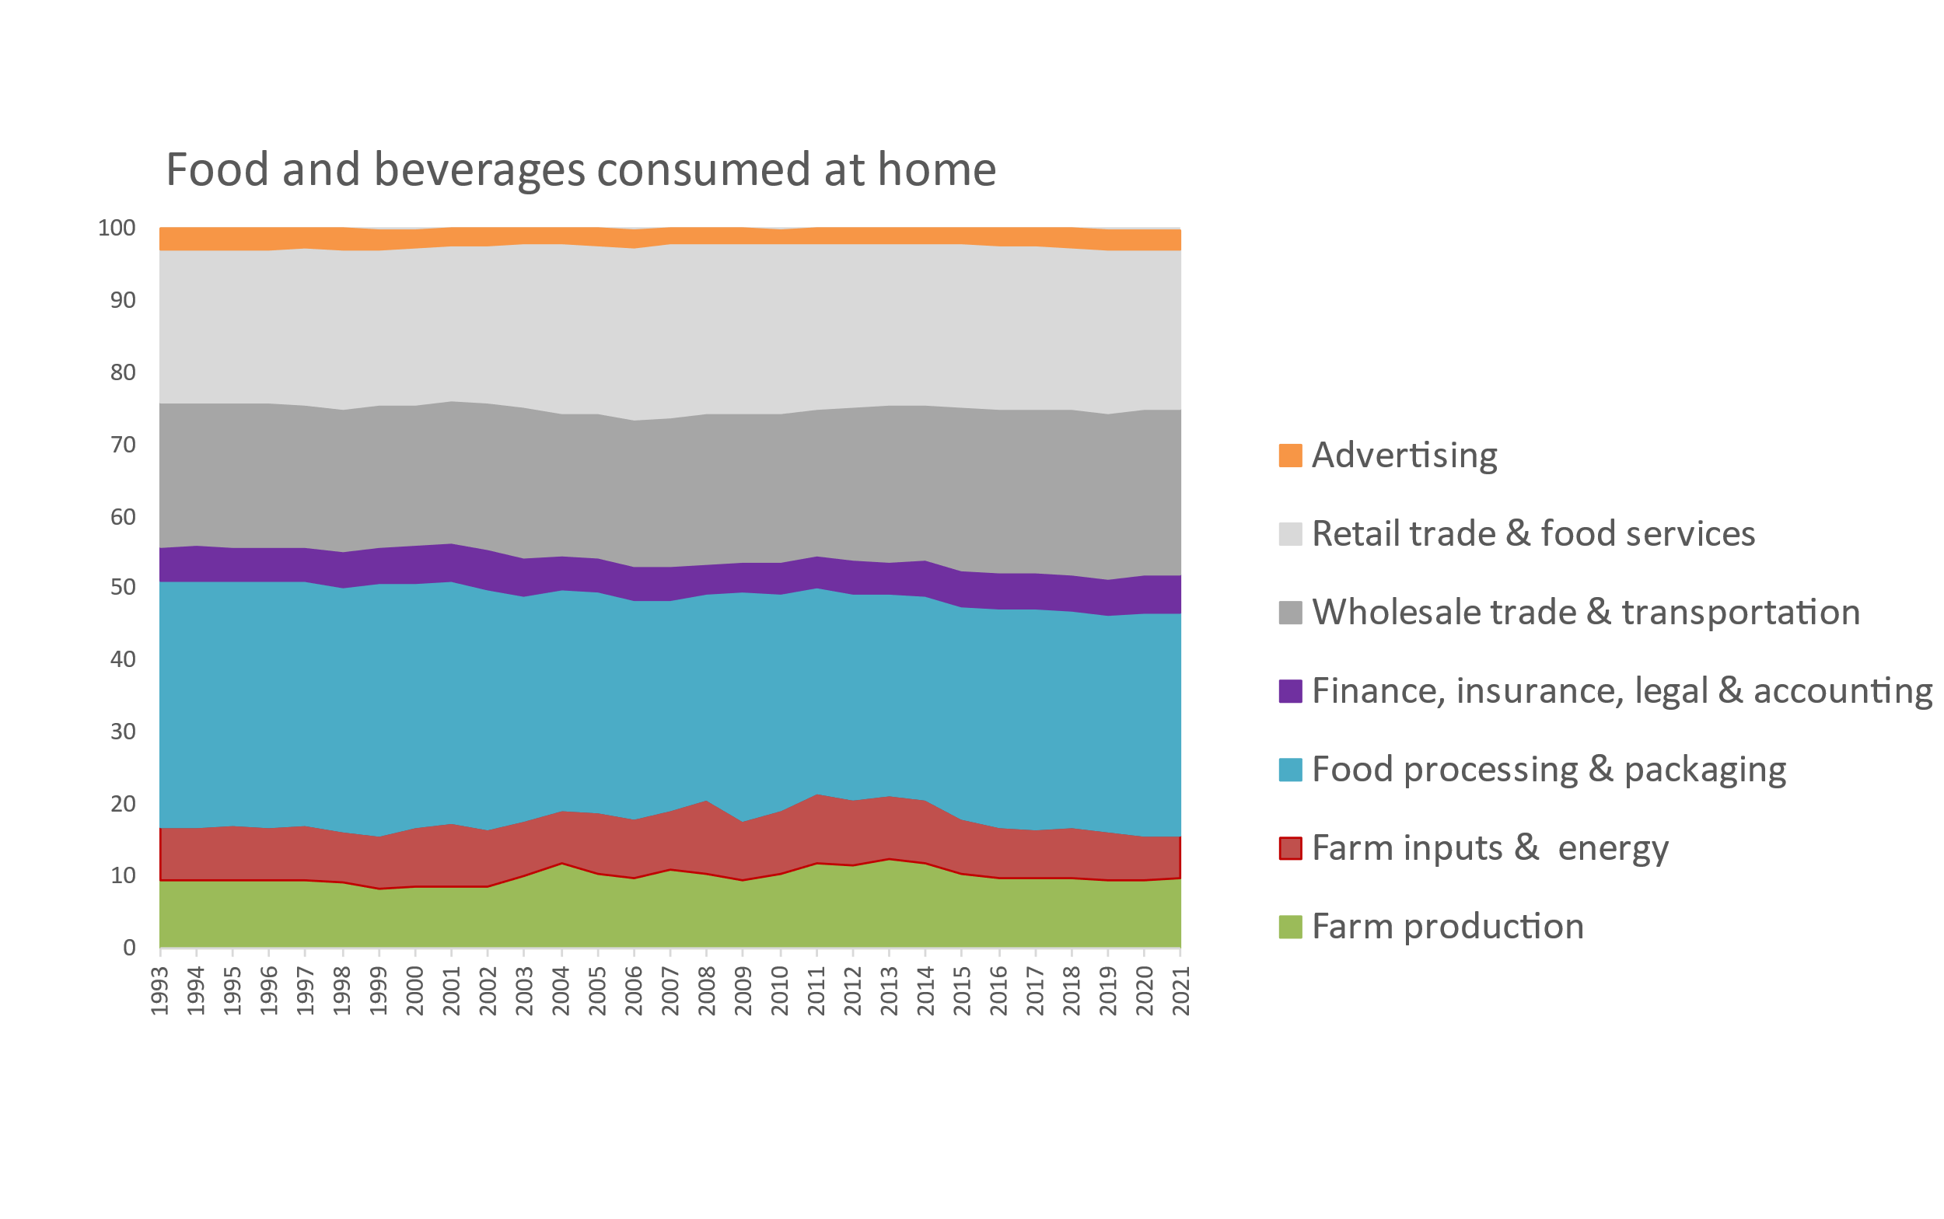
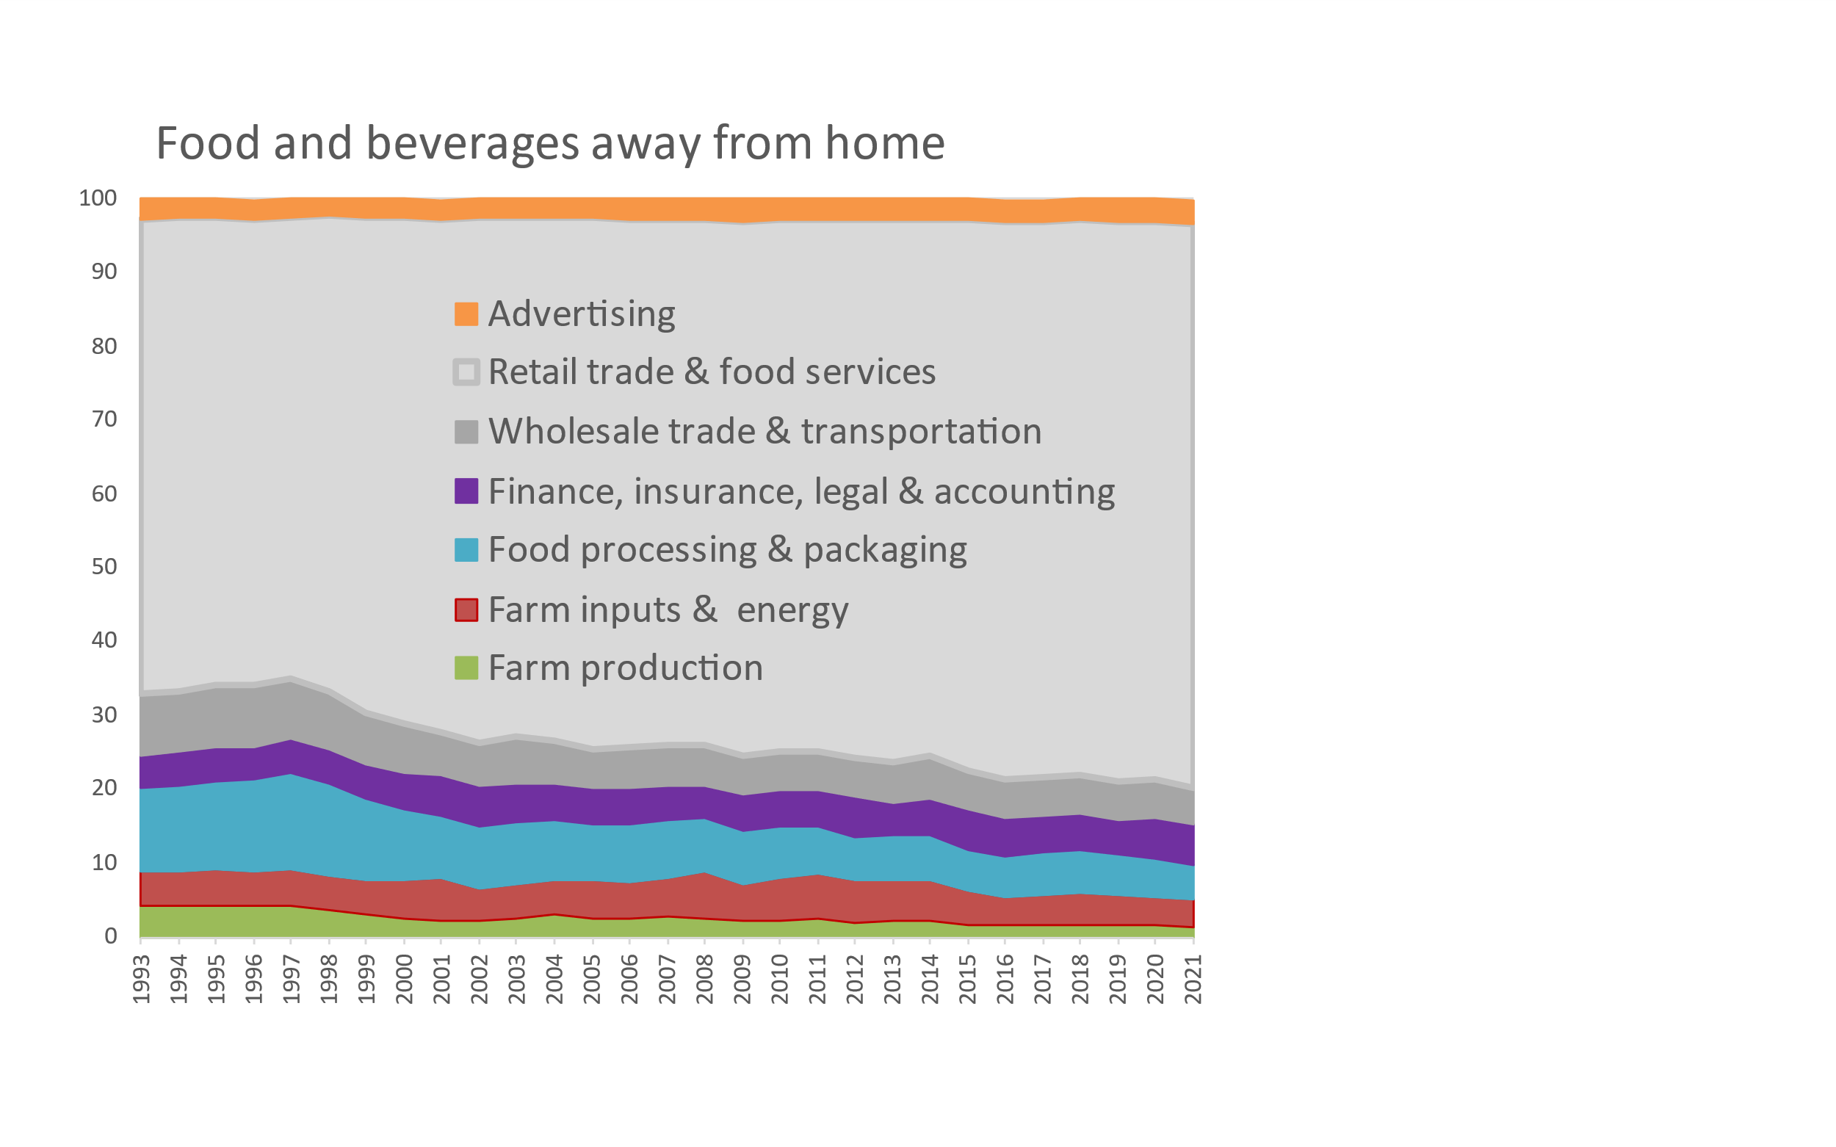
Food costs for consumers are mostly post-harvest services
Share retail food costs by stage of production and distribution in the U.S., 1993-2021
When we buy food, we pay a lot for brands & services!
Cumulative percent of consumer price
2.6%
3.4%
22.2%
76.2%
23.1%
5.3%
30.8%
5.0%
6.1%
5.5%
9.8%
4.8%
3.7%
1.3%
Note: Author’s calculations. Data shown are from the USDA Economic Research Service (2023), Food Dollar Series. Last updated Feb. 15, 2023, available at https://www.ers.usda.gov/data-products/food-dollar-series. Implied total spending on food advertising is roughly $60 billion per year, more than the NIH and CDC budgets combined. (Overall food spending is about $6,200 per person, about half our total health-care spending.) The FAO has piloted a global version of these data based on Yi et al. (2021) “Post-farmgate food value chains make up most of consumer food expenditures globally” in Nature Food, with downloadable data for a few countries available in FAOSTAT at https://www.fao.org/faostat/en/#data/GFDI.

Slide 4
Food spending is now mostly on food away from home
Real expenditure on food at home and away from home, 1929-2022 (US$/day at 2017 prices)
Food away from home reached 50% of spending around 2005 and recovered quickly after 2020
From the 1950s through the 1990s,
almost no change in real grocery spending
Grocery spending has now been rising since the 1990s
Food away from home started its rapid rise in the 1960s
Source: Food expenditure is from the USDA Economic Research Service (https://www.ers.usda.gov/data-products/food-expenditure-series). Data collection methods changed in 1997, so data for 1996 are omitted to show lack of comparability. Real values adjust for inflation using the Bureau of Economic Analysis PCE deflator.

Slide 5
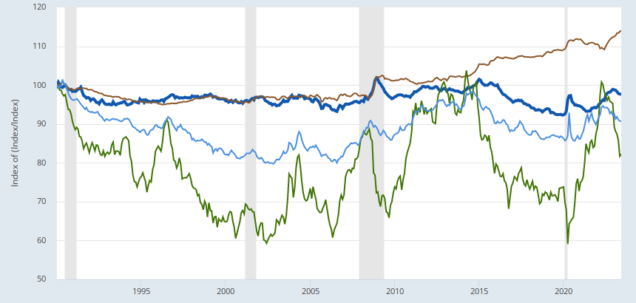
Food prices are more variable for farmers than consumers
Consumer prices for groceries and restaurants vs. wholesale costs, Jan 1990 – June 2023
Restaurant prices rise with wages and rents
Restaurant prices (food away from home)
Index value (January 1990=100)
Grocery prices (food at home)
Grocery prices vary with overall inflation
Wholesale producer prices for processed foods
Wholesale prices for raw commodities have brief spikes and long valleys
Wholesale producer prices for unprocessed foods
Note: Author’s calculations. Data shown are from the US Bureau of Labor Statistics, as the average for each category relative to the overall U.S. consumer price index for all goods and services. Data to June downloaded Aug 5th 2023, with the latest updated data available from https://fred.stlouisfed.org/graph/?g=12MMl.

Slide 6
Food price spikes cause brief but damaging food crises
Average rise in retail food prices relative to all other goods and services over previous 12 months in the U.S. and worldwide, Jan. 1998 - June 2023
Recent food price spikes:
2020-21
(COVID onset)
2022-23
(COVID recovery)
2008-09
2015-16
2011-12
United States
Global average (up to 138 countries)
…but even when food prices are normal or low, many people cannot afford healthy diets
Note: Author's calculations. U.S. data are calculated from the Bureau of Labor Statistics (updates: https://fred.stlouisfed.org/graph/?g=12Myr). Global data are from the IMF, averaging up to 138 countries reporting monthly consumer price indexes (CPI) for food and for all goods and services, Jan. 2000 through Dec. 2022. Each observation is the average monthly rise over the previous 12 months, times 12 to obtain an annualized value. Number of countries rises from 51 in Jan 2000 to 95 in 2005 and then 138 from 2015 onwards. Raw data for all countries are at https://data.imf.org.

Slide 7
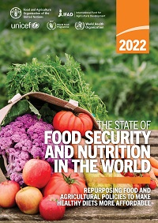
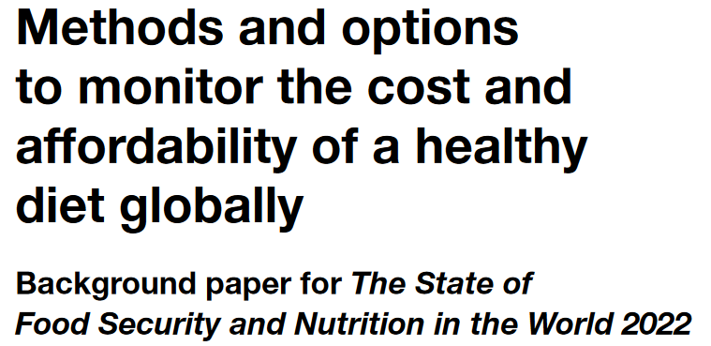
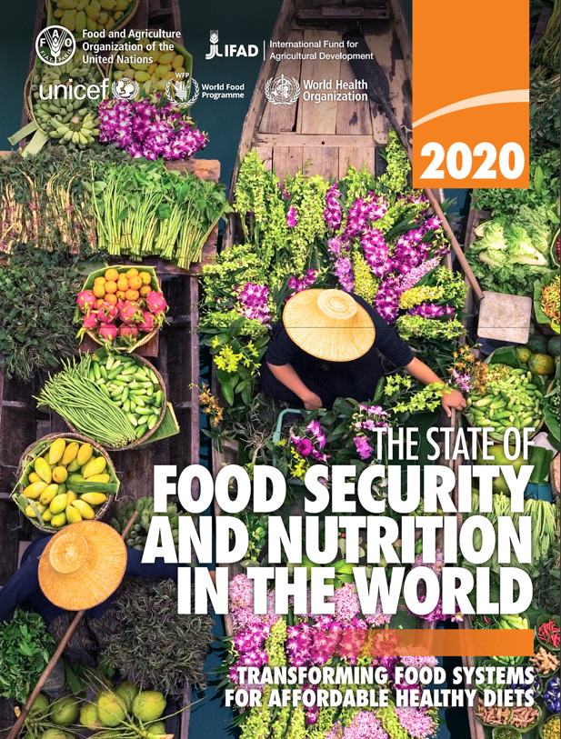
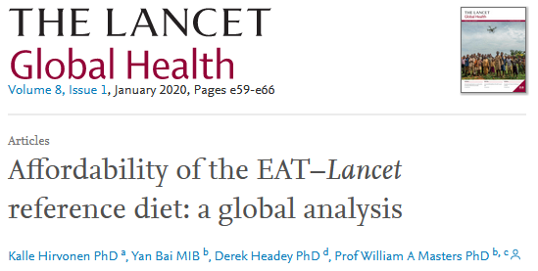
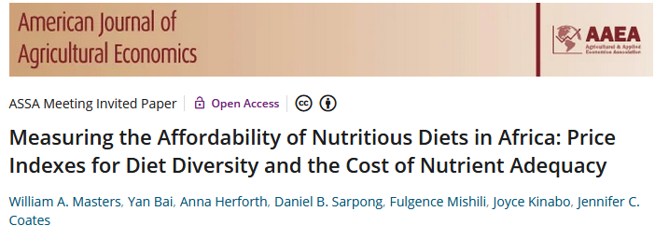
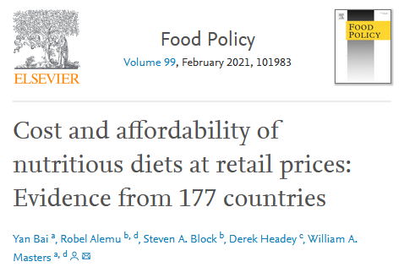
New metrics are tracking the cost and affordability of healthy diets in all countries of the world
The Food Prices for Nutrition project monitors access to healthy diets using the least expensive locally available foods as a kind of price index, measuring the cost of food as an input to health
Our aim is to distinguish among barriers to healthy eating
We find a ladder of diet costs for nutrient and other food attributes
 |  |  | Food preferences, convenience and other goals (including food security, diet diversity, sustainability, equity and inclusion)
 | Caloric adequacy (short-term subsistence)
For actual food choice among affordable options, observed consumption often displaces healthy items with other foods
For SOFI 2022, the updated standard for the Cost of a Healthy Diet (CoHD) is a “Healthy Diet Basket” of the 11 least-cost items from 6 food groups
Actual global food spending =
$5.46/day
 |  |  | Healthy diets Meets national dietary guidelines by food group
 |  | Nutrient adequacy Avoids deficiency or excess of essential macro- and micronutrients
 | Daily energy Meets only calorie needs, for short-term survival and physical work
For SOFI 2020, we used 10 countries’ guidelines for the Cost of Recommended Diets (CoRD)
Our AJAE 2018 article introduced a Cost of Diet Diversity (CoDD) metric
Global ave. in 2017 = $3.31/day
and many other studies analyze the cost of nutrients
Global average in 2017 = $2.46/day
Global average in 2017 = $0.83/day
Source: Food Prices for Nutrition (2023). https://sites.tufts.edu/foodpricesfornutrition

Slide 8
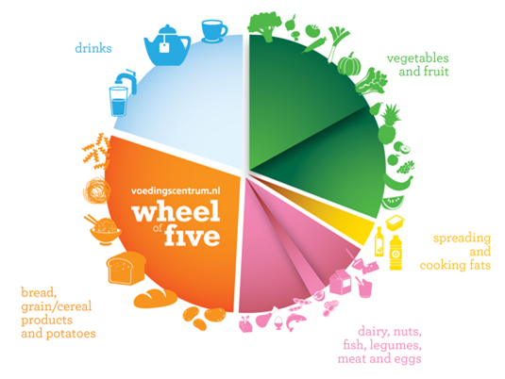
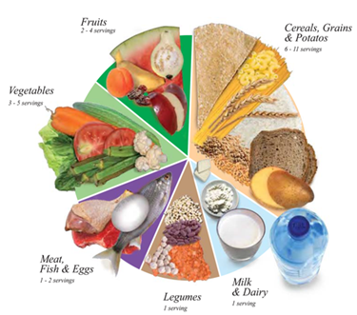
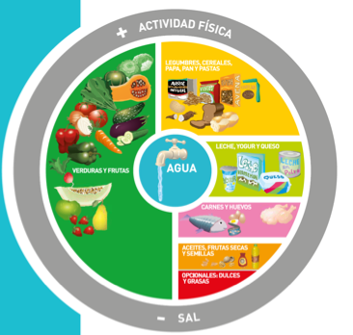
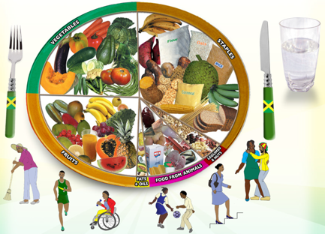
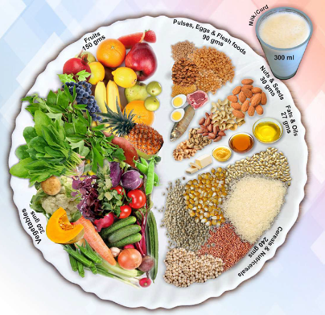
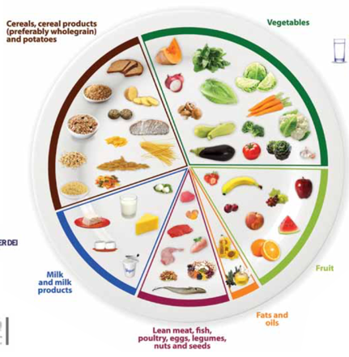
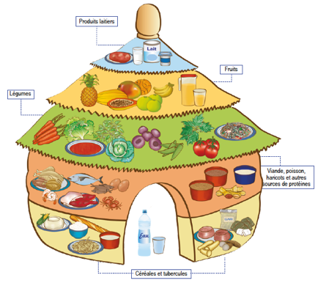
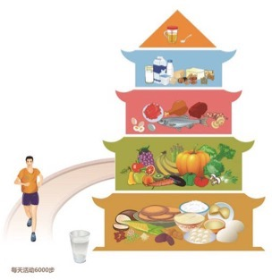
How do we define healthy diets to measure their cost and affordability?
Use national dietary guidelines, in terms of food groups
Meet target quantities of each food group needed for a healthy diet
Allow substitution within energy balance, by converting volume and weight to calories
Guidelines differ in details but food group requirements are similar
For the SOFI 2020 report, used median cost of 10 quantified guidelines from all UN regions
Since SOFI 2022, we use a single Healthy Diet Basket from 31 guidelines with food guides
Methods refined through many workshops with stakeholders in priority countries
Quantities of food in the healthy diet
Typical weight (grams) | Typical volume (plate share)
322g dry rice | 25%
270-400g veg. | 25%
230-300g fruits | 25%
210g egg | 25%
85g dry bean
34g oil
Definition of the Healthy Diet Basket
Food group | Number of items | Total energy (kcal)
Starchy staples | 2 | 1,160
Vegetables | 3 | 110
Fruits | 2 | 160
Animal-source foods | 2 | 300
Legumes, nuts & seeds | 1 | 300
Oils and fats | 1 | 300
Total: 2,330

Slide 9
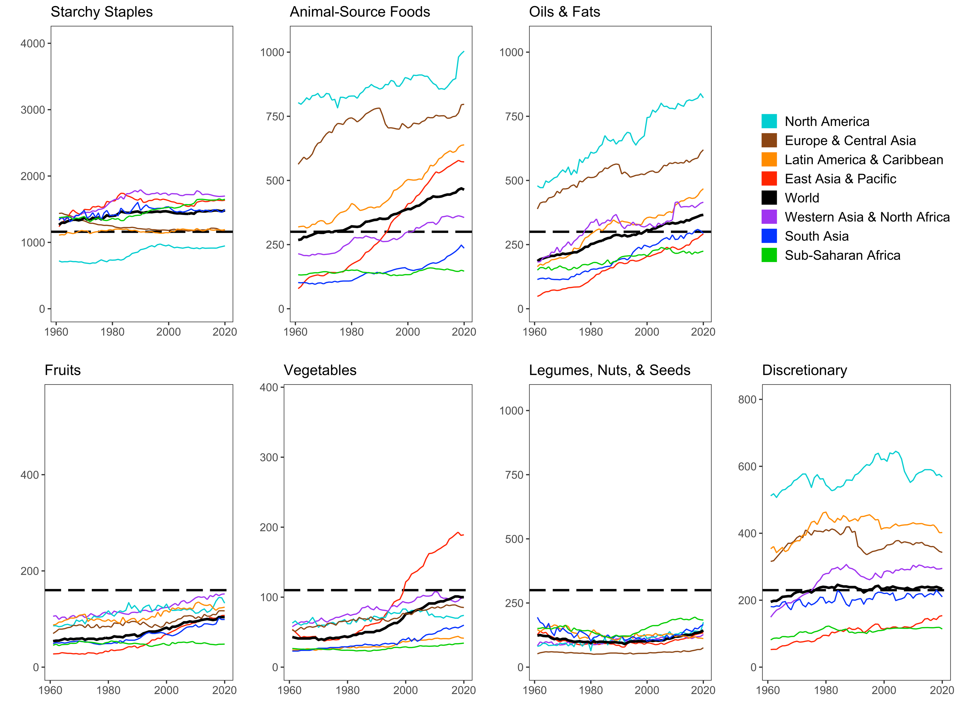
Actual food supplies are far from Healthy Diet Basket targets, in ways that differ by region and over time
North America is an outlier (=U.S. and Canada, + Bermuda)
Food supply data are from FAO Food Balance Sheets and show total daily kilocalories available per capita for food consumption in each geographic region, aggregated by HDB food group.

Slide 10
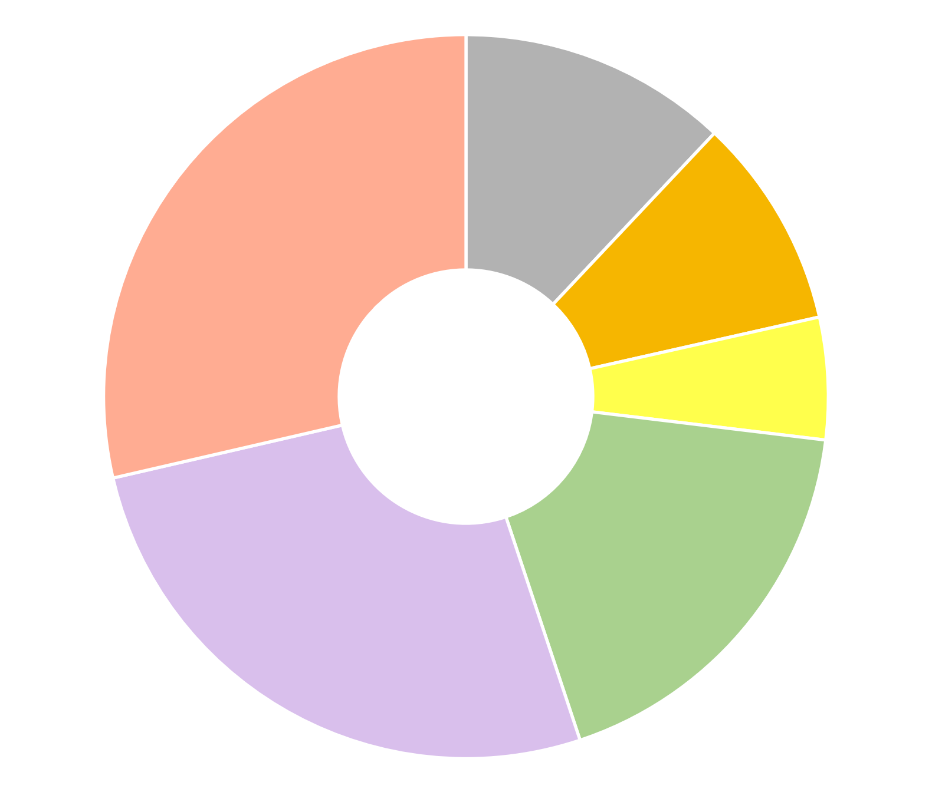
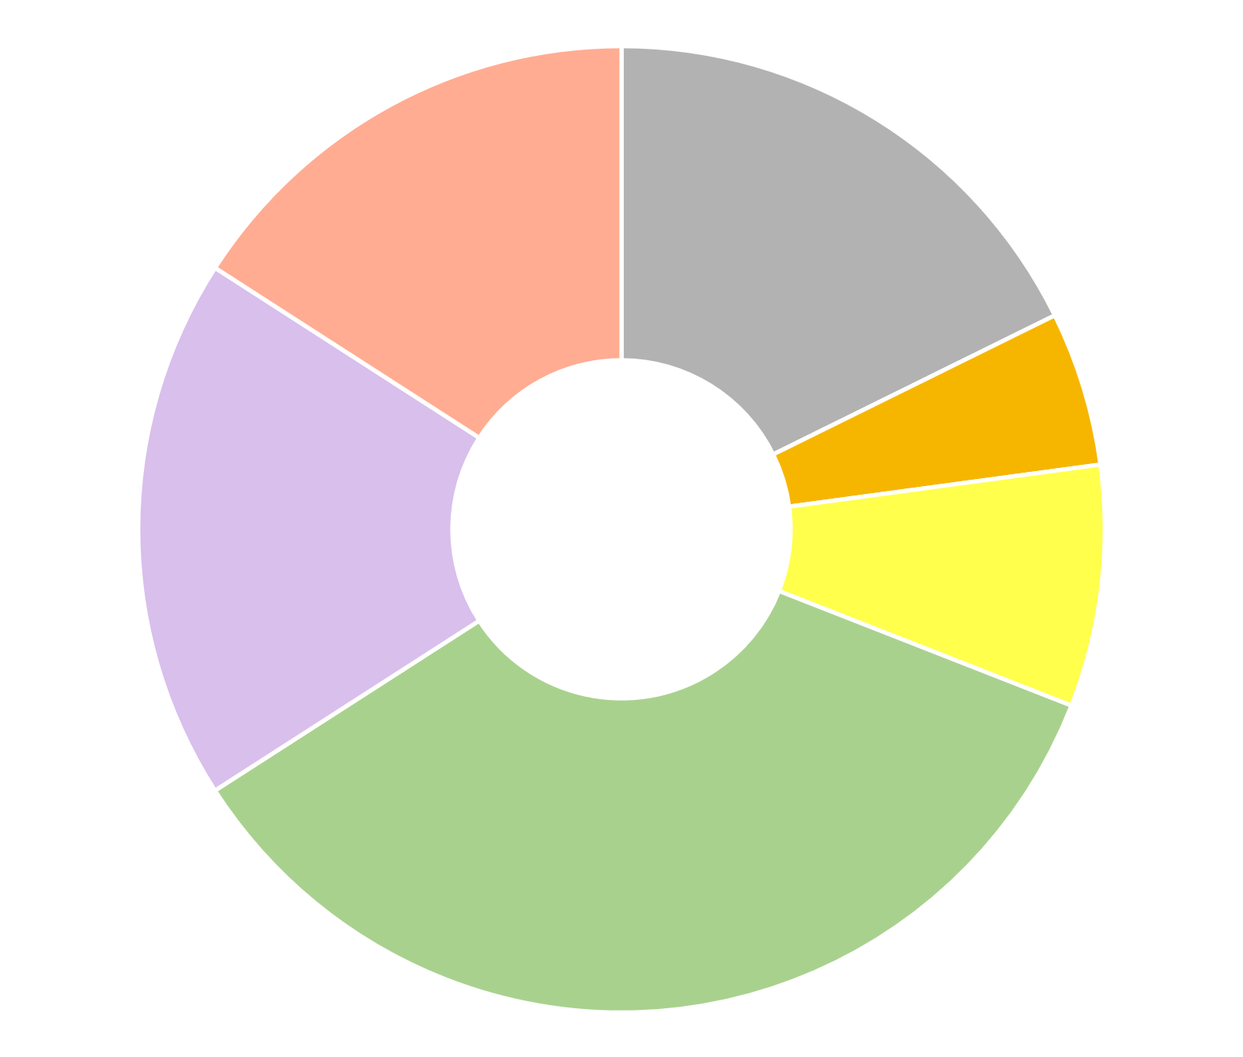
Are poor diets due to lack of access, or to food choice among affordable options?
Our “Cost of a Healthy Diet” uses the least expensive items to meet Healthy Diet Basket targets, selecting 11 items across 6 food groups from each country’s list of locally available foods
Pakistan
Senegal
Items selected reflect local availability and price, delivering the same balance across food groups in all settings
Animal source foods (2 items, 150 kcal each)
Starchy staples (2 items, 580 kcal each)
Wheat flour, maize (12% of cost)
Legumes, nuts & seeds
(1 item, 300 kcal)
Sardines, small fish
(dried)
16%
All items shown are widely consumed in each country, but in very different quantities from these benchmark diets; in these countries actual diets are mostly starchy staples which results in undernutrition
Areas show share of cost needed to meet HDB targets
Maize, rice (25% broken) 18%
Buffalo milk, live chicken (29% of cost)
Red lentils (9% of cost)
Oils & fats (1 item, 300 kcal)
Groundnuts 5%
$3.41 per day
Vegetable oil (5% of cost)
Dates, mangoes 18%
$2.19 per day
Palm oil 8%
Bananas, coconut (27% of cost)
Onions, carrots, water spinach (18% of cost)
Benchmark costs shown here are for based on national average item availability and price reported for 2017, converted to US dollars at purchasing-power parity exchange rates
Onions, carrots, eggplant
35%
Fruits (2 at 80 kcal each)
Vegetables (3 at 30 kcal each)
Note: Each item’s cost is for a sufficient weight or volume to meet the HDB targets, based on matching item descriptions to food composition data. In food groups requiring multiple items, the lowest-cost foods are listed first. Item descriptions are standardized across countries, with its availability and national average price reported by each country’s statistical agency to the International Comparison Program (ICP) for 2017. Cost levels are as published by FAO and the World Bank with methods detailed at Food Prices for Nutrition (2022). https://sites.tufts.edu/foodpricesfornutrition

Slide 11
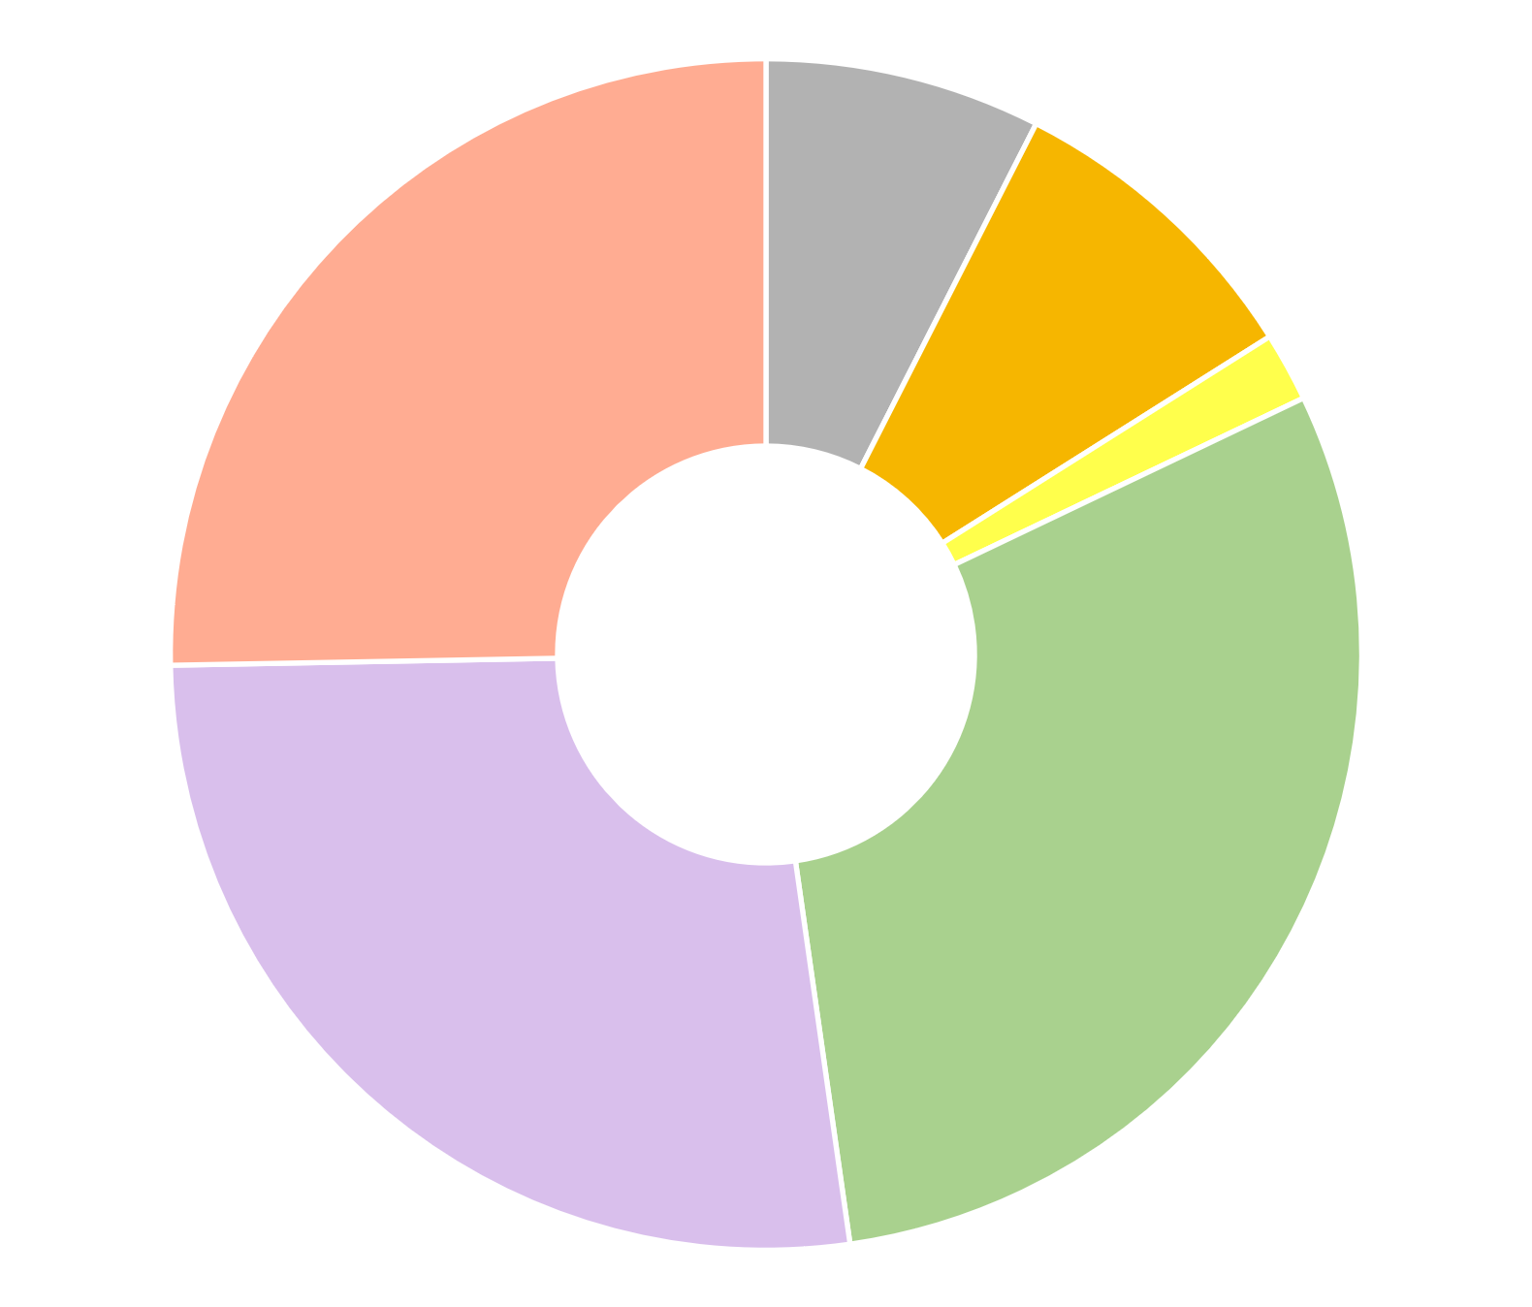
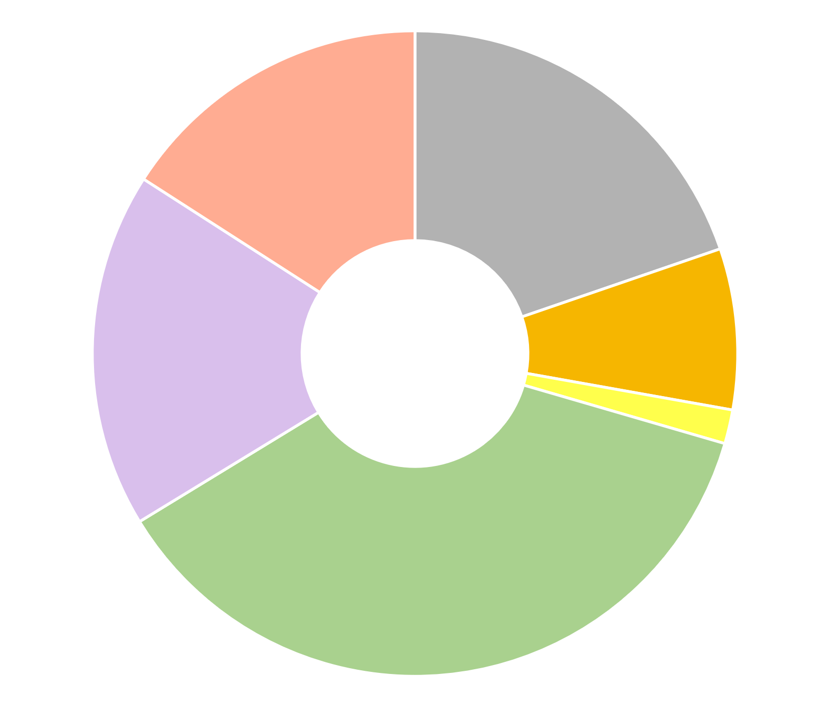
Are poor diets due to lack of access, or to food choice among affordable options?
Our “Cost of a Healthy Diet” uses the least expensive items to meet Healthy Diet Basket targets, selecting 11 items across 6 food groups from each country’s list of locally available foods
Comparisons with higher-income, more industrialized countries are also revealing
Italy
The HDB target is designed for global monitoring, based on commonalities among national dietary guidelines.
United States
Wheat flour, pasta (7% of cost)
Main difference is these animal source foods
White beans, dried (9% of cost)
Resulting diets are close but may not exactly meet all DRI requirements for nutrients, or the U.S. DGAs
Whole milk, semisoft cheese (16% of cost)
Boxed UHT milk, frozen chicken (25% of cost)
Sunflower oil (2% of cost)
Rice, spaghetti (20% of cost)
$2.89 per day
Bananas, apples (18% of cost)
$3.23 per day
White beans, dried (8% of cost)
Carrots,
onions, cabbage (30% of cost)
Sunflower oil (1% of cost)
Bananas, apples (27% of cost)
Carrots,
cabbage,
Iceberg lettuce (37% of cost)
Additional costs to meet DRIs or DGAs would be small, but actual spending in Italy or the U.S. is much greater due to other attributes of foods being purchased
Note: Each item’s cost is for a sufficient weight or volume to meet the HDB targets, based on matching item descriptions to food composition data. In food groups requiring multiple items, the lowest-cost foods are listed first. Item descriptions are standardized across countries, with its availability and national average price reported by each country’s statistical agency to the International Comparison Program (ICP) for 2017. Cost levels are as published by FAO and the World Bank with methods detailed at Food Prices for Nutrition (2022). https://sites.tufts.edu/foodpricesfornutrition

Slide 12
What have we discovered about the cost and affordability of healthy diets worldwide?
Food costs differ but are not lower in low-income countries when measured in real terms, compared to other goods & services
Least-cost healthy diets are unaffordable for the very poor, about 3 billion people
Based on overall food price inflation relative to incomes, real costs rose to $3.66 in 2021, up from $3.54 in 2020
Global average costs in 2017
$3.31
(meets dietary guidelines for overall health)
$2.46
(within upper & lower bounds for nutrients)
$0.83
(sufficient calories for work each day)
Diet cost data are from FAO and the Food Prices for Nutrition project, using item prices reported by national statistical organizations through the International Comparison Program (ICP), downloaded from https://databank.worldbank.org/source/food-prices-for-nutrition, and national income (GNI) is from the World Development Indicators https://databank.worldbank.org/source/world-development-indicators. Guidelines are linear in the logarithm of income shown on the horizontal axis.

Slide 13
How does actual spending on food compare to the cost of healthy diets?
Average food spending is much greater than least-cost healthy diets in middle- and high-income countries
…but that is the national average, many households in these countries cannot afford healthy diets
Global average costs in 2017
$5.64
(pursues many goals other than health)
Actual food spending is less than healthy diet costs in low-income countries
$3.31
(meets dietary guidelines for overall health)
$2.46
(within upper & lower bounds for nutrients)
$0.83
(sufficient calories for work each day)
Diet cost data are from FAO and the Food Prices for Nutrition project, using item prices reported by national statistical organizations through the International Comparison Program (ICP), downloaded from https://databank.worldbank.org/source/food-prices-for-nutrition. Food expenditures are derived from those data, and national income (GNI) is from the World Development Indicators https://databank.worldbank.org/source/world-development-indicators. Guidelines are linear in the logarithm of income shown on the horizontal axis.

Slide 14
How does affordability of healthy diets relate to hunger and food insecurity?
Unaffordability of healthy diets drops with income from >95% to near zero
In contrast, “prevalence of food insecurity” drops from 50-80% to 5-15%
Here, food insecurity is defined as a survey respondent’s answers to whether they went hungry, ate less or differently, skipped meals, etc. due to lack of resources to buy food
Food insecurity refers to a person’s usual diet, which if often not healthy: in poor countries it is mostly starchy staples, in rich countries it is more expensive than a least-cost healthy diet due to other needs such as taste, convenience and aspirations
Data shown are FAO estimates, downloaded from https://databank.worldbank.org/source/food-prices-for-nutrition for affordability of healthy diets, and from https://databank.worldbank.org/source/world-development-indicators for experience of food insecurity and national income (GNI).

Slide 15
Conclusion: Improving dietary patterns can be informed by least-cost healthy diets
For about 3 billion people (40% of the global population), healthy diets remain unaffordable
Nutrient-rich foods are more costly to grow and distribute than starchy staples, vegetable oil & sugar
At times and places where prices are unusually high, supply improvements can lower cost
Most unaffordability is due to low incomes, so healthier diets will require higher earnings or safety nets
For almost all Americans (and most people worldwide), healthy foods are “affordable” but not used
Many factors beyond health drive food choice, as people transition from inadequacy to excess
overshooting on animal-source foods, sweeteners and oils, even for home-cooked meals
switching to food away from home and packaged items, leading to excess salt, refined grains etc.
Frontiers for future work include time use and cost of meal preparation, role of nonfood factors
Identifying least-cost items and diet costs helps guide intervention
Which items have the most potential to improve affordability of healthy diets
Which people would need higher incomes or safety nets to afford healthy diets
How and why unhealthy foods enter to displace the items in least-cost healthy diets
many different kinds of analysis as done at UGA!

Slide 16
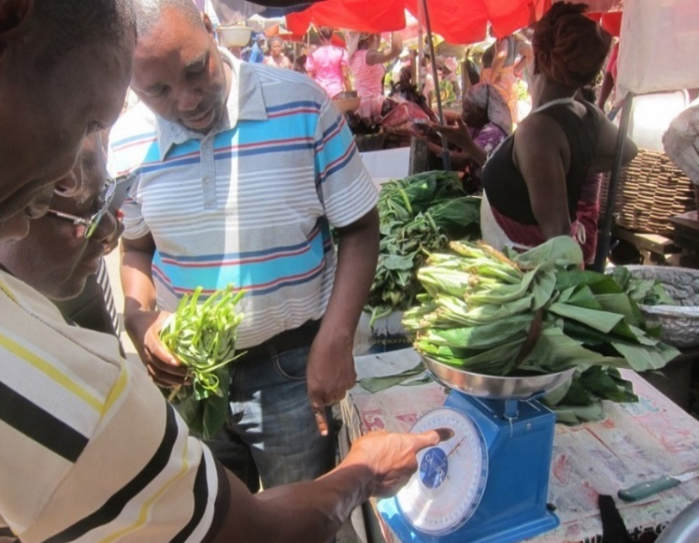
https://sites.tufts.edu/foodpricesfornutrition
Thank you!
We thank the many price collectors and contributors to the diverse databases used in this work and are grateful for funding to the Bill & Melinda Gates Foundation and UKAid, as well as complementary funding from FAO.
Photo by Anna Herforth
at Agbogbloshi market, Ghana

