Slide 1
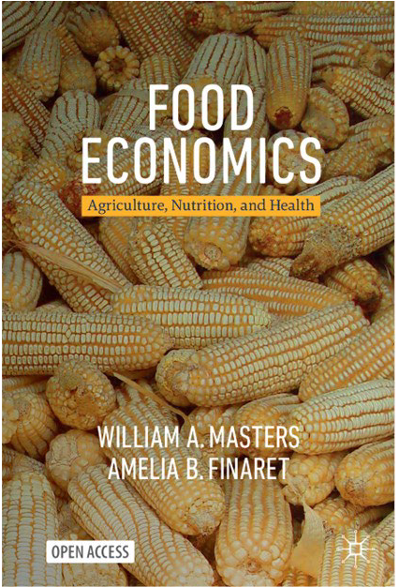
https://sites.tufts.edu/foodpricesfornutrition
What we’ve learned from retail food prices about
Access to Healthy, Sustainable Diets in the United States and worldwide
Teaching at Friedman
William A. Masters
sites.tufts.edu/willmasters
sites.tufts.edu/foodecon
Principal funders
Global monitoring

Slide 2
Global hunger and nutrition measures are changing
Undernourishment reported by FAO since 1974 for “global hunger”, developed by FAO in 1960s based on countries’ total energy in available food, if it were distributed log-normally
Now 9% of the world population (0.7 billion people) are undernourished in this sense
Food insecurity reported by FAO since 2014, and by USDA earlier, developed at Cornell in 1980s based on asking people if lack of resources caused them to experience any food-related hardships (skipped a meal, went to bed hungry, ate less, ate fewer foods, ran out of food, etc.) over the past year
About 25% of the world population (2 billion people) are food insecure in this sense
Cost and affordability of healthy diets reported by FAO and others since 2020, from Tufts based on lowest-price retail items to meet nutritional needs, and income available for food
About 40% of the world (3 billion people) cannot afford a healthy diet in this sense
Tracking lowest-cost healthy diets helps identify remedies for malnutrition
If prices for lowest-cost foods are high, need more efficient supply and distribution
If incomes available for food are low, need income growth and social protection
If unhealthy items displace the available low-cost healthy items, need to ask why those are chosen

Slide 3
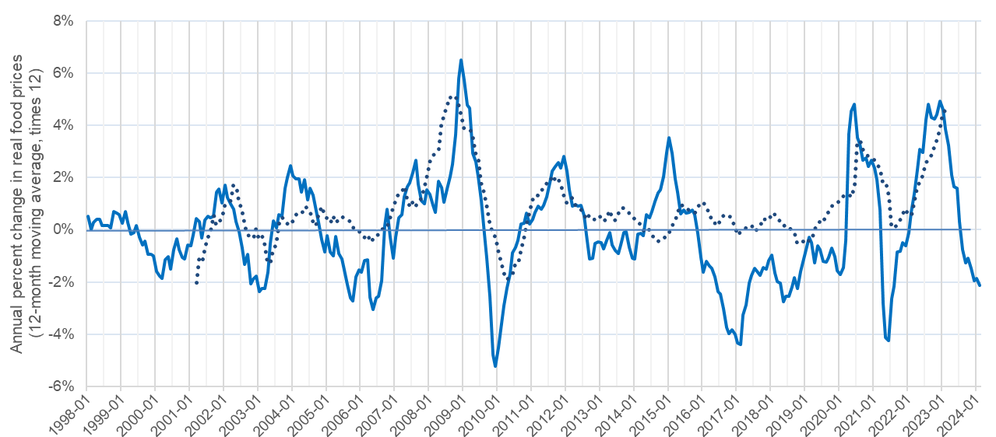
Food prices sometimes spike up
…but even when food prices are low, many cannot afford healthy diets
Change in retail food prices relative to all other goods and services, Jan. 1998 - Feb 2024
Recent food price spikes:
2008-09
2020-21
(COVID onset)
2022-23
(COVID recovery)
2015-16
2011-12
United States
Global average (up to 138 countries)
Note: Author's calculations. U.S. data are calculated from the Bureau of Labor Statistics, from most recent data available at https://fred.stlouisfed.org/graph/?g=1iNGd. Similar results without moving averages can be seen with year-on-year changes at https://fred.stlouisfed.org/graph/?g=12Myr. Global data are from the IMF, averaging up to 138 countries reporting monthly consumer price indexes (CPI) for food and for all goods and services, Jan. 2000 through Dec. 2022, with the number of countries rising from 51 in January 2000 to 95 in 2005 and then 138 from 2015 onwards. Raw data for all countries are at https://data.imf.org.

Slide 4
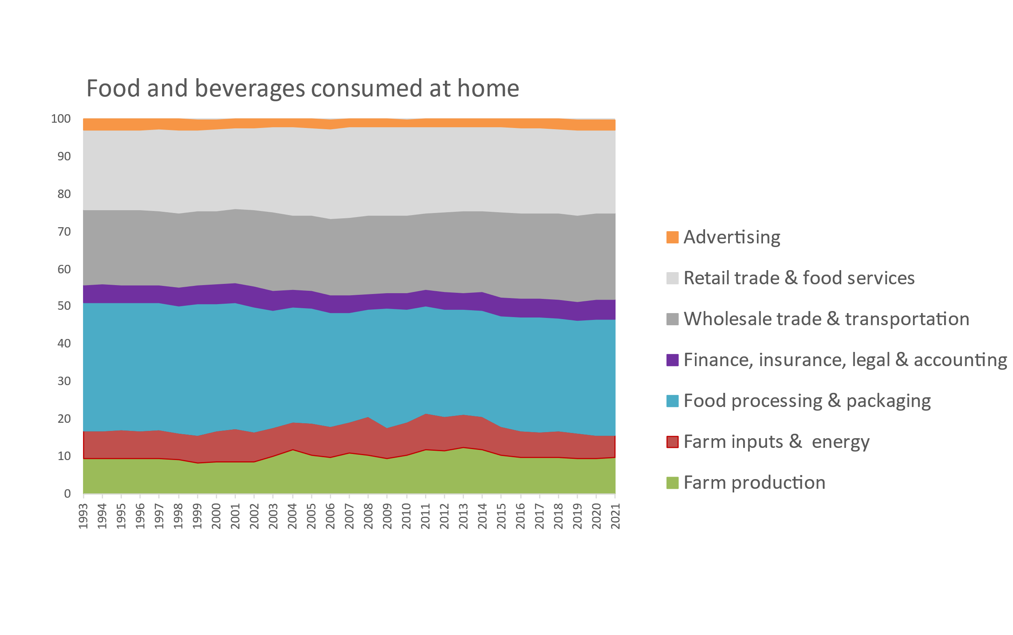
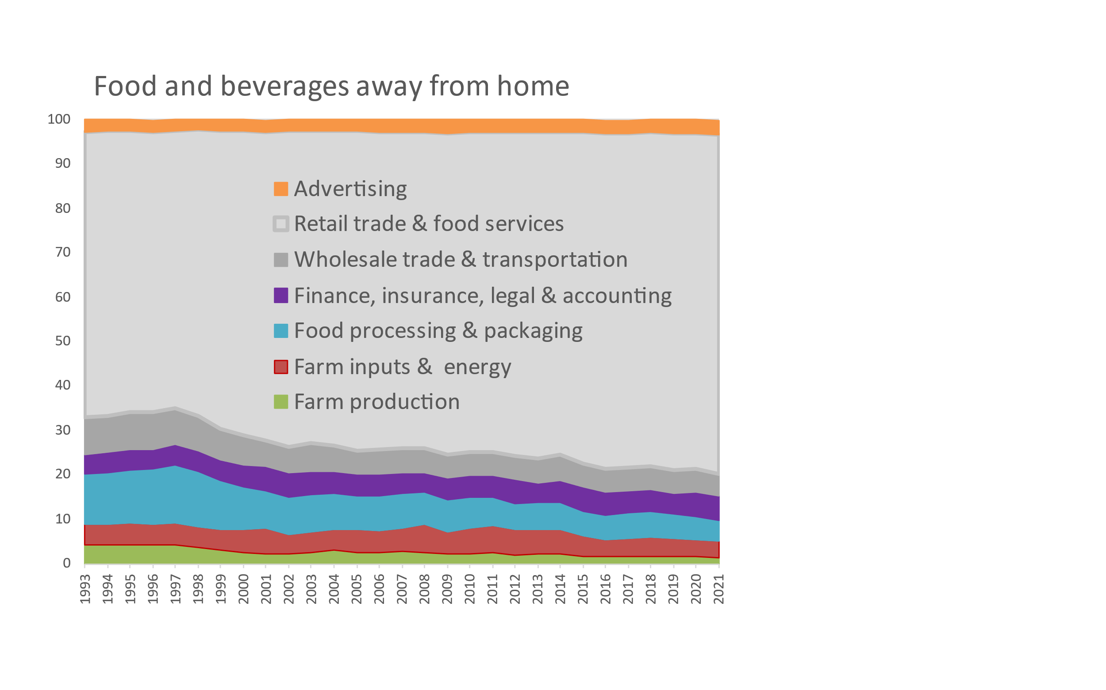
Retail food costs are mostly post-harvest services
Farm produce accounts for a small fraction of consumer prices
Share of retail food costs by stage of production and distribution in the U.S., 1993-2021
Cumulative percent of consumer price
2.6%
3.4%
22.2%
76.2%
23.1%
5.3%
30.8%
5.0%
6.1%
5.5%
9.8%
4.8%
3.7%
1.3%
Note: Author’s calculations. Data shown are from the USDA Economic Research Service (2023), Food Dollar Series. Last updated Feb. 15, 2023, available at https://www.ers.usda.gov/data-products/food-dollar-series. Implied total spending on food advertising is roughly $60 billion per year, more than the NIH and CDC budgets combined. (Overall food spending is about $6,200 per person, about half our total health-care spending.) The FAO has piloted a global version of these data based on Yi et al. (2021) “Post-farmgate food value chains make up most of consumer food expenditures globally” in Nature Food, with downloadable data for a few countries available in FAOSTAT at https://www.fao.org/faostat/en/#data/GFDI.

Slide 5
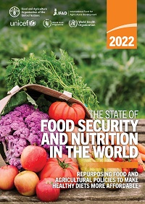
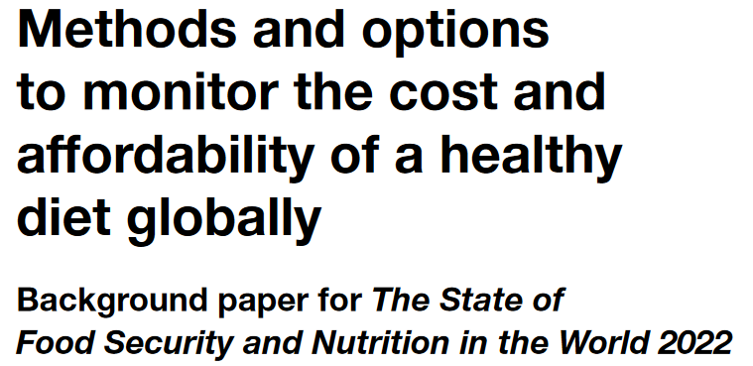
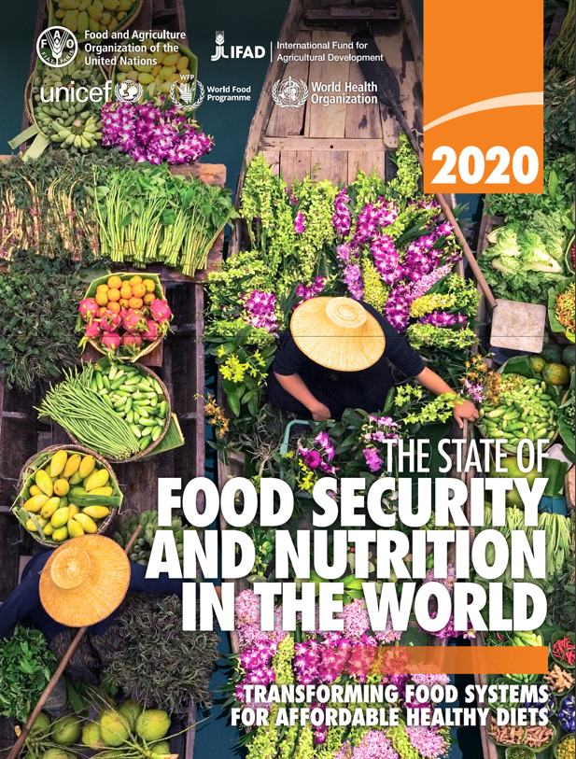
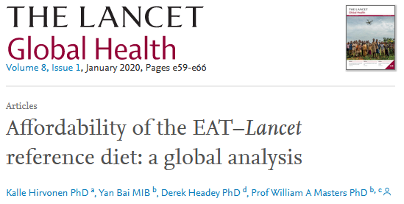
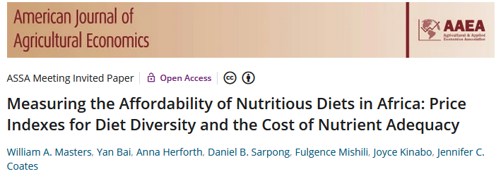
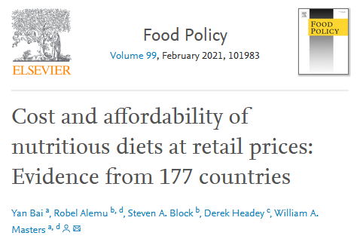
We use retail prices to track diet costs and affordability
We find a ladder of diet costs, based on the least expensive locally available items in each country
Actual choices are not low-cost healthy items, due to other factors driving food choice
Since SOFI 2022, our standard for the Cost of a Healthy Diet (CoHD) is a “Healthy Diet Basket” of the 11 least-cost items from 6 food groups
 |  |  | Food preferences, convenience and other goals (including food security, diet diversity, sustainability, equity and inclusion)
 | Caloric adequacy (short-term subsistence)
For SOFI 2020, we used 10 national guidelines for the Cost of Recommended Diets (CoRD)
Actual global food spending =
$5.46/day
 |  |  | Healthy diets Meets national dietary guidelines by food group
 |  | Nutrient adequacy Avoids deficiency or excess of essential macro- and micronutrients
 | Daily energy Meets only calorie needs, for short-term survival and physical work
Our 2018 journal article introduced a Cost of Diet Diversity (CoDD) metric
and many other studies analyze the cost of nutrients
Global ave. in 2017 = $3.31/day
Global ave. in 2017 = $2.46/day
Global average in 2017 = $0.83/day
Source: Food Prices for Nutrition (2023). https://sites.tufts.edu/foodpricesfornutrition

Slide 6
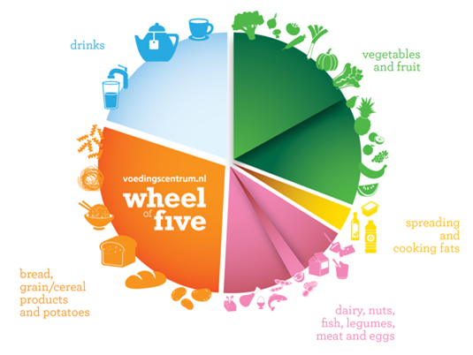
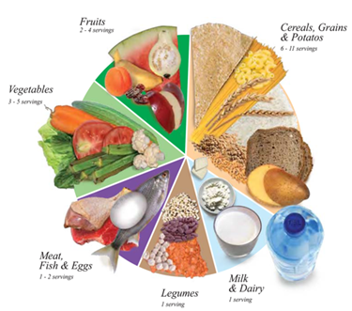
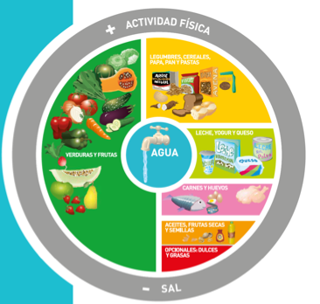
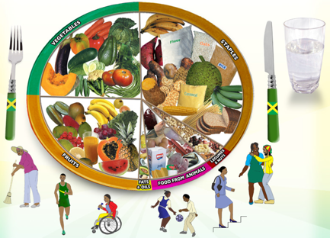
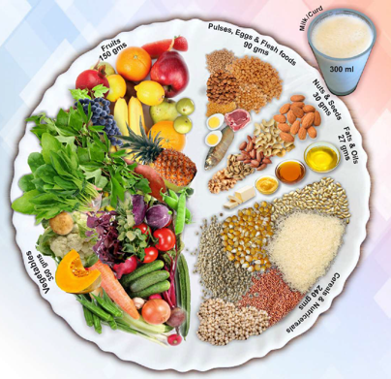
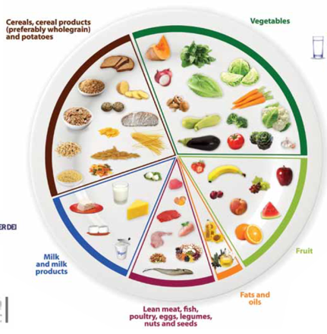
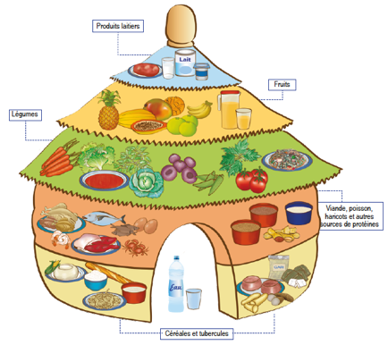
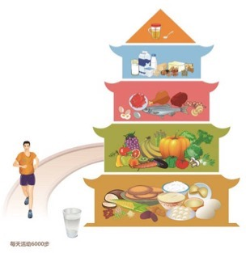
We measure diet costs using locally-available items that would meet national dietary guidelines
To guide intervention and align our metrics with government policies we define healthy diets in terms of food groups
Meet target quantities of each food category needed for a healthy diet
Allow substitution within food groups, by converting volume and weight to energy shares
Food group targets can differ and change over time
For SOFI 2020, used median cost of 10 quantified guidelines from all UN regions
For SOFI 2022, introduced the Healthy Diet Basket from 31 guidelines with food guides
For SOFI 2024, will have updated price and income data but same health criteria
Nigeria is first country government to publish national statistics using global HDB
Ethiopia and others also publish the cost of meeting their own dietary guidelines
Energy shares
50%
5%
7%
13%
13%
13%
Quantities of typical items
Typical weight (grams) | Typical volume (plate share)
322g dry rice | 25%
270-400g veg. | 25%
230-300g fruits | 25%
210g egg | 25%
85g dry bean
34g oil
Definition of the global Healthy Diet Basket
Food group | Number of items | Dietary energy (kcal/day)
1. Starchy staples | 2 | 1,160
2. Vegetables | 3 | 110
3. Fruits | 2 | 160
4. Animal-source foods | 2 | 300
5. Legumes, nuts & seeds | 1 | 300
6. Oils and fats | 1 | 300
11
2,330
Source: Herforth et al., Methods and options to monitor the cost and affordability of a healthy diet globally. Background paper for FAO, IFAD, UNICEF, WFP and WHO (2022)

Slide 7
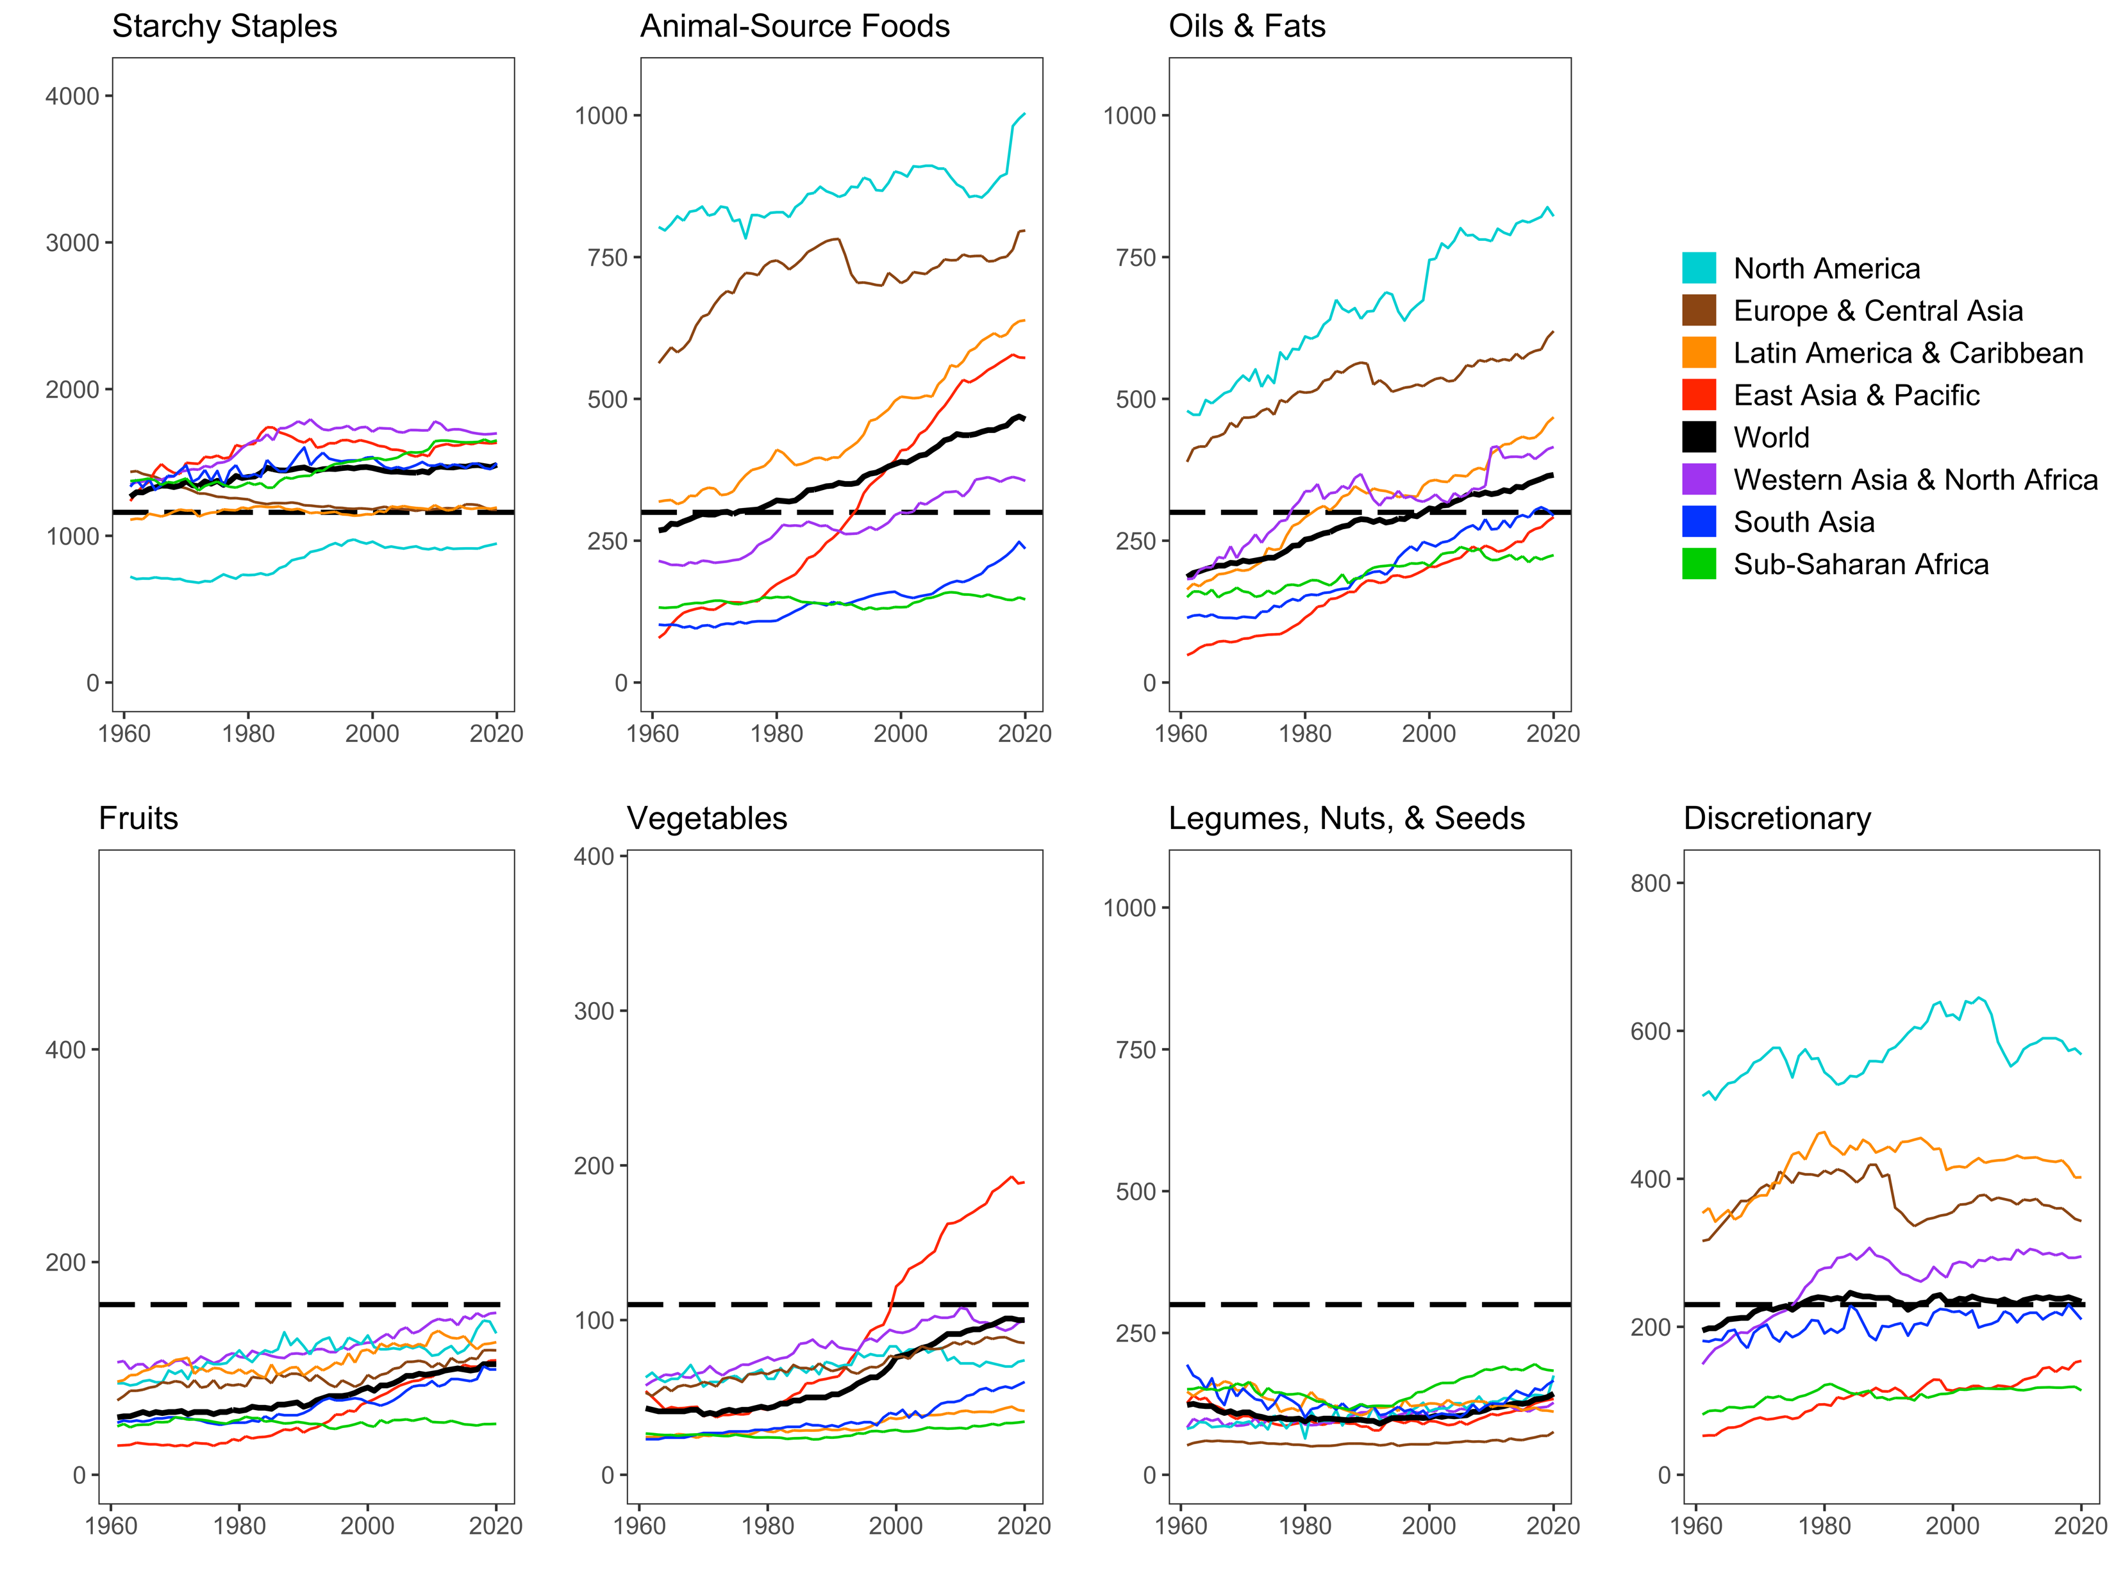
Actual food use is far from Healthy Diet Basket targets, in ways that differ by region and over time
North America has high use of animal foods, oils & fats, and sugar
Africa has low use of all food groups
that are relatively costly per calorie
Source: Leah Costlow, doctoral dissertation in progress, Friedman School of Nutrition, Tufts University. Data shown are from FAO Food Balance Sheet data, for total daily kilocalories available per capita in each region aggregated by HDB food group. Reproduced in Masters & Finaret (2024), Food Economics: Agriculture, Nutrition and Health. Palgrave MacMillan, open access at https://link.springer.com/book/9783031538391.

Slide 8
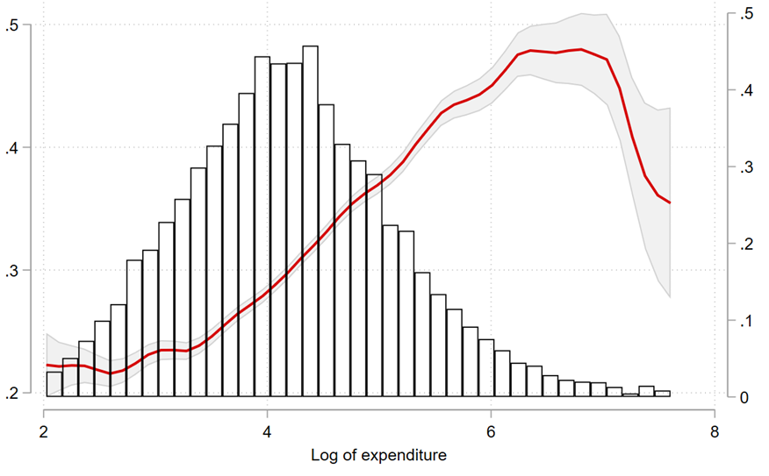
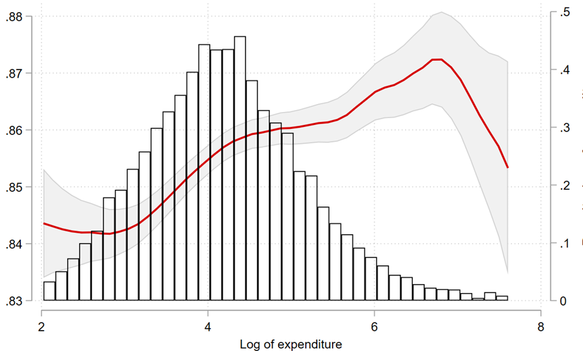
Higher income is closely linked with meeting targets, but only for the world’s poorest people e.g. in Malawi
In Malawi, almost everyone is in the range where adequacy rises with income
Mean adequacy over 6 HDB food groups
Mean adequacy over 13 essential nutrients
Household income (kwacha/person, log scale)
Household income (kwacha/person, log scale)
Source: Rachel Gilbert, “The cost and consumption of healthy diets.” PhD dissertation in progress, Friedman School of Nutrition, Tufts University.
Data shown are for n=9,073 households over four rounds of the Malawi Integrated Household Panel Survey (2010, 2013, 2016, 2019), trimmed at the 1st and 99th percentile of total expenditure per adult male equivalent. Food consumption is from 7-day recall of ~150 items matched to nutritional composition and food group, after adjusting the self-reported total consumption of all foods to the household’s estimated energy balance in kcals per adult male equivalent person. Nutrient adequacy is energy, carbs, protein, lipids, vitamin A, vitamin C, vitamin E, vitamin B6, vitamin B12, calcium, copper, iron, and zinc.

Slide 9
As incomes rise, people overshoot healthy diet targets for animal foods and vegetable oils
Only the world’s lowest-income countries are in the range where adequacy rises with income
Starchy staple use shrinks with higher income
ASFs + oils & fats overshoot and displace healthy foods
Everyone loves sugar, but use changes little
Globally, the average share of each food group’s target
rises then falls with income,
from 0.75 to 0.85 and back
National income ($/pers/year, log scale)
Source: W. Martin and W.A. Masters, “Consumer demand and access to healthy diets worldwide”, in progress. Data shown are modeled estimates due only to income growth, holding prices constant at 2017 levels, using income elasticities from Gouel and Guimbard (AJAE, 2018).

Slide 10
The cost of healthy diets is roughly similar worldwide
Food costs differ but are not lower in low-income countries when measured in real terms, compared to other goods & services
Least-cost healthy diets are unaffordable for the very poor, about 3 billion people
Based on overall food price inflation relative to incomes, real costs rose to $3.66 in 2021, up from $3.54 in 2020
Global average costs in 2017
$3.31
(meets dietary guidelines for overall health)
$2.46
(within upper & lower bounds for nutrients)
$0.83
(sufficient calories for work each day)
Diet cost data are from FAO and the Food Prices for Nutrition project, using item prices reported by national statistical organizations through the International Comparison Program (ICP), downloaded from https://databank.worldbank.org/source/food-prices-for-nutrition, and national income (GNI) is from the World Development Indicators https://databank.worldbank.org/source/world-development-indicators. Guidelines are linear in the logarithm of income shown on the horizontal axis.

Slide 11
Spending on food rises with income
Most people spend much more on food than the least expensive locally available healthy diet
Average food spending is much greater than least-cost healthy diets in middle- and high-income countries
…but that is the national average, many households in these countries cannot afford healthy diets
Global average costs in 2017
Actual food spending is less than healthy diet costs in low-income countries
$5.64
(pursues many goals other than health)
$3.31
(meets dietary guidelines for overall health)
$2.46
(within upper & lower bounds for nutrients)
$0.83
(sufficient calories for work each day)
Diet cost data are from FAO and the Food Prices for Nutrition project, using item prices reported by national statistical organizations through the International Comparison Program (ICP), downloaded from https://databank.worldbank.org/source/food-prices-for-nutrition. Food expenditures are derived from those data, and national income (GNI) is from the World Development Indicators https://databank.worldbank.org/source/world-development-indicators. Guidelines are linear in the logarithm of income shown on the horizontal axis.

Slide 12
Higher-cost items in each food group use more resources
Lower-cost items in each food group usually have smaller climate and water footprints
Climate change (kg of CO₂-eq. emissions/100 kcal)
Water use (liters of water footprint/100 kcal)
Diet cost ($/100 kcal, log scale)
Diet cost ($/100 kcal, log scale)
Source: Elena Martinez, “Market and non-market costs of affordable, healthy diets.” PhD dissertation in progress, Friedman School of Nutrition, Tufts Univ.
Price data shown are for n=811 food items in 181 countries observed in 2011 and 2017, reported by national statistical agencies through the International Comparison Program (ICP), matched to climate and water footprint estimates from Petersson et al. (2021). Figures are binned scatter plots, where each food group is represented by 100 data points, each of which is the mean value of the y-axis variable at the mean level of price per 100kcal across 100 equal-sized bins of price per 100kcal.

Slide 13
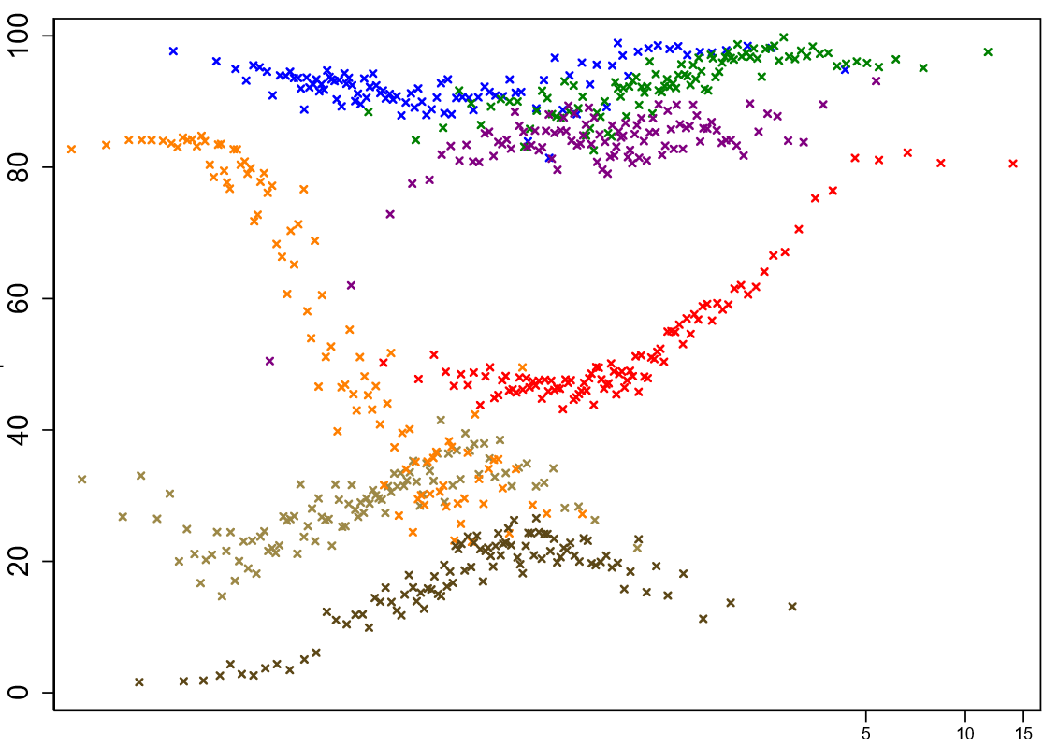
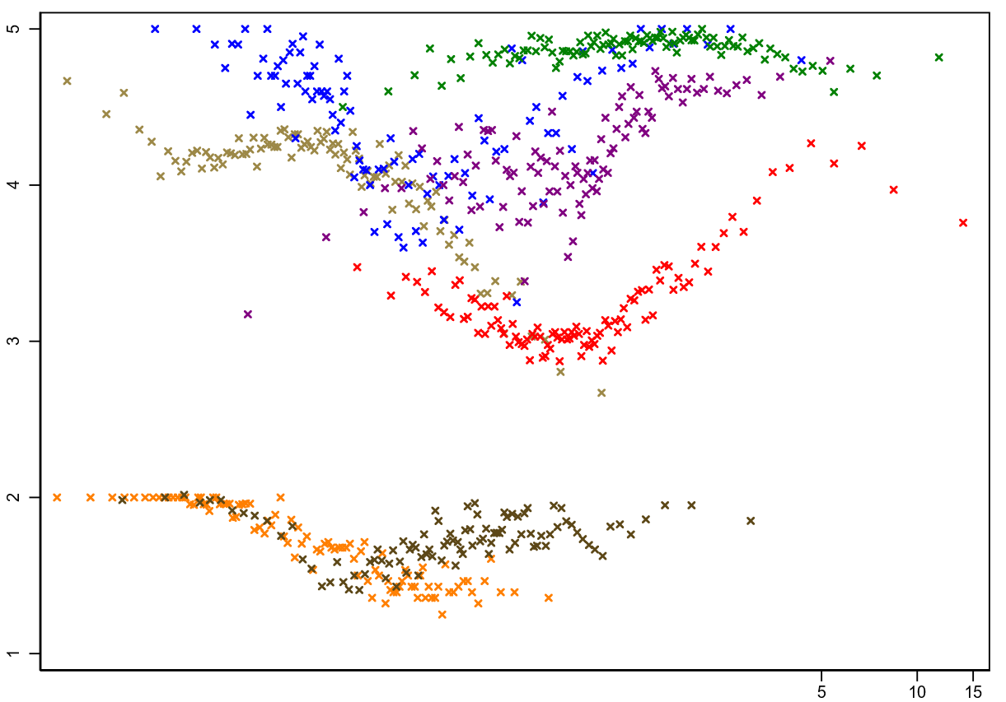
Higher-cost items in each food group vary in nutritional quality associated with health
Each food group has different, often nonlinear link between price and healthfulness
Food Compass score (0-100 points)
Health Star rating (1-5 points)
Diet cost ($/100 kcal, log scale)
Diet cost ($/100 kcal, log scale)
Source: Elena Martinez, “Market and non-market costs of affordable, healthy diets.” PhD dissertation in progress, Friedman School of Nutrition, Tufts Univ.
Price data shown are for n=811 food items in 181 countries observed in 2011 and 2017, reported by national statistical agencies through the International Comparison Program (ICP), matched to Food Compass scores and Health Star ratings by Elena Martinez et al. (2024). Figures are binned scatter plots, where each food group is represented by 100 data points, each of which is the mean value of the y-axis variable at the mean level of price per 100kcal across 100 equal-sized bins of price per 100kcal.

Slide 14
Conclusion: Matching prices to food attributes reveals the cost and affordability of healthy, sustainable diets
For about 3 b. people (40% of the world), healthy diets remain unaffordable
Nutrient-rich foods are more costly to grow and ship than starchy staples, vegetable oil & sugar
At times and places where prices are unusually high, supply improvements can lower cost
Most unaffordability is due to low incomes, so healthier diets requires higher income or safety nets
For most people (and almost all in the U.S.), healthy foods are “affordable” but not used
Many factors beyond health drive food choice, as people transition from inadequacy to excess
overshooting on animal-source foods, sweeteners and oils, even for home-cooked meals
switching to food service and packaged items, leading to excess salt, refined grains etc.
Frontiers for future work include time use and cost of meal preparation, role of nonfood factors
Identifying least-cost items and diet costs helps guide intervention
Within food groups, lower-priced items generally have less environmental cost as well
… but lower-priced items are not necessarily healthier, because of harmful processing
New measurements tools could also guide food business innovation
Food Prices for Nutrition initial project aims focus on government use of the data
Future initiatives could aim to guide private investment towards healthy, sustainable diets

Slide 15
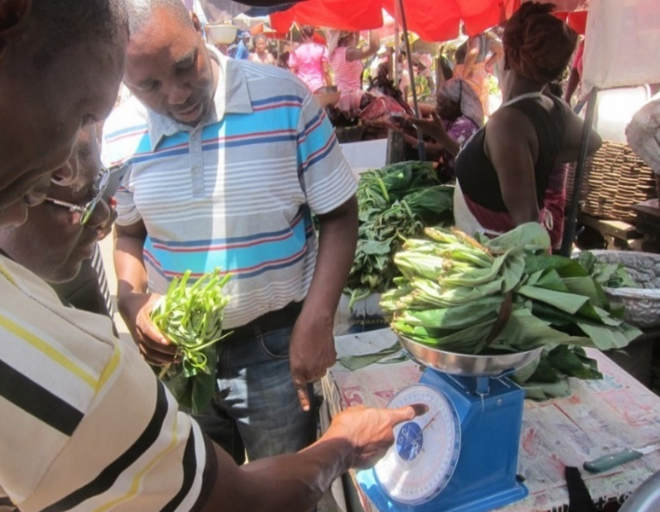
https://sites.tufts.edu/foodpricesfornutrition
Thank you!
We are grateful to the many food price collectors, analysts and project collaborators who contributed to these data, to the Bill & Melinda Gates Foundation and UKAid for core funding, and to FAO for additional funding and collaboration.
Photo by Anna Herforth
at Agbogbloshi market, Ghana
…and there’s more:
new textbook in June 2024, open access through the ANH Academy
www.anh-academy.org,
with details at
https://sites.tufts.edu/foodecon

Slide 16
Other slides

Slide 17
Notes for how to use the grids
The blue lines are where there are slight gaps with the TVs at the MC kitchen
We recommend keeping content and design elements within the 9 boxes when possible
Right now there is an image added to the slide master. Feel free to add that image to your preferred template. Or just use the image to check your existing slides.
Be sure to delete the grid when you are finished with your slide deck
It might feel weird, but centering content within each section is what reads best on the screens
Where content cannot be centered in sections, we suggest that it only overlap one set of grid lines, so either only overlapping the vertical grid lines or only overlapping the horizontal grid lines
The grids attached are formatted for a widescreen presentation ratio

