Slide 1
The new economics of food: agriculture, nutrition, and health
Global Food+ symposium May 5th, 2025
Will Masters
Friedman School of Nutrition and Department of Economics, Tufts University
https://sites.tufts.edu/foodeconomics

Slide 2
What is the new economics of food?
Recent findings about a big, rapidly changing sector of society:
We trace how agriculture relates to input supply and food businesses
A huge and consequential sector, with a distinctive structure and large role for policy
the world’s poorest remain farmers, trapped by need to meet subsistence needs on low productivity farms
when incomes grow, non-farm food businesses grow and change rapidly
…then add nutrition and health, with new data about both deficiencies and excesses
Many nutrients and bioactive attributes of food cannot be seen, tasted or smelled
people want healthier food, but usually do not know what is actually needed for health
marketing of premium products creates the impression that healthier products are more expensive
…leading to surprising insights, because much of the food system is hidden from view
For example:
family farming remains dominant for most crops, largely due to information asymmetry about labor effort
people in most places specialize in a few foods, but want diverse diets leading to a big role for imports

Slide 3
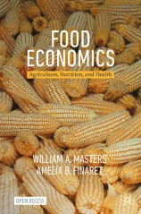
What is the new Food Economics?
Principles of economics (Chapters 1-6)
Data about the food system (Chapters 7-12)
1. Introduction Motivating food economics
2. Individual Choices Consumption and production theory
3. Societal Outcomes Supply, demand, trade, elasticity
4. Social Welfare Economic surplus, externalities
5. Market Power Imperfect competition, game theory
6. Collective Action Public goods, non-market goals
7. Poverty and Risk Inequality, safety nets, vulnerability
8. Food and Health Behavioral economics, interventions
9. Food in the Macroeconomy Recessions, unemployment, inflation
10. International Development Ag. transformation, diet transition, urbanization
11. From Local to Global International trade, globalization, value chains
12. The Future of Food Agribusiness and agroecology, food environments
https://bit.ly/FoodEconBook

Slide 4
Figure 5.1 Scale economies in agrifood systems
The book covers all aspects of the food system
An unusual industrial structure
…where food demand is shaped by biology
Figure 7.15 Interaction of conscious and unconscious mechanisms driving dietary intake
Agribusinesses, supplying farm inputs of all kinds
Conscious choices
Biological drivers
Many farms, the vast majority of which are self-employed households
Food businesses, for product transformation and marketing
Households, using time and money to meet food needs
Energy balance

Slide 5
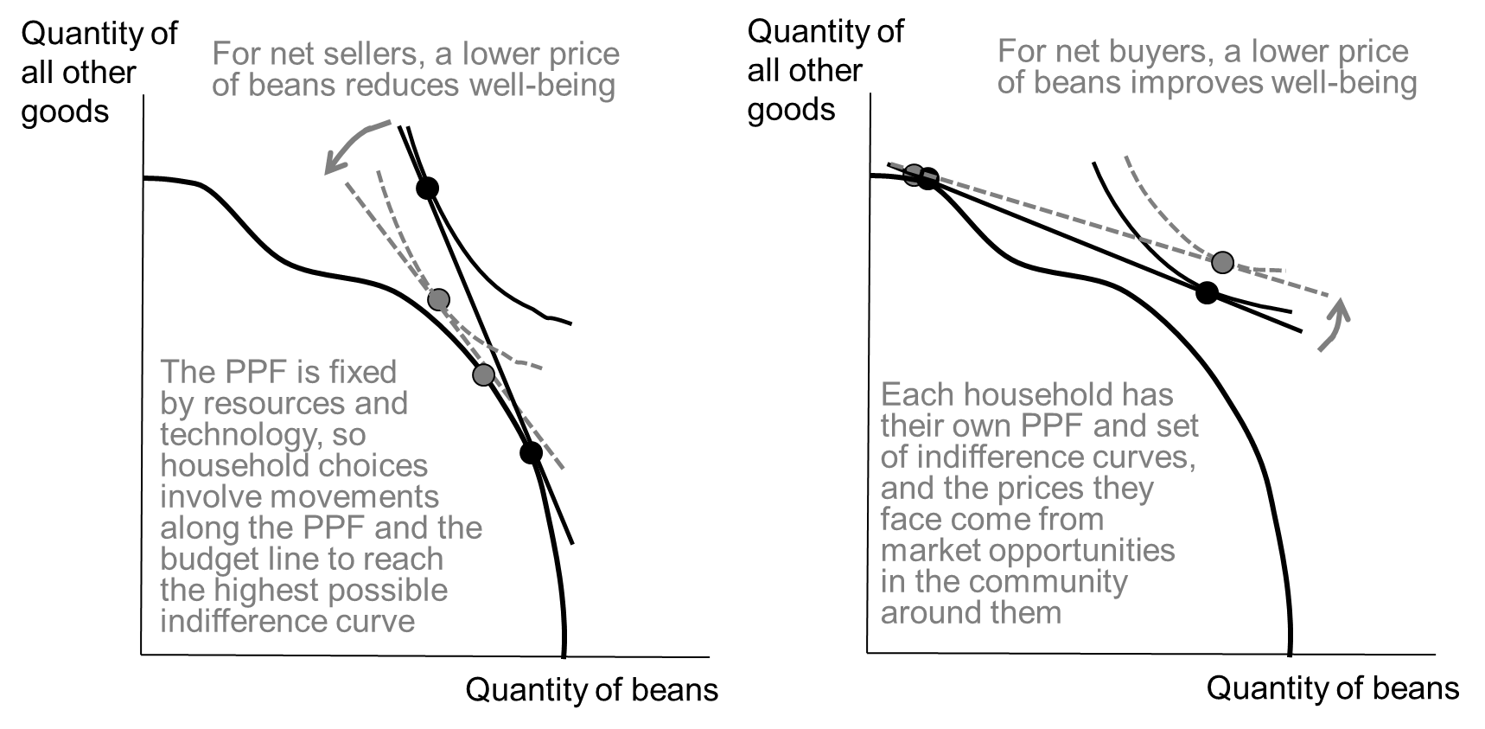
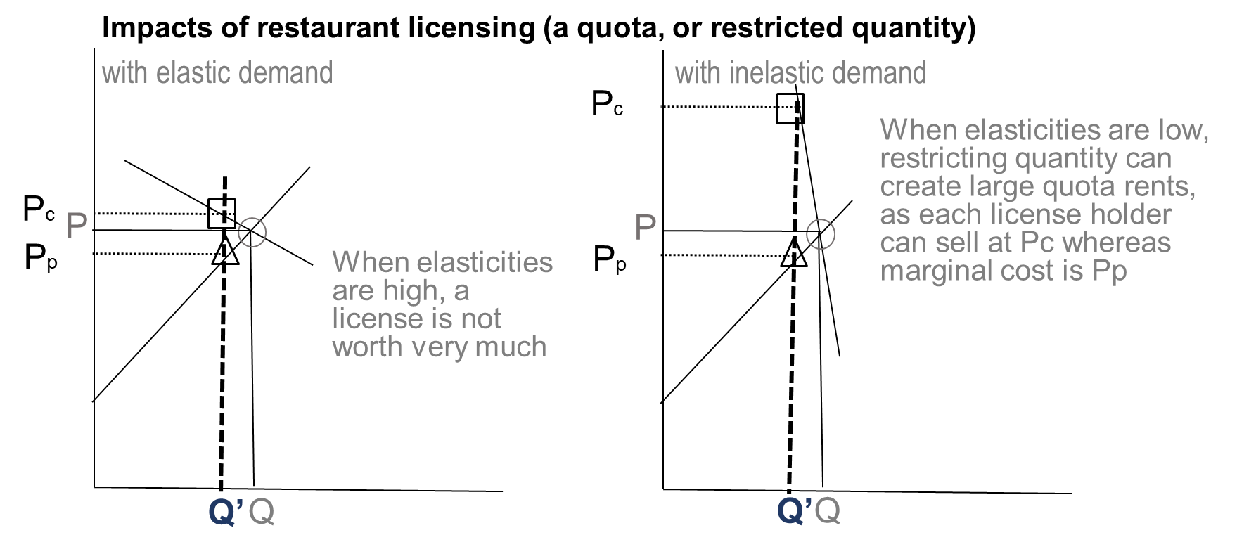
The book starts with economic principles, taught graphically
Analytical diagrams are built up gradually, and can be taught in more or less depth
…and focus on food-related decisions
Figure 2.2.14 The impact of a lower price on net sellers and net buyers
Figure 3.2.6 Elasticities tell us how a quota affects prices paid and received

Slide 6
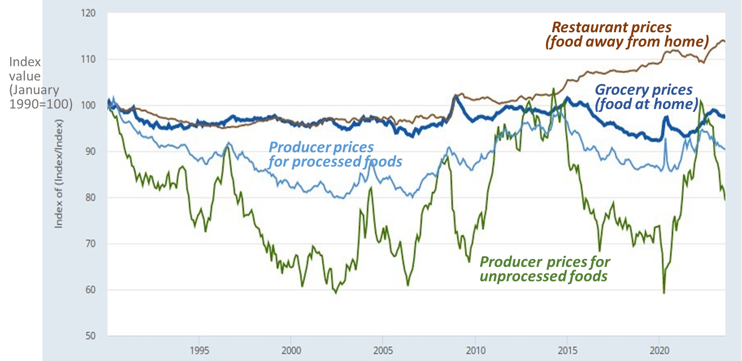
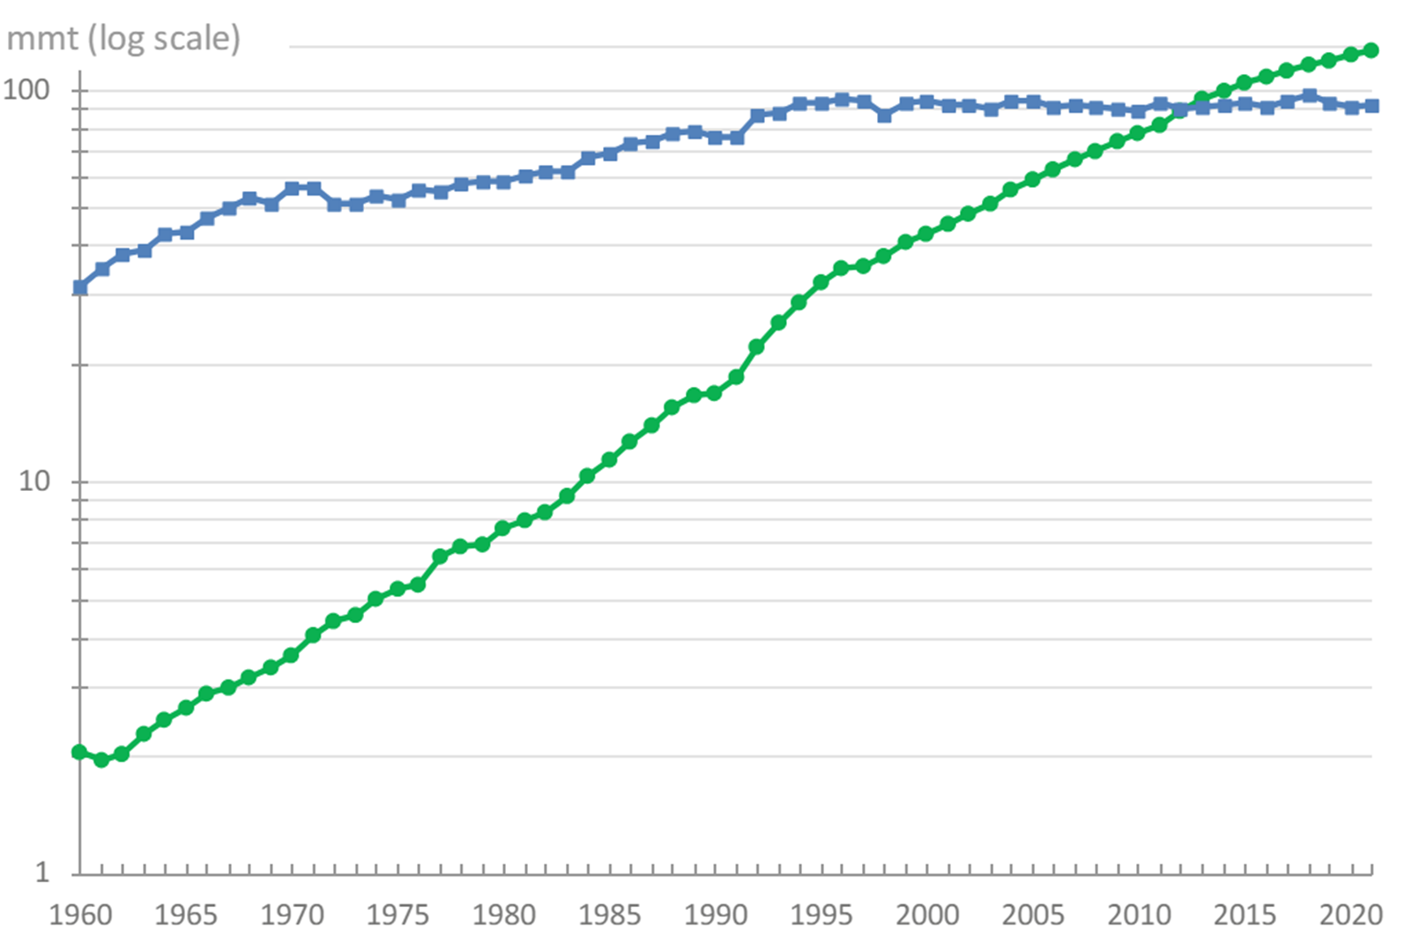
The second half uses data to describe the food system
New images, linked to updated sources where possible
…with focus on policy choices and market trends
Fig. 7.13 U.S. price indexes for consumer and producer prices, January 1990– August 2023
Fig. 12.4 The global transition from capture fisheries to aquaculture, 1960–2021
Source: Reproduced from Federal Reserve Economic Data [FRED], using price indexes from the U.S. Bureau of Labor Statistics as the average for each category relative to the overall U.S. consumer price index for all goods and services. Updated versions at https://fred.stlouisfed.org/graph/?g=12MMl
Source: Authors’ chart showing total worldwide production, in millions of metric tons, using FAO data from the World Bank, World Development Indicators. Other regions, countries and updates are at https://databank.worldbank.org/From-WildCaught-Fish-to-Aquaculture/id/b567055f

Slide 7
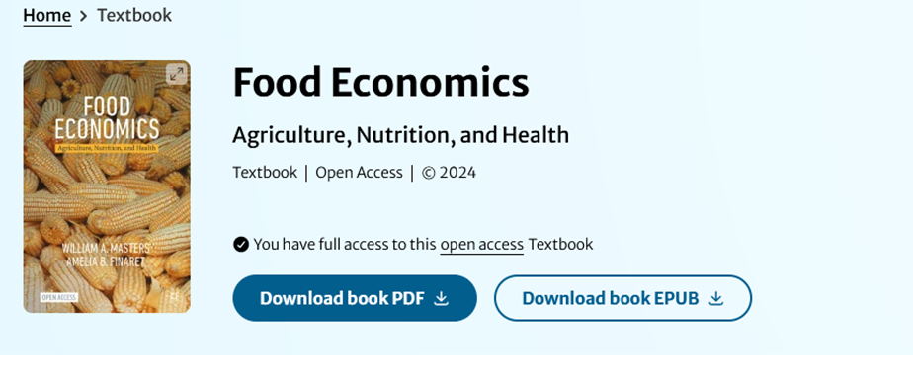
The book is open access, for use on any device (or in print)
Features of the online version
• Syllabus can link to specific pages online
• Students can share comments on the text itself
• All figures are available as powerpoint slides
• Analytical diagrams can be edited
• Data visualizations can be updated
Other teaching materials coming soon
Class materials developed for and with Tufts students
https://sites.tufts.edu/foodecon
• Warm-up exercise finding errors in ChatGPT
• Excel exercise on nutrient adequacy of real diets
• Weekly exercises to draw analytical diagrams matched to current news stories
Welcome to our resource page for the new open-access textbook on Food Economics: Agriculture, Nutrition and Health, published in May 2024 from Palgrave MacMillan.
This site will soon have password-protected links to course materials (slides, exercise prompts, past exams and answer keys). For now we invite you to subscribe to our elist so that you can receive and share teaching material and updates related to the book.
• Midterm or course project (partial draft)
• Weekly exercises to make data visualizations with downloaded data from official sources
• Final or course project (report + slides)

