Slide 1
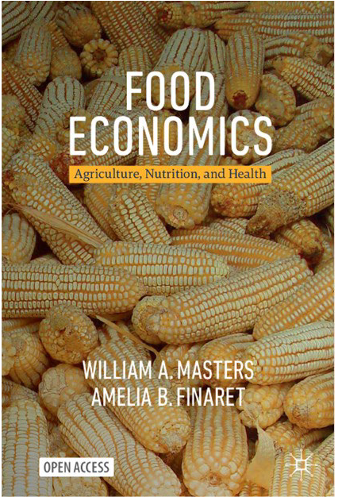
https://sites.tufts.edu/foodpricesfornutrition
Food prices and the affordability of healthy diets:
Insights from global data
William A. Masters
Friedman School of Nutrition Science and Policy
Tufts University
sites.tufts.edu/willmasters
sites.tufts.edu/foodeconomics
May 8th, 2025
Nutrition Security and Economic Development Working Group
Tufts Food and Nutrition Innovation Institute
https://innovation.nutrition.tufts.edu
Open access, at bit.ly/FoodEconBook

Slide 2
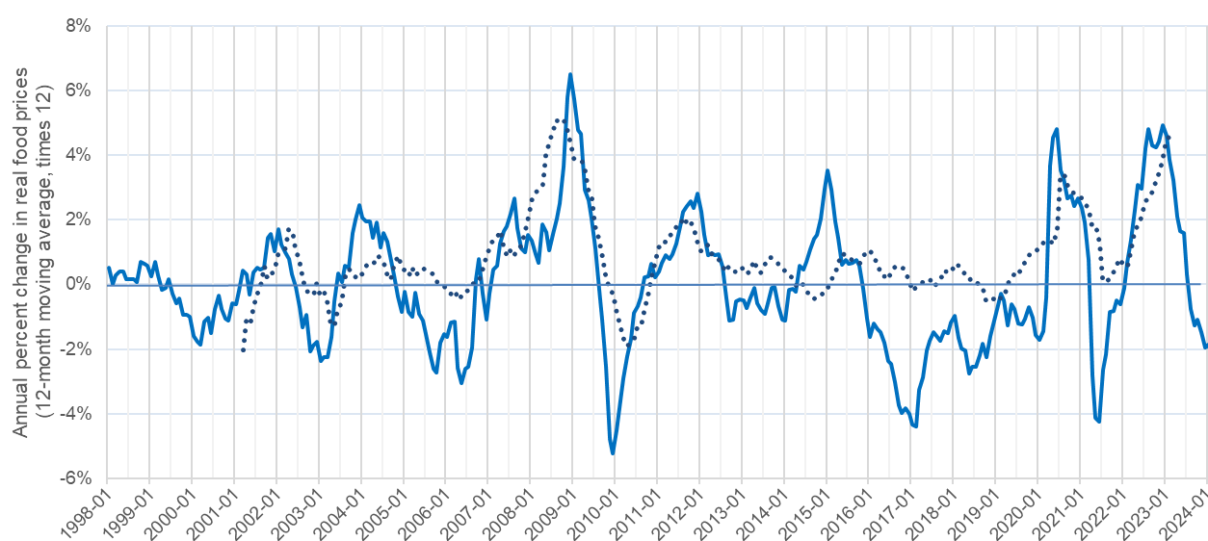
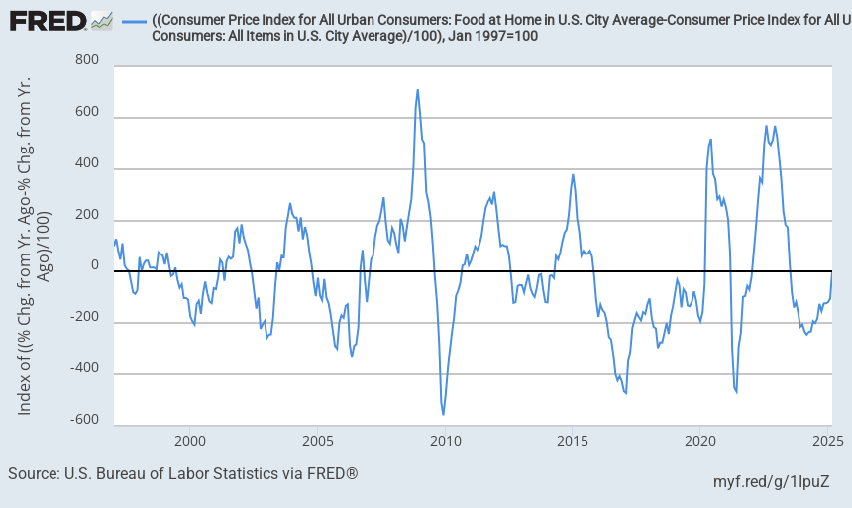
How do food prices limit affordability of healthy diets?
Average rise in retail food prices relative to all other goods and services over previous 12 months in the U.S. and worldwide, Jan. 1998 - Mar 2025
Recent food price spikes:
2008-09
2020-21
(COVID onset)
2022-23
(COVID recovery)
2015-16
2011-12
2025??
(trade restriction +labor shortage)
…but even when prices are low, many cannot afford or do not choose healthy diets
Note: Updated from Figure 7.1 in Masters & Finaret, Food Economics (2024). U.S. data are from the Bureau of Labor Statistics (https://fred.stlouisfed.org/graph/?g=12Myr). Global data are from the IMF, averaging up to 138 countries reporting monthly consumer price indexes (CPI) for food and for all goods and services, Jan. 2000 through Dec. 2022. Each observation is the average monthly rise over the previous 12 months, times 12 to obtain an annualized value. Number of countries rises from 51 in Jan 2000 to 95 in 2005 and then 138 from 2015 onwards. Raw data for all countries are at https://data.imf.org.

Slide 3
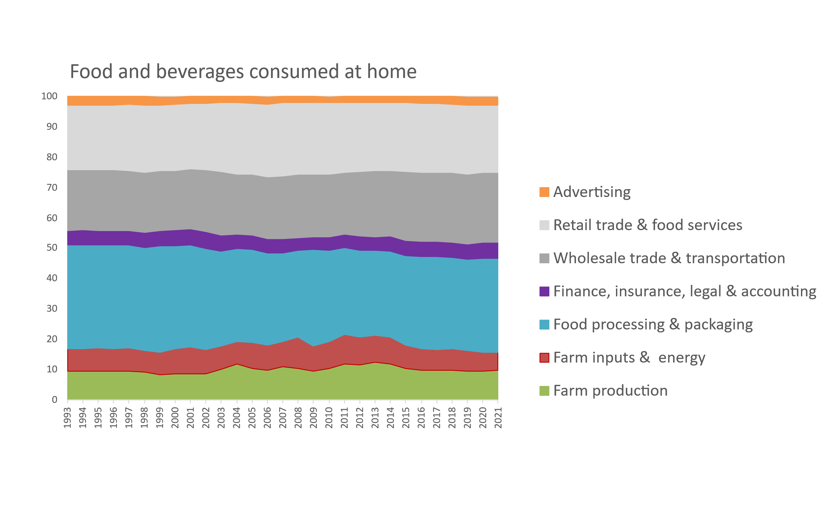
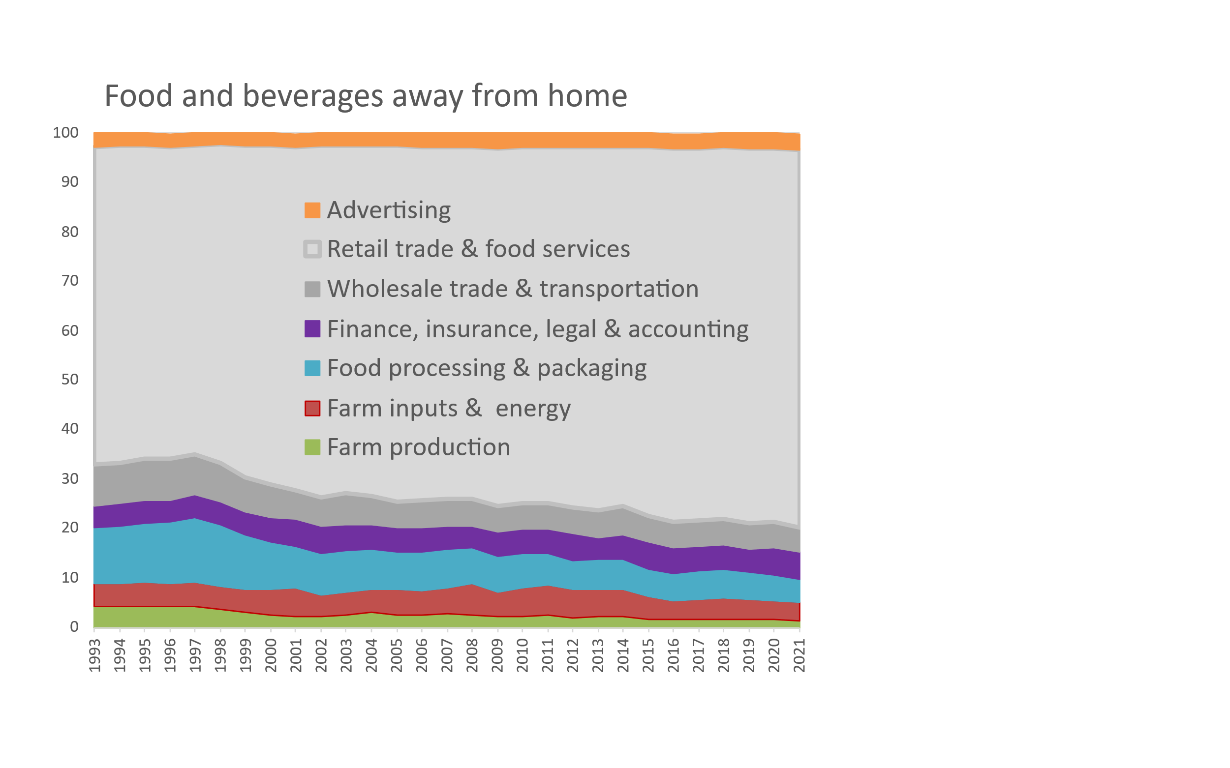
When we buy food, what are we paying for?
Cost of food by stage of value added in the United States, 1993 – 2021
What consumers pay for is mostly post-harvest transformation and services
Cumulative percent of consumer price
2.6%
3.4%
22.2%
76.2%
23.1%
5.3%
30.8%
5.0%
6.1%
5.5%
9.8%
4.8%
3.7%
1.3%
Note: Author’s calculations. Data shown are from the USDA Economic Research Service (2023), Food Dollar Series. Last updated Feb. 15, 2023, available at https://www.ers.usda.gov/data-products/food-dollar-series. Implied total spending on food advertising is roughly $60 billion per year, more than the NIH and CDC budgets combined. Total food spending per person is about $4,000 at home and $3,000 away from home (excl. alcohol), in contrast to $1,800 in prescription drugs.

Slide 4
Can we distinguish access to healthy diets from what people actually consume?
For decades, food security was defined and measured as calories for survival
Since 1974, the FAO has used its “Prevalence of Undernourishment” metric for the number of hungry people in the world, based on total food consumption relative to estimated level of dietary energy requirements
Now 9% of the world population (0.7 billion people) are undernourished in this sense
More recently, food security is defined and measured as access to desired foods
Since 1995, the USDA (and then FAO since 2014) have used “Experience of Food Insecurity” for the number of people who went to bed hungry, skipped meals, ate less or other foods etc. due to lack of resources to buy their usual foods
About 25% of the world population (2 billion people) are food insecure in this sense
Now we can use data on retail prices, to track the cost and affordability of healthy diets
Since 2016, a series of Tufts projects have developed new metrics of food and nutrition security, designed to measure whether a population has access to foods that meet international criteria for a healthy diet
About 34% of the world population (2.8 billion people) cannot afford a healthy diet in this sense
Our goal is to guide intervention, by distinguishing among three causes of unhealthy diets:
High prices: if healthy foods are unusually expensive, need to invest in production and distribution to lower cost
Low incomes: if people lack enough money to buy a healthy diet, need higher earnings or assistance
Displacement of a healthy diet by other options, due to taste, convenience, aspirations and marketing, etc.

Slide 5
Our discovery is that the least-cost locally available items in sufficient quantities for a healthy diet cost about $3-4/day
These data are before the 2021-23 burst of inflation!
As of Jan. 2025, the USDA’s Thrifty Food Plan guiding SNAP benefits is $8.15/day for an adult woman
2021 US dollars
National income per person, at purchasing power parity prices (2021 US dollars)
Source: FAO and World Bank, 2023. The latest Cost of a Healthy Diet data are at https://www.fao.org/faostat/en/#data/CAHD, and published simultaneously alongside actual food spending at https://databank.worldbank.org/source/food-prices-for-nutrition. Circles are proportional to population size, and countries are arrayed by level of national income using World Development Indicators data.
Notes:
One key finding is that CoHD doesn’t vary systematically with national income...
Actual food spending and number/proportion of people who can afford a healthy diet varies widely between countries

Slide 6
The latest UN estimate is that 2.8 billion people (34% of the world) could not afford a healthy diet in 2022
Number and proportion of people who cannot afford a healthy diet
Note: Data shown are based on 2021 item prices projected forward to 2022, relative to income data in 2022.
Source: FAO and World Bank, 2024. The latest data are at https://www.fao.org/faostat/en/#data/CAHD and https://www.worldbank.org/foodpricesfornutrition.
Notes:
Key messages from SOFI 2024 updates:
Affordability improved, with # of people who cannot afford now below pre-pandemic levels, in Asia and in Northern America and Europe
Affordability decreased substantially in Africa, where the number of people who can’t afford a healthy diet rose to ~925 million in 2022, up by ~25 million from 2021
Unequal recovery from pandemic and other financial crises also occurred across country income groups – low income countries at worst rates since monitoring began in 2017
~60% of people who can’t afford are in LMIC
---
Updated from previous rounds of the SOFI, now using ICP 2021 prices and a new affordability method
Previous finding from SOFI 2022 (?) was that over 3 billion people (42% of population) could not afford a healthy diet in 2021
Now reporting on 2022
New affordability method has different non-food costs depending on country income level
------
This statistic was published by FAO et al., and you can find the information on FAOSTAT and our [FPN] DataHub hosted at the World Bank.
The Cost and Affordability of a Healthy Diet is an indicator recently adopted by FAO as a global food security indicator to complement the Prevalence of Undernourishment and Food Insecurity Experience Scale. This indicator has revealed that approximately three billion people cannot afford a healthy diet, meaning a least-cost diet that satisfies dietary guidelines. The majority of those who cannot afford a healthy diet are living in sub-Saharan Africa and South Asia.

Slide 7
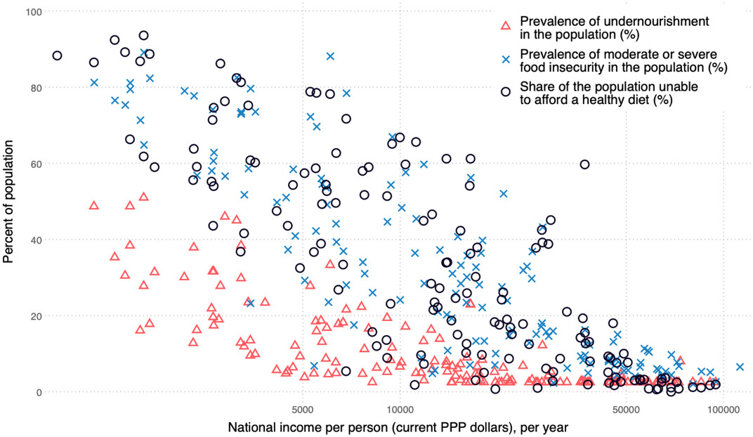
Unaffordability of healthy diets is
more prevalent than other food security metrics in poor countries, but less prevalent than other metrics in rich countries
Prevalence of unaffordability, food insecurity and undernourishment in 2021
Unaffordability of a healthy diet
Food insecurity (moderate or severe)
Undernourishment
Source: Reproduced from Figure 5 of W.A. Masters, J.K. Wallingford, A.W. Herforth and Y. Bai, 2025. Measuring Food Access as Affordability of Least‐Cost Healthy Diets Worldwide. Agricultural Economics. https://doi.org/10.1111/agec.70028.
Notes:
Key messages from SOFI 2024 updates:
Affordability improved, with # of people who cannot afford now below pre-pandemic levels, in Asia and in Northern America and Europe
Affordability decreased substantially in Africa, where the number of people who can’t afford a healthy diet rose to ~925 million in 2022, up by ~25 million from 2021
Unequal recovery from pandemic and other financial crises also occurred across country income groups – low income countries at worst rates since monitoring began in 2017
~60% of people who can’t afford are in LMIC
---
Updated from previous rounds of the SOFI, now using ICP 2021 prices and a new affordability method
Previous finding from SOFI 2022 (?) was that over 3 billion people (42% of population) could not afford a healthy diet in 2021
Now reporting on 2022
New affordability method has different non-food costs depending on country income level
------
This statistic was published by FAO et al., and you can find the information on FAOSTAT and our [FPN] DataHub hosted at the World Bank.
The Cost and Affordability of a Healthy Diet is an indicator recently adopted by FAO as a global food security indicator to complement the Prevalence of Undernourishment and Food Insecurity Experience Scale. This indicator has revealed that approximately three billion people cannot afford a healthy diet, meaning a least-cost diet that satisfies dietary guidelines. The majority of those who cannot afford a healthy diet are living in sub-Saharan Africa and South Asia.

Slide 8
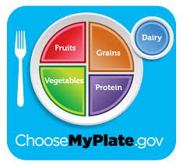
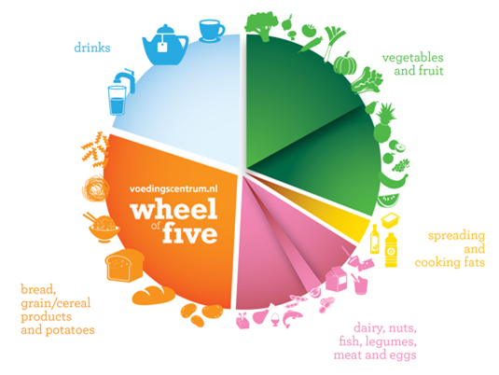
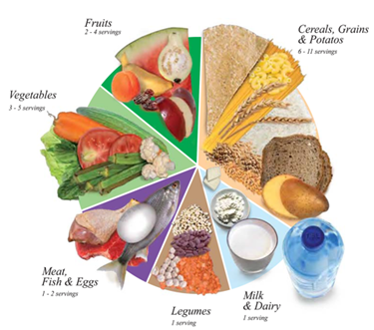
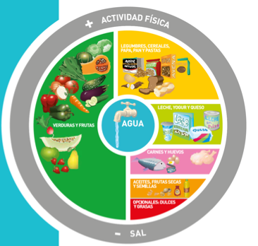
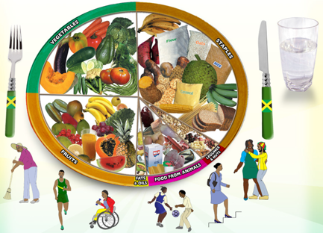
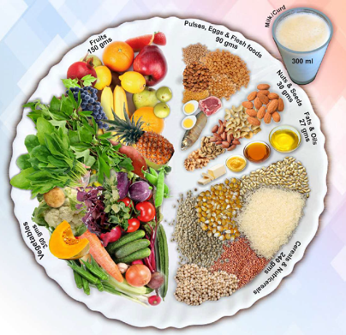
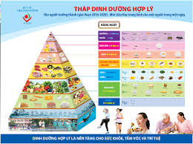
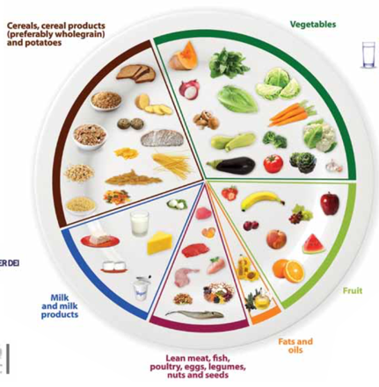
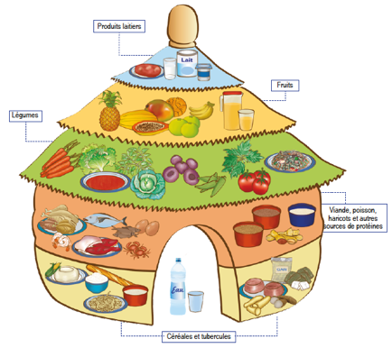
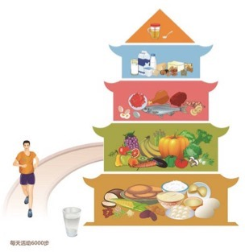
Our benchmark least cost healthy diets use locally available items that meet national food-based dietary guidelines
Dietary guidelines define healthy diets in terms of food groups
To allow substitution within food groups, we convert volume and weight to energy shares
Food group targets can differ and change over time
For SOFI 2020, used median cost of 10 quantified guidelines from all UN regions
For SOFI 2022, introduced the Healthy Diet Basket from 31 guidelines with food guides
For SOFI 2024, use updated price and income data but same health criteria
In Jan. 2024, Nigeria became first country to publish national statistics using global HDB
Ethiopia and others also publish the cost of meeting their own dietary guidelines
Energy shares
50%
5%
7%
13%
13%
13%
Quantities of typical items
Typical weight (grams) | Typical volume (plate share)
322g dry rice | 25%
270-400g veg. | 25%
230-300g fruits | 25%
210g egg | 25%
85g dry bean
34g oil
Definition of the global Healthy Diet Basket
Food group | Number of items | Dietary energy (kcal/day)
1. Starchy staples | 2 | 1,160
2. Vegetables | 3 | 110
3. Fruits | 2 | 160
4. Animal-source foods | 2 | 300
5. Legumes, nuts & seeds | 1 | 300
6. Oils and fats | 1 | 300
11
2,330
Note the global Healthy Diet Basket is just the most basic food groups -- U.S. dietary guidelines include other recommendations!
Source: Herforth et al., (2022), Methods and options to monitor the cost and affordability of a healthy diet globally. Background paper for FAO, IFAD, UNICEF, WFP and WHO.

Slide 9
Within each food group, lower cost items are more affordable and also have less emissions (usually - not always!)
…because they use less resources, with closer link to emissions than to water:
Emissions (kg of CO2-eq./100 kcal)
Water footprint (liters of water/100 kcal)
Animal-source foods
Sugars, sweets and candies
Vegetables
Oils & fats
Fruits
Starchy staples
Legumes, nuts & seeds
Cost of each food item ($/100 kcal, log scale)
Cost of each food item ($/100 kcal, log scale)
Source: Elena Martinez, “Market and non-market costs of affordable, healthy diets.” PhD dissertation, Friedman School of Nutrition, Tufts University. Prices shown are for n=811 food items in 181 countries observed in 2011 and 2017, reported by national statistical agencies through the International Comparison Program (ICP), matched to climate and water footprint estimates from Petersson et al. (2021). Figures are binned scatter plots, where each food group is represented by 100 data points, each of which is the mean value of the y-axis variable at the mean level of the x-axis variable across 100 equal-sized bins.

Slide 10
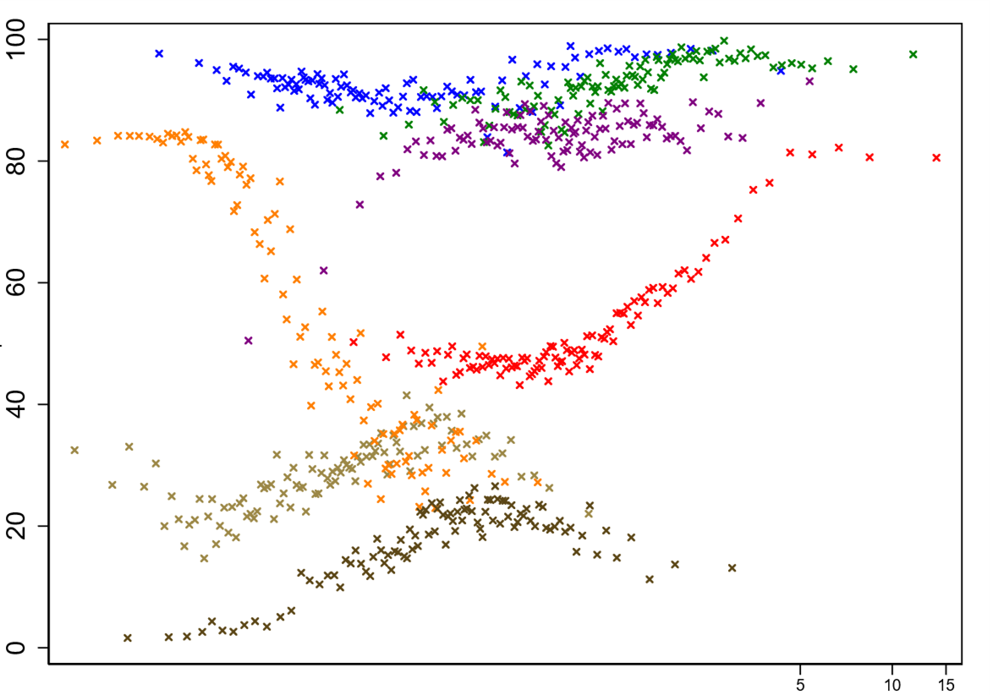
Within each food group, lower cost items are more affordable and also have less emissions (usually - not always!)
…and lower cost items do not generally have a healthier nutritional profile:
Emissions (kg of CO2-eq./100 kcal)
Nutritional profile (Food Compass score/100 kcal - higher is healthier)
Legumes, nuts & seeds
Vegetables
Oils & fats
Fruits
Animal-source foods
Starchy staples
Sugars, sweets and candies
Cost of each food item ($/100 kcal, log scale)
Cost of each food item ($/100 kcal, log scale)
Source: Elena Martinez, “Market and non-market costs of affordable, healthy diets.” PhD dissertation, Friedman School of Nutrition, Tufts University. Prices shown are for n=811 food items in 181 countries observed in 2011 and 2017, reported by national statistical agencies through the International Comparison Program (ICP), matched to climate and water footprint estimates from Petersson et al. (2021). Figures are binned scatter plots, where each food group is represented by 100 data points, each of which is the mean value of the y-axis variable at the mean level of the x-axis variable across 100 equal-sized bins.

Slide 11
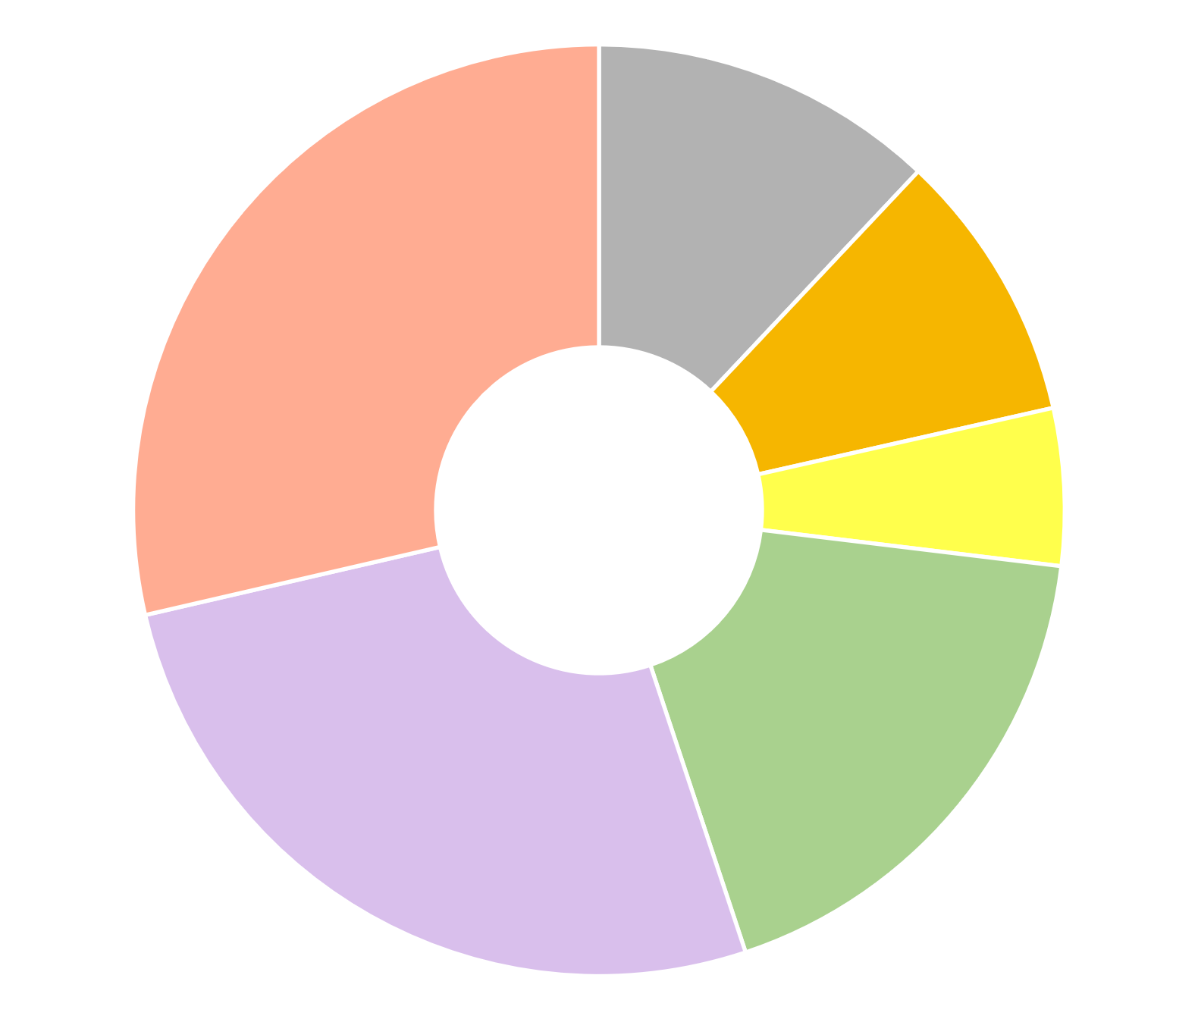
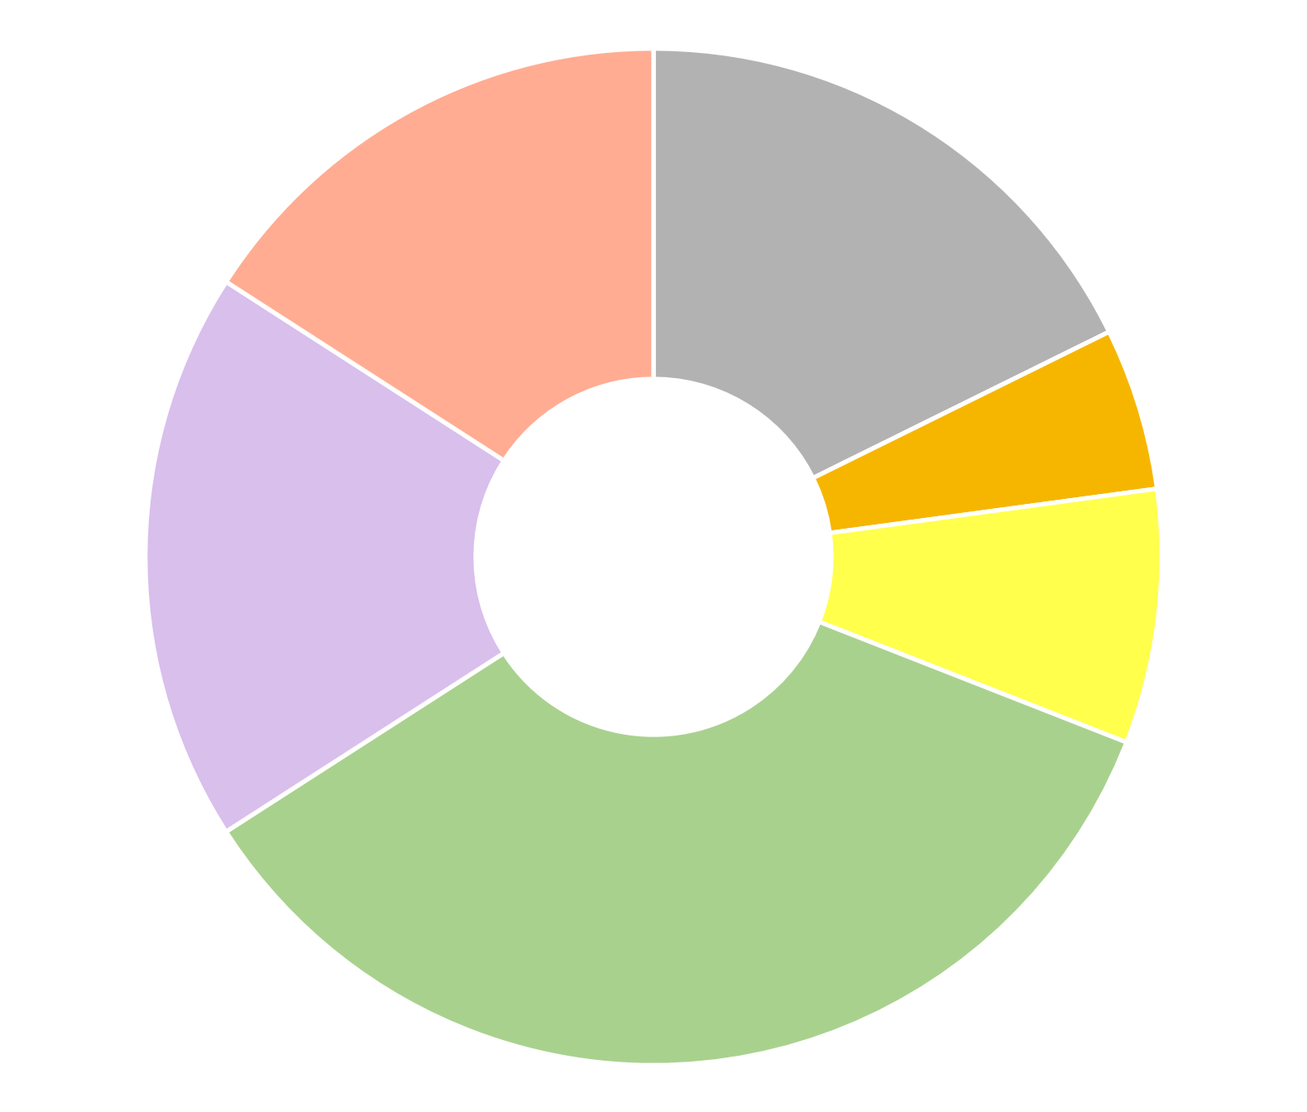
Identifying least-cost healthy options reveals whether poor diets are due to high cost, low incomes, or food choice
The benchmark Cost of a Healthy Diet is the least expensive Healthy Diet Basket of 11 items in 6 food groups using data reported by each country about the availability and price of locally consumed foods
Pakistan
Senegal
Animal source foods (2 items, 150 kcal each)
Starchy staples (2 items, 580 kcal each)
Wheat flour, maize (12% of cost)
Legumes, nuts & seeds
(1 item, 300 kcal)
Sardines, small fish
(dried)
16%
Areas show share of cost needed to meet HDB targets
Maize, rice (25% broken) 18%
Buffalo milk, live chicken (29% of cost)
Red lentils (9% of cost)
Oils & fats (1 item, 300 kcal)
Groundnuts 5%
$3.41 per day
Vegetable oil (5% of cost)
Dates, mangoes 18%
$2.19 per day
Palm oil 8%
Bananas, coconut (27% of cost)
Onions, carrots, water spinach (18% of cost)
Onions, carrots, eggplant
35%
Fruits (2 at 80 kcal each)
Vegetables (3 at 30 kcal each)
Note: Each item’s cost is for a sufficient weight or volume to meet the HDB targets, based on matching item descriptions to food composition data. In food groups requiring multiple items, the lowest-cost foods are listed first. Item descriptions are standardized across countries, with its availability and national average price reported by each country’s statistical agency to the International Comparison Program (ICP) for 2017. Cost levels are as published by FAO and the World Bank with methods detailed at Food Prices for Nutrition (2022). https://sites.tufts.edu/foodpricesfornutrition
Notes:
Items selected reflect local availability and price, delivering the same balance across food groups in all settings.
All items shown are widely consumed in each country, but in very different quantities from these benchmark diets; in these countries actual diets are mostly starchy staples which results in undernutrition.
Benchmark costs shown here are for based on national average item availability and price reported for 2017, converted to US dollars at purchasing-power parity exchange rates

Slide 12
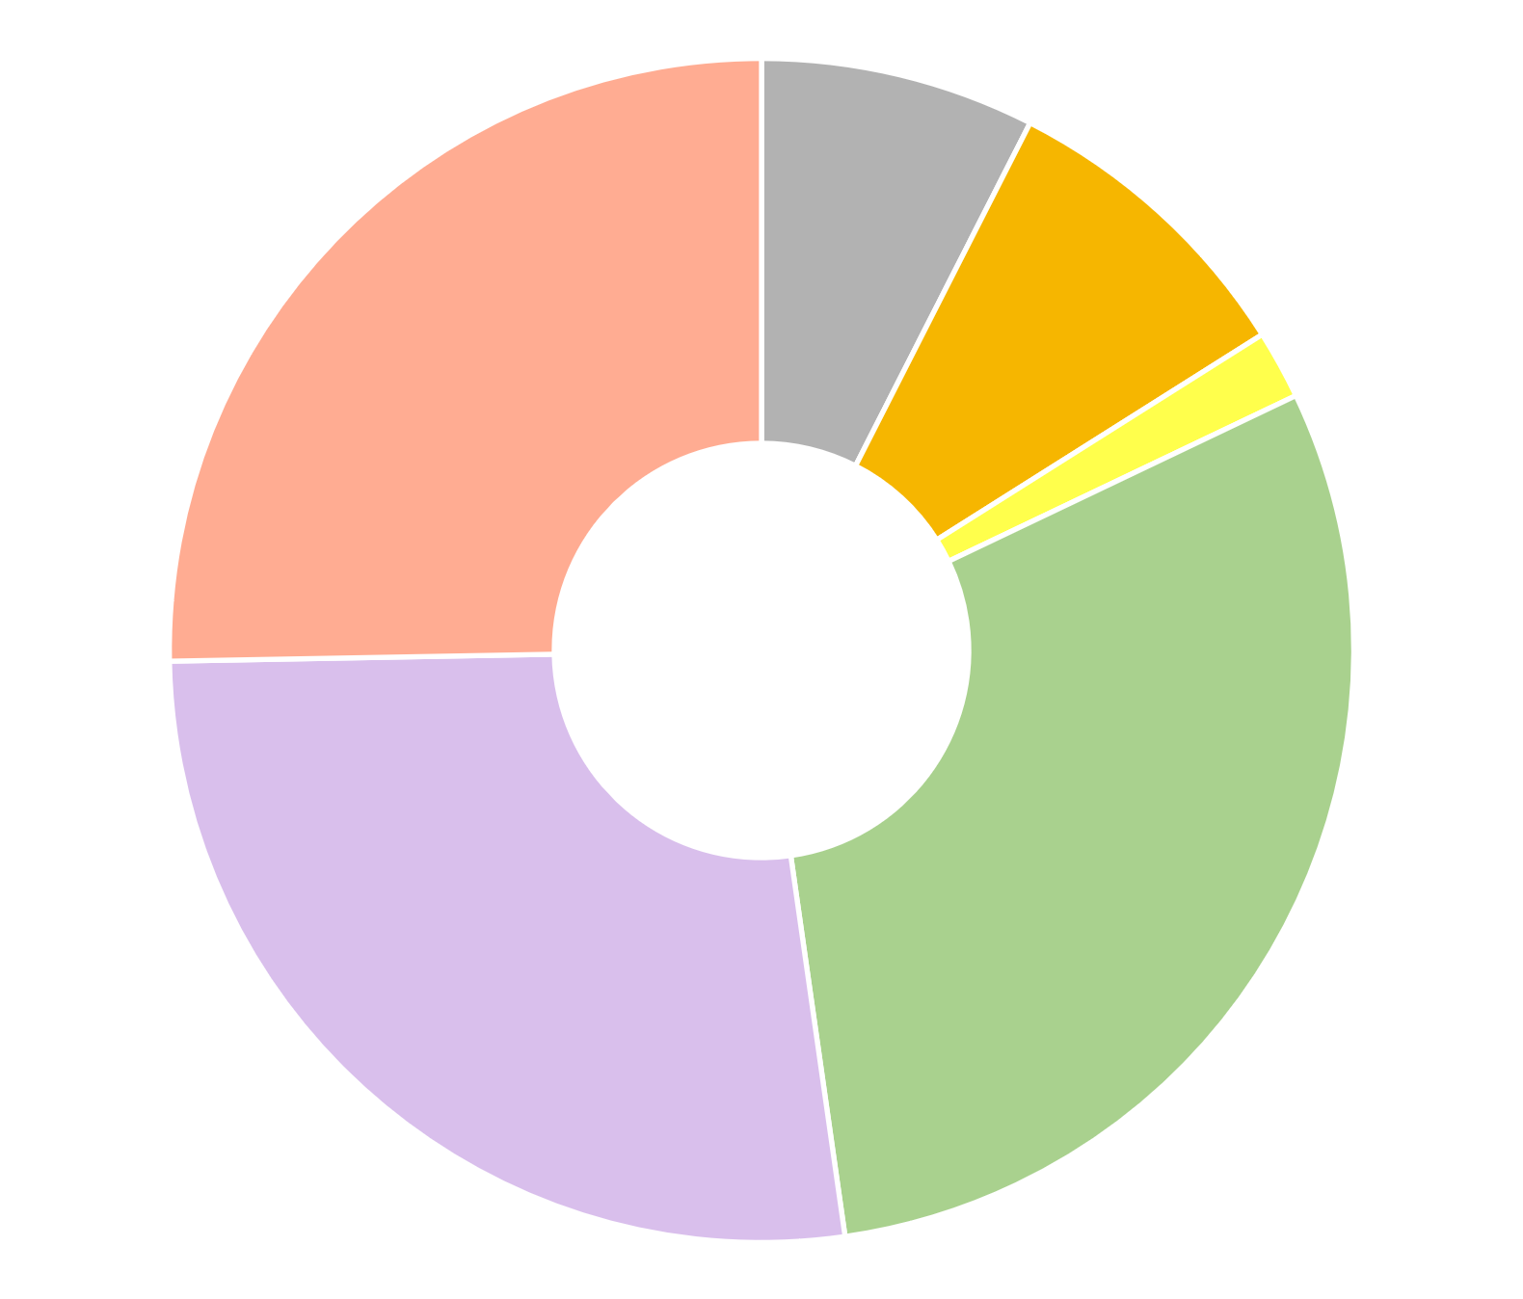
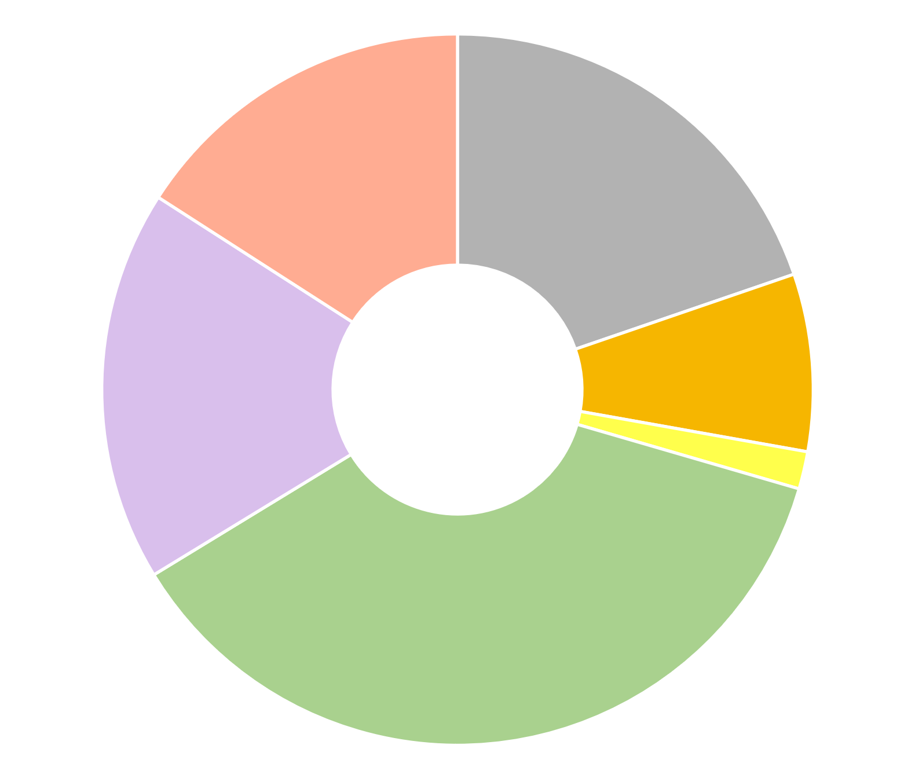
Identifying least-cost healthy options reveals whether poor diets are due to high cost, low incomes, or food choice
The benchmark Cost of a Healthy Diet is the least expensive Healthy Diet Basket of 11 items in 6 food groups using data reported by each country about the availability and price of locally consumed foods
This is a much cheaper diet than would actually be recommended; Remember that as of Jan. 2025, the USDA’s Thrifty Food Plan guiding SNAP benefits is $8.15/day for an adult woman
Italy
United States
Wheat flour, pasta (7% of cost)
White beans, dried (9% of cost)
Whole milk, semisoft cheese (16% of cost)
Boxed UHT milk, frozen chicken (25% of cost)
Sunflower oil (2% of cost)
Rice, spaghetti (20% of cost)
$2.89 per day
Bananas, apples (18% of cost)
$3.23 per day
White beans, dried (8% of cost)
Carrots,
onions, cabbage (30% of cost)
Sunflower oil (1% of cost)
Bananas, apples (27% of cost)
Carrots,
cabbage,
Iceberg lettuce (37% of cost)
Note: Each item’s cost is for a sufficient weight or volume to meet the HDB targets, based on matching item descriptions to food composition data. In food groups requiring multiple items, the lowest-cost foods are listed first. Item descriptions are standardized across countries, with its availability and national average price reported by each country’s statistical agency to the International Comparison Program (ICP) for 2017. Cost levels are as published by FAO and the World Bank with methods detailed at Food Prices for Nutrition (2022). https://sites.tufts.edu/foodpricesfornutrition
Notes:
The HDB target is designed for global monitoring, based on commonalities among national dietary guidelines.
Resulting diets are close but may not exactly meet all DRI requirements for nutrients, or the U.S. DGAs
Additional costs to meet DRIs or DGAs would be small, but actual spending in Italy or the U.S. is much greater due to other attributes of foods being purchased

Slide 13
Conclusion: Matching prices to food attributes and dietary guidelines reveals how to bring healthy, sustainable diets within reach
For about 2.8 b. people (34% of the world), healthy diets remain unaffordable
Nutrient-rich foods are more costly to grow and ship than starchy staples, vegetable oil & sugar
Most unaffordability is due to low incomes, so healthier diets requires higher income or safety nets
Even if healthy diets are affordable, they are often displaced by less healthy items
Many factors beyond health drive food choice, as people transition from inadequacy to excess
overshooting on animal-source foods, sweeteners and oils, even for home-cooked meals
switching to food service and packaged items, leading to excess salt, refined grains etc.
Calculating benchmark modeled diets identifies the frontier of potentially affordable foods
Reveals role of income, safety nets and nonfood spending in unaffordability of healthy diets
Reveals role of innovation in lowering product cost per unit of each food
product cost is closely correlated with emissions (lower cost -> lower emissions, but not always)
product cost has varied correlations with nutritional value (depends on product category)
In the U.S., poor diet quality is caused by factors other than income and price
==> main factor is innovation in product profiles that drive demand: taste, convenience, aspirations

Slide 14
https://sites.tufts.edu/foodpricesfornutrition
Thank you!
We are grateful to many price data collectors, analysts and project collaborators, and to the Bill & Melinda Gates Foundation and the UKAid government for funding
…and there’s more:
Open-access textbook at https://bit.ly/FoodEconBook
Global monitoring is done jointly by the FAO and the World Bank, with the most recent data updated on December 20th, 2024

Slide 15
Other slides

Slide 16
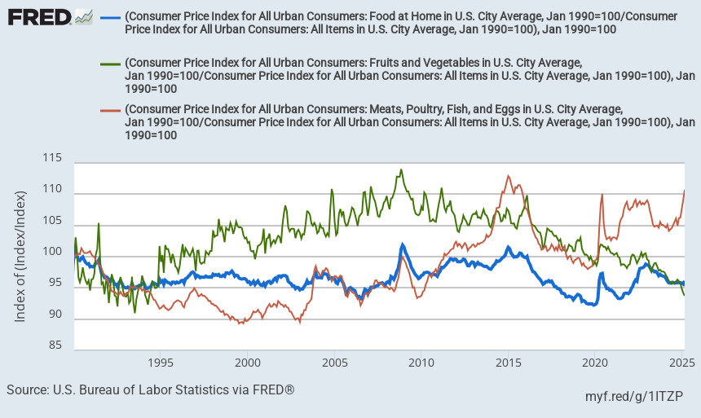
Price variation differs by type of food
Price level for major nutrient-rich food groups in the U.S., January 1990 – March 2025
Fruits & vegetables
(rose in 1990s & 2000s, fallen 15% since peak)
Meats, poultry, fish & eggs (rose 20% since 2000s)
Index value (January 1990=100)
All food at home
Note: Author’s calculations. Data shown are from the US Bureau of Labor Statistics, as the average for each category relative to the overall U.S. consumer price index for all goods and services. Fruits and vegetables may be fresh, frozen or canned. Updated values can be obtained at https://fred.stlouisfed.org/graph/?g=1ITZO.

Slide 17
Price variation differs by stage of the value chain
Consumer prices versus wholesale producer prices in the U.S., January 1990 – March 2025
Restaurant prices (food away from home)
Grocery prices (food at home)
Index value (January 1990=100)
Producer prices for processed foods
Producer prices for unprocessed foods
Note: Author’s calculations. Data shown are from the US Bureau of Labor Statistics, as the average for each category relative to the overall U.S. consumer price index for all goods and services. Fruits and vegetables may be fresh, frozen or canned. Updated values can be obtained from https://fred.stlouisfed.org/graph/?g=12MMl.

Slide 18
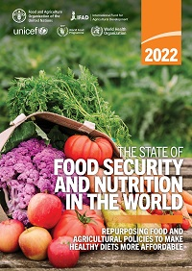
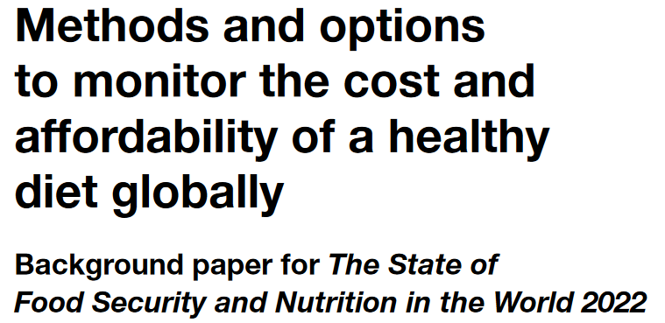
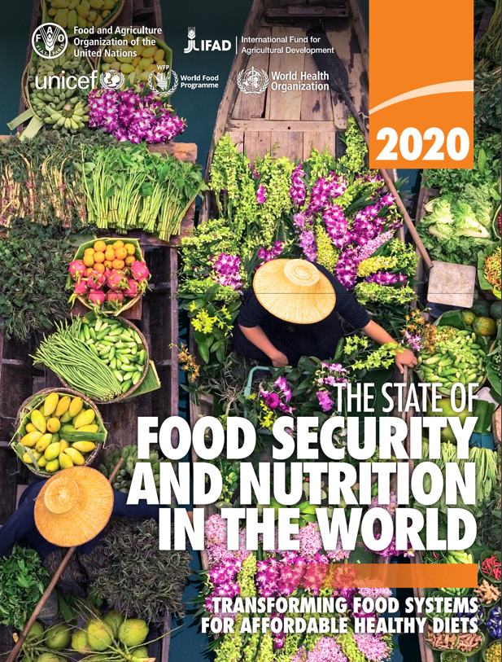
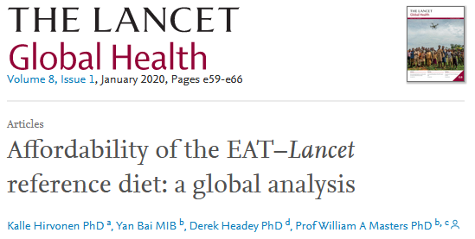
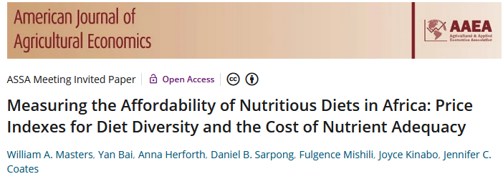
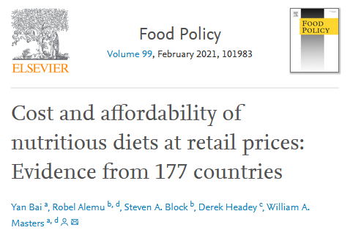
Diet costs use local availability and price data,
matched to food composition and health needs
We find a ladder of diet costs, from the cheapest energy source to higher-priced foods
…so we can now compare low-cost healthy diet benchmarks to actual food choice
SOFI 2024 updated the price data to items observed in 2021, and updated the income data & method to compute unaffordability
SOFI 2022 introduced the Cost of a Healthy Diet (CoHD) based on the “Healthy Diet Basket” of each country’s 11 least-cost items in 6 food groups
 |  |  | Food preferences, convenience and other goals (including food security, diet diversity, sustainability, equity and inclusion)
 | Caloric adequacy (short-term subsistence)
SOFI 2020 used 10 national guidelines for the Cost of Recommended Diets (CoRD)
 |  |  | Healthy diets Meets national dietary guidelines by food group
 |  | Nutrient adequacy Avoids deficiency or excess of essential macro- and micronutrients
 | Daily energy Meets only calorie needs, for short-term survival and physical work
Our 2018 journal article introduced a Cost of Diet Diversity (CoDD) metric
and we have many other studies analyzing other aspects of diet costs
Global ave. in 2021 = $3.56/day
Global average in 2021 = $2.45/day
Global average in 2021 = $0.93/day
Source: Food Prices for Nutrition (2023). https://sites.tufts.edu/foodpricesfornutrition

Slide 19
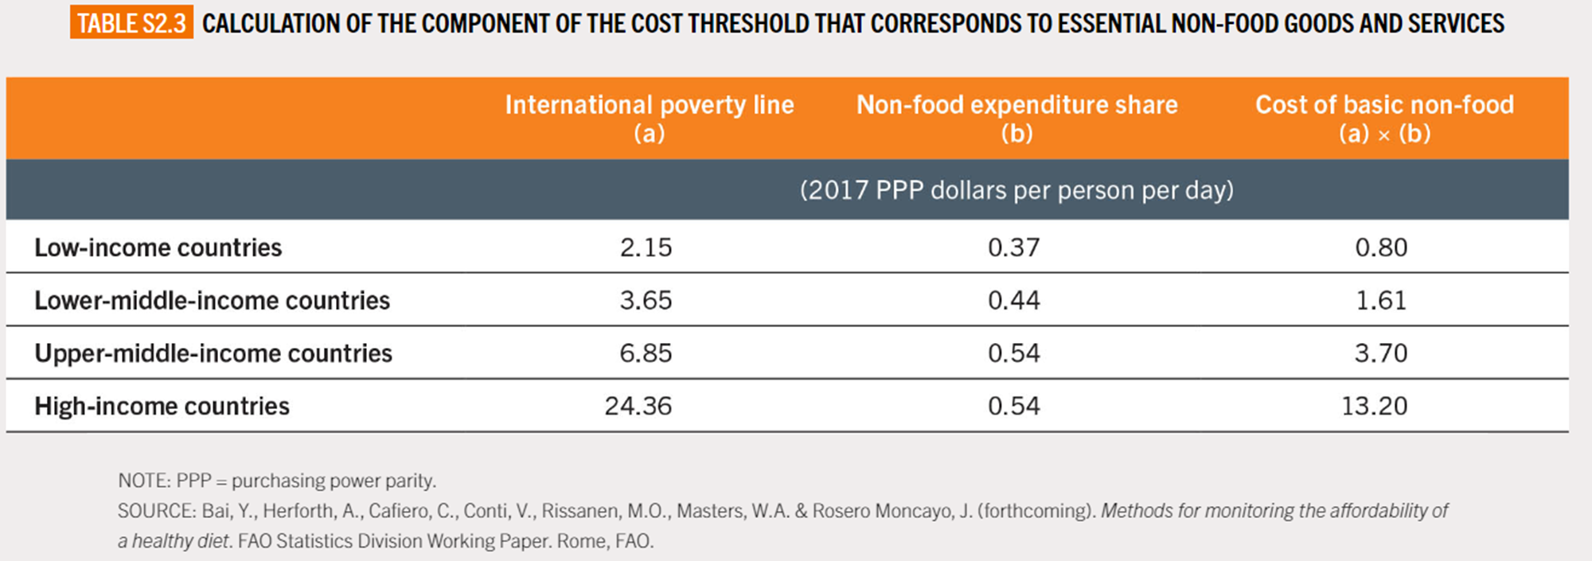
To track affordability, we compare the least-cost healthy diet in each country to household income, minus non-food needs
The new affordability method used by FAO and the World Bank for global monitoring in SOFI 2024 allows for higher non-food needs in higher-income countries
Average of poorer residents’ spending on nonfood goods & services
Required nonfood spending used to obtain income available for food
Average of national governments’ poverty lines
X
=
Source: FAO, IFAD, UNICEF, WFP and WHO. 2024. The State of Food Security and Nutrition in the World 2024. Rome, https://doi.org/10.4060/cd1254en.

Slide 20
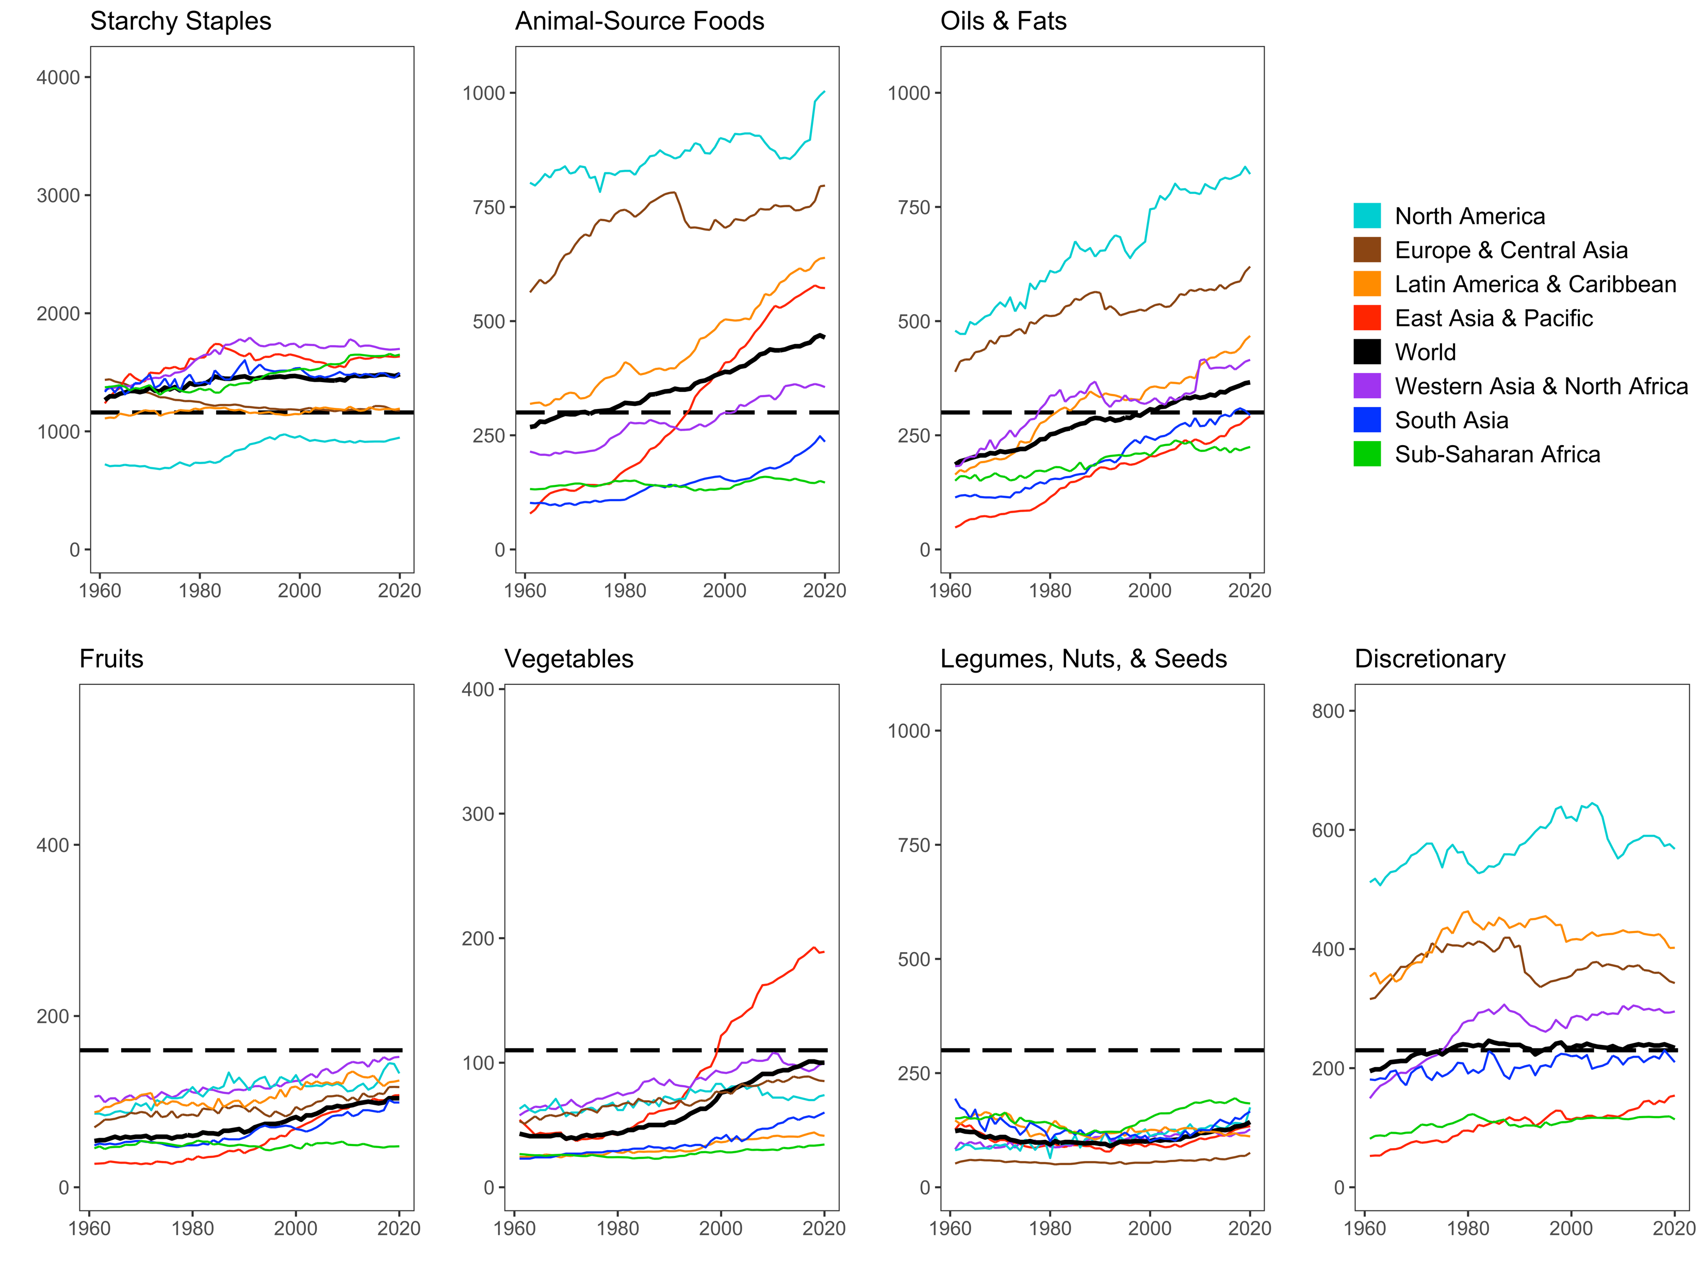
Globally, actual food use is far from Healthy Diet Basket targets in ways that differ by region and over time
North America has highest use of animal foods, oils & fats, and sugar
Africa has low use of all food groups
that are relatively costly per calorie
Source: Leah Costlow, doctoral dissertation in progress, Friedman School of Nutrition, Tufts University. Data shown are from FAO Food Balance Sheet data, for total daily kilocalories available per capita in each region aggregated by HDB food group. Reproduced in Masters & Finaret (2024), Food Economics: Agriculture, Nutrition and Health. Palgrave MacMillan, open access at https://link.springer.com/book/9783031538391.

